Slide 1
2024 American College of Rheumatology (ACR) Guideline for the Screening, Treatment, and Management of Lupus Nephritis
Lisa Sammaritano, Amy Turner, Michael George
A feature designed to facilitate discussion of published research. This slide presentation accompanies the below article:
Sammaritano LR, Askanase A, Bermas BL, et al. 2024 American College of Rheumatology (ACR) Guideline for the Screening, Treatment, and Management of Lupus Nephritis. Arthritis Care Res (Hoboken) 2025. https://doi.org/10.1002/acr.25528

Slide 2
Background
The American College of Rheumatology last published lupus nephritis guidelines in 2012 and recommended high-dose glucocorticoids with mycophenolate or cyclophosphamide for induction therapy, with mycophenolate maintenance therapy.
The emergence of positive data on new therapies led to the need for updated guidelines.
The current guideline focuses on lupus nephritis but was part of a larger effort that also included recommendations for the management of SLE (separate GL/manuscript).
These guidelines can be interpreted in the context of guidelines from the European Alliance of Associations for Rheumatology (EULAR) and Kidney Disease Improving Global Outcomes (KDIGO).
Sammaritano LR, Askanase A, Bermas BL, et al. 2024 American College of Rheumatology (ACR) Guideline for the Screening, Treatment, and Management of Lupus Nephritis. Arthritis Care Res (Hoboken) 2025. https://doi.org/10.1002/acr.25528

Slide 3
Methods
GRADE methodology used to develop recommendations
Developed 249 PICO (Population-Intervention-Comparator-Outcome) questions related to lupus nephritis
Systematic literature review performed to generate evidence summaries
Patient panel (n=14) convened to help define patient values and preferences
Voting panel (n=21) including adult and pediatric rheumatologists, adult and pediatric nephrologists, and patients (2) voted on the direction and strength of recommendations, requiring >70% agreement
Sammaritano LR, Askanase A, Bermas BL, et al. 2024 American College of Rheumatology (ACR) Guideline for the Screening, Treatment, and Management of Lupus Nephritis. Arthritis Care Res (Hoboken) 2025. https://doi.org/10.1002/acr.25528

Slide 4
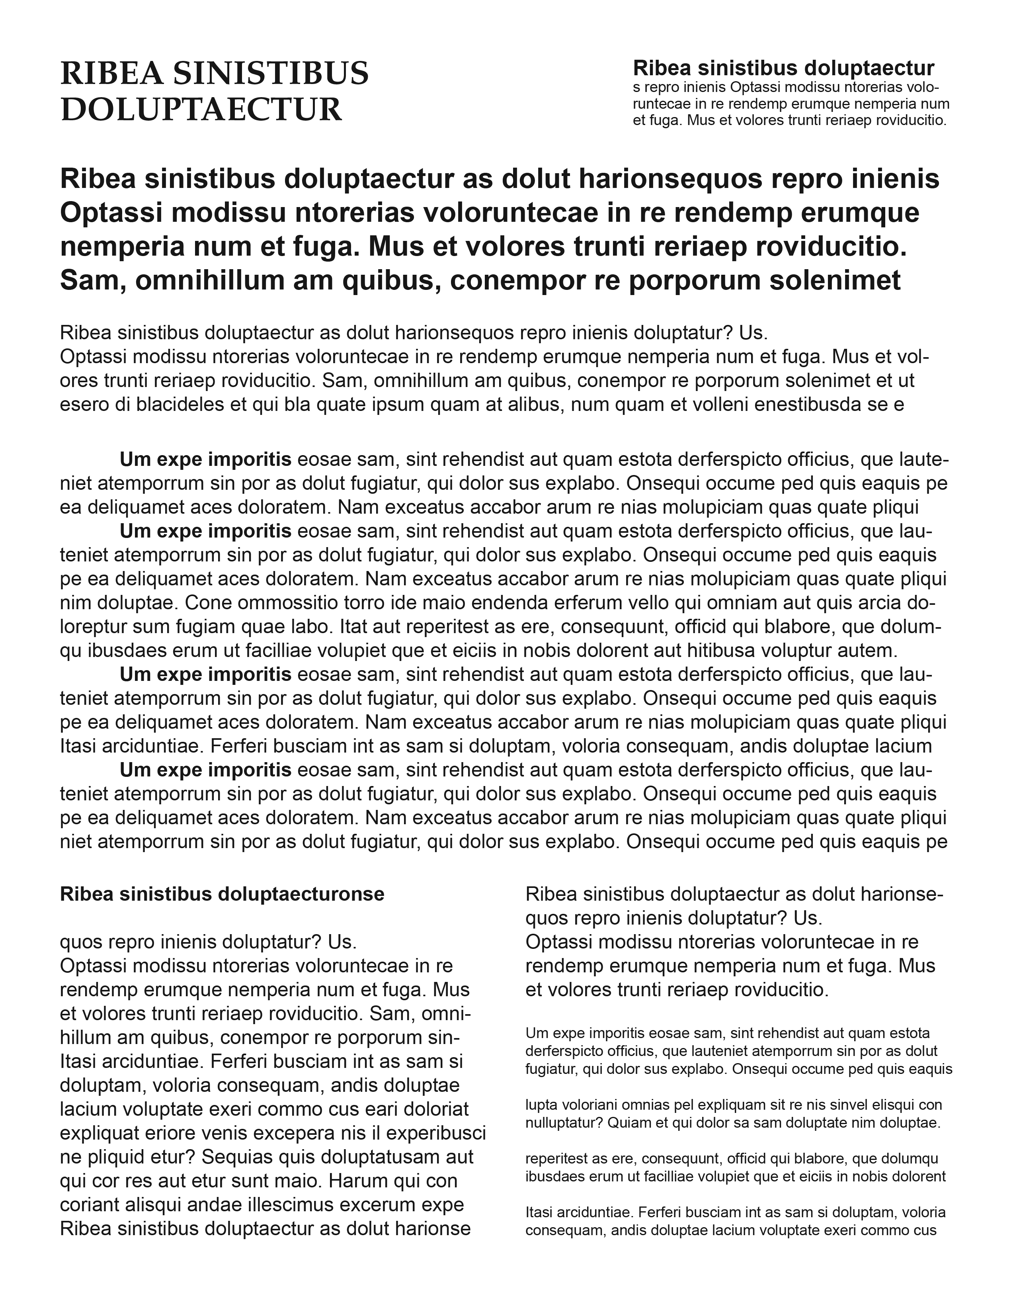
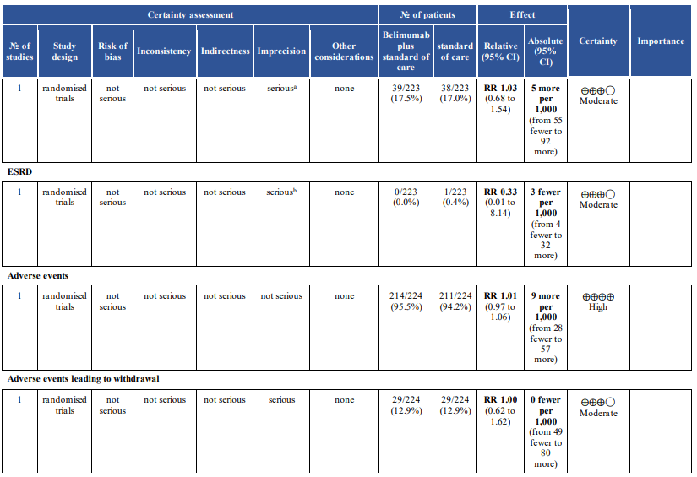
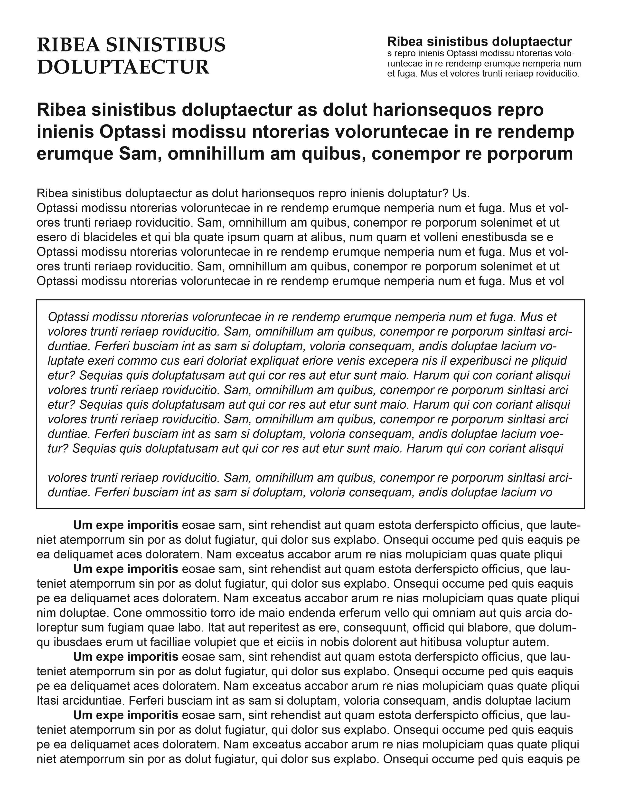
Outcomes across studies
Randomization raises initial quality RCTs: high
Observational: low
Create evidence profile with GRADEpro
Rate quality of evidence for each outcome
Formulate question
Select outcomes
Rate importance
P
I
C
O
Outcome
Critical
High
Moderate
Low
Very low
Risk of bias
Inconsistency
Indirectness
Imprecision
Publication bias
Outcome
Critical
Grade down
Outcome
Important
Outcome
Not important
Summary of findings & estimate of effect for each outcome
Large effect
Dose response
Opposing bias & confounders
Grade up
Evidence synthesis
Recommendation
Grade overall quality of evidence across outcomes based on lowest quality of critical outcomes
Grade recommendations (Evidence to Recommendation)
For or against (direction) ↓↑
Strong or conditional (strength)
Panel
Patient panel
Guideline
By considering balance of consequences (evidence to recommendations):
Quality of evidence
Balance benefits/harms
Values and preferences
Feasibility, equity and acceptability
Resource use (if applicable)
GRADE process
Notes:
This guideline follows the ACR guideline development process and policy directing management of conflicts of interest and disclosures (https://rheumatology.org/clinical-practice-guidelines), which includes Grading of Recommendations, Assessment, Development, and Evaluation (GRADE) methodology.
Key steps of the GRADE Process are shown:
The team drafts clinical population, intervention, comparator, and outcomes (PICO) questions and identifies the critical and important outcomes of interest.
The literature review team performs systematic literature reviews for the PICO questions, grades the quality of evidence (high, moderate, low, very low), and produces an evidence report.
The resulting evidence is reviewed, and recommendations are formulated by the Core Team and voted on by an expert Voting Panel. Additionally, a Patient Panel (in this study comprised of 15 patients with lupus nephritis, two of whom also served on the Voting Panel) review the evidence report and provide patients’ perspectives and preferences for the Voting Panel.
Consensus requires ≥70% agreement on direction (for or against) and strength (strong or conditional) of each recommendation.

Slide 5
Methods
Factors influence strength of a recommendation:
Quality of evidence
Degree of certainty on balance of harms and benefits
Whether recommendations are particularly sensitive to different patient values/references
Notes:
It is important to understand what a strong recommendation is vs. a conditional recommendation, particularly since many of the recommendations are conditional.

Slide 6
Guiding Principles
PRESERVE KIDNEY FUNCTION AND MINIMIZE MORBIDITY / MORTALITY FROM CKD AND TREATMENT
ENSURE COLLABORATIVE CARE WITH NEPHROLOGY
UTILIZE SHARED DECISION-MAKING INCLUDING PATIENT VALUES AND PREFERENCES
AIM TO REDUCE HEALTHCARE DISPARITIES
CONSIDER PEDIATRIC AND GERIATRIC POPULATIONS
28 graded recommendations (7 strong, 21 conditional), 13 ungraded Good Practice Statements (GPS)
Apply to all patients with LN regardless of age, race, ethnicity, other patient variables. No recommendations are based on race or ethnicity as evidence is limited/confounded by socioeconomic factors.
Therapeutic decisions:
Vary - depending on clinical presentation/patient preferences
May be limited - by access to specialists, procedures, and medications
Available traditional therapies should be used if recommended medications are not available or not preferred by patients

Slide 7
Results
From Table 3
Screening: check proteinuria q6-12 mo. or at time of clinical flare for all patients with SLE without known LN (S)
Suspected Lupus Nephritis:
Perform kidney biopsy promptly (GPS)
Treat promptly with glucocorticoids (while awaiting a kidney biopsy and the histopathology results) (GPS)
Kidney biopsy for:
SLE with urine Pr:Cr >0.5 g/g -or- unexplained impaired kidney function (C)
In patients with known lupus nephritis for:
Suspected flare OR
Lack of response/worsening after 6 months of therapy (C)
Hydroxychloroquine for all pts (S)
RAAS-I for all pts with elevated proteinuria (even <0.5 g/g) (C)
Adjust lupus nephritis medication dosages in patients with decreased GFR (GPS)
S: strong recommendation C: conditional recommendation GPS: Good Practice Statement
Sammaritano LR, Askanase A, Bermas BL, et al. 2024 American College of Rheumatology (ACR) Guideline for the Screening, Treatment, and Management of Lupus Nephritis. Arthritis Care Res (Hoboken) 2025. https://doi.org/10.1002/acr.25528

Slide 8
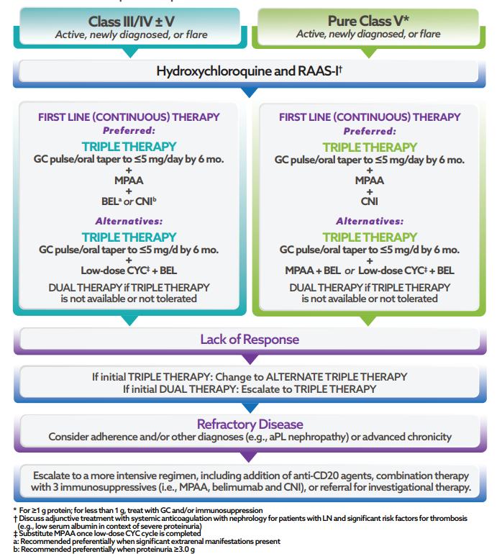
Guideline Summary
Goal: Complete renal response (CRR)
Within 6-12 mo., reduction in proteinuria to ≤0.5 g/g and
Stabilization or improvement in kidney function (±20% baseline)
Duration of therapy: at least 3-5 years after achievement of CRR
* For ≥1 g protein; for <1 g, treat with GC and/or immunosuppression.
† Discuss adjunctive treatment with systemic anticoagulation with nephrology for patients with LN and signiﬁcant factors for thrombosis (eg, low serum albumin in context of severe proteinuria).
‡ Substitute MPAA once low-dose CYC cycle is completed.
a: Recommended preferentially when signiﬁcant extrarenal manifestations are present.
b: Recommended preferentially when proteinuria is ≥3.0 g.
GC pulse/oral taper: pulse intravenous GCs (250–1,000 mg methylprednisolone daily for 1–3 days) followed by oral GC ≤0.5 mg/kg/day (maximum dose 40 mg/day) and taper. Low-dose CYC: as per Euro-Lupus Nephritis Trial protocol, 500 mg IV CYC every 2 weeks for 6 doses. Dual therapy: GC plus/oral taper plus one immunosuppressive agent, usually MPAA or low-dose CYC. RAAS-I, renin-angiotensin-aldosterone system inhibitors; GC, glucocorticoid; MPAA, mycophenolic acid analogs (including mycophenolate mofetil [MMF]; BEL, belimumab; CNI, calcineurin inhibitor; CYC, cyclophosphamide.

Slide 9
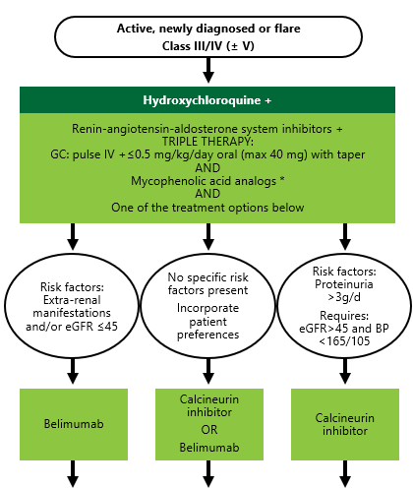
Results
Figure 1: Class III/IV nephritis treatment
Hydroxychloroquine (strong), RAAS inhibitor for any increased proteinuria
“Triple therapy”:
1. Glucocorticoids:
Pulse IV 250-1000mg/day × 1-3 days, then
Oral prednisone ≤0.5mg/kg/day (max 40mg) with taper to ≤5mg by 6 months
2. Mycophenolate (preferred over cyclophosphamide)
3. Belimumab or calcineurin inhibitor (CNI) *
*GL does not recommend a particular CNI because comparative effectiveness and safety studies are not available.
Sammaritano LR, Askanase A, Bermas BL, et al. 2024 American College of Rheumatology (ACR) Guideline for the Screening, Treatment, and Management of Lupus Nephritis. Arthritis Care Res (Hoboken) 2025. https://doi.org/10.1002/acr.25528
Notes:
Figure 1

Slide 10
Results
Why triple therapy for Class III/IV nephritis?
RCTs (BLISS-LN and AURORA 1) showed improved outcomes with initial triple versus initial dual therapies → guided Voting Panel discussion, along with Patient Panel input and clinicians’ experience
Mycophenolate + belimumab preferred: if there are significant extrarenal manifestations (or CrCl<45, significant HTN given potential nephrotoxicity and HTN from CNI)
Mycophenolate + calcineurin inhibitor (cyclosporine, tacrolimus, voclosporin) preferred: for proteinuria ≥3 g/g
If cyclophosphamide is used, prefer Euro-Lupus Nephritis Trial low-dose CYC 500 mg IV q2 weeks × 6 doses (then mycophenolate)
For triple therapy, can be combined with belimumab (limited data from BLISS-LN)
Combination with calcineurin inhibitor not studied in RCTs
Sammaritano LR, Askanase A, Bermas BL, et al. 2024 American College of Rheumatology (ACR) Guideline for the Screening, Treatment, and Management of Lupus Nephritis. Arthritis Care Res (Hoboken) 2025. https://doi.org/10.1002/acr.25528

Slide 11
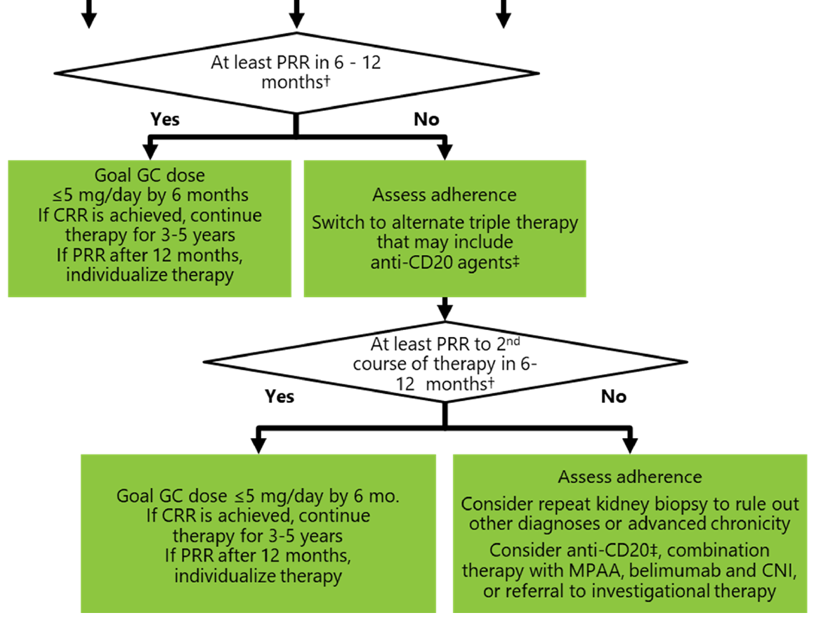
Results
Figure 1 continued
Figure 1 continued:
If not achieving partial renal response (PRR)
Assess adherence
Switch to alternative triple therapy
If continued lack of partial renal response
Consider repeat kidney biopsy
Alternative combinations
Consider clinical trial
Sammaritano LR, Askanase A, Bermas BL, et al. 2024 American College of Rheumatology (ACR) Guideline for the Screening, Treatment, and Management of Lupus Nephritis. Arthritis Care Res (Hoboken) 2025. https://doi.org/10.1002/acr.25528
Notes:
Figure 1 continued

Slide 12
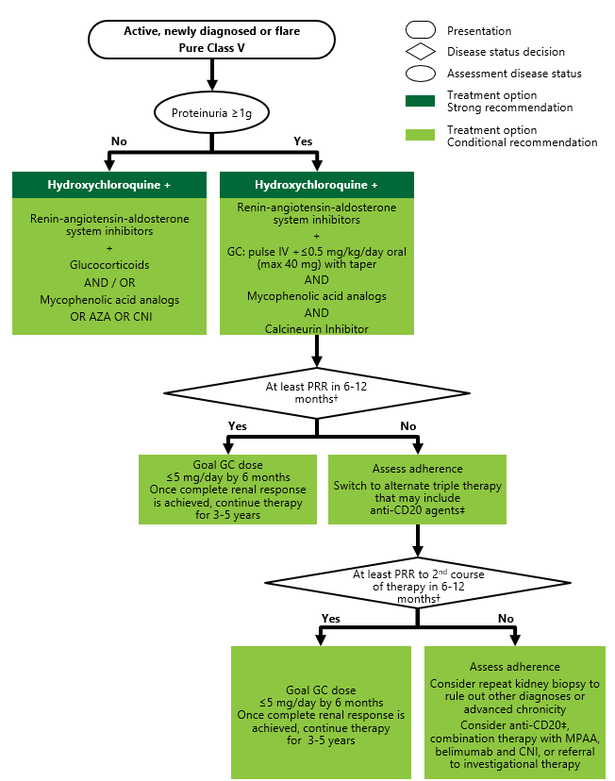
Results
Figure 2: Class V nephritis treatment
Hydroxychloroquine (strong)
RAAS inhibitor (any level of increased proteinuria)
Treatment depending on degree of proteinuria
≥1g → triple therapy with glucocorticoids, mycophenolate, calcineurin inhibitor
<1g → glucocorticoids and/or mycophenolate OR azathioprine OR calcineurin inhibitor
Assess adherence and switch therapy if lack of at least partial renal response
Sammaritano LR, Askanase A, Bermas BL, et al. 2024 American College of Rheumatology (ACR) Guideline for the Screening, Treatment, and Management of Lupus Nephritis. Arthritis Care Res (Hoboken) 2025. https://doi.org/10.1002/acr.25528
Notes:
Figure 2

Slide 13
Results
Total therapy duration for patients with complete renal response: at least 3-5 years
Goal: rapid control of disease activity and continued therapy until sustained inactive disease
Repeat biopsy studies show immunologic activity/immune complexes persisting in the kidneys for several years
Withdrawal of immunosuppression while histologic activity remains predisposes patients to LN flare
Over time, immunosuppressive therapy may be tapered, as determined by renal and extra-renal disease activity and medication tolerability
Sammaritano LR, Askanase A, Bermas BL, et al. 2024 American College of Rheumatology (ACR) Guideline for the Screening, Treatment, and Management of Lupus Nephritis. Arthritis Care Res (Hoboken) 2025. https://doi.org/10.1002/acr.25528

Slide 14
Results
Other considerations, including cardiovascular health, bone health, infection risk, and reproductive health concerns were not voted on, but general suggestions for care are offered.
Good practice guidance and references to other ACR guidelines are summarized in Table 4.
Sammaritano LR, Askanase A, Bermas BL, et al. 2024 American College of Rheumatology (ACR) Guideline for the Screening, Treatment, and Management of Lupus Nephritis. Arthritis Care Res (Hoboken) 2025. https://doi.org/10.1002/acr.25528

Slide 15
Discussion
Many conditional recommendations – apply to many patients but decisions may be sensitive to individual circumstances and patient values/preferences – requires shared decision making.
Recommendations for a lower glucocorticoid regimen aim to reduce toxicity but are not based on RCTs directly comparing different glucocorticoid regimens.
RCTs of triple therapy suggested improved renal outcomes, but data on long-term renal outcomes (i.e., need for ESRD) are currently limited. Information on which patients are most likely to benefit from triple therapy vs. dual therapy is also limited.
RCT evaluating addition of obinutuzimab to standard therapy was published after these guidelines; will be considered in future guidelines.
No consensus for treatment of Class II lupus nephritis, and no recommendations for lupus podocytopathy.
Sammaritano LR, Askanase A, Bermas BL, et al. 2024 American College of Rheumatology (ACR) Guideline for the Screening, Treatment, and Management of Lupus Nephritis. Arthritis Care Res (Hoboken) 2025. https://doi.org/10.1002/acr.25528

Slide 16
Discussion
Discussion questions:
How do recommendations for glucocorticoid taper compare to your current practice? Will these recommendations change how you prescribe glucocorticoids?
Will recommendations for triple therapy change your practice? What factors might affect your decision to suggest triple therapy for an individual patient?
Are there other ways these guidelines will change how you diagnose or treat patients with lupus nephritis?
What do you think are the key next research steps?
Sammaritano LR, Askanase A, Bermas BL, et al. 2024 American College of Rheumatology (ACR) Guideline for the Screening, Treatment, and Management of Lupus Nephritis. Arthritis Care Res (Hoboken) 2025. https://doi.org/10.1002/acr.25528

Slide 17
Lupus Nephritis Guideline Team
Core Team:
Lisa Sammaritano (PI)
Reem Mustafa (Lit review lead / GRADE methodologist)
Anca Askanase
Bonnie Bermas
Maria Dall’Era
Ali Duarte-Garcia
Linda Hiraki (pediatric rheum)*
Brad Rovin (nephrology)
Mary Beth Son (pediatric rheum)*
Voting Panel:
Anthony Alvarado (nephrology)
Cynthia Aranow
April Barnado
Anna Broder
Hermine Brunner (pediatric rheum)
Vaidehi Chowdhary
Gabriel Contreras (nephrology)
Christele Felix (patient representative)
Elizabeth Ferucci
Keisha Gibson (nephrologist)
Aimee Hersh (pediatric rheum)
Peter Izmirly
Kenneth Kalunian
Diane Kamen
Brandi Rollins (patient representative )
Benjamin Smith (rheumatology PA)
Asha Thomas
Homa Timlin
Daniel Wallace – also worked on the 2012 ACR LN GL!
Michael Ward
Literature Review Team:
Led by Reem Mustafa with Hassan Kawtharany
Muayad Azzam
Christie Bartels
Joanne Cunha
Kimberly DeQuattro (pediatric- adult rheum)
Andrea Fava
Gabriel Figueroa-Parra
Shivani Garg*
Jessica Greco (peds adult nephrology)
Maria Cuellar-Gutierrez
Priyanka Iyer
Andrew Johannemann
April Jorge
Shanthini Kasturi
Hassan Kawtharany
Jana Khawandi
Kyriakos Kirou
Alexandra Legge
Kelly Liang (nephrology)
Megan Lockwood
Alain Sanchez-Rodriguez
Marat Turgunbaev (ACR)
Jessica Williams
ACR: Amy Turner, Regina Parker, Cindy Force
ACR Board liaison: Jane Kang
Librarian: Kathryn Vela
Patient Panel: N= 14 * Leaders of patient panel discussion

