Slide 1
2024 U.S. Paralympic Team Trials - Swimming Technical Meeting Wednesday, June 26 at 5:00pm

Slide 2
Technical Meeting
A summary of this document, along with any updates will be covered at the Technical Meeting on Wednesday June 26th at 5:00pm CDT
Technical Meeting will be held in person at the Recreation and Wellness Center, room MP 3/4, on the second floor. The address for the Rec Center is 123 Harvard Street SE, Minneapolis, MN 55455.
Questions must be submitted in writing prior to the meeting to Rachel.McKivigan@usopc.org
Updated information will be posted after the meeting at
https://www.usparaswimming.org/parateamtrials-swimming

Slide 3
Introductions
Director, U.S. Para Swimming Erin Popovich
Meet Director Rachel McKivigan
Meet Management Jenny Sternecker & Rebecca Binder
USOPC Athlete Safety Lindsay Griswold
Officials Team Lead Mark Rieniets
Director of Aquatics Linda McKee

Slide 4
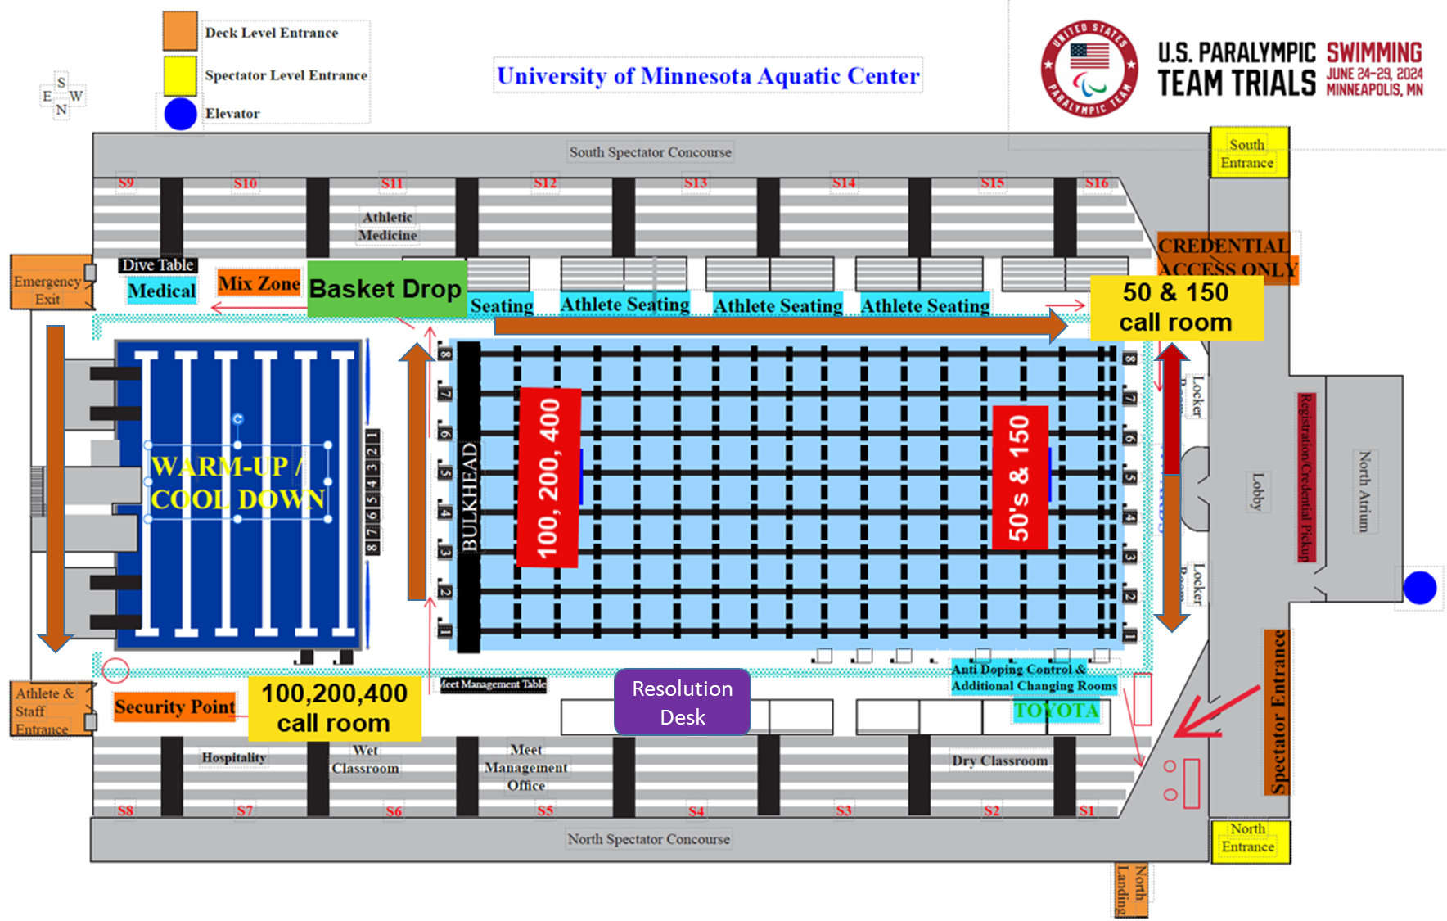

Slide 5
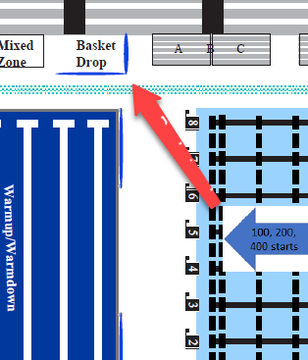
Race Competition Flow
All 100, 200 and 400 events will start at the dive tower end of the pool
All 50 and 150 events will start at the opposite end of the pool
Personal mobility aids and baskets will be available next to lane 8

Slide 6
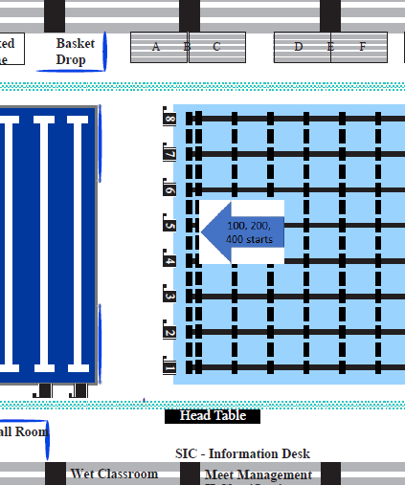
100m Race Completion Flow
To call room
Pool Exit
To call room entrance
Athletes’ bags
Competition
Competition
Call room entrance

Slide 7
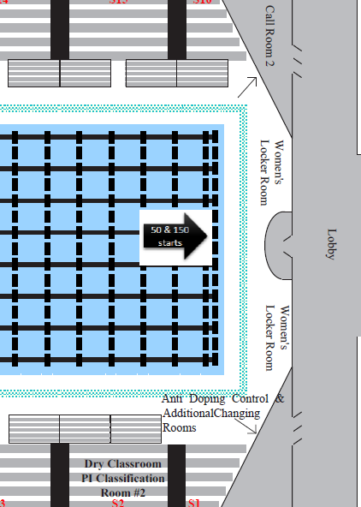
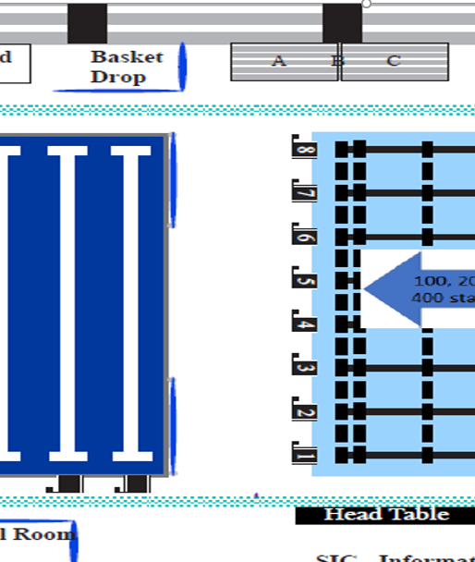
50m Race Completion Flow
Call room entrance
Pool Exit
Competition
Athletes’ bags
Pool Exit

Slide 8
Locker Rooms
Locker room access is from the pool deck.
MAAPP and II policies will be in effect for all locker rooms on complex and will be monitored.
Athletes needing assistance with a suit may use the Athlete Assisted Changing Room.
No phones or cameras may be used in the locker room.
Additional changing rooms are located in the hallway near USADA.

Slide 9
Restrooms
MAAPP and II policies will be in effect for all locker rooms on complex and will be monitored.
Bathrooms for officials, coaches, and volunteers are located next to the meet management office. Additional restrooms are located in the back hallway near Doping Control.
Bathrooms in the Sports Science/Kinesiology area are reserved for Doping Control.

Slide 10
Athlete Safety Policies
As a Participant of the 2024 U.S. Paralympic Team Trials - Swimming, you must be familiar with and abide by the below USOPC Athlete Safety Policies:
1. USOPC Athlete Safety Policy
2. USOPC Minor Athlete Abuse Prevention Policies (MAAPP)
Outlines requirements for interactions between adult participants and minor athletes to include:
One-on-One Interactions
Meetings and Training Sessions
Therapeutic and Recovery Modalities and Manual Therapy
Locker Rooms & Changing Areas
Electronic Communications
Transportation
Lodging
3. Supporting Athletes with an Intellectual Impairment Policy
One-on-One Interactions
Electronic Communications
Transportation
Lodging
Mandatory Reporting
10

Slide 11
How to Report
Points of Contact
Lindsay Griswold, Athlete Safety Coordinator
lindsay.Griswold@usopc.org
+1-719-238-0781
Sexual Misconduct, Retaliation, & Child Abuse
Report to The U.S. Center for SafeSport
Online: https://uscenterforsafesport.org/report-a-concern/
Phone: +1-833-587-7233
- AND –
Report Child Abuse to Law Enforcement
All other forms of Misconduct, MAAPP Violations, II Policy Violations
Report to the USOPC Office of Security & Athlete Safety
Online: https://www.teamusa.org/AthleteSafetyReportingForm
Phone: +1-719-866-3869
- OR –
Report to The U.S. Center for SafeSport
Do not evaluate the credibility of the allegation or investigate the allegation. Your vital job is simply to report the allegation.
11

Slide 12
Competition Format
Heats:
Building Opens: 7:00am
Warm-ups: 7:30am-8:45am
Competition: 9:00am
Finals:
Building Opens: 3:00pm
Warm-ups: 3:30pm-4:45pm
Competition: 5:00pm
Facility will close 45 minutes after the conclusion of competition.
Dive starts will be permitted during the last 30 minutes of each warmup session in the designated Diving lanes if the athlete/coaches wish
All Heats and Finals will be held using 8 lanes in long course competition pool , and the short course diving well will be available for warm-up/cool down during competition.

Slide 13
Warm up Lane Assignments
Lane 1: Reserved for S1 - S5 category swimmers
Lane 2: Any Sport Class - Last 30 minutes reserved for dive starts - One Way from Start End
Lane 3: Reserved for swimmers in categories S4 and above
Lane 4: Reserved for swimmers in categories S4 and above
Lane 5: Reserved for swimmers in categories S4 and above
Lane 6: Reserved for swimmers in categories S4 and above
Lane 7: Any Sport Class - Last 30 minutes reserved for dive starts - One Way from Turn End
Lane 8: Reserved for swimmers in categories S11

Slide 14
Heats / Finals and Medals
Prelims will be Multi-Class Events swum slowest to fastest by entry time.
National level athletes who are not eligible to advance to finals per the meet information are marked exhibition and an “X” will appear next to their time. All times will still count for future use.
The top 8 in each sport class will advance to finals.
Finals with less than 5 swimmers will be swum with another sport class and seperated by a lane.
Finals will be Single Class Events with medals awarded for 1st place only per class.
There will be medal ceremonies at each finals session. Please check the schedule for the ceremony for each event.
Only the athlete winning the award will be allowed on the medal stand. Friends and Family members of any age cannot be on deck for awards.

Slide 15
Heat Sheets and Results
Heat sheets will be at the meet admin table and posted online.
Results will be posted in the venue
Live results will be available on meet mobile
Colorado timing system and Hytek meet management software will be used

Slide 16
Competition Procedures
Scratches & Withdrawals
Scratches are allowed until 5:00pm local time, Wednesday, June 26 and must be submitted to Rachel.McKivigan@usopc.org
Medical Withdrawals must be reported no later than 30 minutes prior to the start of the session on the new WPS withdrawal form.
Medical Withdrawal forms are available at the Meet Management table.
$50 USD fine for non-compliance – the athlete will be withdrawn from future events until the fine is paid.

Slide 17
Competition Procedures
Advertising / Swimwear
Team’s are responsible for ensuring compliance with World Para Swimming Rules and Regulations and the specific guidelines published for this competition
Only swimwear* that is approved by World Para Swimming and complies with the Trials commercial guidelines will be permitted to be worn
Body advertisement (including tattoos and symbols e.g. the Olympic Rings) is not allowed and must be covered.
Swimmers must bring their suits, caps, goggles, backpacks, warmups, etc to registration to check they comply with the Trials commercial guidelines.
* Athletes must comply with the posted Trials Commercial Guidelines posted at: https://www.usparaswimming.org/competition-information

Slide 18
Competition Procedures
Tapping and Starting Devices
All tapping and starting devices must be deemed safe and checked by the designated person during training sessions.
Unapproved devices will lead to disqualification.

Slide 19
Backstroke Ledges
They are automatically retractable. Athletes may practice utilizing ledges during scheduled training sessions.
It is the athletes responsibility to ensure the ledges are placed correctly and at the desired height. During competition, officials will be available to provide assistance setting the ledge.

Slide 20
Strobes
One strobe will be located on the starting device
All starting blocks have a strobe in the front of the blocks
One portable strobe are available for placement on the deck. Must be requested to Rachel McKivigan during Warmups and will be allocated on a first come firsst served basis.

Slide 21
Support Staff
Any accredited person designated by a team to assist a swimmer
Swimmers with an A, Y or T rule exception are allowed Support Staff
Exceptions will be checked in the call room and by Technical Officials when on the Field of Play
Support Staff on the Field of Play when no A/Y/T exception code is present will result in the athlete being disqualified
No hats, bags, cameras, clipboards or stopwatches are permitted with support staff
Support Staff shall not coach the competitor while assisting or tapping. If such coaching occurs, the competitor shall be disqualified

Slide 22
Call Area
Call rooms located at each end of the pool for different length races

Slide 23
Reporting to the Call Room
For prelims and finals swimmers must report to the call room 15 minutes prior to the posted start time of their event.
If a swimmer has any events back to back, they may check in for both events when they check in for the first one.
If the second event is within 20 minutes of the time of the first event they will be permitted to check in for both.
If they check in for more than a single event, failure to be in the call room for the subsequent event before the prior heat leaves the call room will result in removal from the meet and a fine of $50.00 to return to the meet.

Slide 24
Reporting to the Call Room
Support staff must accompany the athlete when they report to the call room
Support staff will not be allowed to stay in the call room
Can re-join athlete as they exit the call room
Swimmer must show accreditation to enter call room

Slide 25
Technical Protests
Technical Protests must be submitted to the Resolution Desk
Must be submitted on the World Para Swimming Protest Form, available from the Resolution desk, together with a deposit of $50 USD in cash of card payment. A receipt will be issued upon request.
The Referee will then be notified and given the protest.
Jury of Appeal may be requested after a protest has been ruled upon for $100 USD in cash or card payment.
Must be submitted on the World Para Swimming Protest Form
Both must be submitted within 30 minutes of the results being posted

Slide 26
Doping Control
USADA is responsible for doping operations in accordance with the IPC Anti-Doping Code and compliance with WADA
Blood and/or urine samples may be taken
Athletes will be chaperoned from the Field of Play to the Doping Control Station
Athletes may cool-down and compete as required
Athletes should be accompanied by a member of their team. Any minor athlete must have a team staff/coach them at the time of reporting.

Slide 27
TV and Streaming
Date | Event | Network | Time (ET)
Thurs., June 27 | Qualifying Heats | Peacock | 10-11:30 a.m.
 | Finals | Peacock | 6-8 p.m.
Fri., June 28 | Qualifying Heats | Peacock | 10-11:45 a.m.
 | Finals | Peacock | 6-8 p.m.
Sat., June 29 | Qualifying Heats | Peacock | 10-11:30 a.m.
 | Finals | CNBC, Peacock | 6-8 p.m.
Sun., June 30 | Finals | CNBC | 1-3 p.m.*

Slide 28
U.S. Paralympic Team Trials - Swimming Coaches Group
Want to get important information such as notices of start lists being posted?
Use the CR code to join.

Slide 29
Questions Submitted in Advance
Questions Submitted

Slide 30
Thank you!

