Slide 1

SPORT:80 GUIDE FOR INDIVIDUALS, CLUBS, ASSOCIATIONS, AND ZONES

Slide 2

MEMBERSHIP REMINDERS 2025-2026
SafeSport is still required for anyone 18 and older, regardless of interactions with minor athletes
Background screening discount available every other year for Athlete Safety Members
Life Members (Active & Retired)
Do not need to register again
Adult Membership: Anyone who turns 18 before August 31, 2026
Youth Membership: Anyone who is 17U on August 31, 2026
All athletes competing in a USAAS national championship event must have a Competitive Athlete Membership

Slide 3


Slide 4
INDIVIDUAL MEMBERSHIP

Slide 5
ACCESSING YOUR ACCOUNT
Click the link in the email from Sport80 to activate your account
For those who have not already accessed their profile and/or did not receive an email from Sport80:
Go to usaas.sport80.com and click “Forgot Password”
For new members only:
Go to usaas.sport80.com and click “Create Account”

Slide 6
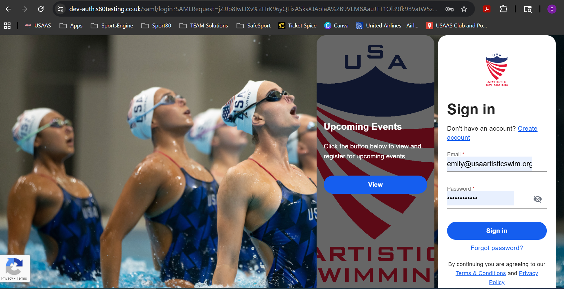
NEW MEMBERS
EXISTING MEMBERS

Slide 7
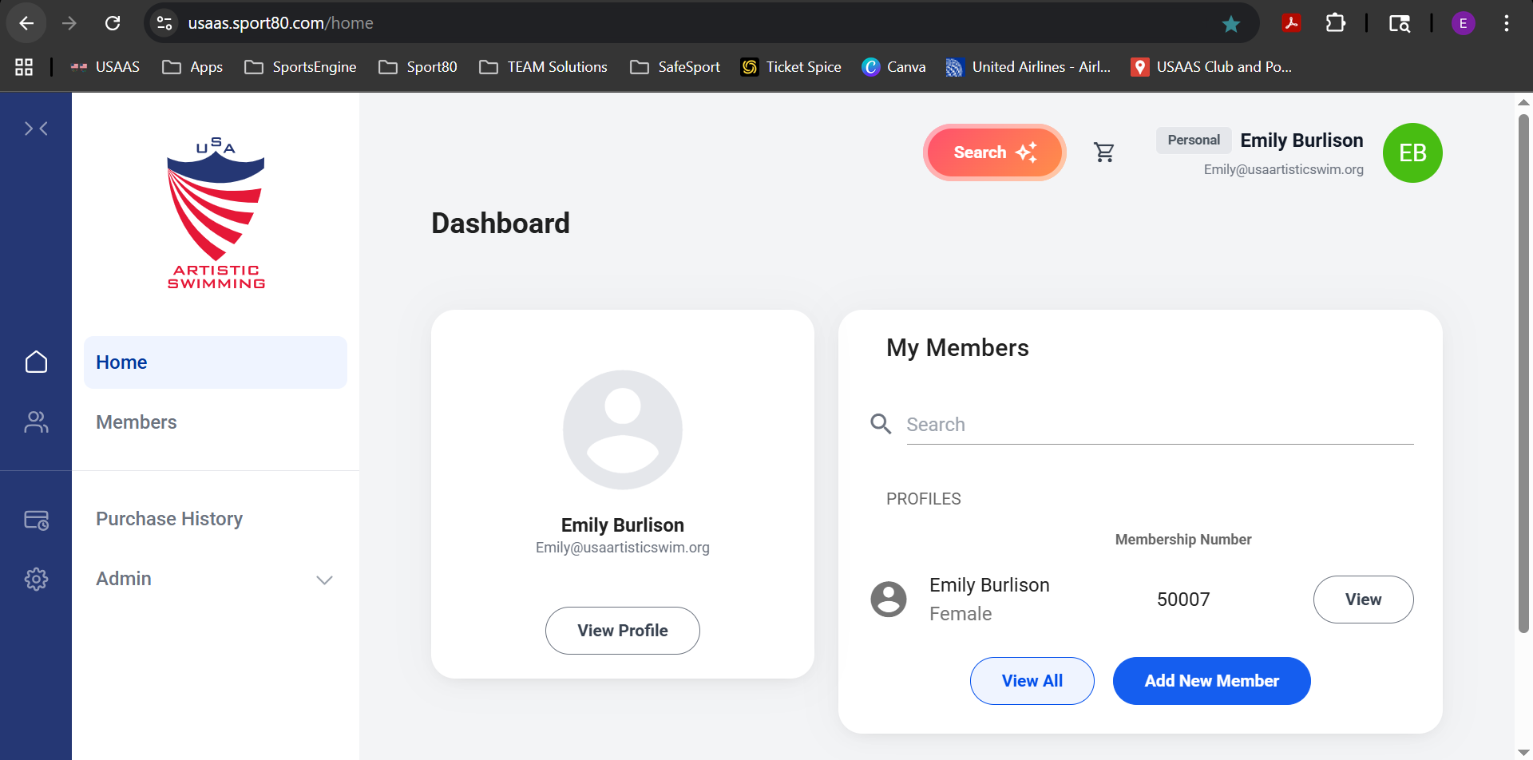

Slide 8
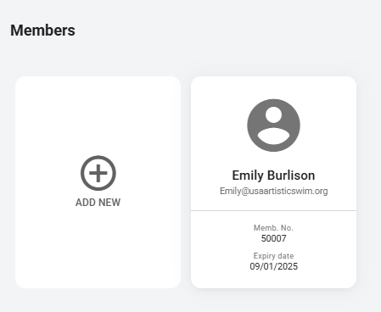
ADDING A MEMBER TO YOUR ACCOUNT
From either your dashboard or the members tab:
Click “add new member”

Slide 9
ADDING A MEMBER TO YOUR ACCOUNT
Select “A New Member” or “An Existing Member”
If the athlete had a SportsEngine profile, select “An Existing Member.”
Only select “A New Member” if the athlete is new to the sport and has not had a profile or account.
If you have a multiple members to add, you can upload a CSV file
For individual members, you can add manually.
You will need the members ID and date of birth for each member when adding manually or via CSV.

Slide 10
RENEWING AND PURCHASING A MEMBERSHIP
Click the profile card of the individual needing to renew or purchase their membership
Select the “Individual Membership” tab from the tool bar on the left-hand side of the user profile
To purchase for the first time:
Select “Add Individual Membership” and complete the required fields
To renew a membership:
Select the three dots under “Actions” and select “Edit” or select the membership line that is in “Lapsed” status
This will bring you to the individual membership form. Complete all required fields and select “Add & Checkout” and follow instructions to complete payment

Slide 11
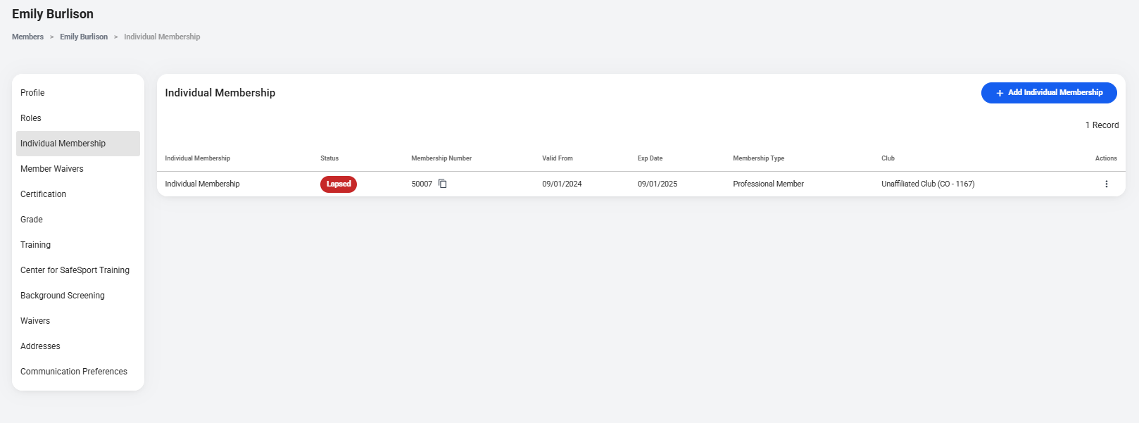
RENEWING AND PURCHASING A MEMBERSHIP

Slide 12
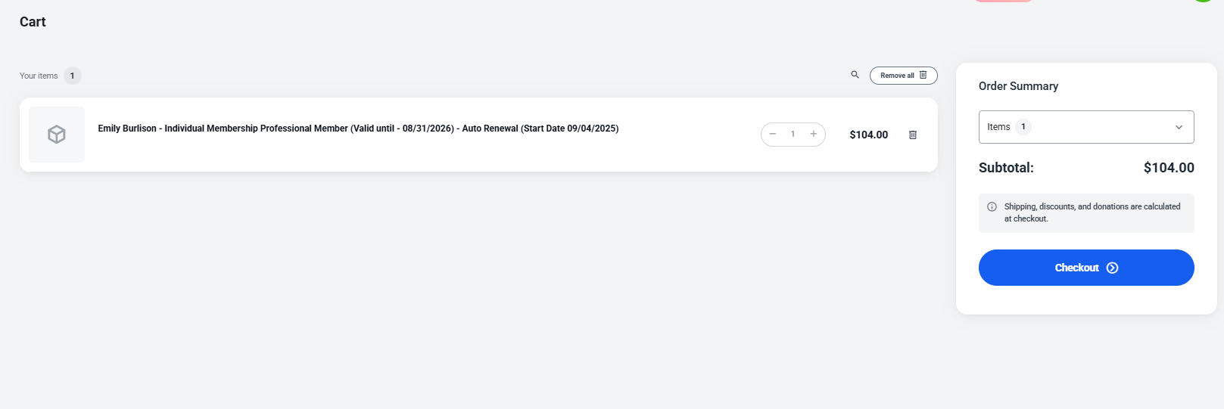
RENEWING AND PURCHASING A MEMBERSHIP

Slide 13
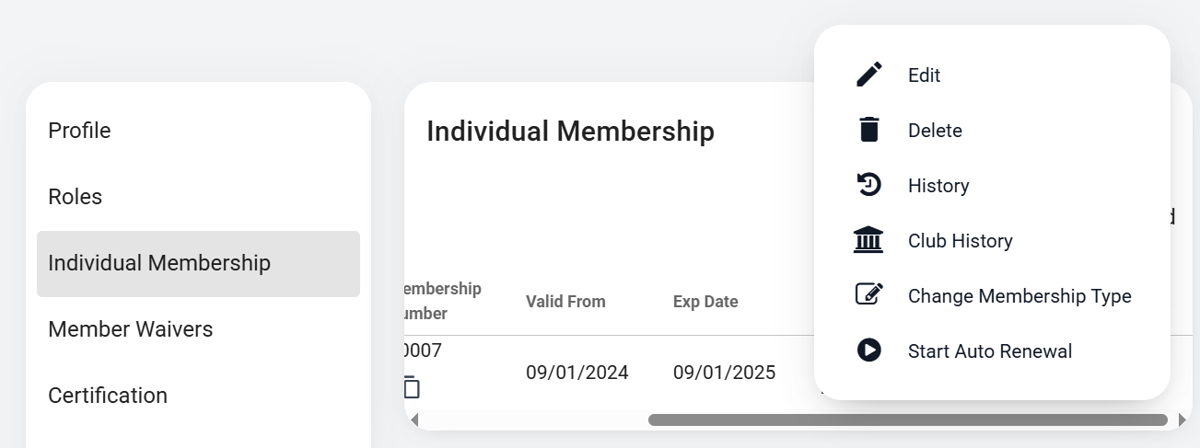
SETTING UP AUTO RENEWAL
You can set your membership to renew automatically by selecting "Start Auto Renewal" from the menu that pops up when you select the three dots under "Actions."
Please note, all auto renewals will process on September 1st and will not charge your card or show as current before then.

Slide 14
UPGRADING A MEMBERSHIP
To upgrade a membership or change a membership type:
Select the three dots under “Actions” and select “Change Membership Type”

Slide 15
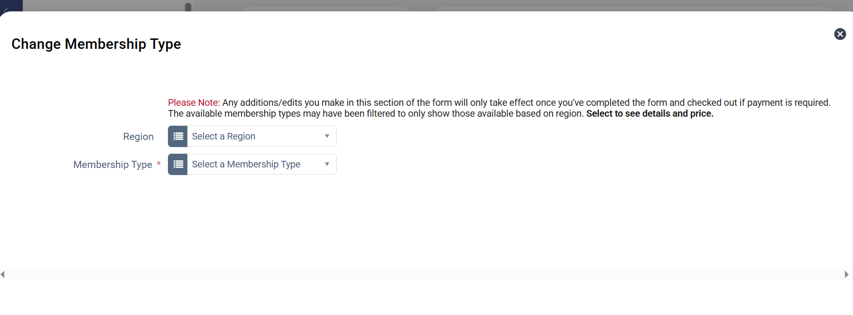
UPGRADING A MEMBERSHIP

Slide 16
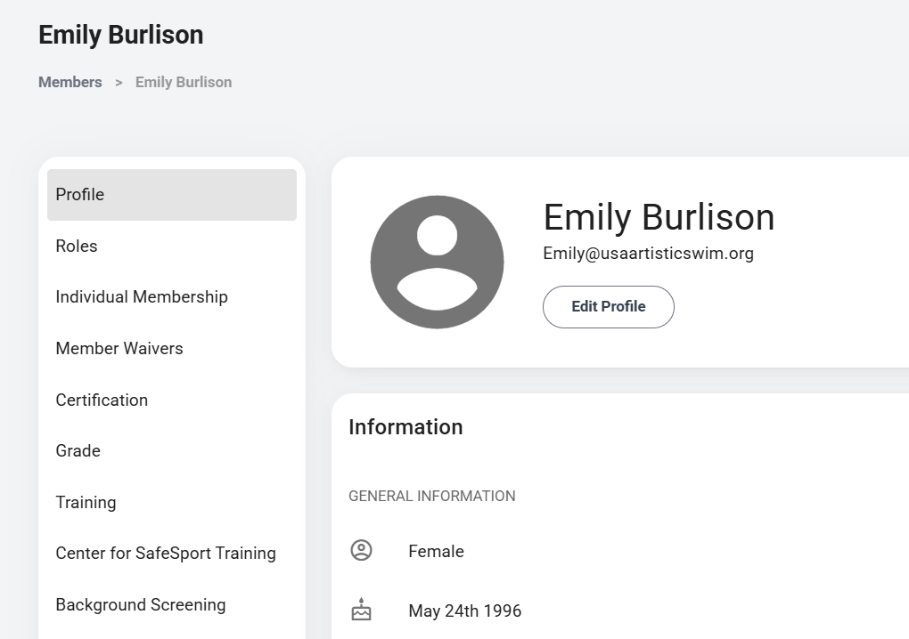
BACKGROUND SCREENING
Log in to the Platform using your email address and password
Click your profile card
Select “Background Screening” and click the blue “Add” button
Select the type of background screening you wish to complete
Complete the form as instructed and click ‘Add & Checkout’
Complete the checkout process as instructed

Slide 17
CLUB MEMBERSHIP

Slide 18
ACCESSING YOUR CLUB ACCOUNT
Log in to the Platform using your email address and password
Click the circle with your initials at the top right of the page
Select “Switch Account” from the drop-down menu
Select the club account

Slide 20
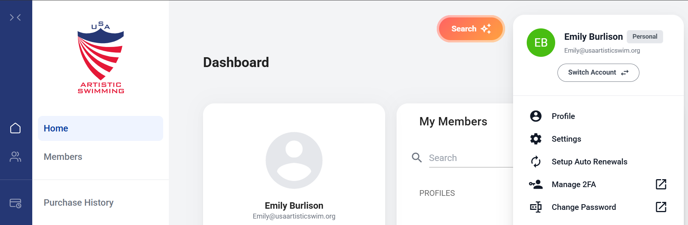
ACCESSING YOUR CLUB ACCOUNT
Log in to the Platform using your email address and password
Click your profile card
Select “Background Screening” and click the blue “Add” button
Select the type of background screening you wish to complete
Complete the form as instructed and click ‘Add & Checkout’
Complete the checkout process as instructed

Slide 21
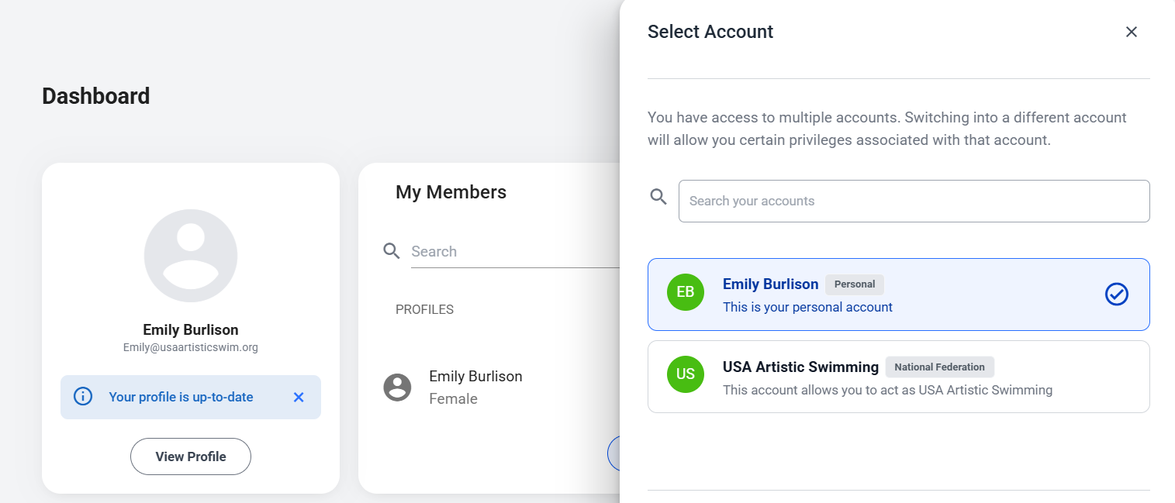
ACCESSING YOUR CLUB ACCOUNT

Slide 22
RENEWING AND PURCHASING A CLUB MEMBERSHIP
Log in to your account and switch to your club account
Select the “Club Membership” tab from the tool bar on the left-hand side of the club profile
To purchase for the first time:
Select “Add Club Membership” and complete the required fields
To renew a membership:
Select the three dots under “Actions” and select “Edit” or select the membership line that is in “Lapsed” status
This will bring you to the club membership form. Complete all required fields and select “Add & Checkout” and follow instructions to complete payment
Once you have checked out, the membership will either go into a current or pending approval status. If the membership goes into a pending approval status, USAAS staff will review and approve the club membership.

Slide 23
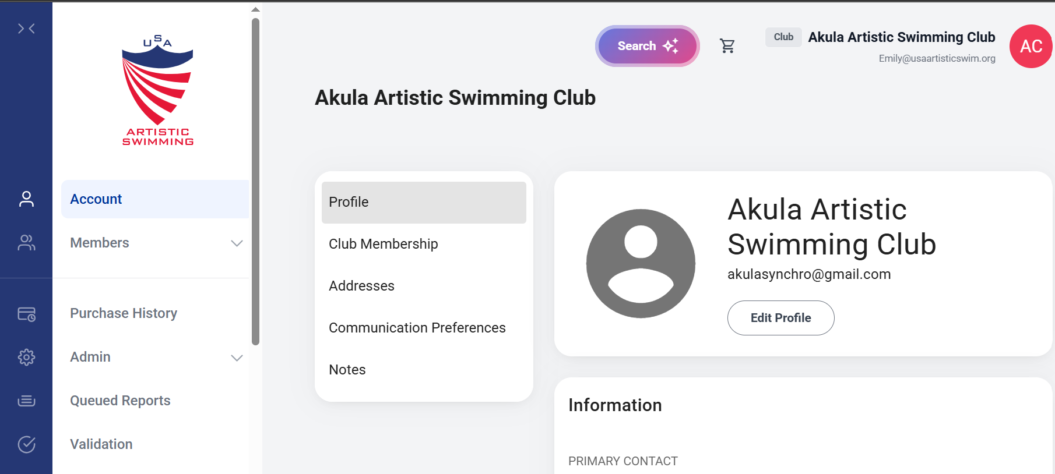
RENEWING AND PURCHASING A CLUB MEMBERSHIP

Slide 24
VIEWING AND ADDING CLUB MEMBERS
To view club members when logged into the club account
Select the “Members” tab and then select “Smart List” from the blue tool bar on the left-hand side of the club page
To search for a specific member or members
Select the “Members” tab and then select “Quick Search” from the blue tool bar on the left-hand side of the club page
Enter the information of the member you want to search for
Only one field is required for searching

Slide 25
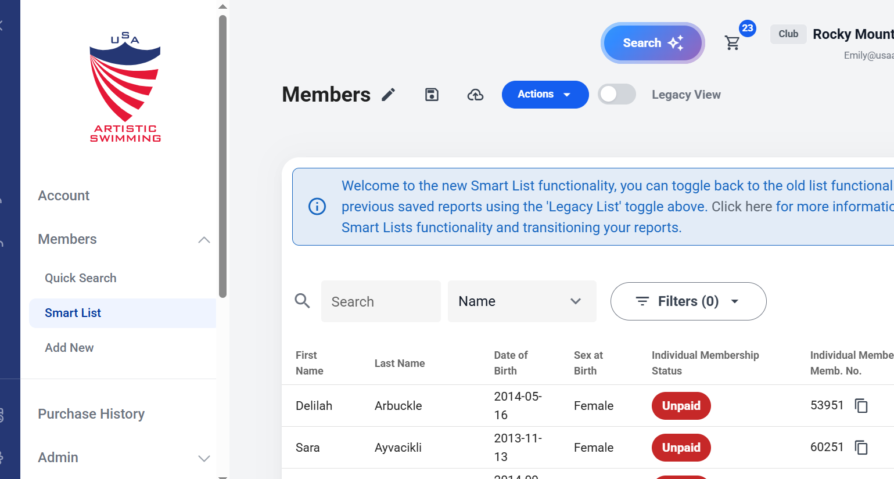
SMART LIST VIEW

Slide 26
VIEWING AND ADDING CLUB MEMBERS
To add members to your club
Select the “Members” tab and then select “Add New” from the blue tool bar on the left-hand side of the club page
Select “A New Member,” “An Existing Member,” or “Bulk Upload”
Only select “A New Member” if the athlete is new to the sport and has not had a profile or account
Select “Bulk Upload” if you have multiple members you want to add to your club at the same time
When adding members through bulk upload, select “Individual Membership” from the drop-down menu for “Type”

Slide 27
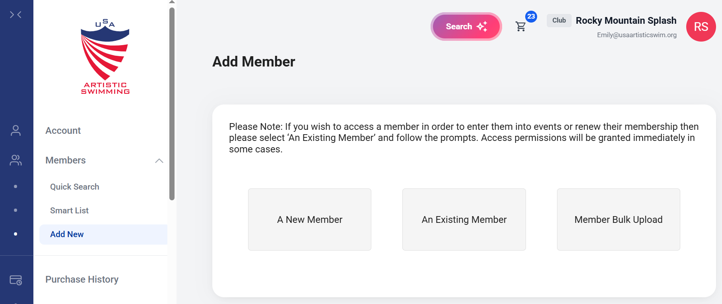

Slide 28
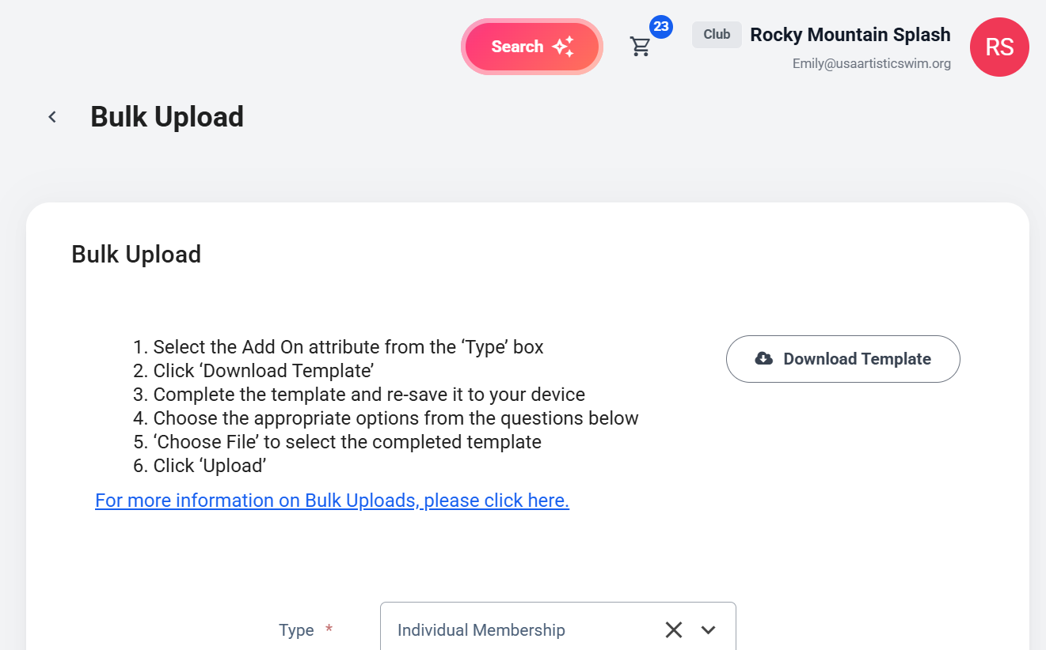

Slide 29
RENEWING AND PURCHASING A MEMBERSHIP FOR A CLUB MEMBER
Option 1
Go to https://usaas.sport80.com/public/wizard/a/1452/home
Log into your account
Select organization role
Locate the member you want to buy a membership for and click “Select”
Follow the on-screen prompts
Complete check out process as instructed

Slide 30
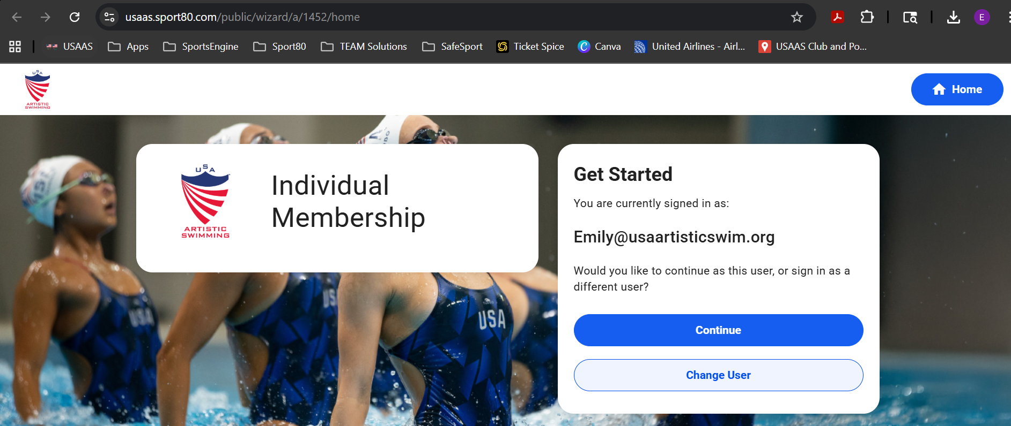
OPTION 1

Slide 31
RENEWING AND PURCHASING A MEMBERSHIP FOR A CLUB MEMBER
Option 2
Log into your account
Switch from personal account to club account
Select the “Members” tab and then select “Smart List” or “Quick Search” from the blue tool bar on the left-hand side of the club page
Click on the individual you want to renew for
Select “Individual Membership”
Select the three dots under “Actions” and select “Edit” or select the membership line that is in “Lapsed” status
This will bring you to the individual membership form. Complete all required fields and select “Add & Checkout” and follow instructions to complete payment

Slide 32
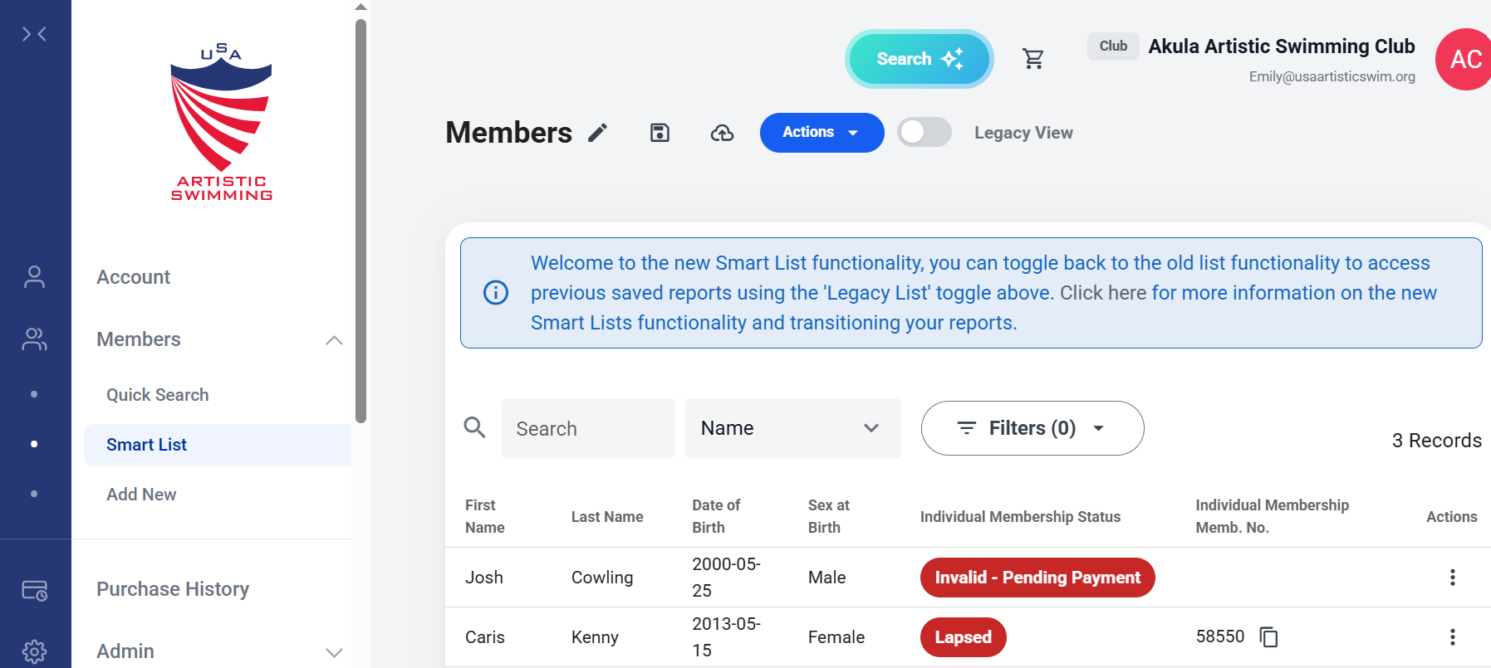
OPTION 2

Slide 33
EVENT SANCTIONING
STILL A WORK IN PRGOGRESS – AVAILABLE SOON

Slide 34
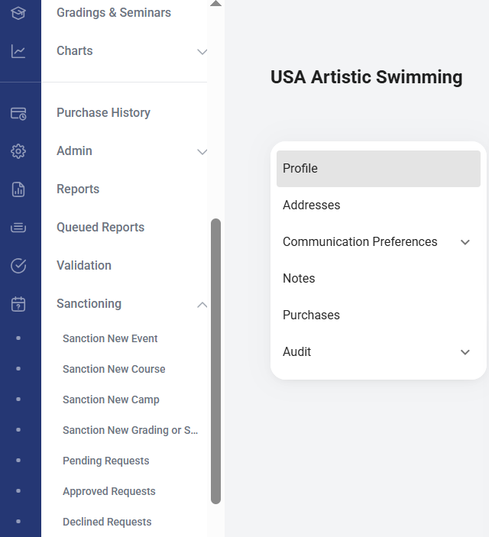
SUBMITTING A SANCTION REQUEST

Slide 35
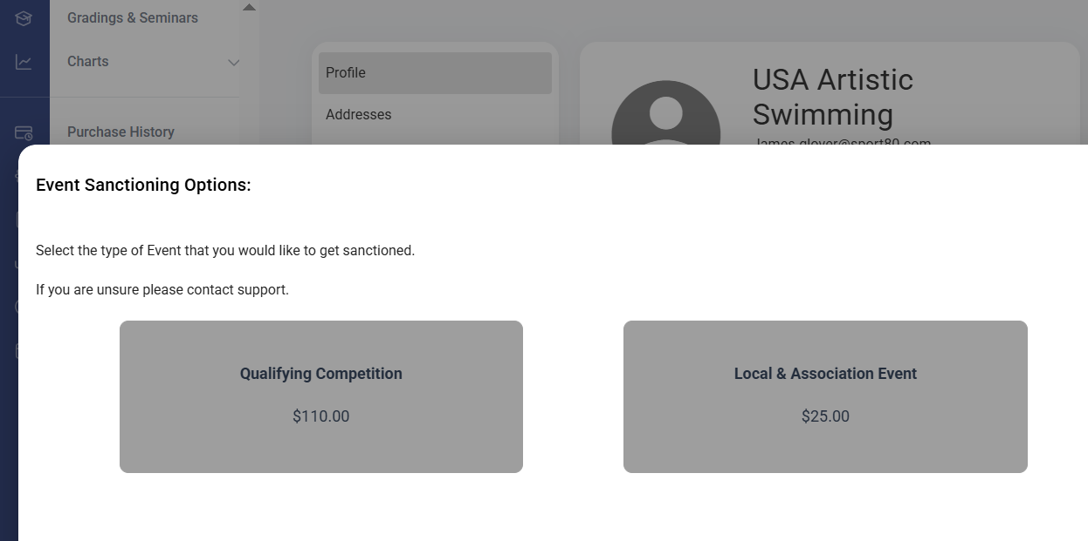
SUBMITTING A SANCTION REQUEST

Slide 36
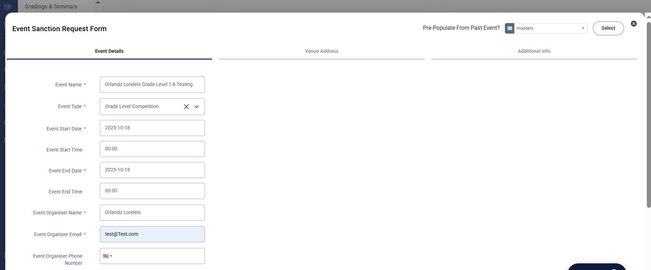
SUBMITTING A SANCTION REQUEST

Slide 37
EVENT REGISTRATION
STILL A WORK IN PRGOGRESS – AVAILABLE SOON

Slide 38
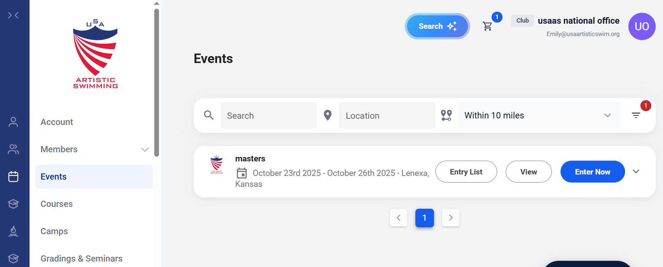
REGISTERING FOR AN EVENT

Slide 39
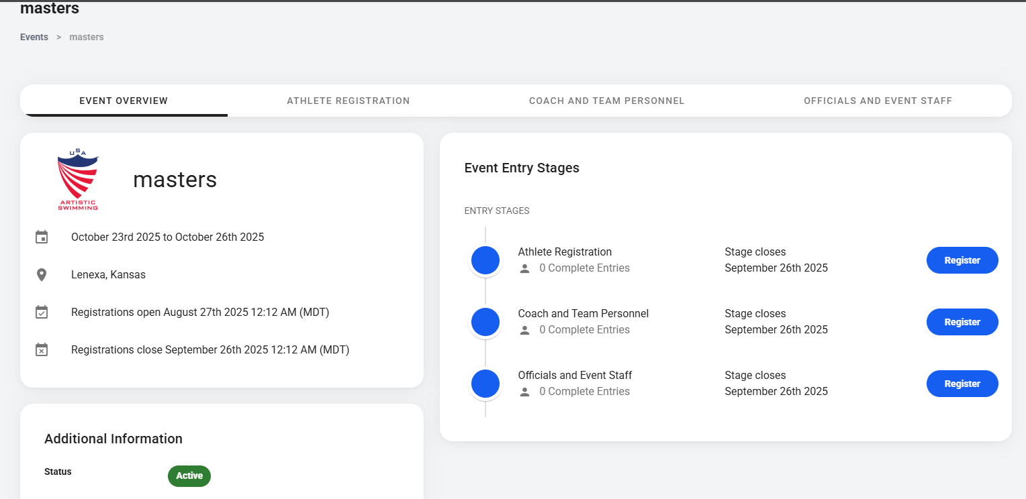
REGISTERING FOR AN EVENT

Slide 40
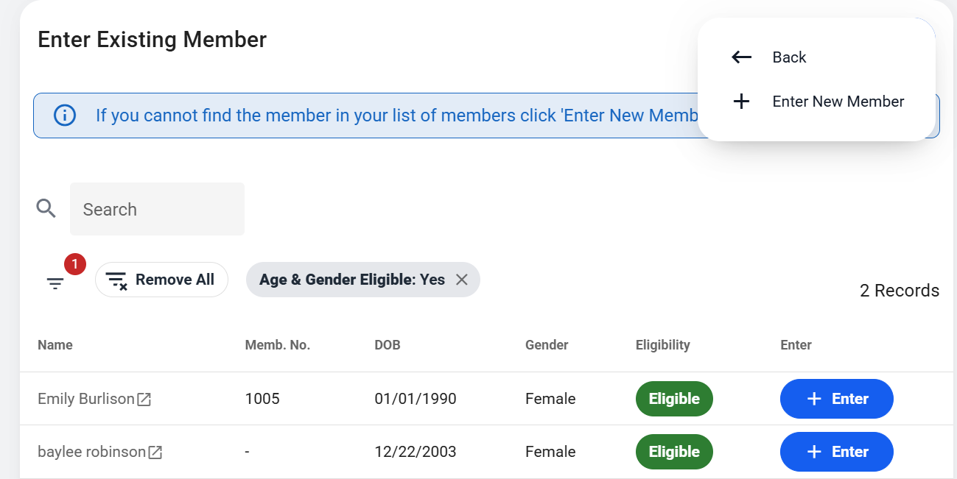
REGISTERING FOR AN EVENT

Slide 41
SUPPORT
www.usaartisticswim.org/sport-80
support@usaartisticswimming.zendesk.com

Slide 42




