Slide 1
Technical Meeting April 15, 2:30PM

Slide 2
World Boxing Technical Delegate: Angel Villarreal
LOC Competition Manager: Michael Campbell
WhatsApp +1832-439-8534
LOC Event Manager: Megan Schuller
WhatsApp +1402-429-2483
Contact for logistical questions (hotel, travel, schedule)

Slide 3
ROLL CALL
Brazil, USA, Denmark, Barbados, Algeria, Canada, France, Germany, Australia, Great Britain, China, Czech Republic, Philippines, Sweden, Chinese Taipei

Slide 4
AGENDA
Participation
Eligibility
Event and competition schedule
Official draw & daily weigh-Ins
Transportation
Training
Key rules
Medical and anti-doping procedures
Medal ceremony procedure
World Boxing Code of Conduct
Other matters

Slide 5
PARTICIPATION
Total Boxers - 105
Female Boxers - 59
Male Boxers - 46

Slide 6
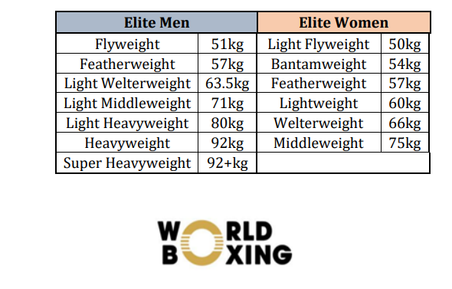
ELIGIBILITY
Nationality: Only Boxers with a nationality of the country/NF they represent are allowed to participate

Slide 7
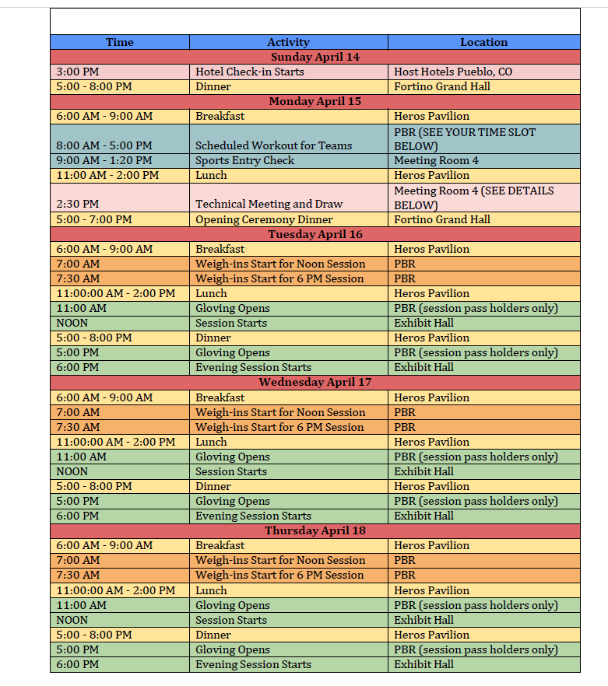
EVENT SCHEDULE

Slide 8
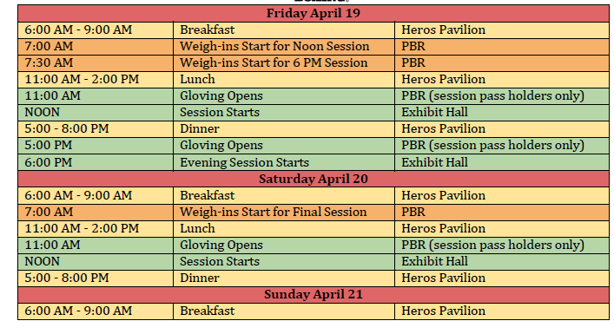
EVENT SCHEDULE (continued)

Slide 9
PRELIMINARY COMPETITION SCHEDULE
Division Boxers Division Boxers
Elite Female 50kg 11 Elite Male 51kg 6
Elite Female 54kg 11 Elite Male 57kg 8
Elite Female 57kg 9 Elite Male 63.5kg 7
Elite Female 60kg 8 Elite Male 71kg 8
Elite Female 66kg 9 Elite Male 80kg 8
Elite Female 75kg 11 Elite Male 92kg 5
Elite Male 92+kg 4
TOTAL Female Boxers = 59
TOTAL Male Boxers = 46

Slide 10
PRELIMINARY COMPETITION SCHEDULE
Division Preliminaries Division Preliminaries
Elite Female 50kg Tuesday 12 Noon, Thursday 12 Noon Elite Male 51kg Wednesday 12 Noon
Elite Female 54kg Tuesday 12 Noon, Thursday 6 PM Elite Male 57kg Wednesday 6 PM
Elite Female 57kg Tuesday 12 Noon, Thursday 12 Noon Elite Male 63.5kg Wednesday 12 Noon
Elite Female 60kg Thursday 6 PM Elite Male 71kg Wednesday 6 PM
Elite Female 66kg Tuesday 12 Noon, Thursday 12 Noon Elite Male 80kg Wednesday 12 Noon
Elite Female 75kg Tuesday 12 Noon, Thursday 6 PM Elite Male 92kg Wednesday 6 PM
Elite Male 92+kg None
Semi-Finals ALL Friday 12 Noon & 6 PM
FINALS ALL Saturday 12 Noon

Slide 11
OFFICIAL DRAW
Will take place after the Technical Meeting Conducted by Xempower (Room 4/5)
No seeding at this competition, boxers from the same NF split upon request
The weight category of each boxer confirmed at the Sport Entries Check is final
After the Official Draw, draw sheets will be available online, please check the QR code on your credential

Slide 12
DAILY WEIGH-IN & MEDICAL CHECK
Will be conducted daily in the Exhibit Hall at 7:00am
During the Boxer’s first Daily Weigh-In of the Competition, the minimum and the maximum weight limits are controlled
Only the maximum weight limit is controlled after the first weigh-in
Boxers must wear their credential to daily weigh-in
Facial hair is allowed as per World Boxing Rules
No piercings are allowed (will be checked)
The Boxers are allowed one opportunity at the official scale to make weight
Only boxers are allowed to enter the Weigh-In & Medical Check rooms (no coaches or other Team Delegation Members)
Test scales are accessible at any time in the Bernstein area. Please go through the Courtyard Marriott lobby to access (getting on the trial scale before official weigh-in is required)

Slide 13
TRAINING
LOCAL GYMS:
Stylers Boxing Club - 205 N. Main St. – one block from the Convention Center Call Scott Gomez for scheduling 17192404749
Open 8am – 6pm – No cost, but you must call to book time!
Yabarra’s Gym – 330 Court St. – two blocks from the Convention Center Call Luis Yabarra for scheduling 17192376982
PBR – Open daily for open training 6am – 10am
Change to competition schedule – Session pass/Gloving now opens at 10:30am daily for the early session and 4:30pm daily for the late session.

Slide 14
KEY RULES
World Boxing Competition Rules apply to this competition
Three rounds of three minutes with one minute rest periods
Gloves and headguards will be provided by LOC (personal equipment not allowed!)
Equipment provider: Sting
Professional tape and gauze will be provided by the LOC for each bout and personal tape or Velcro bandages are not allowed (issued at the back of house once you arrive)
Boxers will put their gloves on in the back of house and put their headgear on in the ring – Tape will be applied to the gloves by the Equipment Table
Long hair needs to be controlled prior to putting on the headgear
Flags, signs, posters or banners are NOT allowed in the Field of Play

Slide 15
KEY RULES
10-Point Must System will be used
Draw of Judges for each bout will be done by Xempower
Five judges will score each bout
To win a bout a boxer must be declared winner by the majority of the Judges
Unsportsmanlike Behaviour will lead to the opponent declared winner by DQB and additional sanctions may apply.
No protests are allowed according to the rules, but we welcome substantiated complaints submitted at sport@worldboxing.org (competition name, date, session, bout number, detailed description of the complaint) and ethics@worldboxing.org, using the whistleblowing form found at https://worldboxing.org/governance/

Slide 16
KEY RULES
No Boxer will be saved by the bell
After three (3) warnings an automatic disqualification will be issued to the boxer
Three compulsory counts in the same round leads to RSC
Four compulsory counts in any bout leads to RSC
A compulsory count caused by a foul will not be included in the compulsory count limit

Slide 17
KEY RULES
Seconds are not permitted to encourage or incite spectators by words or signs while in the FOP
Seconds are not allowed to clap during the bout
Seconds are not allowed to leave their designated area, touch the ring, clap, address the technical officials or judges, opposing boxer or coaches during a bout
Seconds are not allowed to cause any type of scandal in the FOP or take any other action that may be deemed as unsportsmanlike behavior
Seconds are not allowed to use cameras or communication devices in the FOP, such as, but not limited to, smart phones, tablet PCs, walkie-talkies, headsets, radios, etc.
Seconds are not allowed to administrate supplemental oxygen or any type of inhaler to a boxer during a bout

Slide 18
KEY RULES
If a Team Delegation Member, Boxer or Competition Official is suspected of a serious offence that is likely to constitute an ethic or disciplinary offence by breaching the World Boxing Code of Conduct, any Competition Official, on their own motion or based on a complaint by anyone, has the right to refer the matter to World Boxing for further prosecution and possible sanctions

Slide 19
KEY RULES
For a first violation of any of the prohibited activities, a Second receives a caution.
For a second violation of any of the prohibited activities, a Second receives a warning. They must then be placed just outside of the Field of Play area but are allowed to remain at the Competition Venue.
For a third violation of any of the prohibited activities, a Second is removed by the Technical Delegate for the rest of the day.
If a Second is removed for a second time, that Second is completely suspended from the Competition until its conclusion.
The Technical Delegate has the right to caution, to remove from the Field of Play, and to remove the accreditation of a Second who has infringed the Rules.

Slide 20
KEY RULES (UNIFORMS)
Boxers shall box in boots or shoes (without spikes or heels), socks, shorts or skirt (not shorter than mid-thigh and cannot cover the knees) and a vest covering the chest and back
Boxers can wear a sport form-fitting Hijab
Mouth Guards can be of any color
The belt line of shorts must be clearly indicated by a 6 – 10 cm wide white or contrasting elastic waistband
Boxers are not allowed to have tape on any part of their uniform
COACHES ATTIRE – Coaches attire inside the FOP can’t have any other sanctioning organization’s logo such as WBA, WBC, IBA, WBO, or any other organization other than WB. If needed, there will be tape at the Equipment Table to cover any prohibited logos.

Slide 21
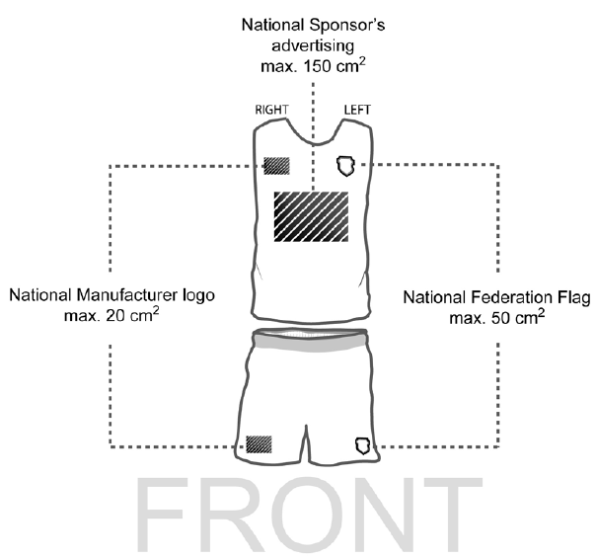
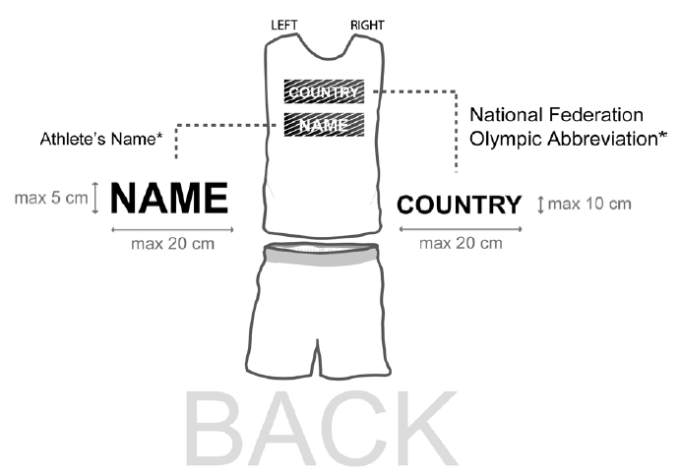
KEY RULES (UNIFORMS)

Slide 22
MEDAL CEREMONY
All medalists in each weight category are required to participate in the Medal Ceremony on Saturday after the finals (bronze medalists must also attend)
All medalists must wear their own country tracksuit, shirts and shoes
Boxers are NOT allowed to participate in the Medal Ceremony with any flag, sign, banner, poster and/or any prohibited attire

Slide 23
WORLD BOXING CODE OF CONDUCT
All Boxers, Team Delegation Members, National Federation representatives and all World Boxing officials are required to comply with and respect the World Boxing Code of Ethics and Code of Conduct
Proper decorum and respect for property is to be maintained at the Team Delegation hotel and in Event Venues. Any material damage done by event participants shall be settled immediately or will be billed to the respective National Boxing Federation.

Slide 24
QUESTIONS?

Slide 25
THANK YOU FOR YOUR PARTICIPATION!
Opening dinner starts at 5pm!

