Slide 1
2024-2025 SENIOR NATIONAL TRAINING SQUAD 2024 JUNIOR NATIONAL TEAM WORLD CHAMPIONSHIPS 2024 ELITE CAMP SELECTION EVENT National Skills Testing Protocols
January 2024

Slide 2
SELECTION EVENT
APPENDIX E
2024 – 2025 Senior National Training Squad SELECTION 1
Through the evaluation process we will select up to 20 athletes who will be eligible for the 2024-2025 Senior National Training Squad. Exact number to be determined by the High Performance Director or designee; including remote athletes.
All members in good standing who will be 15 years of age or older by December 31, 2028, are eligible to participate in Phase 1.
2024 Junior World Championship Team
Through the evaluation process we will select athletes who will be eligible for the 2024 Junior World Championships Team. Up to 14 athletes will be selected. The exact number of female and male athletes will be determined by the High Performance Director or Designee in consultation with the National Team Coaching Staff and selected Judges.
2024 Junior National Elite Camp
Through the evaluation process we will select up to 10 athletes who will be invited to attend the National Elite Camp.
Full details for National Training Squad Trials process can be found here.

Slide 3
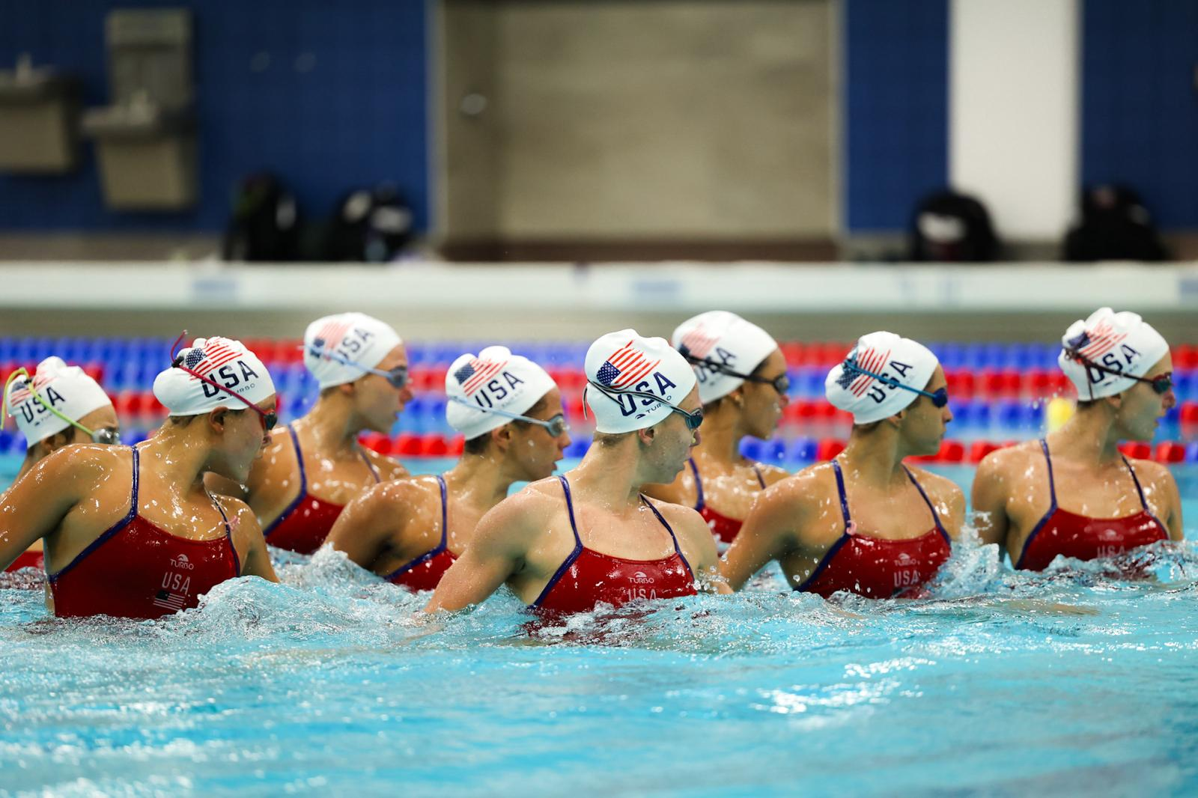
National SKILL TESTING RULES
IMPORTANT: Athletes participating only in the Junior National Team Trials only will need to have completed Grade Level 5. Athletes participating in Senior National Team Trials are required to have completed Grade Level 6.
All athletes must wear a black swimming suit and white swim cap for the water testing. There may not be any club affiliation displayed on the athlete’s outfit.
The draw numbers may be written on the caps or the athletes’ bodies.
The Evaluators will be selected by the High Performance Director (or Designee).
The AAC Athlete Representative and VP Olympic International, or Designee, will be in attendance for oversight.
The evaluation system is based on the NT skill testing protocol as follows.

Slide 4
Selection Important Notes
Dates: April 14-15, 2024
Location: Houston, Texas
Registration Open: March 1. https://usasynchronizedswimming.sportngin.com/register/form/011284542
Registration Fee for Athletes: $150.00
Deadline Registration: March 31st
Late Fee: $25 per person (between April 1-6)

Slide 5
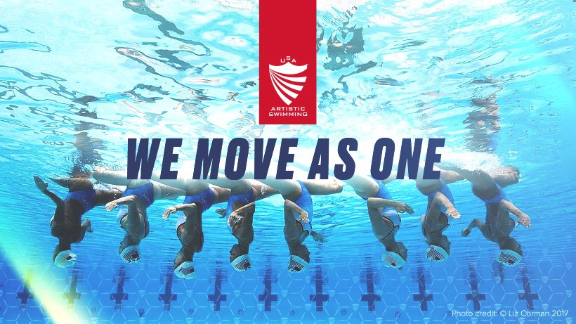
SUMMARY OF SKILL TESTING
Phase 1A – Individual Routine Swim
Individual Routine Swim – Senior Tech Team
(MJ Routine from the Pan Am Games)
Routine will be swum individually one time.
Phase 1B - Coaches Observations: Throughout the day National Team Coaches will evaluate the athletes for preparedness, attitude and competitiveness. Athletes shall perform a warm-up lead by one of the NT coaching staff.
Phase 1 – Final Score:
Phase 1A – Individual Routine Swim 70%
Phase 1B – Observation 30%
Up to 16 athletes, in rank order, shall advance to Phase 2A.
NOTE: TIED ATHLETES: If one or more athlete(s) attain a score. of 0.1 or less below the score of the last qualified athlete for Phase 2A, it will be considered a tie. All tied athletes shall advance to Phase 2A.
Phase 2A – Group Swim:
Eligible athletes will compete in a Routine competition, which will consist of 1
group routine swim. All athletes from Phase 2A shall advance to Phase 2B.
Phase 2B – Trials Interview:
Eligible athletes will participate in an in-person interview conducted by the National Team Coaching Staff.
Final Score: The final score will be calculated using the following percentages:
Phase 1 - Final Score 40%
Phase 2A - Group Swim 40%
Phase 2B - Trials Interview 20%
Entire Playlist for Trials can be found HERE

Slide 6
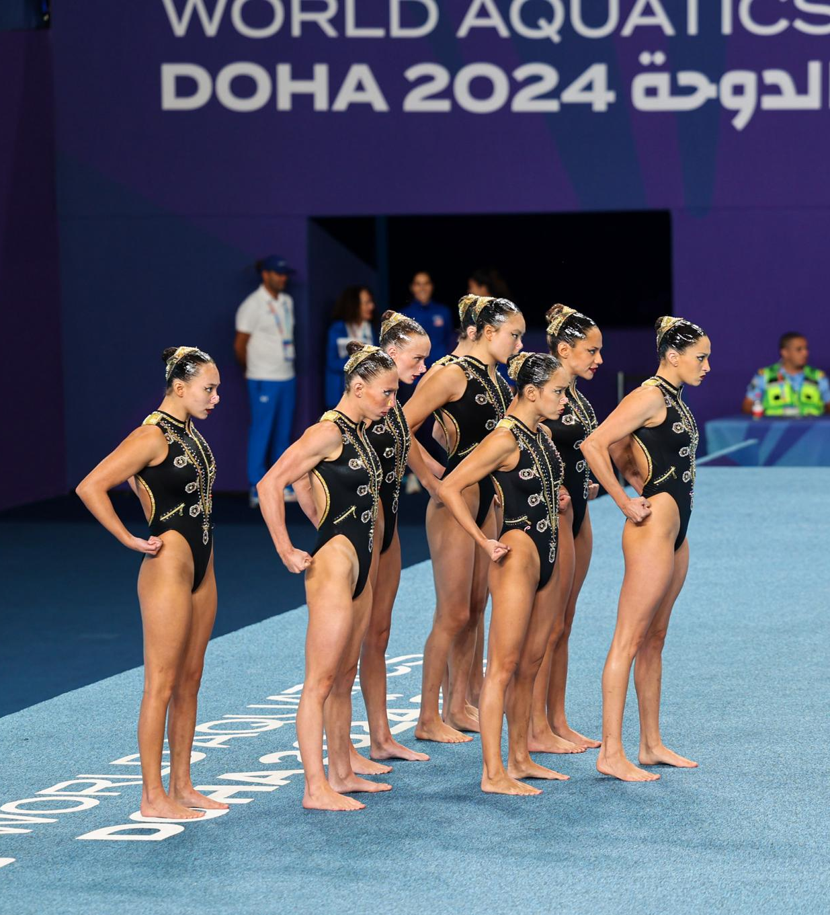
PHASE 1A –
ROUTINE ASSESSMENT

Slide 7
ROUTINE ASSESSMENT
Description of Routine:
Pre-learned routine as posted. Senior National Technical Team routine from PAG
Scoring Criteria:
Maximum height, extension, accuracy of movements, artistic impression.
10 points possible for each TRE
10 points possible for Execution on each Hybrids
10 points for Performance
10 points for transitions
How is the test evaluated?
Up to 5 Evaluators will evaluate:
Elements: TRE & 3 Hybrid Execution Scores
Performance and Transitions:
Artistic Impression - Performance/Presentation - Effortlessness throughout, Consistency of performance, Charisma and communication, Interpretation of character, mood, feeling. Transitions should be smooth and seemingly effortless, without bouncing, jerkiness or splashing unless clearly intended otherwise in the choreography. There should not be any excessive, extraneous movements, loss of control, extension or height during a transition. Pool coverage, constant flowing actions should be shown.
Routine starts from DECK. Athlete should perform your own Deck work = Confidence & Originality.
Each Judge shall award scores from 0-10 points in increments of 0.25
A National Team Coach will evaluate Synchronization. Deductions for Synchronization will be the following:
Small mistakes (-0.1) / Obvious mistakes (-0.5) / Major mistakes (-1.0)
Entire Playlist for Trials can be found HERE
SCORESHEET – Each Element is worth 10 points AQUA Scoring Rules

Slide 8
ROUTINE ASSESSMENT
SYNCHRO ROUTINE – Phase 3B
SYNCHRO ROUTINE – Phase 3B
SCORING SPREADSHEET - EXECUTION
Area – Execution | Description of requirement | Score Given
PERFECT | Maximum height - over 9.5 in scale both dynamic and stable, accurate lines in all Hybrids • Full control - solid stability, full extension of body and all joints, effortless, clean • Extreme flexibility (hips, shoulders, spine) • No deviation | 10
NEAR PERFECT | Maximum height - over 9.5 in scale both dynamic and stable, accurate lines in all Hybrids • Full control - solid stability, full extension of body and all joints, effortless, clean • Extreme flexibility (hips, shoulders, spine) • No deviation | 9.75 – 9.5
EXCELLENT | Average height clearly on 9.0-9.5 • Full extension, minimum problems in stability • Few (2-3) Small deviations • Extreme range of flexibility | 9.25 – 9.0
VERY GOOD | Average height 8.5 to 9.5 • May loose full extension or total stability but for a minimum duration • Few (2-3) small deviations • Large range of flexibility | 8.75 – 8.0
GOOD | Average height 7.5 to 8.5 • May loose full extension or total stability for a few moments during Hybrids (obvious) • Small and medium deviation, no large deviation • May show average / medium range of flexibility | 7.75 – 7.0

Slide 9
ROUTINE ASSESSMENT
SCORING SPREADSHEET - EXECUTION
Area - Execution | Description of requirement | Score Given
COMPETENT | Average height 6.5 to 7.5 • Not full extension at any moment, but not poor either; may show obvious lack of stability • Small and medium deviations, may contain large deviations • Medium to small range of flexibility | 6.75 – 6.0
SATISFACTORY | Average height 5.5 to 6.5. • Not full extension at any moment, even poor occasionally. Obvious lack of stability • Medium and large deviations • Small range of flexibility | 5.75 – 5.0
DEFICIENT | Average height 4.5 to 5.5. • Poor extension and obvious lack of stability during all Hybrids • Medium and large deviations • Small range of flexibility | 4.75 – 4.0
WEAK | Struggling in all aspects. • Low height • Large deviations • Unclear | 3.75 – 3.0

Slide 10
ROUTINE ASSESSMENT
SYNCHRO ROUTINE – Phase 3B
SYNCHRO ROUTINE – Phase 3B
SCORING SPREADSHEET - ARTISTIC IMPPRESSION (PERFORMANCE & TRANSITIONS)
Area - Performance & Transitions | Description of requirement | Score Given
EXCELLENT / PERFECT | Total command throughout routine with use of face and whole body (90-100% of the routine). Flawless. Outstanding charisma. Routine appears effortless. Performs transitional movements showing constant action of many different body parts performed in an excellent manner. Complexity is performed effortlessly and can be appreciated throughout the routine. | 10 - 9
VERY GOOD | Well accomplished total command during routine with use of face and whole body (80% of the routine). Minor breaks in total command. Majority of the routine is performed effortlessness. Movements are seamlessly and accurately performed. | 8.75 – 8.0
STANDARD | Achieved total command and use of face/body (70% of the routine) but may lack physical and/or emotional energy to stay connected for entire routine. Efficiency and execution level may deteriorate as routine progress. Variety in Transitions although mainly standard actions. | 7.75 – 7.0
COMPETENT | Attempts command (60% of the routine) but lacks physical and/or emotional energy to stay connected for entire routine. Some Transitions produce a lack of fluidity; execution level is limited by the athlete’s abilities. May show lack of efficiency in propulsions/ sculling techniques in some spots | 6.75 – 6.0

Slide 11
ROUTINE ASSESSMENT
SCORING SPREADSHEET - ARTISTIC IMPPRESSION (PERFORMANCE & TRANSITION)
Area - Performance & Transitions | Description of requirement | Score Given
SATISFACTORY | Some attempt at command (50% of the routine). Only able to project for ½ of the routine while the remainder of the routine is inner focused. Lacks physical and/or emotional energy causing the routine to appear insecure. Transitions fluency is poor and routines lacks fluidity. Difficulties with execution of the Transitions. Simple Transitions with evident problems in execution. Lack of efficiency evident in propulsions/ sculling. | 5.75 – 5.0
DEFICIENT | Majority of the routine is inner focused with small attempts to connect to audience (40% of the routine). Unconfident. Transitions are mostly breathing/resting sections. No fluency. Mostly, low execution level. Transitions with large problems in execution. Lack of efficiency in propulsions/ sculling | 4.75 – 4.0
WEAK | Inward focused for the entire of the routine. Even the simplest movements show large execution problems. Transitions, difficult to identify with large problems in execution. | 3.75 – 3.0

Slide 12
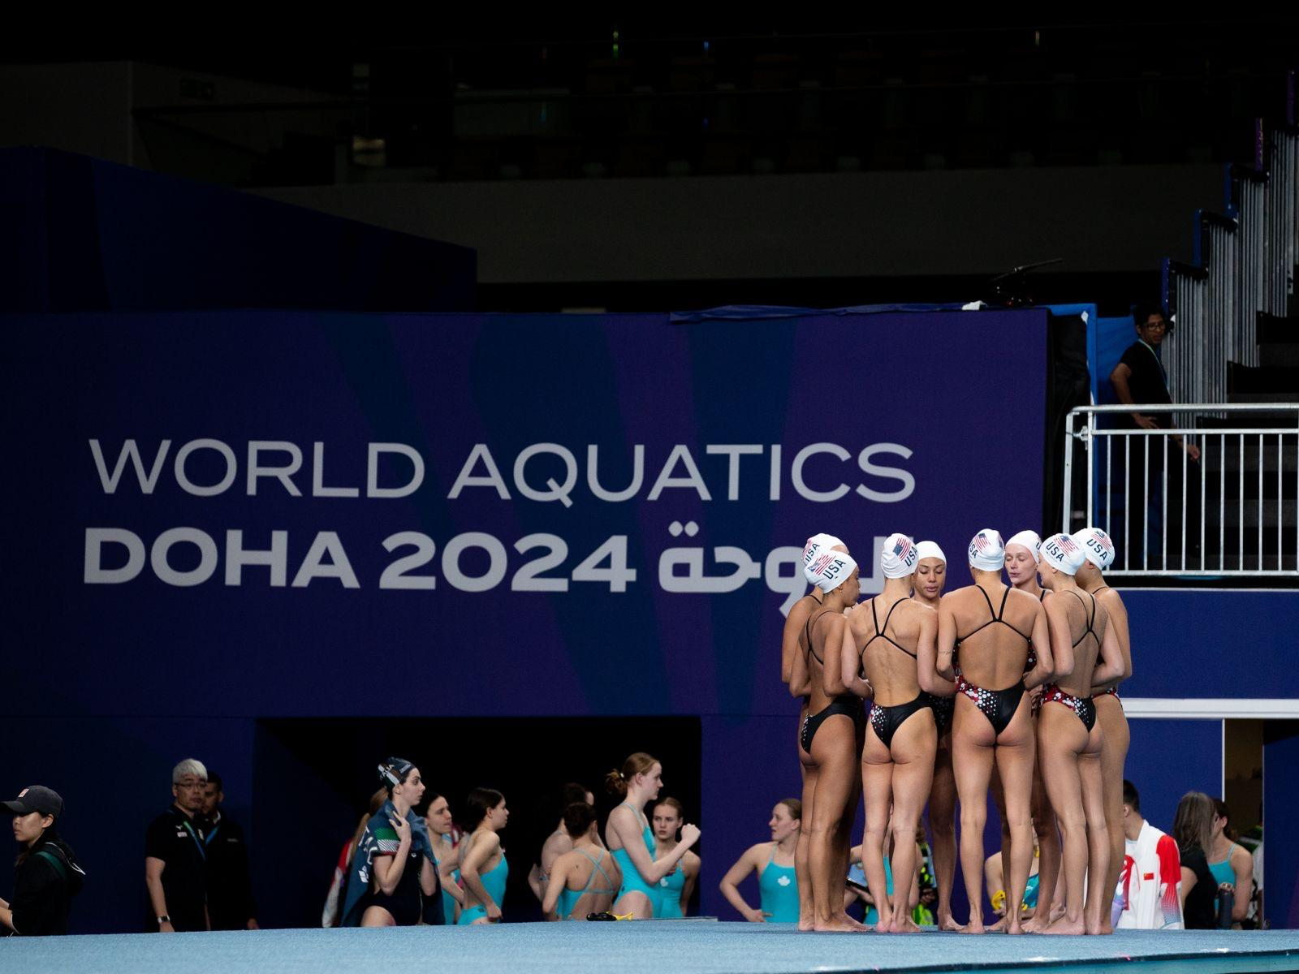
PHASE 1B –
OBSERVATION

Slide 13
COACHES OBSERVATION
Coaches Observation by National Team Coaches
Description
National Team Coaches will assess athletes throughout the day based on their preparedness, attitude, and competitiveness. The trials will kick off with a group land warm-up and technical water session led by a designated National Team coach. Athletes will be evaluated on their coachability, focus, and adaptability to the exercises taught.
Possible Points for Coaches Observation:
10 points.

Slide 14
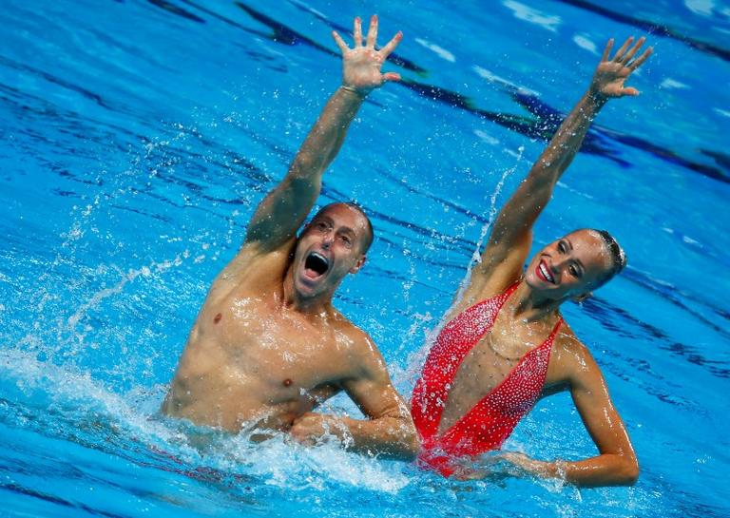
PHASE 2A –
GROUP SWIM

Slide 15
ROUTINE ASSESSMENT
Description of Routine:
Pre-learned routine as posted. SNT Team Free routine from the Pan American Games – 2nd Lap. The draw and the number of athletes in each group for the group routine swim will be decided by the HPD.
Groups of 4 swimmers will perform a short section of the SNT Team Free routine and will be asked to switch pattern to a specific spot. This same section will be performed 4 times.
SNT Team Free (PAG) 2nd lap of the routine. Around 1:53 – 3:05 of the PAG Streaming video. Note* Athletes must learn Anita Alvarez’s spot for accuracy of counts. Landrill videos are posted for better understanding of counts.
Entire Playlist for Trials can be found HERE
Scoring Criteria:
Pattern awareness, space awareness, presentation, sharp movements throughout the performance and charisma.
Possible Points for Group Routine Assessment:
Pattern Awareness/ Spacing Awareness – 10 points
Artistic Impression / Performance – 10 points
Execution of hybrids – 10 points
How is the test evaluated?
Up to 5 Evaluators.
Important Note: In the second lap of the SNT Team Free, various stroke movements occur. Athletes must familiarize themselves with all positions and numbers as we will assess their capacity to swiftly adjust to new positions under the A.I scores.

Slide 16
GROUP ROUTINE ASSESSMENT
SCORESHEET – GROUP SWIM
Area | Description of requirement | Max Score
PATTERN & SPACE AWARENESS Number of points possible: 10 | Very Weak | 4.5-5.5
 | Weak | 5.5-6.5
 | Good | 6.5-7.5
 | Very Good | 7.5-8.5
 | Outstanding | 8.5-10
PERFORMANCE Manner of Presentation Connection with judges, confidence, charisma and how you sell it Number of points possible: 10 | See SCORING SPREADSHEET - ARTISTIC IMPRESSION (PERFORMANCE & TRANSITION)
HYBRIDS EXECUTION Number of points possible: 10 | See SCORING SPREADSHEET - EXECUTION

Slide 17
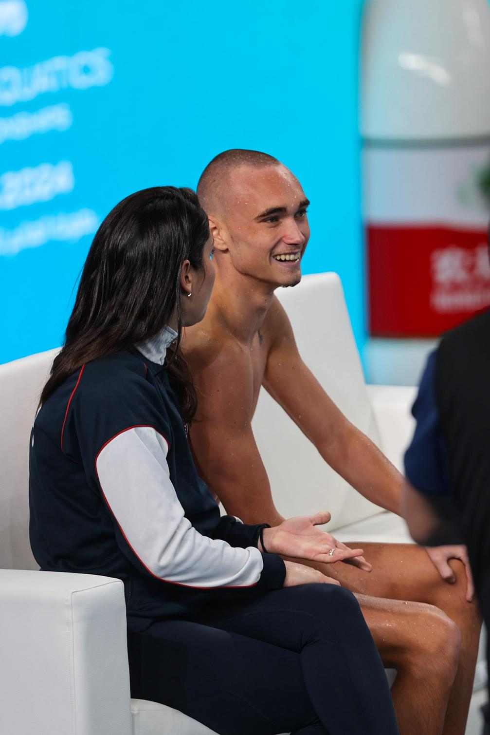
PHASE 2B - INTERVIEWS

Slide 18
INTERVIEW
Individual Interviews with National Team Coaches
Description
Eligible athletes will participate in an interview conducted by the National Team
Coaching Staff onsite. Meeting will take no longer than 10 min.
The meeting is a dedicated space on the Selection event to learn more about the athletes. It will be an open-ended conversation between athlete & National Team Coaches. The questions will be regarding the motivation to enter the National Team, the athlete’s mindset, commitment & attitude towards the program.
The order of the interview will be decided by the High Performance Director (or Designee).
The interview has a 20% weight on the final score.
Scoring Criteria:
Motivation, Mindset, Team player, Commitment, Attitude
Possible Points for Individual Interview:
10 points.

Slide 19
FINAL SCORE CALCULATIONS
FINAL SCORING SPREADSHEET
PHASE 1A + 1B
 | Observation | Routine
% | 30% | 70%
PHASE 2A
 | Pattern Awareness | Performance | Hybrid Execution
% | 20% | 50% | 30%
FINAL SCORE
 | Phase 1 | Phase 2A | Interview 2B
Overall Weighting | 40% | 40% | 20%

Slide 20
FOR ANY QUESTIONS CONTACT
Lara Teixeira at lara@usartisticswim.org

