Slide 1
Treasurer’s Report
Saturday, September 9th | King of Prussia, PA
So sad to miss you all ☹

Slide 2
Agenda
Look Back – how did we manage the our finances last year?
Look at the Present – how are we doing today?
Look Forward – how are we thinking about allocating our money in the future?

Slide 3
Look Back – 2023 Financial Strategy
Our Financial Strategy: we have been in an investing year – with a strong National Team, we are investing to shore up competitive prospects and give our team the best possible chance at success in the long run
Goals: we set several goals to guide our financial planning efforts
Support National Team Training: continue athlete payments, facility pool rentals, etc. to ensure consistent training in prep for competition
Fund Active Competitive Season: ensure sufficient airfare, lodging, and ground transport for international competitions (+30% spend on this over this time in 2022 season)
Maximize and Diversify Income: manage events (and improve operations) on a responsible budget and minimize administrative costs, while seeking additional, diversified sources of revenue

Slide 4
Look Back – How Does that Shape Our Plan?
 | What We Earned Last Year (2022 December Actuals) | What We Budgeted for this Year (2023 Full Year Budget) | % Change YoY
Revenue
Communications | $ 50,000 | $ 59,400 | 19%
Administrative | $ 104,400 | $ 399,900 | 283%
Education | $ 26,000 | $ 51,000 | 96%
Events - Competitive Ops | $ 727,300 | $ 650,000 | -11%
Fundraising | $ 101,500 | $ 75,000 | -26%
Marketing | $ 234,100 | $ 205,500 | -12%
Membership | $ 378,900 | $ 401,000 | 6%
National Teams | $ 837,500 | $ 765,000 | -9%
Pipeline Revenue | $ 188,500 | $ 179,500 | -5%
TOTAL Revenue | $2.6M | $2.8M | +5%
Expenses
Communications | $ 5,000 | $ 6,500 | 29%
Administrative | $ 883,300 | $ 1,102,400 | 25%
Board of Directors | $ 7,400 | $ 9,100 | 22%
CEO | $ 2,600 | $ 4,000 | 50%
Education | $ 47,600 | $ 40,700 | -15%
Events - Competitive Ops | $ 670,500 | $ 440,200 | -34%
Fundraising | $ 20,500 | $ 21,900 | 7%
Marketing | $ 2,900 | $ 2,200 | -25%
Membership | $ 45,400 | $ 53,500 | 18%
National Teams | $ 955,700 | $ 962,000 | 1%
Pipeline Revenue | $ 169,900 | $ 133,800 | -21%
TOTAL Expenses | $2.8M | $2.8M | ~0%
*Note – figures rounded to the nearest $100 USD and nominal revenues (Corporate Ops, BOD, and CEO were removed for simplicity)
We continue to see improvements in our ability to recognize revenue Administratively and through our Education programs
We are expecting to see continued growth in Membership revenue – and anticipate that this may increase in a future Olympic year
While our growth in Administrative expenses is high, it is matched by a commensurate increase in Administrative revenue
We are driving improved event efficiency through our partnerships and event planning procedures
We continue to invest in our National Team and membership development (after a large increase in spending last year)

Slide 5
Look at the Present – Our Current Standing
As of July 2023:
Income vs. Expenses
INCOME | $1.2M
EXPENSE | $1.5M
TOTAL | -$0.3M
Much of our expense to-date has been international competition and funding our Competitive Operations – at this point in the year, expenses typically reduce and we begin building our income again as the new Membership year begins
Current Checking Account
PNC Bank | +$100K
As the membership year starts the finances are good, but we are always operating with narrow margins.
Our Investments
Springer General | $100K
Springer Edmark | $50K
TOTAL | $150K
We have small investments that are available. We will exhaust the generous $1M donation of Tomima Edmark after five years.

Slide 6
LOOK FORWARD
Over the next few months, we will align our investments to our strategic plan – focusing our resources on the areas that we have prioritized for growth going forward

Slide 7
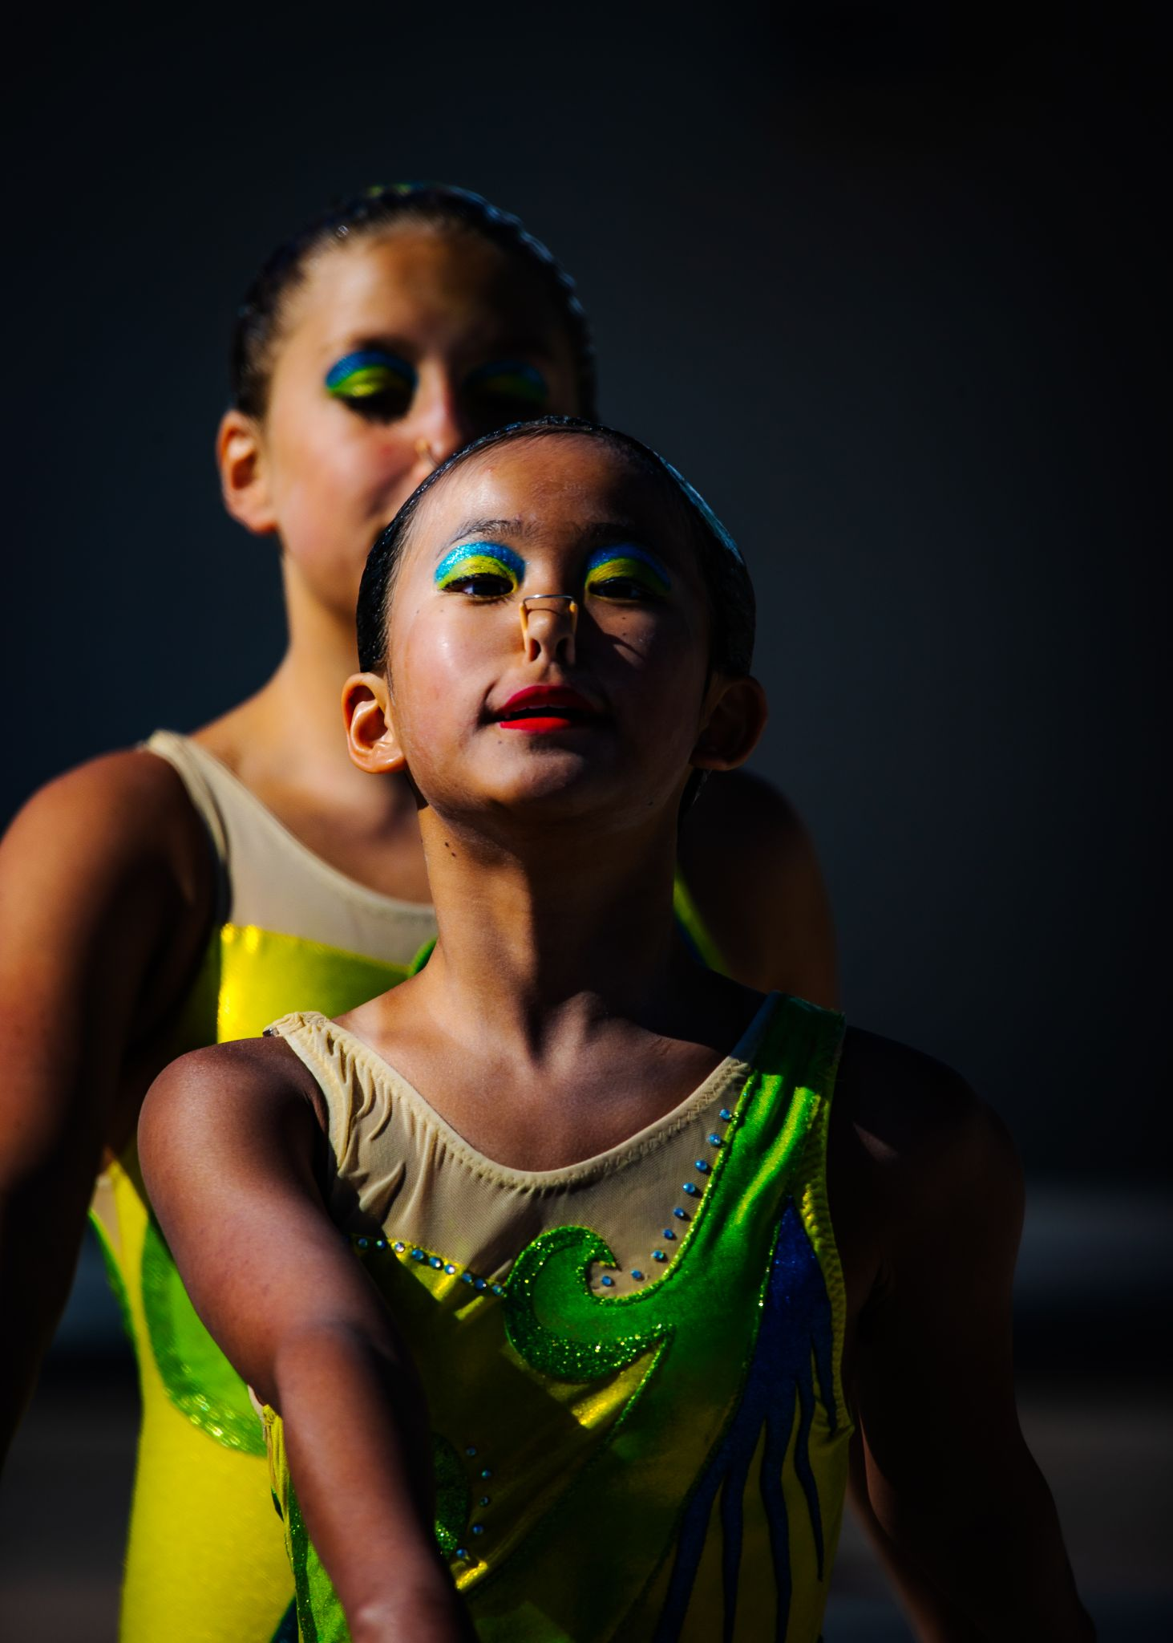
If you know nothing else…
We are investing to WIN
We are setting a positive, long-term foundation for the organization, focused on
Supporting National Team
Funding an Active Competitive Season
Maximizing and Diversifying Income
Over the next few months, we will be focusing our investment on the areas in our strategic plan that have been prioritized

