Slide 1
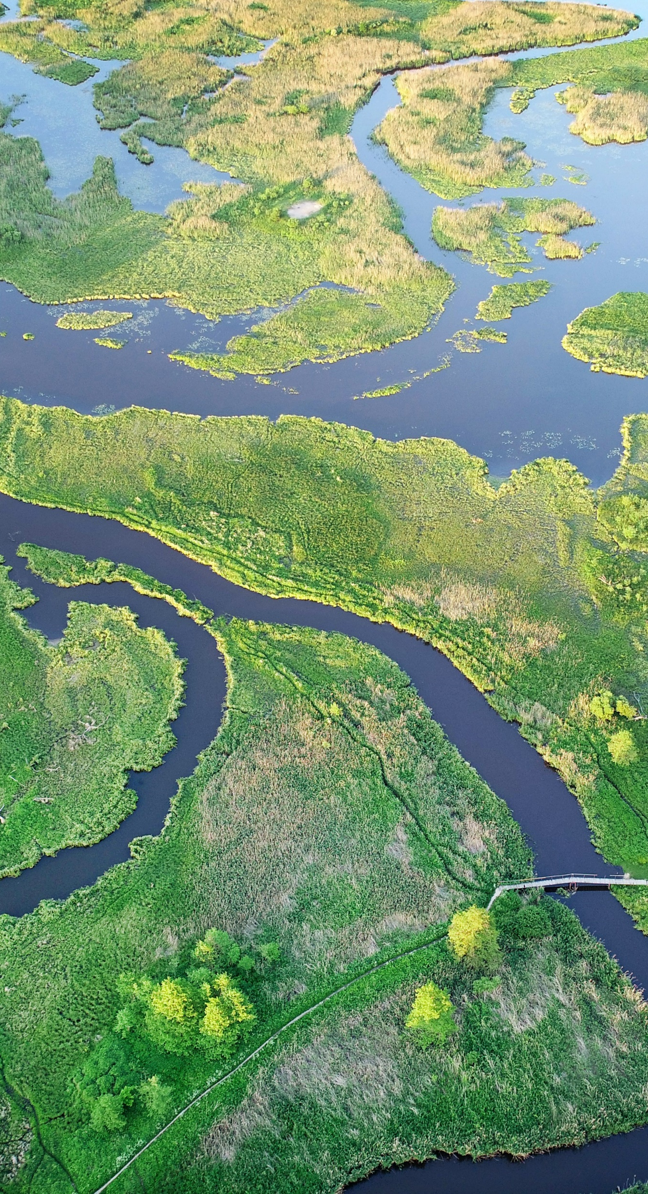
Roadmap to Impact Toolkit
Learning in Practice Toolkit
[Reference: Module 1 Strategy & Design]

Slide 2
How to use the Roadmap to Impact Tool
Purpose: The Roadmap to Impact (sometimes called a Theory of Change) is a practical tool that helps you map out how your investment is expected to create change. It sets out the impact you want to achieve, the outcomes needed to get there, and how your activities are expected to contribute to those outcomes.
By making your thinking explicit, the Roadmap to Impact helps teams clarify priorities, test assumptions, and build a shared understanding of how change is expected to happen. It also provides the foundation for measuring progress (see Impact Framework toolkit) and helps guide investment decisions by identifying opportunities that align with your strategy.
Remember that a Roadmap to Impact is not a static document. It should evolve as you learn more about the issue, test your assumptions, and adapt to changes in context.
When to develop & review: Develop the Roadmap to Impact during strategy development and investment design. Review and update it regularly during implementation, at key decision points, and when significant changes occur in the operating environment.
Who develops it: The people responsible for designing and delivering the investment, drawing on evidence, stakeholder perspectives, and insights from those closest to the issue.
Who should use it: Investment teams, delivery partners, funders and decision-makers to guide implementation, learning, adaptation and investment decisions.
Key inputs: Impact goals, evidence and insights from landscape analysis, expected outcomes, assumptions about how change will happen, emerging learning and working hypotheses.

Slide 3
ROADMAP TO IMPACT – TEMPLATE GUIDANCE
There is no set number of boxes. Add or remove boxes as needed to reflect the scale, complexity and context of the investment.
.
Over time, what broader impact do you expect that to contribute to?
System points most
outsideour control
INDIRECTIMPACT
If the impact goal is achieved, what collective outcomes do you expect?
DIRECTIMPACT
ACCOUNTABILITYLINE: distinguishes the changes a project is expected to achieve from the longer-term impact it aims to influence
IMPACTGOAL
THE IMPACT GOAL
What is the long-term change we are trying to achieve?
OUTCOMES
A
B
C
What foundational changes should emerge from those results?
System points most
withinour control
INTERMEDIATE
OUTCOMES
What direct results need to happen first to enable that change?
Each layer should connect clearly to the next, showing how the activities and investments you support are expected to contribute to change impact. Assumptions capture the conditions and circumstances that need to hold true for one level of change to lead to the next. Making these explicit helps teams test and refine their thinking as they learn.

Slide 4
ROADMAP TO IMPACT – EDUCATION PROJECT EXAMPLE
Youth unemployment among NEET young people in Kalgara falls as digital skills pathways become embedded in the local economy
The program model informs how digital skills investment is designed and delivered in other remote Australian communities
Investment in digital skills for NEET young people in remote communities is recognized as effective and prioritized by government and funders
INDIRECTIMPACT
System points most
outsideour control
Digital skills training is established as a credible and effective route to employment for NEET young people in Kalgara
Employer confidence in program graduates is established, with hiring patterns in Kalgara shifting toward locally trained digital talent
Digital skills training for NEET young people in remote communities is increasingly prioritized for public and philanthropic funding
DIRECTIMPACT
ACCOUNTABILITYLINE
IMPACTGOAL
Digital skills are a recognised and accessible route to employment for NEET young people in Kalgara, Northern Territory,
with 500 young people having completed an accredited qualification and moved into work by 2030
OUTCOMES
A
NEET young people in Kalgara enrol and complete an accredited digital kills program.
B
The accredited digital skills program is accessible and high quality.
C
Employer connections are established
and active, linking program
graduates to local job opportunities
System points most
withinour control
The community in Kalgara is aware of and engaged with the digital skills program,
and there is trust between the vocational provider, young people, families, and local employers
INTERMEDIATE
OUTCOMES
An accredited digital skills curriculum is
delivered and adapted to the needs of
NEET young people in Kalgara
NEET young people in Kalgara have a
supported and clearly signposted route
to enrol in the program
Local employers' hiring needs are understood and documented, and relationships with
the program are formalized
Program delivery data and participant feedback is collected and used to continuously improve the curriculum
Employer confidence in the program's graduates is built through early placements and positive hiring experiences
Assumption examples: Young people will enrol in digital skills training if is accessible and relevant.
Employers will hire qualified graduates.

Slide 5
ROADMAP TO IMPACT – TEMPLATE FOR DOWNLOAD
INDIRECTIMPACT
System points most
outsideour control
DIRECTIMPACT
ACCOUNTABILITYLINE
IMPACTGOAL
THE IMPACT GOAL
OUTCOMES
A
B
C
System points most
withinour control
INTERMEDIATE
OUTCOMES

Slide 6
Tips for using this tool
Broaden your perspectives early, so a wider range of voices can challenge and strengthen your logic before decisions are locked in.
Make your assumptions explicit, ensure the rationale is clear, then keep testing and retesting them, and the causal links between layers, as you learn more.
Build in regular checkpoints to revisit and test your assumptions. Once funding and partnerships are in place, it can be tempting to focus only on delivery rather than asking whether the approach is still the right one.
Keep the roadmap practical and usable, not just detailed. Try a simple test: would someone unfamiliar with the project understand the logic just by looking at it? If it's too complicated to use, it won't actually shape decisions.
Focus on the connections between layers. Each layer should link clearly to the next, showing how activities contribute to outcomes and how outcomes contribute to impact. Explicit assumptions should explain why you expect one level of change to lead to the next.

Slide 7
Thank you

