Slide 1

E-Commerce
How to maximise your online sales.

Slide 2
ACUVUE® - E-COMMERCE GUIDE
How to maximise your online sales
Why E-Commerce?
What is E-commerce?
E-commerce, also known as electronic commerce, refers to the buying and selling of goods or services using the internet, and the transfer of money and data to execute these transactions. Every time individuals and companies are buying or selling products and services online, they’re engaging in E-commerce.
Why should you sell through E-Commerce?
Using a hybrid model, combining your physical store with E-Commerce benefits both businesses and consumers in many different ways:
Your online store is still open when your practice is closed
It is quick and easy for consumers to locate products and they can compare them easily
You can easily provide a lot of information to your consumers and that will create a more informed purchase from the practice
You can gain new customers with Search Engine Visibility
ACUVUE® tip: for more information on Search Engine Visibility please see our SEO (Search Engine Optimisation) and PPC (Pay-per-click) guide by logging into myAccount on our professional website. Go on the Practice Centre, open the promotional materials section and then open the 'Logos & Packshots' folder.

Slide 3
ACUVUE® - E-COMMERCE GUIDE
How to maximise your online sales
How to use E-Commerce for your practice
Step 1
Website search visibility
Ensure consumers can find what they are looking for easily.
Step 2
Content integrity
Ensure the information you are displaying is full and accurate, helping the consumer progress through the purchase
funnel.
Step 3
Assortment availability
Consumers expect a wide range of products to be consistently available through online stores.
Step 4
Navigation presence
Measure how easily consumers can find products when using your menu system.
Step 5
Reviews efficacy
Remember that reviews can heavily influence buyer purchase decision.

Slide 4
ACUVUE® - E-COMMERCE GUIDE
How to maximise your online sales
Step 1: Website search visibility
Users of your website search bar are more likely to convert when compared to the average user navigating their own way through the website. Therefore your E-commerce website should focus on producing the best possible experience for them:
Optimising the search bar:
Be sure your consumers can find it easily
Autocomplete for site search is a very useful feature which improves the search experience by reducing the work that users need to do
Be sure to have a search bar on every single page
Contact lens
Personalising the search results:
It’s important to understand which set of products are visible to consumers on the first page of search results and what keywords you need to use to ensure consumers find what they are looking for easily
Allow consumers to personalise how the products are displayed in the search results page

Slide 5




ACUVUE® - E-COMMERCE GUIDE
How to maximise your online sales
Step 2: Content integrity
It is important to monitor the quality and consistency of the content on your Product Detail Pages. Always ensure the information you are displaying is full and accurate, helping the consumer progress through the purchase funnel. That is why we have released new ACUVUE® Product Detail Pages for you to use on your e-commerce websites. You can find them here on our professional website.
88%
of shoppers research
online before they buy*
67%
of shoppers consider product
images “very important” when it comes to making a buying decision*
BUY NO W
73%
of shoppers say that detailed
product content is the No. 1 reason they click “Buy.”*
33%
of shoppers buy from a different
company than expected because of information they found online.*
ACUVUE® tip:
You can find all the most updated ACUVUE® products images to update your online store by logging into myAccount on our professional website. Go on the Practice Centre, open the promotional materials section and then open the 'Logos & Packshots' folder.
*Source: Salsify, Jan 2018

Slide 6
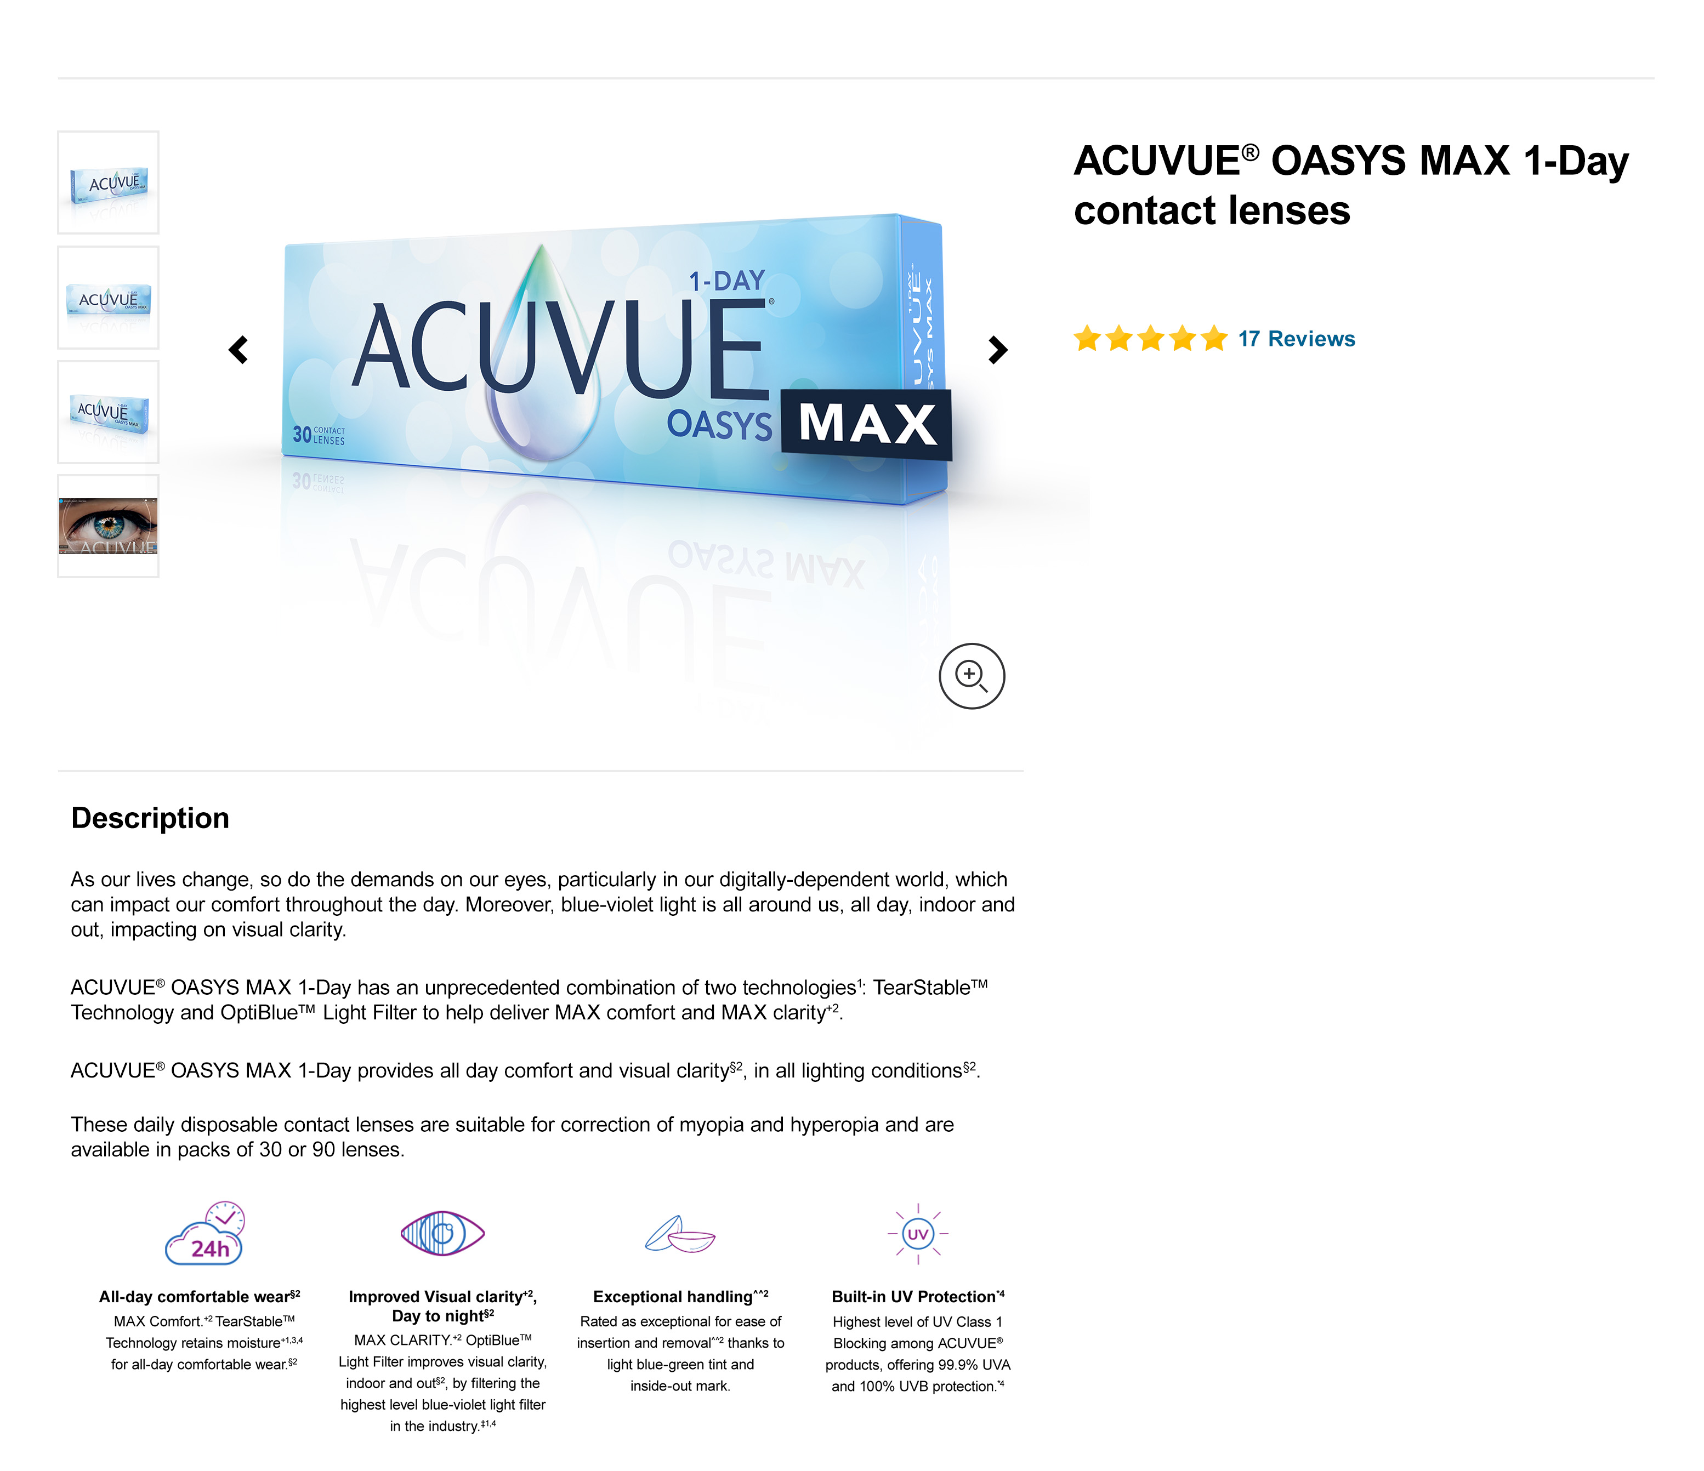
ACUVUE® - E-COMMERCE GUIDE
How to maximise your online sales
What you should check
on a Product Detail Page
Presence of brand in product title
Presence of keywords in product title
No presence of unwanted characters in product title
Presence of primary image
Is it a trusted source image?
Presence of secondary image
Presence of product description
Presence of product features and benefits
Presence of product warnings

Slide 7

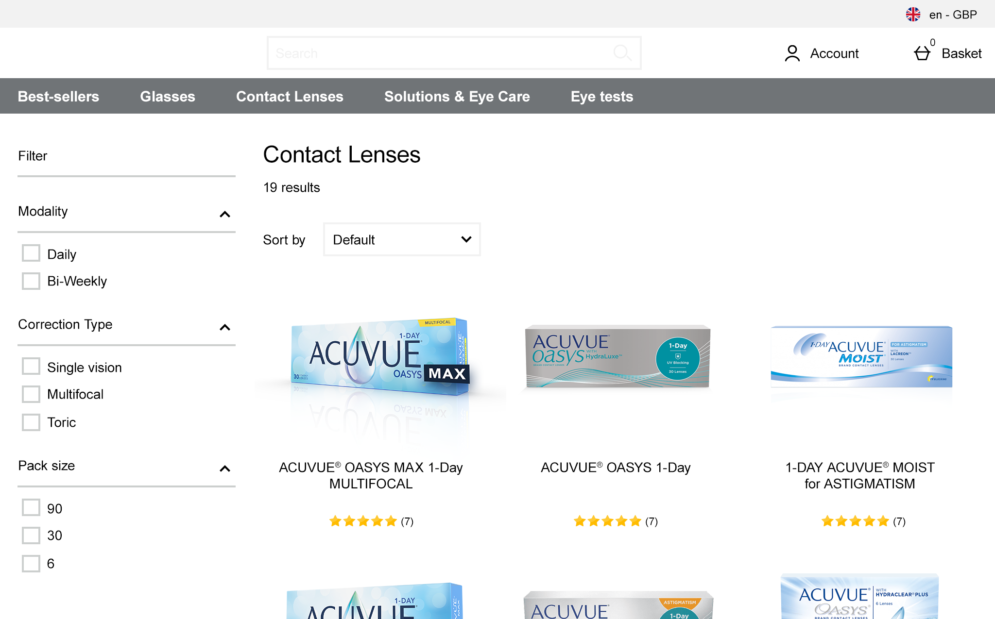
ACUVUE® - E-COMMERCE GUIDE
How to maximise your online sales
Step 3: Assortment availability
One of the advantages of online stores for consumers, is that they can always find what they are looking for. This is why they expect a wide range of products to be consistently available.
For this reason, you should always track the availability of the products you sell to minimise a lengthy delivery time due to product unavailability.
Shoppers expect a larger product assortment online vs offline.
Shoppers see convenient methods
of shopping and reordering.
Retail is credible when a broad assortment is available online.

Slide 8
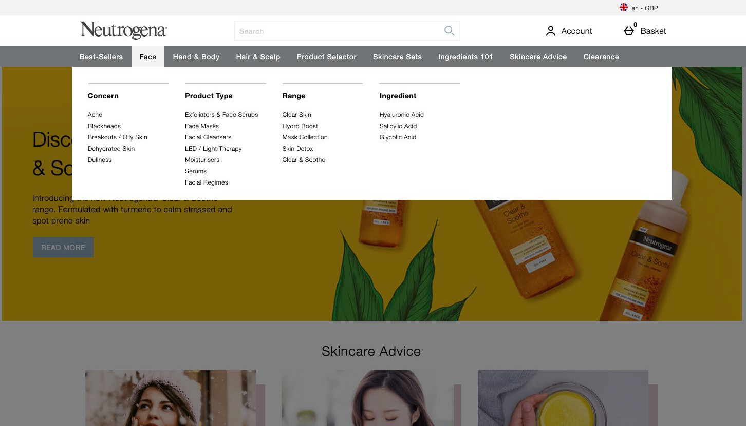
ACUVUE® - E-COMMERCE GUIDE
How to maximise your online sales
Step 4: Navigation presence
Many shoppers use the site menu navigation to find products, so this becomes another important instrument in the consumer journey.
The right products should be visible in the right category menus to ensure buyers navigate to Product Detail Pages quickly. To be sure your consumers are getting the best possible experience, you should always check how easily they can find products when using your menu system.
Consumers search by brand
Consumers search by category
Consumers search by reviews
Consumers search by feature

Slide 9
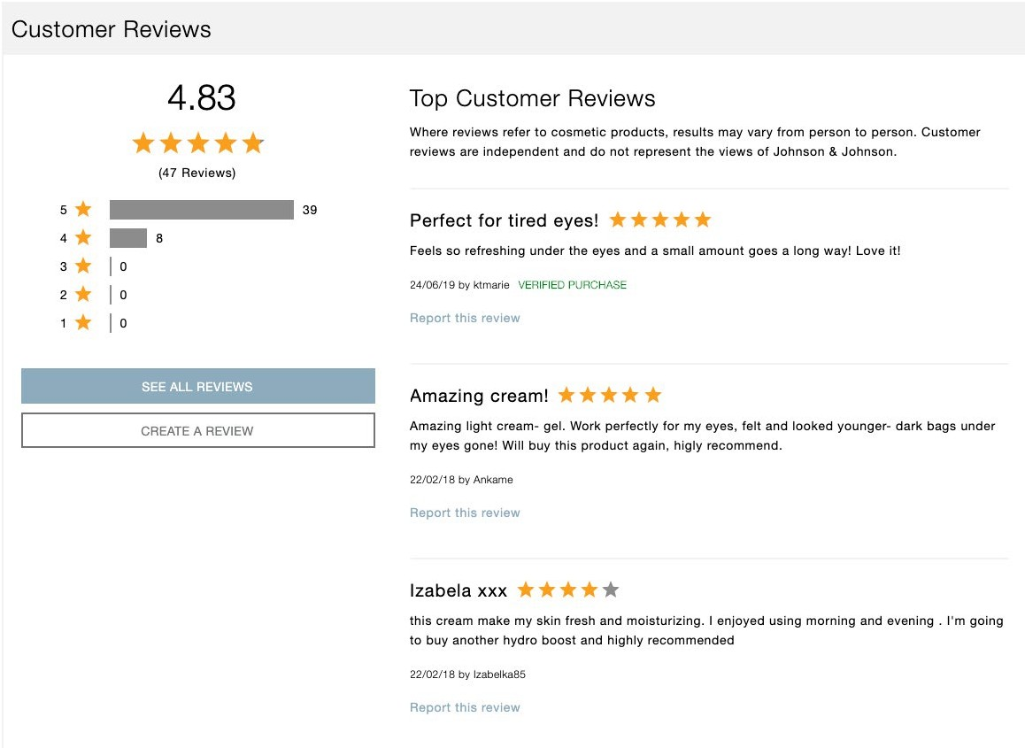
ACUVUE® - E-COMMERCE GUIDE
How to maximise your online sales
Step 5: Reviews efficacy
Reviews can heavily influence buyer purchase decisions, both for online and offline purchases, as many shoppers usually check online reviews before making a purchase.
It is important to check how many reviews consumers are writing for the products you sell and what rating they give to your products or services.
95%
of buyers read online reviews before making a purchase.¹
72%
of consumers don’t take any action until they read reviews.²
40
reviews per product is the tipping point to drive purchase.³
Sources: ¹Spiegel Research Center 2017, 2Testimonial Engine, 3BrightLocal 2018
ACUVUE® Contact Lenses are indicated for vision correction. For detailed product description and safety information, please consult the
Instructions for Use or visit our Johnson & Johnson Vision website https://jnjvisionpro.co.uk/instructions-for-use
All trademarks are the property of Johnson & Johnson 2023. PP2023AMB6460

