Slide 1
Introduction to Open Banking
(for Clients/Investors)

Slide 2
What is Open Banking?
Open banking refers to the sharing of financial information and data between banks and third-party financial service providers, at the direction of and with the explicit consent of the account holders.
Share your financial data transparently and more securely with other authorized third-party providers like your financial advisor or applications of your choosing.
No longer share your account credentials with a financial data aggregator. Instead, you are redirected to your financial institution to provide your credentials and consent to share your financial information with your third-party provider of choice.
This data may include details about the banking and investment products you have, as well as your transactions and balances.

Slide 3
Open Banking Can Make Data Access Faster, More Secure, and More Reliable
Account Holder Benefits
Advisor Benefits
Account holders are redirected to their bank site to grant access to third-parties.
Once Established, the connection:
  Eliminates the need to share credentials with third-parties
  Bypasses disruptions caused by multi-factor authentication
  Allows account owners to manage access to their data at each of their institutions
Open banking establishes direct connections between the banks and ByAllAccounts via APIs.
Once established, the connection:
  Eliminates the need for screen scraping
  Client only enters their credentials at their financial institutions
  Results in quicker connects
  Reduces connectivity disruptions

Slide 4
Open Banking Process
Process | Benefits
Step One: Account holders are redirected to their FI site to login and authorize access to their accounts | Improved security and transparency for the account holder ByAllAccounts will no longer require user login credentials to access data Banks manage credential security Account holders can manage access to their accounts from their financial institution’s security center
Step Two: ByAllAccounts accesses account holder data via an API | Improved connectivity – quicker aggregation with less downtime Screen scraping is replaced with an API connection which means changes to the financial institution website will not “break” aggregation activity
Step Three Upon authorization, the FI shares a secure token w/ ByAllAccounts to aggregate the account holder’s data | Fewer interruptions in uptime Multi factor authentication will not be required to establish ongoing account updates, reducing aggregation disruptions Changes to account holder credentials (password expirations for instance) will not “break” aggregation activity

Slide 5
Open Banking Conversion Process
1. Open Banking APIs Enabled for New Accounts
2. Migration of Existing Accounts to Open Banking APIs
Accounts currently aggregating through website connections will continue to aggregate.
If accounts or credentials fail at these FIs, users will still be able to “fix” them.
Migrations will be scheduled in coordination with you in order to minimize operational impact.
Existing accounts will be moved to the relevant Open Banking APIs.
These accounts will then fail with a credential error, and users will be required to take action to “fix” these accounts before they resume successful aggregation.

Slide 6
Open Banking Aggregation Reauthorization Workflow

Slide 7
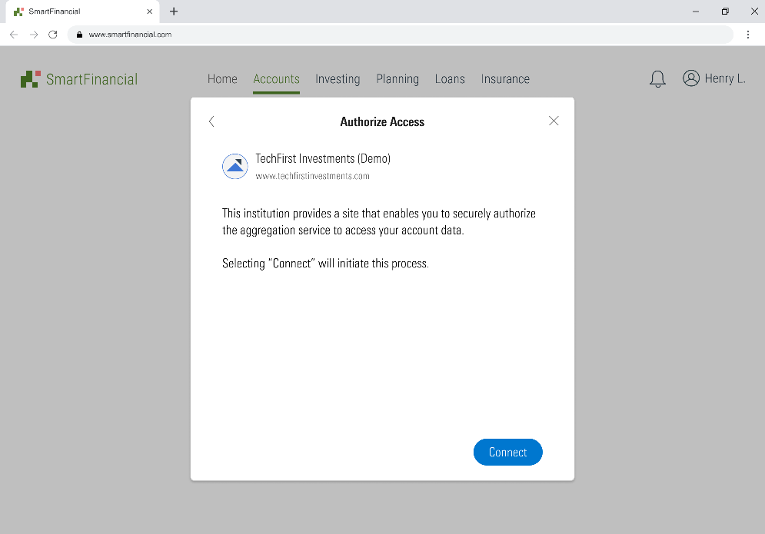
Open Banking Aggregation Account Setup Workflow
When you select your financial institution, instead of being prompted to enter your login credentials into the aggregation application, you will select “Connect” to begin the process to authorize access to your account data directly with your financial institution.
Step 1: Selecting "Connect" will transfer you to your Financial Institution so you can authorize your app to receive your data. Please make sure you select all the accounts you want to add to this service.

Slide 8
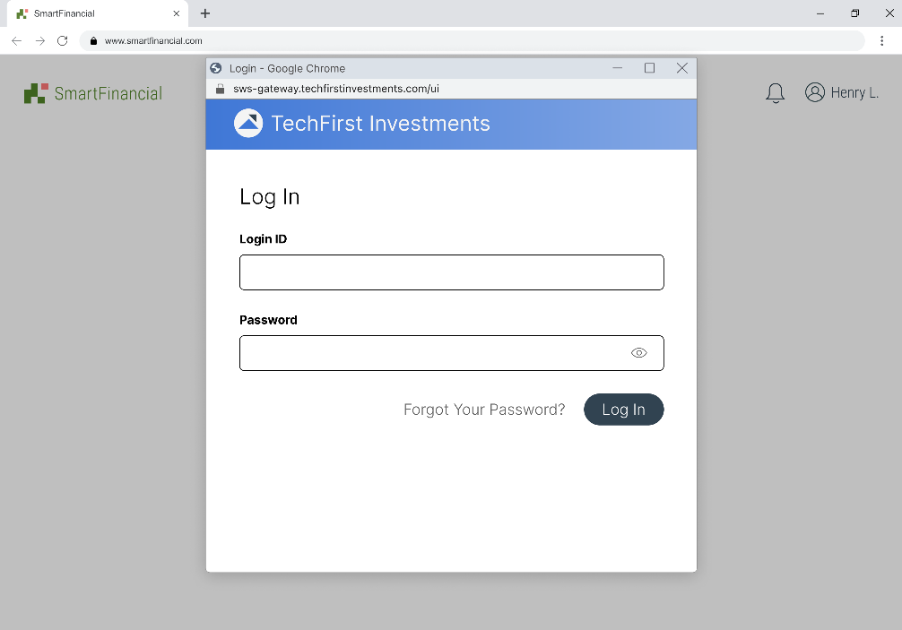
Open Banking Aggregation Account Setup Workflow
Step 2: You will be redirected to a Login Page for the financial institution. You will then login to the financial institution following the same process as if you were accessing that institution via the native online banking site:

Slide 9
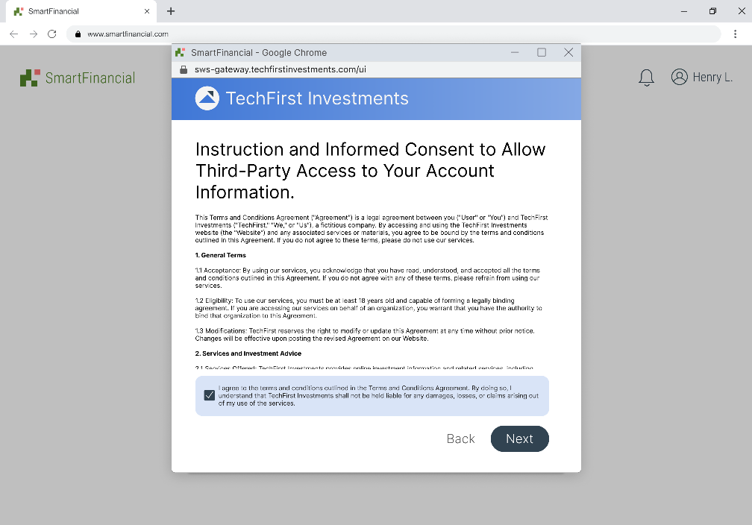
Open Banking Aggregation Account Setup Workflow
Step 3: You will be presented with their institution's Terms and Conditions to provide consent for the institution to issue a token credential to ByAllAccounts so your data can be shared with the application you are using:

Slide 10
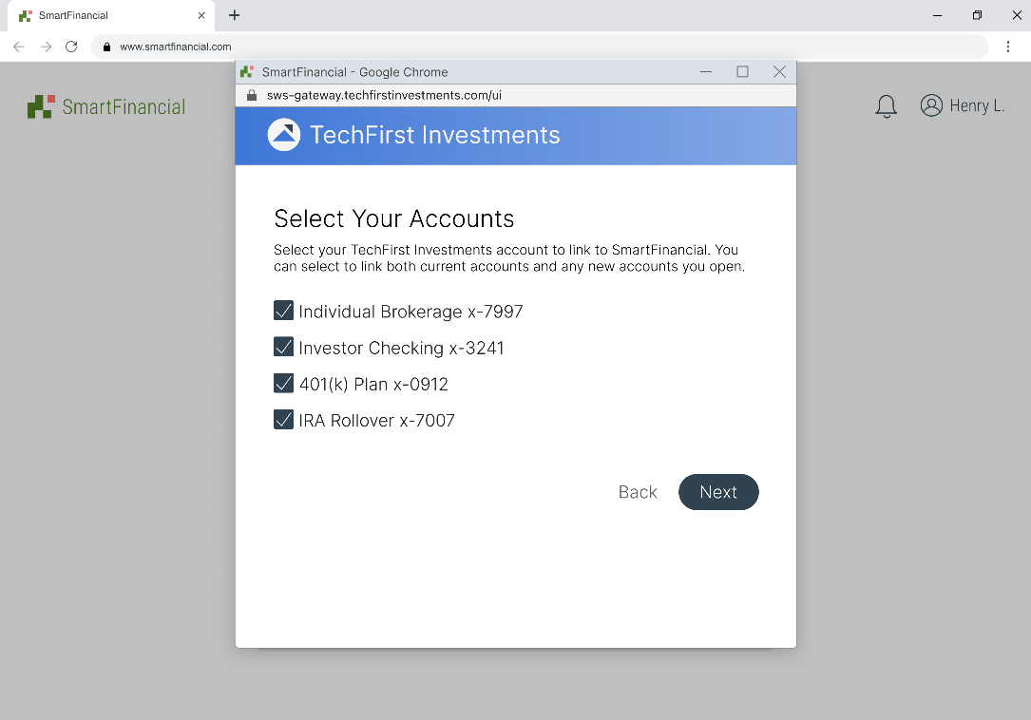
Open Banking Aggregation Account Setup Workflow
Step 4: Next, Select your accounts to aggregate, the screen below will contain the name of the third-party application that you will be connecting to:

Slide 11
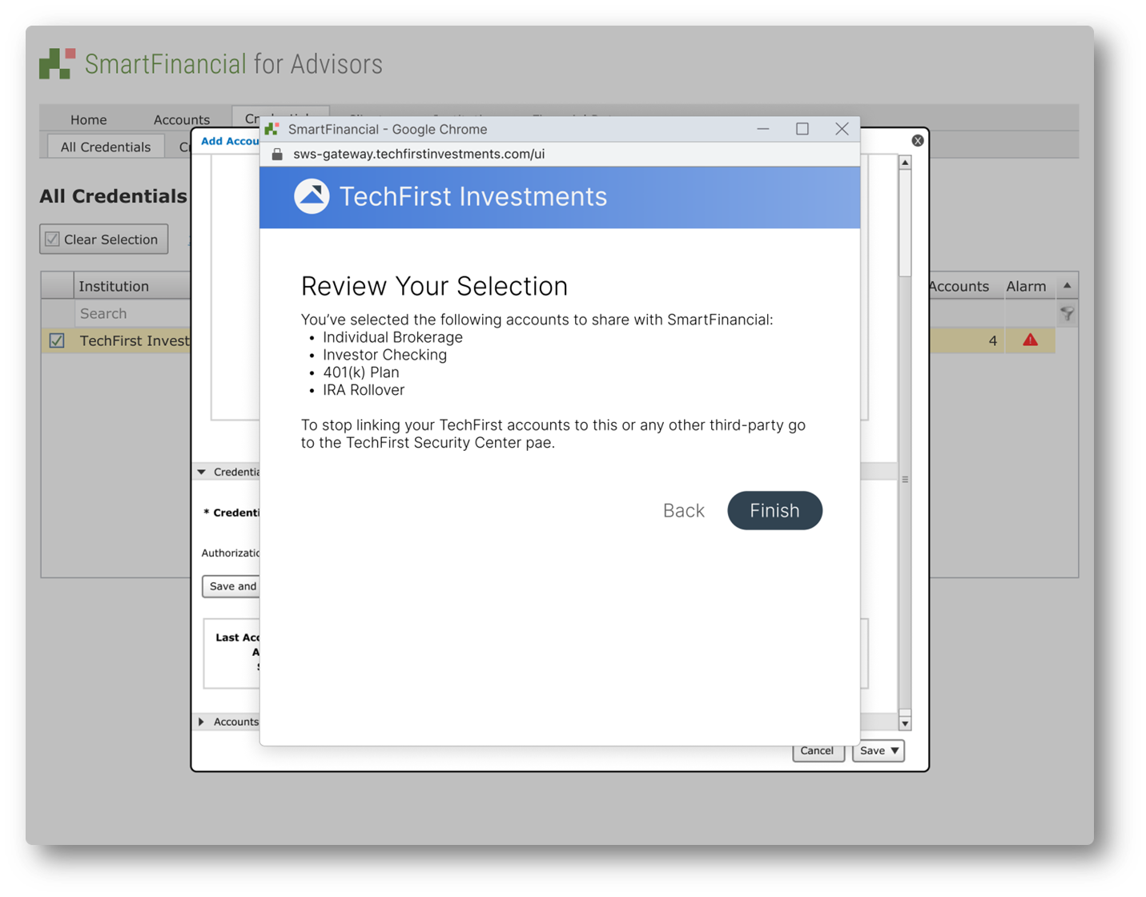
Open Banking Aggregation Account Setup Workflow
Step 5: You will be asked to Review & Finish your selection. Again, the below screen will contain the name of the third-party application:

Slide 12
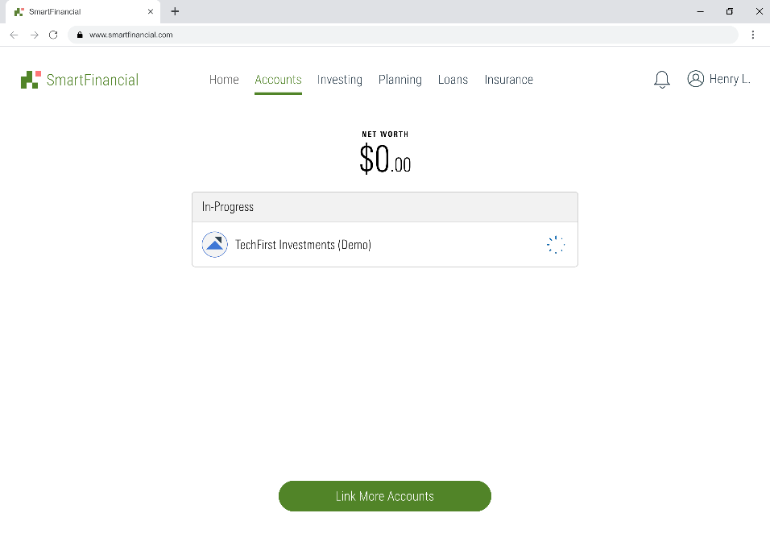
Open Banking Aggregation Account Setup Workflow
Step 6: Finally, you will be returned to the aggregation application where the accounts will Complete aggregating with an initial data pull from the institution:

