Slide 1
Pop-Up Shop Customer Toolkit

Slide 2
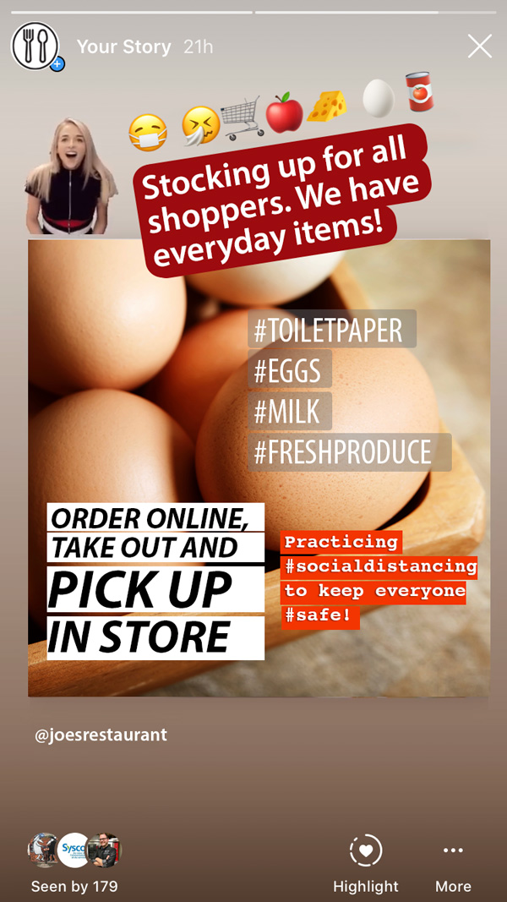
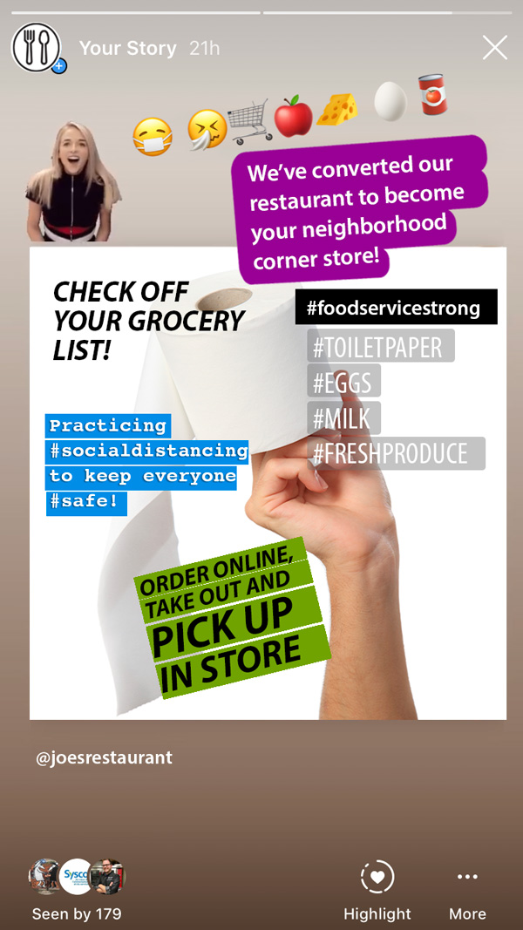
Sample Posts
Instagram Story

Slide 3
Sample Post Copy
Instagram Story
Check off your grocery list! We have stock on groceries and essential items. Paper towels, toilet paper and MORE! #socialdistancing #orderonline #takeout #freedelivery.
Stocking up for all shoppers. We have everyday items! #toiletpaper #eggs #milk #freshproduce Order online and take out the next day.
Our grocery takeout & delivery is up and running! Pantry items and essentials INCLUDED. We offer grocery delivery and curbside pick-up. Click here for more details.
We are stocking shelves with produce, toilet paper, napkins, spices, beans, soups, sauces, pasta, plenty of milk dried and fresh pasta and much more. PLACE ONLINE ORDER FOR CURBSIDE PICK-UP.
Our chefs are now busy creating prepared takeout meals while our restaurant is able to offer grocery delivery and curbside pick-up. We are in this together!
We’ve converted our restaurant to become your neighbourhood corner store during these uncertain times! We have you covered -fresh produce to everyday pantry essentials.
Attention to our community - we’ve transformed our restaurant into a MARKET place! [share products stocked in your dining room]

Slide 4
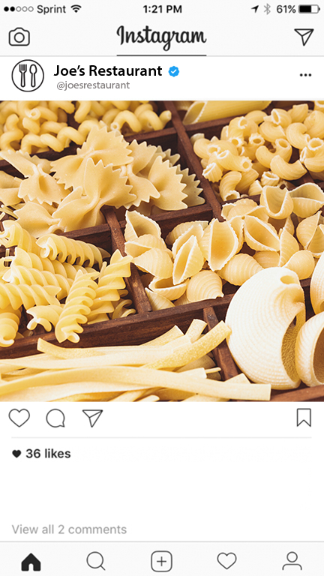
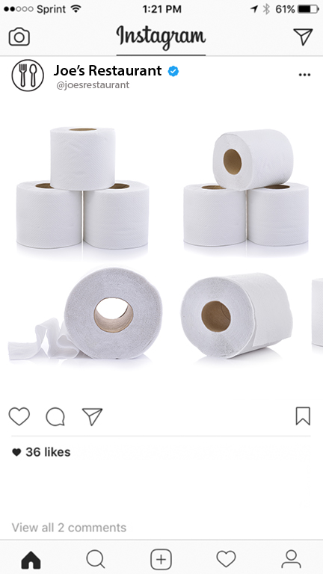
Sample Posts
Instagram Feed
Our grocery takeout & delivery is up and running! We have extended our favorite menus items to also include pantry items and essentials. We offer grocery delivery and curbside pick-up. Produce, jarred goods, dried noodles, rice, toilet paper and more... CALL NOW!
While our chefs are busy creating prepared takeout meals, our restaurant is able to offer grocery delivery and curbside pick-up. Some grocery items include eggs, produce, milk, rice, pasta, nuts, cheddar cheese, butter, and more. Deliveries go out daily at noon. We are in this together with good food and taking care of your essential product needs!
Attention to our community - we’ve converted our restaurant into a MARKET place! We have stocked fresh produce, eggs, pasta, house made sauces, tomato cans, dairy products and even PAPER GOODS... the list goes on! Ask for our grocery delivery and curbside pick-up.
😷 🤧🛒🍎🧀 🥚🥫
😷 🤧🛒🍎🧀 🥚🥫
#covıd19 #socialdistancing #foodservicestrong #takeout
#delivery #popupstore #grocerystore #pantryitems #curbsidedelivery #grocerydelivery #ordernow #restaurant
#covıd19 #socialdistancing #foodservicestrong #takeout
#delivery #popupstore #grocerystore #pantryitems #curbsidedelivery #grocerydelivery #ordernow #restaurant

Slide 5
Sample Post Copy
Instagram Feed
While our chefs are busy creating prepared takeout meals, our restaurant is able to offer grocery delivery and curbside pick-up. Some grocery items include eggs, produce, milk, rice, pasta, nuts, cheddar cheese, butter, and more. Deliveries go out daily at noon. We are in this together with good food and taking care of your essential product needs!
We transformed our restaurant into your neighbourhood corner store during this period of uncertain times, stocking our shelves with everything from fresh produce to everyday pantry essentials such as eggs, butter and towel tissue. We are happy to help your family and our community!
Attention to our community - we’ve converted our restaurant into a MARKET place! We have stocked fresh produce, eggs, pasta, house made sauces, tomato cans, dairy products and even PAPER GOODS... the list goes on! Ask for our grocery delivery and curbside pick-up.
Our restaurant is offering products that currently are in short supply at your local grocery store, and other staples that are out of stock in big-box retailers. We will be ordering and restocking them daily! Order online or call us for a full list of products available for purchase – we deliver and offer take out.

Slide 6
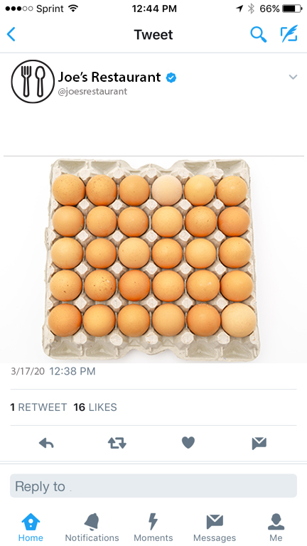
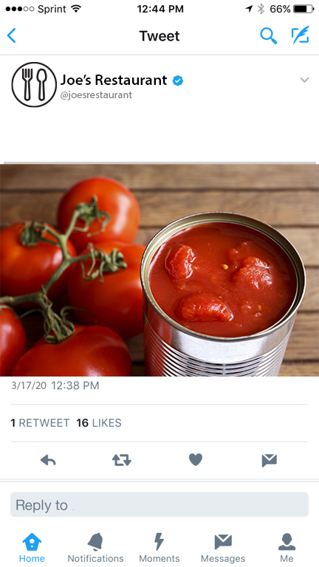
Sample Posts
Twitter Feed
Our grocery takeout & delivery is up and running! We have extended our favorite menus items to also include pantry items and essentials. We offer grocery delivery and curbside pick-up. Produce, jarred goods, dried noodles, rice, toilet paper and more... CALL NOW!
The "market" is already in the house! We are heavily stocking up for all shoppers. We have everyday items such as toilet paper, eggs, milk, fresh produce and other paper essentials. When you order online and take out.
😷 🤧🛒🍎🧀 🥚🥫
#covıd19 #socialdistancing #foodservicestrong #takeout
#delivery #popupstore #grocerystore #pantryitems #curbsidedelivery #grocerydelivery #ordernow #restaurant
#covıd19 #socialdistancing #foodservicestrong #takeout
#delivery #popupstore #grocerystore #pantryitems #curbsidedelivery #grocerydelivery #ordernow #restaurant
😷 🤧🛒🍎🧀 🥚🥫

Slide 7
Sample Post Copy
Twitter Feed
Quarantine Survival Kits! We have stock on groceries and essential items such as paper towels and toilet paper! Order online, take out or free delivery and can keep practicing #socialdistancing. [198/280 characters]
The "market" is already in the house! We are heavily stocking up for all shoppers. We have everyday items such as toilet paper, eggs, milk, fresh produce and other paper essentials. When you order online and take out. [238/280 characters]
Our grocery takeout & delivery is up and running! We have extended our favorite menus items to also include pantry items and essentials. We offer grocery delivery and curbside pick-up. Produce, jarred goods, dried noodles, rice, toilet paper and more... CALL NOW! [263/280 characters]
We have reconfigured our dining room to stock shelves of produce, toilet paper, napkins, spices, beans, soups, sauces, pasta, plenty of milk dried and fresh pasta and much more. PLACE ONLINE ORDER FOR CURBSIDE PICK-UP. We’ll do what it takes to get your order processed quickly! [278/280 characters]

Slide 8
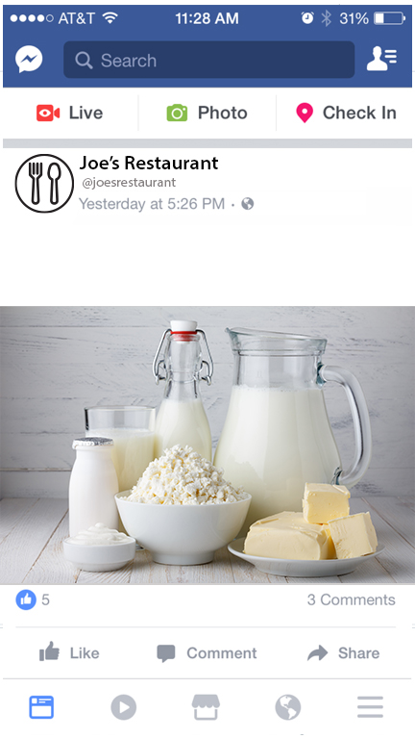
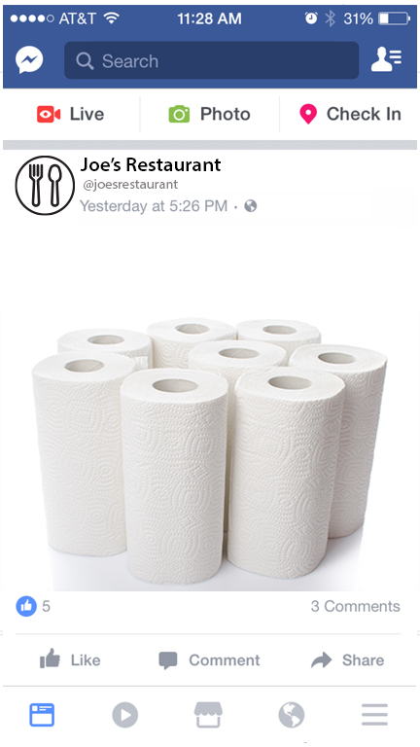
Sample Posts
Facebook Feed
Practicing social distancing has become a part of everyone’s routines, therefore, we have extended our restaurant services to support our community by stocking essential products such as fresh produce, milk, eggs, butter, pasta, tomato cans as well as toilet paper, napkins, paper tissue and more. Feel comfortable to place your order online or by phone we deliver and offer for takeout.
Are you desperately looking for toilet paper, paper towel or other pantry essentials? Our restaurant has you covered! We are stocking grocery essentials during the COVID-19 pandemic. Fresh produce, jarred goods, dried pasta, rice, eggs, dairy and, much more. Visit our website, order online or call us now! Free delivery and pick-up available until 9 pm.
😷 🤧🛒🍎🧀 🥚🥫
😷 🤧🛒🍎🧀 🥚🥫
#covıd19 #socialdistancing #foodservicestrong #takeout
#delivery #popupstore #grocerystore #pantryitems #curbsidedelivery #grocerydelivery #ordernow #restaurant
#covıd19 #socialdistancing #foodservicestrong #takeout
#delivery #popupstore #grocerystore #pantryitems #curbsidedelivery #grocerydelivery #ordernow #restaurant

Slide 9
Sample Post Copy
Facebook Feed
Practicing social distancing has become a part of everyone’s routines, therefore, we have extended our restaurant services to support our community by stocking essential products such as fresh produce, milk, eggs, butter, pasta, tomato cans as well as toilet paper, napkins, paper tissue and more. Feel comfortable to place your order online or by phone we deliver and offer for takeout.
Our dining area looks a little different today! We have transformed it into a pop-up store stocking a full variety of pantry items. We’re here to support you through these uncertain times! Call for a full list of products, we have expanded our take out and delivery schedule with your needs in mind!
Are you desperately looking for toilet paper, paper towel or other pantry essentials? Our restaurant has you covered! We are stocking grocery essentials during the COVID-19 pandemic. Fresh produce, jarred goods, dried pasta, rice, eggs, dairy and, much more. Visit our website, order online or call us now! Free delivery and pick-up available until 9 pm.
Keep up with the #socialdistancing practices – grocery shoppers are WELCOME! In an effort to support our community and offer your favorite menu items, our restaurant is now stocking pantry items and essentials. We offer grocery delivery and curbside pick up. Our stock includes fresh produce, dairy products, dried noodles, rice, beans, canned tomatoes and paper goods such as toilet paper!

Slide 10
Suggested Hashtags
Instagram, Facebook and Twitter
COVID-19 UPDATES #coronavirus #covid #covıd19 #viruses #covid_19 #virus #socialdistancing #hygiene #donttouchyourface #diseaseprevention #safetyfirst #sanitation #foodsafety #foodhandling #quarantine
FOODSERVICE SUPPORT #foodservicestrong #syscofoodie#foodiesunite #SupportDiningOutChallenge
#TakeoutToGiveBack #InThisTogether #supporting #supportingthecommunity #community #neighbourhood
RESTAURANT SERVICE UPDATES #takeoutfood #togofood #fooddelivery #menu #menuispirations #limitedoffer #menuplan #popupstore #pantryitems #grocerystore #essentials #takeout #freedelivery #delivery #toiletpaper #papertowels #curbsidedelivery #menu #menualternatives #placeyourorder #callusnow #grocerydelivery #ordernow #specialmeals #eggs #freshproduce #produce #milk #dairy #pasta #driedpasta #cheddarcheese #butter #cannedtomatoes #foodonthetable #diningarea #noodles #rice #purchase #online
FOODSERVICE IN GENERAL #restaurant #restaurants #cheflife #chefsofinstagram #chefstagram #chefsofIG #kitchenlife #syscofoodie

Slide 11
Email Templates

Slide 12
Sample Email
Email Anatomy
SUBJECT AND PREHEADER
Recommended: 40 to 60 characters. Short and direct Include call to action.
Email Subject: POP-UP MARKET IN OUR RESTAURANT
Preheader: Place your order now! 😀
BUSINESS LOGO
Recommended: 120 px width /
61 px height
Add a ink to your website.
MAIN IMAGE
Photos of your business, products or menu. Recommended: 600 px width /
variable height
Add a ink to your website.
INTRO TITLE
color #008cd2
Recommended : weight bold
font size 30 px
5-6 words / 35 characters
POP-UP MARKET IN OUR RESTAURANT! Our restaurant dining area is now open as a pop-up market where we have a variety of pantry items and essentials, such as eggs, butter, paper towels, toilet paper for purchase to help you through these tough times.
BODY TEXT
Use black color
Recommended size: font size 16 px
50 words / 225 chars
These items are also available for takeout or delivery!
CTA BUTTON
Use outstanding colors
Recommended: font size 16 px
PLACE ORDER NOW
FOOTER
Identify your business name, address, telephone and other contact details. Include website and social media links. Provide an unsubscribe mechanism.

Slide 13
Email Process
DEFINE Define the message you want your audience to receive and keep in mind about your goals when crafting it– traffic, awareness, more business.
TARGET Determine the target audience for your message. Use your promotional or commercial email distribution lists. Remember that you need consent from your audience to receive emails to comply with the CAN-SPAM Act. You are required to provide an “unsubscribe mechanism” and identify “yourself” the sender, with name, telephone and address. Many third-party email providers like Constant Contact or MailChimp offer these tools. Note that mass emails with the mentioned tools are not supported by Outlook, Yahoo or Gmail.
DESIGN Craft a simple email message about the new opportunity for your community and diners. Include photos of your products, menu and restaurant new set-up.
SCHEDULE Always check for grammar and spelling before you send the email to target audience. Send at times when your audience is online active.
RESULTS & ENGAGE Email service providers offer tools to review email results, it will allow you continuous improvement and the opportunity to keep engaging with your audience. Monitor your inbox for replies, questions and concerns and follow up.

Slide 14
Sample Email Copy
Email Sample
SUBJECT LINE PREHEADER
Check Out Our New Pop-up Store
We are here to support our community!
MAIN IMAGE
INTRO TITLE
Pop-up Store at our Restaurant We have transformed our restaurant dining area into a pop-up store where we have a variety of pantry items and essentials, such as eggs, butter, paper towels, toilet paper for purchase to help you through these uncertain times. In addition, we are offering these items for takeout, curbside and delivery! Please place your order online ___________ or call us at____________ to place your order.
Your patronage is very important to us. Stay tuned for more!
BODY TEXT
CTA BUTTON
CONTACT US NOW
FOOTER
BUSINESS DETAILS
SOCIAL MEDIA AND WEBSITE LINKS UNSUBSCRIBE LINK

Slide 15
Sample Email Copy
Email Sample
SUBJECT LINE PREHEADER
Expanded Takeout Products During COVID-19
Are you looking for pantry items and essentials? We can help!
MAIN IMAGE
INTRO TITLE
Expanded Takeout Products at our Restaurant Our grocery takeout & delivery is up and running! We have extended our takeout and delivery of your favorite menus items to also include pantry items and essentials. While our chefs are busy creating your special meals, we are able to offer grocery delivery and curbside pick-up. Items include eggs, produce, milk, canned goods, pasta and butter. We are happy to be in the position to help your family and our friends during this unprecedented time and make it through this together with good food on the table. Call us at _________ or order online at ___________ to place your order!
BODY TEXT
CTA BUTTON
VISIT OUR WEBSITE NOW
FOOTER
BUSINESS DETAILS
SOCIAL MEDIA AND WEBSITE LINKS UNSUBSCRIBE LINK

Slide 16
Sample Email Copy
Email Sample
SUBJECT LINE PREHEADER
Market Pop-up at our Restaurant During COVID-19
We are here to help with extended takeout products!
MAIN IMAGE
INTRO TITLE
Stock up on Essential Products at our Restaurant If the thought of wrestling over the last bag of dried pasta in a grocery store sounds like the most stressful way to stock up for coronavirus quarantine, you’re probably right. Thankfully, we are here to help, we’ve turned our restaurant dining area into a pop-up market packed with produce, jarred goods, dried noodles, rice, paper towels and other hard-to-finds during these hard times. We are offering these products for takeout, curbside and delivery! Order online at ____________ or call us for a full list of products available for purchase!
BODY TEXT
CTA BUTTON
ORDER NOW
FOOTER
BUSINESS DETAILS
SOCIAL MEDIA AND WEBSITE LINKS UNSUBSCRIBE LINK

Slide 17
Supporting
Marketing Assets

Slide 18
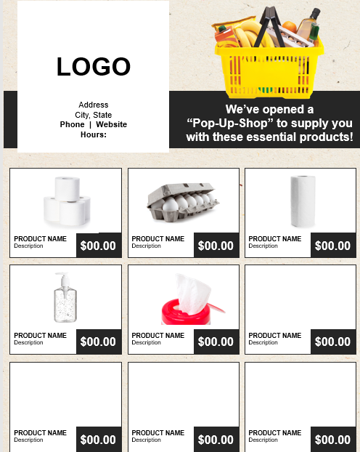
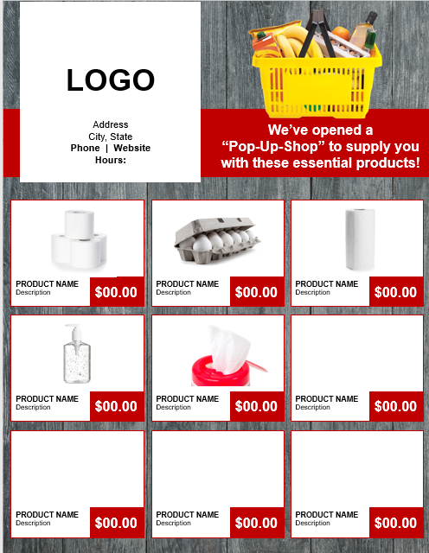
Sample Product Flyers
Editable Product Flyers
These editable product flyers can be customized easily with your logo and products for purchase. Please visit www.sysco.ca/pop-up-shop to access these flyers.

Slide 19
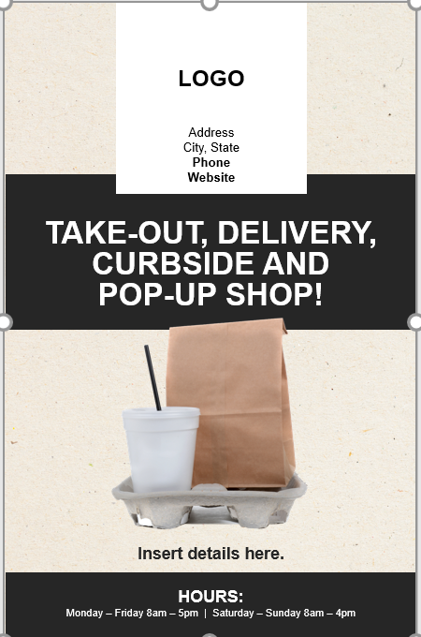
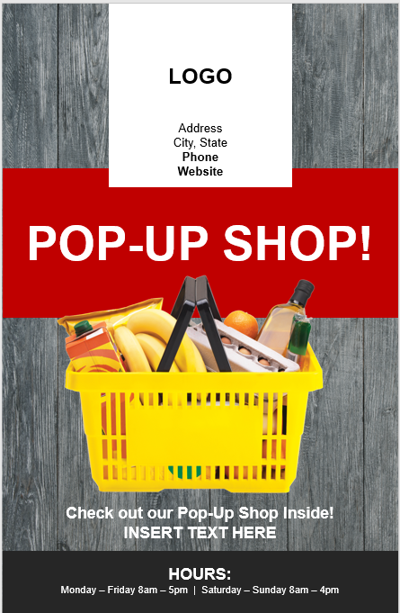
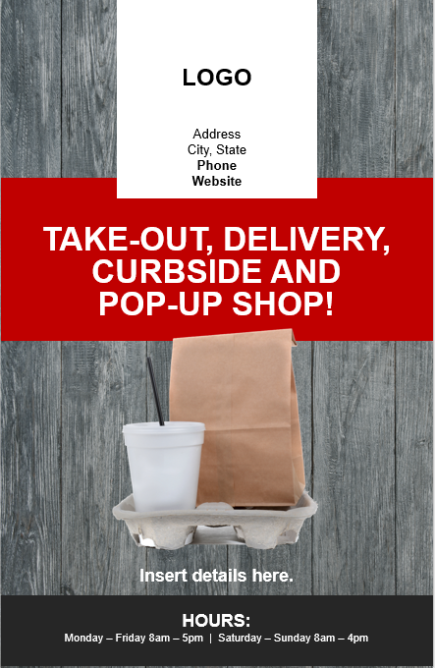
Sample Window Signage
Editable Window Signage
These editable signs can be easily customized with your logo, contact information and store hours. Please visit www.sysco.ca/pop-up-shop to access these signs.

Slide 20
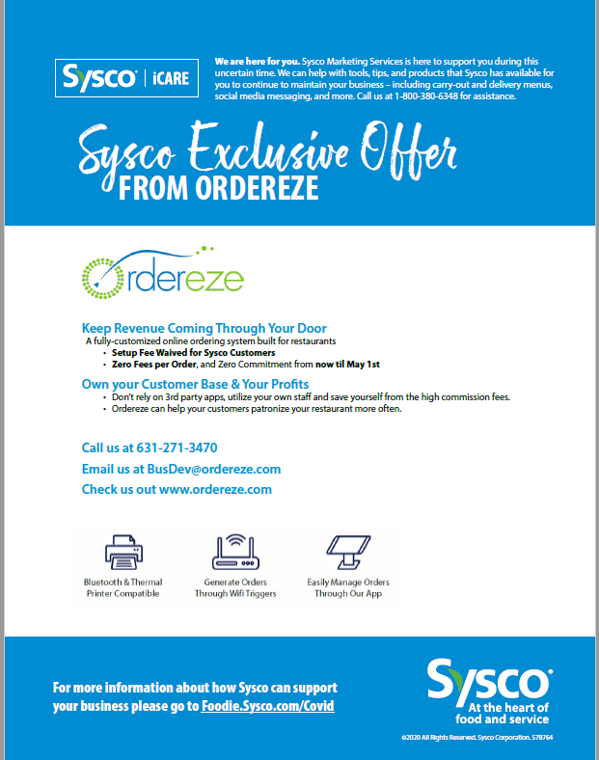
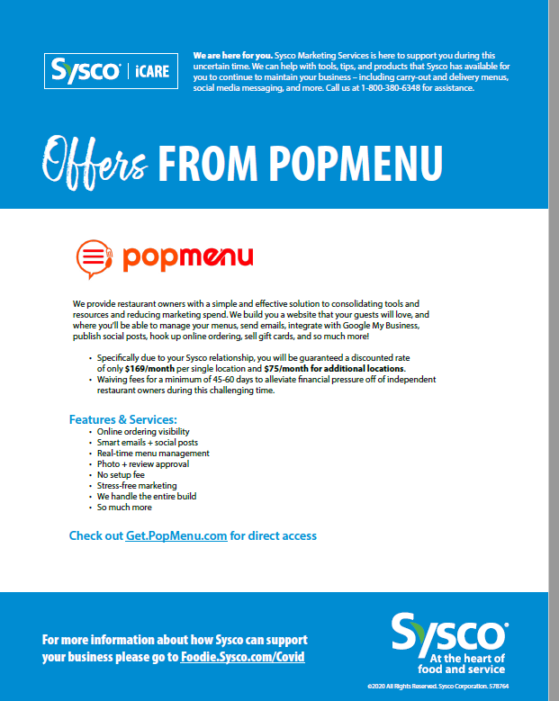
Online Ordering Services
Order Eze & Pop Menu
Ordereze
A fully-customized online ordering system built for restaurants
• Setup Fee Waived for Sysco Customers
• Zero Fees per Order, and Zero Commitment from now til May 1st
Pop Menu
Features & Services:
• Online ordering visibility
• Smart emails + social posts
• Real-time menu management
• Photo + review approval
• No setup fee
• Stress-free marketing
Please visit www.sysco.ca/pop-up-shop to find out more on how our Sysco iCare Partners can help you set-up your Pop-Up Shop online ordering system.

Slide 21
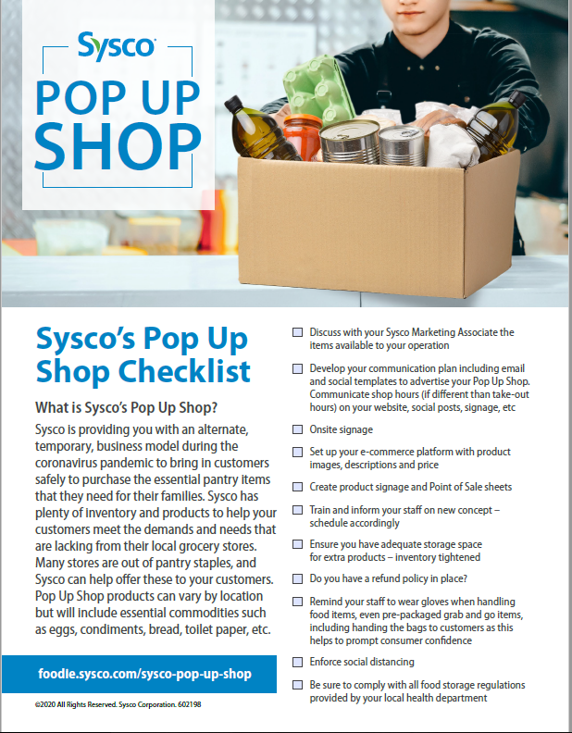
Pop Up Shop Checklist
Checklist For a Successful Start
To ensure you have all your resources and tools covers,
we have provided you a checklist to help you get your Pop Up Shop up and running. Please visit www.sysco.ca/pop-up-shop to access this one pager.

Slide 22
Go To Market Best Practices
Best Practices For Getting Started
To help navigate the current shift in foodservice operations,
we have provided you a list of Best Practices for getting started on your Pop-Up Shop. Please visit www.sysco.ca/pop-up-shop to access the Go To Market Best Practices Page.

Slide 23
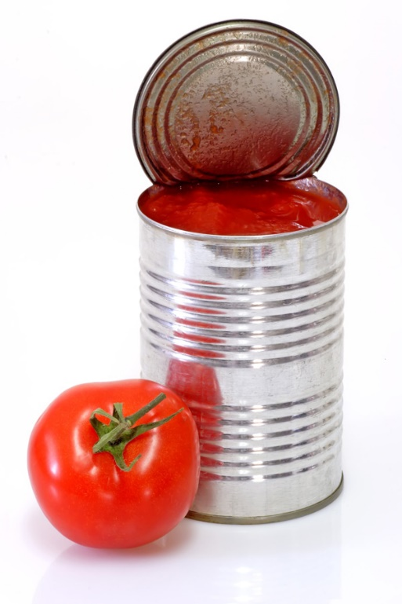
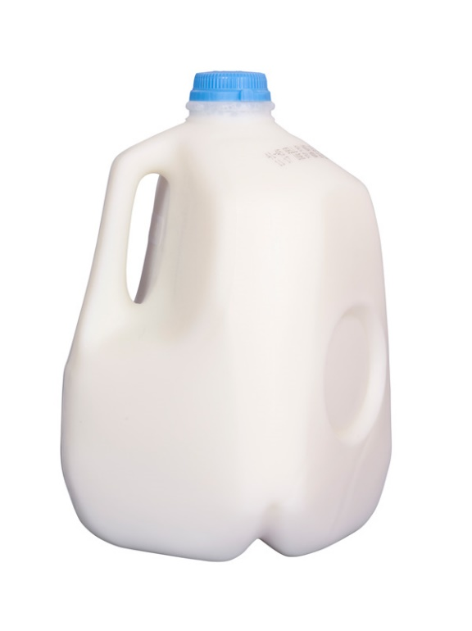
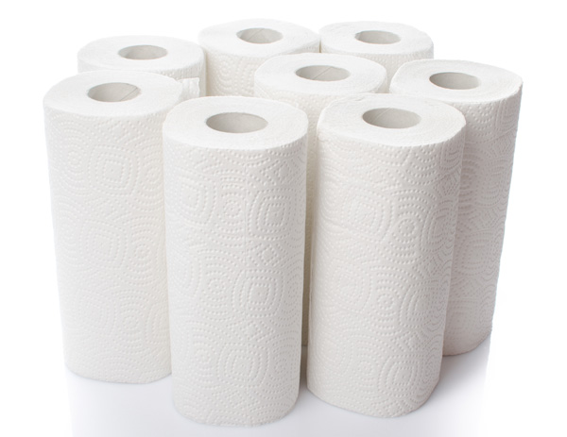
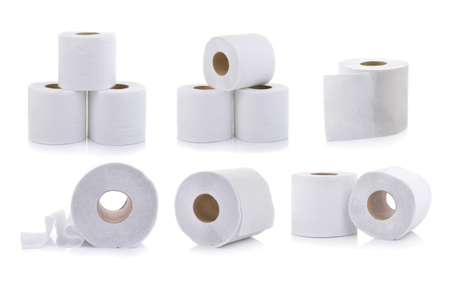
Product Images
Stock Product Images Available
To help with marketing products, we have provided a variety of generic product images to support your new endeavor. Please visit www.sysco.ca/pop-up-shop to access these pictures.

Slide 24
Floor Decal
Social Distancing Floor Decal
To help keep your customers safe, and to ensure social distancing is enforced, this floor decal can be simply placed on the floor (6ft apart). Please visit www.sysco.ca/pop-up-shop to access this decal.

