Slide 1
AVID eBinder

Slide 2
Table of Contents
Classes
Class 1 Name | Class 2 Name
Class 3 Name
Resources
AVID College and Career Readiness Framework | WICOR
Help with Using this eBinder

Slide 3
Class 1 Name

Slide 5
Class 2 Name

Slide 7
Class 3 Name

Slide 9
Resources

Slide 10
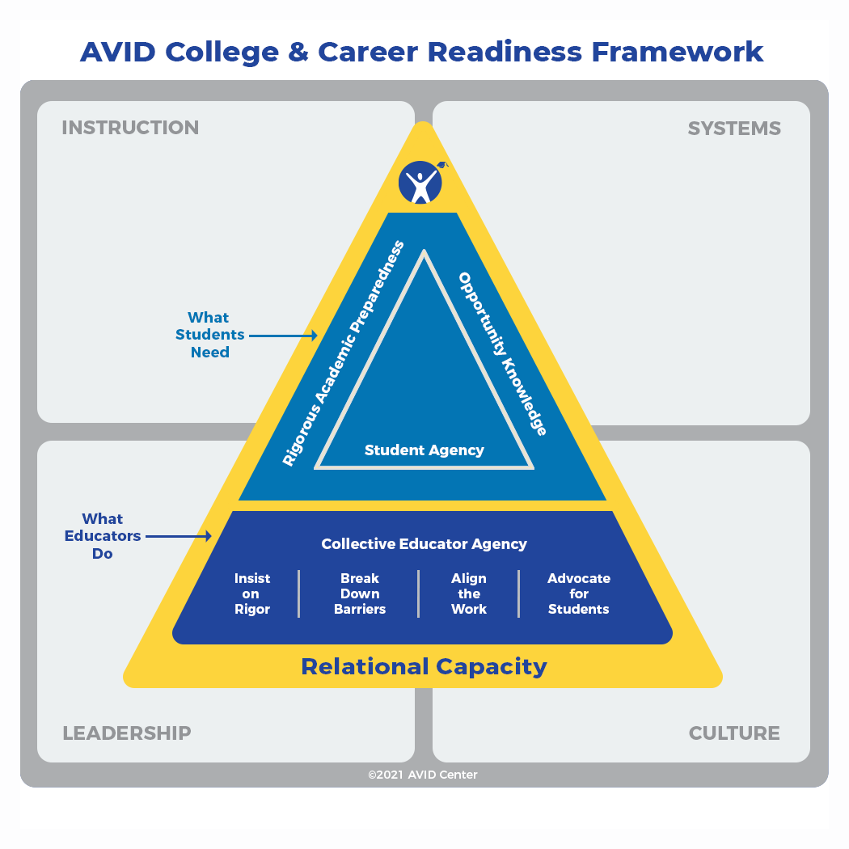



AVID College and Career
Readiness Framework
AVID’s mission is to close the opportunity gap by preparing all students for college and career readiness and success in a global society.
What Educators Do
Teachers and other adults on a school campus play an important role in student success. To bring about this transformation, educators must:
Insist on Rigor:
Educators provide learning experiences in which every student is challenged, engaged, and develops a greater ownership of their learning through increasingly complex levels of understanding.
Break Down Barriers:
Educators actively identify and work to eliminate structural and perceptual barriers that limit students’ access to relevant and challenging learning opportunities.
Align the Work:
Educators increasingly align policies, practices, and beliefs to the shared vision of all students succeeding in college, career, and life.
Advocate for Students:
Educators extend social, emotional, and academic support to students and challenge policies, practices, or beliefs that limit potential.
What Students Need
AVID students receive intentional support and mentoring in three major areas that help them become confident individuals who can successfully navigate life and career.
Rigorous Academic Preparedness:
Students develop academic skills and can successfully complete rigorous college and career preparatory curriculum and experiences.
Opportunity Knowledge:
Students research opportunities, set goals, make choices that support their long-term aspirations, and successfully navigate transitions to the next level.
Student Agency:
Students believe in themselves and act intentionally to build relationships, persist through obstacles, and activate their academic, social, emotional, and professional knowledge and skills to reach their potential.
What Does College and Career Readiness Mean?
No matter what postsecondary path high school graduates choose, students must develop certain essential skills to design their own futures: critical thinking, collaboration, reading, writing, and relationship building. The development of these skills is rooted in the belief in self. If students believe they are capable, there is a foundational confidence to learn and a resiliency to overcome setbacks.
When educators believe in students, learning and confidence are activated. With teacher support for developing a growth mindset and the academic skills they need for future success, students grow to see their capabilities and find their own way.

Slide 11
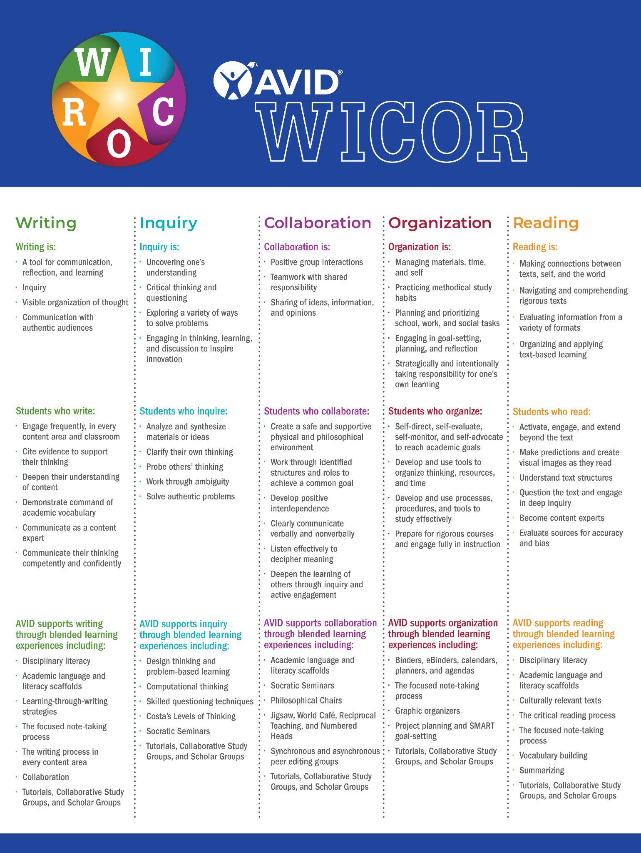

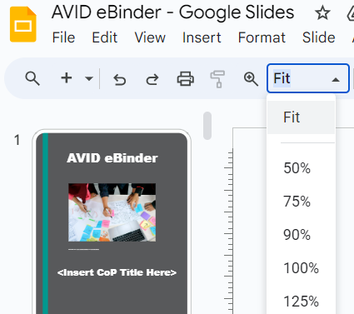
WICOR
Zoom in to read the WICOR descriptions.

Slide 12
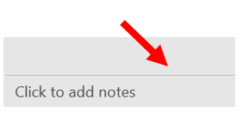
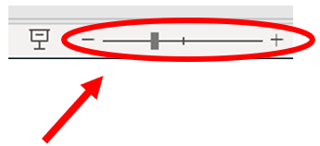
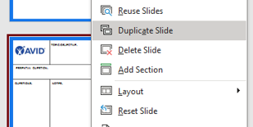

Technology Tips for Using this eBinder
Zoom the page in and out by clicking on the centered horizontal line at the bottom or selecting the magnifying glass.
The gray space around the page is often used for added interactivity.
To duplicate a page, right-click on the page in the left sidebar and select duplicate. Then, click and drag to reorder the page in your eBinder.
Web links: Copy URLs to an eLearning page or collaborative activity and paste them into your eBinder to access later.
Image by Mohamed Hassan from Pixabay

Slide 13
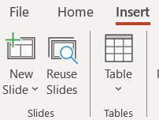
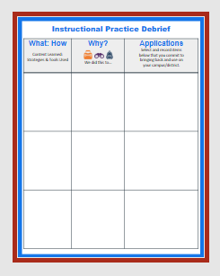


Help with Using this eBinder
Copy & Paste a Slide Select the slide you want to copy. (The outline of the slide will turn red once it has been selected.) Right-click to copy or use CTRL+C. To paste, click in the slide area underneath the next slide. A red line will appear. Then, right-click to paste or use CTRL+V. | Add a Page Option 1: Click “Insert” in the toolbar and select New slide. Option 2: In the slide area on the right-hand side (where you see the slide numbers), right-click and choose New Slide.
Move a Page Click and hold on a page (red outline). Drag the page to your desired location. | Duplicate a page Right-click on the page, then select Duplicate Slide from the menu.

