Slide 1


Future Lab
Social Media and Mental Health
Unit 3, Lesson 10

Slide 2

#Impact
Share Your Voice, Shape the Future
LESSON 10
Notes:
In this culminating lesson, students take center stage—sharing their final prototypes or campaigns with an authentic audience and reflecting on the full arc of their project journey. Through this experience, they activate real-world communication, leadership, and creative problem-solving skills while practicing self-regulation and adaptability. This lesson is not just a showcase—it's a moment of transformation. Students are invited to look back at their personal growth, recognize how their work has impact beyond the classroom, and imagine how to carry forward the skills, mindsets, and purpose they’ve developed. By connecting their learning to future goals, they close the unit with agency and a renewed sense of possibility.

Slide 3
Objectives
Students will:
Deliver a clear, engaging final presentation of their prototype or campaign to an authentic audience.
Reflect on their personal growth, their team’s process, and what they learned about social media.
Explore opportunities for broader impact and real-world application of their work.
Practice metacognition by reflecting on how they think, learn, and grow.
Demonstrate a growth mindset through reflection on learning from risk, feedback, and iteration.
Take initiative in exploring next steps for project impact beyond the classroom.
Articulate how this experience supports their journey as lifelong learners.

Slide 4

ESSENTIAL QUESTION
How can I use what I learned throughout this project-based learning process to make a meaningful impact in my life, my community, and my future?

Slide 5


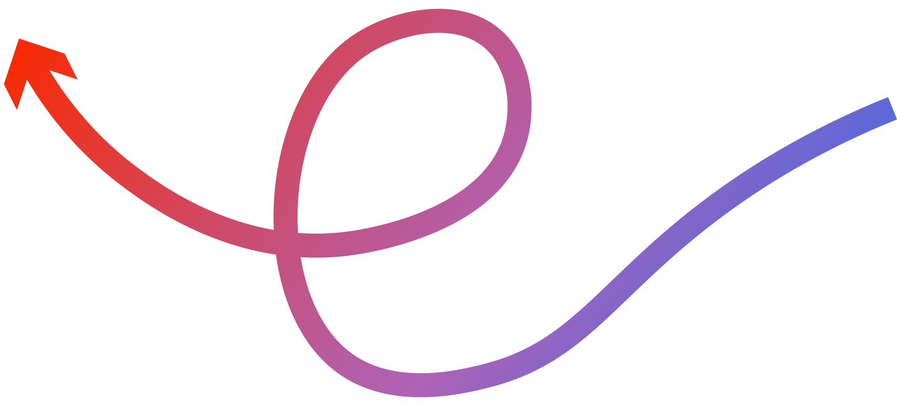
Project Wall
Word Wall
Skills for the Future
​Agency
Creative confidence
Impact
​​​New! Metacognition
New! Taking Initiative
New! Lifelong Learning

Slide 6


Celebration Circle
Take a moment to recognize your growth, creativity, and teamwork!
What’s one thing you’re proud of—either in your own work or your team’s?
How did your voice grow stronger during this project?
Notes:
Teacher Setup: Gather students in a circle. You may wish to dim the lights, play calm music, or create a special space to signal this is a milestone moment.
Teacher Script: Today is a big day—not just because you’re presenting, but because you’ve already done something powerful. You’ve identified a meaningful issue, created something to address it, and grown in ways that deserve to be recognized. Before we take the stage, let’s take a few moments to pause and celebrate the journey that brought us here.
Prompt Students to Reflect: Take a moment to think about the entire process—what you’ve learned, the obstacles you overcame, the ideas you turned into something real. Think back to our first lesson... what’s different about you now?

Slide 7

Hype Each Other Up
A few real words of encouragement can go a long way. Let’s finish strong by giving props where they’re due.
Affirmation Starters:
“I saw your leadership when you…”
“You helped the team move forward by…”
“Your creativity really showed up in…”
“You’ve grown so much in how you…”
“I’m excited to see how you present because…”
Notes:
You can also have students give each other one “shout out” on sticky notes or digital comments to post on their Project Wall (see the Evaluate step on Lesson 9) as a visual celebration and to reinforce the Project Pride statements students shared in Lesson 9.
Teacher Script: You’ve already done something brave by showing up, taking risks, and sharing your ideas. Today isn’t just about the perfect pitch—it’s about using your voice to shape the future. Let’s keep that energy as we step into our presentations. You’ve got this—and we’re here to cheer you on every step of the way.

Slide 8

Final Presentations
It’s time for your final presentation! Ensure your team has chosen a format that best meets the needs of your intended audience. Discuss what you chose and why:
Live presentation to a school panel, teacher team, or peer class
Guest visit to a middle school or community event
Pre-recorded video shared with the school’s digital wellness committee
Slide deck walkthrough with embedded audio for asynchronous viewing
Social media post or campaign launch, followed by live or online feedback
Something else?
Notes:
Teacher Note: Presenting to a real audience is the culmination of the design thinking process—it’s where students move from prototyping and refinement to testing their message in the real world. However, not all students will present on the same day or to the same audience. Some may choose to film and share their project, while others may schedule live sessions with younger students, school board members, or outside organizations. Flexibility is key. Encourage students to adapt to the needs of their audience and reflect on how they can learn from the reactions and feedback they receive.
Teacher Script: This is your moment. You've done the work—research, design, iteration—and today, you’ll share your voice with an audience beyond this classroom. Whether you’re presenting in person, recording a message, or leading a dialogue, you’re stepping into the final phase of the design thinking process: Test. When we test a solution, we're learning how our work lands with others—what resonates, what confuses, and what inspires action. This feedback isn’t just validation; it’s insight. It helps us grow as designers, communicators, and changemakers.
Teacher Note: Encourage students to choose the format that aligns best with their audience and message. The options above are starting points—students may also propose their own creative or context-specific presentation methods. The key is for students to consider how to meaningfully engage their intended audience and gather authentic feedback.

Slide 9
Audience Feedback and
Engagement Collection
Before you present, get ready to learn from your audience by giving them a feedback form (digital or paper). Ask them to share their thoughts using prompts such as:
What stood out to you about this project?
What impact do you think this project could have?
What’s one question or suggestion you have for the creators?
What’s one word you would use to describe this campaign or solution?
Notes:
Optional Tools: Choose a tool available within your school such as Google Forms, Mentimeter, or Padlet to collect feedback.
Note: A version of this feedback form is available in the Student Portfolio for students to copy to the tool they have chosen to collect feedback.

Slide 10
Connecting to Skills for the Future
As you move into this final phase, remember you’re not just finishing a project. You’re building real-world skills you’ll use long after this class. Here’s how this moment connects to skills for the future:
Metacognition: What do I know now about how I learn and grow through feedback?
Taking Initiative: How am I leading this next step to get real-world input?
Lifelong Learning: How can I use this experience to keep improving even after this project ends?
Growth Mindset: What if I discover something I need to change? That’s success—not failure.
Notes:
Skill Spotlight Reminder – Feedback as Growth: Reinforce with students that this part of the process connects directly to:
· Metacognition: What do I know now about how I learn and grow through feedback?
· Taking Initiative: How am I leading this next step to get real-world input?
· Lifelong Learning: How can I use this experience to keep improving even after this project ends?
· Growth Mindset: What if I discover something I need to change? That’s success—not failure.

Slide 11

Behind the Build: Your Story Matters
Choose a tool that will help you tell your story as a creator, teammate, and thinker.
Reflection Options:
Digital journal in your student portfolio
Audio or video
Design a reflection zine or visual journal page
Timeline of growth
Metaphor map
Notes:
From Idea to Impact – Reflecting Through Creative Expression
Teacher Script: You’ve created something meaningful. But your project isn’t the only thing that’s grown—you have, too. Today, we’re going to reflect on your journey, but not just through writing. You’ll choose how you want to express what you’ve learned, how you’ve changed, and what this experience means to you moving forward. Think of this as a way to tell the story behind the story—your personal transformation as a creator, teammate, and thinker.
Reflection Options (Student Choice):
Students may respond to reflection prompts in one of the following formats:
Digital Journal Entry
Use your Student Portfolio to write a traditional response to the reflection prompts.
2. Audio or Video Log ("Creator Commentary")
Record a short voice memo or video where you talk through your experience—like a behind-the-scenes documentary.
Prompts to guide you:
"What surprised me most was..."
"The hardest part was... but I grew by..."
"If I could give advice to my past self, I’d say..."
3. Design a Reflection Zine or Visual Journal Page
Create a one-page visual collage (hand-drawn or digital) that tells the story of your process. Include:
Illustrations, icons, or images
Key quotes, personal insights, or milestones
A “before and after” moment or mindset shift
Optional Tools: Choose a tool available within your school such as Adobe Express, Canva, Google Slides, Microsoft PPT, etc.
4. Timeline of Growth
Draw or digitally create a timeline from Lesson 1 to today. Plot major events, learning moments, obstacles, and insights.
Prompt: What were the turning points in your journey?
5. Metaphor Map
Choose a metaphor to describe your experience (e.g., “It was like climbing a mountain,” or “like designing a puzzle”) and explain why. Illustrate it or describe each “stage” of the metaphor.

Slide 12
The Story Behind the Work
Choose the prompts that help you tell your learning journey.
What did you learn about yourself during this project?
What was the most challenging part of this journey?
How did your understanding of social media evolve?
How did your team grow throughout this process?
What impact do you hope your project has?
How did your thinking or learning habits change over time? (Metacognition)
How did you respond to challenges or setbacks? (Growth Mindset)
What creative risks did you take, and what did you learn from them?
Notes:
Share or Showcase (Optional):
Invite students to share their reflection work in small groups or display them on a “Project Journey Wall.”
Create a class Padlet to post reflection videos.
Have students include this reflection within their Student Portfolio. Frame this step as part of their creative portfolio—something they might revisit in future classes, internships, or career planning.

Slide 13

Future-Back Thinking
Envision the Future
In pairs or teams, respond to the prompt in your student portfolio.
Imagine your project has made a real impact. What does that look like? Who is affected? Where is your project being used or seen?
Notes:
Future-Back Thinking: Have students imagine the future impact of their work first, then collaboratively map realistic paths to make it happen. This strategy builds leadership, initiative, and systems thinking by helping students move from inspiration to action.
Teacher Script: You’ve created something powerful. Now imagine it’s a year from now—your project has made a real difference. Who saw it? Who shared it? Who benefited from it? Today we’ll practice Future-Back Thinking—starting with that future impact, then designing the steps to get there. This is how real-world innovators, creators, and entrepreneurs plan for impact—and now you will, too.
Envision the Future
In pairs or teams, students respond to this question in their Student Portfolio:
· Imagine your project has made a real impact. What does that look like? Who is affected? Where is your project being used or seen?
Use sentence starters:
· “In the future, our project helped...”
· “We saw real change when...”
· “The community that connected with our work was...”

Slide 14
Map The Backwards Path
Map the steps needed to get from your current state to that future vision in the Impact Map in your student portfolio.
Steps | Future Vision | Steps Backward | Actionable Next Steps
Key Milestones
People or Partners Needed
Challenges to Solve
Immediate First Steps
Notes:
Map the Backwards Path
Students map the steps needed to get from their current state to that future vision in the Impact Map in their Student Portfolio:
· Key Milestones
· People or Partners Needed
· Challenges to Solve
· Immediate First Steps
Share Out & Build a Class Wall
Have teams share one “next step” they’re inspired to take.
Add to your project wall with a “What’s Next? Actions” section with sticky notes or a digital board (e.g., Padlet or Figjam) to make commitments public and visible.
Teacher Script: This doesn’t have to end in the classroom. You have tools, voices, and ideas that matter. So take a step forward—even a small one. Reach out to someone. Share your work. Set a reminder for next week to follow through. Your impact can continue if you decide it should.
Extension Options to Help Students Take Action:
Encourage students to submit projects to a student showcase or digital citizenship contest
Schedule time with a school counselor or admin to present campaign ideas and discuss how to more broadly disseminate
Email or DM a local org aligned with their topic
Design a “Phase 2” campaign for the next semester

Slide 15


Lifelong Learner
Invest in Yourself! Gain Personal Growth Through Lifelong Learning
Create a “Postcard to Future Me” with 3 Prompts:
One Thing I’ll Keep Doing
One Thing I’ll Try Next
Words of Advice to Myself
Notes:
Teacher Script: Today, we’re not just closing out a project—we’re stepping into your future. Whether you go into a creative career, become a teacher, an activist, or an entrepreneur, lifelong learning is part of the journey. Let’s hear from real creatives about how they stay curious, adapt, and grow.
Play Video: “Lifelong Learning: How Creatives Keep Growing” (Adobe Express Employee)
Creative Closure Activity: Future Self Postcards
Materials:
Index cards, markers, stickers (for analog) OR
A digital template (Google Slides, Adobe Express, Padlet)
Optional: small envelopes or a class “mailbox” for later rediscovery
Optional Elements:
Let students decorate or illustrate their postcards
Add a quote or phrase from the project that inspired them
Seal it in an envelope for a “1-Year Reunion” letter the teacher can mail or return
Schedule a timed email to their future self using a tool like FutureMe.org or a delayed send feature in their school email account
Project Gallery + Reflection Share-Out
Set the Scene:
Play upbeat music, dim lights, or decorate the classroom like a mini gallery walk
Invite students to post their postcards or “One Step Forward” commitments on the wall
Optional: project photo highlights from the PBL journey on a screen
Invite Volunteers to Share:
“What’s one word that describes how you feel about your growth?”
“What do you want to be remembered for from this project?”
Teacher Script: You started this journey by asking big questions about technology, society, and your role in it. And you’ve ended by creating something meaningful, brave, and yours. You’re not just ending a project—you’re beginning your next chapter as a lifelong learner. Wherever you go next, take this with you: Your ideas matter. Your voice has power. And the future is something you’re already helping to shape.

