Slide 1



Future Lab
Social Media and Mental Health
Unit 2, Lesson 6

Slide 2

From Data to Insights
Surveys, Media, Analysis, and Interviews
LESSON 6
Notes:
Bringing an idea to life requires creativity, strategic planning, and the right tools. Now that students have identified a problem and brainstormed solutions, it’s time to develop the first draft of their team prototype. Whether designing a social media campaign, an infographic, a website, or an interactive tool, students will explore digital storytelling techniques, refine their messaging, and create compelling content to engage their target audience. By analyzing real-world examples, experimenting with design tools, and gathering peer feedback, students will take their first step in transforming their ideas into impactful solutions.

Slide 3
Objectives
Students will:
Collaboratively select a final solution format based on feasibility, engagement, and impact using structured comparison tools.
Create a low-fidelity storyboard to visually map out the narrative structure, content, and audience interaction of their chosen solution.
Give and receive peer feedback on their storyboard, identifying areas of strength and opportunities for improvement.
Reflect on their planning process and articulate next steps to guide their transition into prototyping in the next lesson

Slide 4



How can we use our creativity, collaboration, and audience awareness to design a solution format that transforms our ideas into meaningful change?
ESSENTIAL QUESTION
ESSENTIAL QUESTION
How can we use our creativity, collaboration, and audience awareness to design a solution format that transforms our ideas into meaningful change?
​

Slide 5


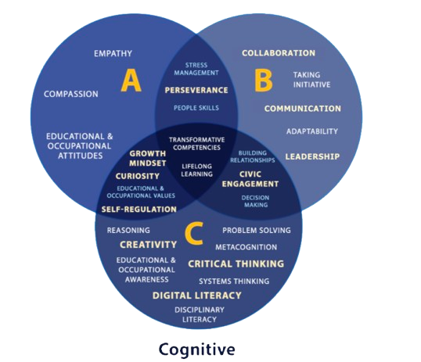

Objectives:
text
Project Wall
Project Wall
Word Wall
Skills for the Future
Word Wall
Storyboarding
User Feedback
Audience Engagement
Design Constraints
Call to Action (CTA)
Storyboarding
User feedback
Audience engagement
Design constraints
Call to action (CTA)
New! Perseverance
New! Reasoning
Skills for the Future
New! Perseverance
New! Reasoning

Slide 6




The Power of Prototyping
The Power of Prototyping
The Iterative Design Process Explained
Respond in your student portfolio:
Why is prototyping important in the design process?
Can you think of an example in your own life when iteration helped improve a project or idea?
Discuss as a class:
How do companies and creators use iteration to improve their projects?
How can we apply these ideas to our own work?
Notes:
Teacher Script: Before we dive into today’s lesson, let’s think about the last time you used a product, app, or tool that just worked really well. Maybe it was your phone, a favorite website, or even a school supply like a mechanical pencil. Do you think the very first version of that product was perfect?[CC1] Probably not! Great designs are the result of many iterations – small improvements based on testing and feedback. Today, we’re going to explore how iteration helps us refine ideas and create stronger prototypes. To start, we’ll watch a short video on how designers test and improve their ideas over time.
Video: Play: “From Concept to Creation: How Designers Test & Iterate” (Length 1-2 minutes)
While watching the video have students respond to these prompts in their student portfolio:
Why is prototyping important in the design process?
Can you think of an example in your own life when iteration helped improve a project or idea?
Whole-class discussion (2 minutes) teacher record responses on Chart Paper, Digital or Whiteboard:
How do companies and creators use iteration to improve their projects?
How can we apply these ideas to our own work?

Slide 7
Designing the Right Solution
Real-World Examples:
#MentalHealthAction on TikTok
Girl and The Gov, the Podcast: Identifying Misinformation & Disinformation
Teen Social Media Infographic from Common Sense Media
Get Bad News
Caleb Williams Talks Mental Health | Seize the Awkward
In your student portfolio:
Which formats catch my eye or spark my interest?
What types of projects do I enjoy creating?
What tools, apps, or media do I feel confident using?
Notes:
Creative Format Exploration: Designing the Right Kind of Solution
Teacher Script: Now that you’ve developed a clear problem statement and thought about who your audience is, it’s time to start imagining what kind of solution you want to create. This decision is a big deal—your solution isn’t just a school project; it’s your chance to make an impact. Whether you’re into coding, storytelling, design, activism, or communication, there are many creative ways to bring your message to life. So let’s explore some options together.
Instructions for Teachers and Students
Inspire & Ideate
Present 4–6 real-world examples (visuals or short videos work well). These could include:
A student-led TikTok mental health campaign (e.g., Tik Tok #MentalHealthAction)
A podcast series about misinformation (Girl & The Gov Podcast, Identifying Misinformation & Disinformation)
An infographic on cyberbullying statistics (Common Sense Media, Teen Social Media Infographic)
A game that simulates social media decision-making (Get Bad News)
A zine or PSA that uses storytelling to spark change (e.g., Seize the Awkward)
As students view the examples, have them jot down their thoughts in their Student Portfolio:
Which formats do I find inspiring or interesting?
What kinds of projects do I enjoy working on?
What tools or media do I feel confident using?
Brainstorm from Your Strengths (5 minutes)

Slide 8

Team Talent Matchup
In your student portfolio, brainstorm and respond as a team:
What are our team’s creative strengths? | What formats allow us to showcase those strengths? | What format would be most engaging to our audience? | What are we excited to build or try?
E.g., video editing, writing, graphic design, coding, storytelling, or public speaking
Notes:
Teams gather and answer these Creative Alignment Prompts in their Student Portfolio:
What are our team’s creative strengths? (e.g., video editing, writing, graphic design, coding, storytelling, public speaking)
What formats allow us to showcase those strengths?
What format would be most engaging to our audience?
What are we excited to build or try?
Encourage teams to list 3 possible formats and then circle or highlight the one they feel best fits.
Empower student teams to weigh multiple options before selecting the format for their solution, using evidence from their problem statement, target audience, and personal interests. This approach builds critical thinking, inclusive collaboration, and metacognitive skills.

Slide 9
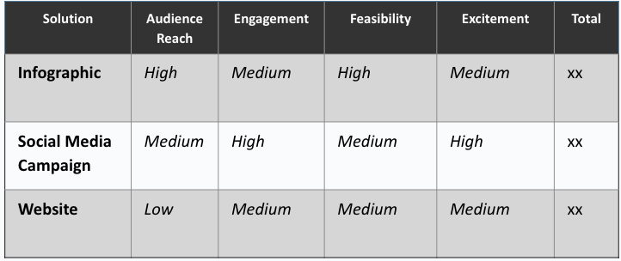
Find Your Best Fit
Pick two or three solution ideas.
Rate each on a scale of 1–3 (1 = low, 3 = high). Use your research and feedback to guide your decision!
Criteria to Consider:
Audience Reach: Who are we trying to reach?
Engagement: How does this group usually engage with content?
Excitement: What are we most excited to make?
Feasibility: What can we realistically create with our time and tools?
Notes:
Each team uses a “Format Fit Grid” (provided in the student portfolio) to compare 2–3 possible solutions for their prototype. Have students evaluate each solution using the following criteria: (Examples listed below.) Students debate impact of audience reach, engagement, feasibility, and excitement based on their research and user feedback.
Guiding Questions:
Who are we trying to reach?
How do people in this group typically engage with information?
What are we excited to make?
What can we realistically create in the time and tools we have?
Teams should rate each category with a 1–3 scale (1 = low, 3 = high) and total the points to determine their strongest candidate.

Slide 10

And the Winner Is….
As a team discuss your outcomes and consider:
  Which format scored the highest and why?
  Are there any trade-offs we’re accepting by choosing this format?
  What strengths do we bring to this format as a team?
Notes:
Consensus & Commitment
Once the evaluation is complete, students discuss:
Which format scored the highest and why?
Are there any trade-offs we’re accepting by choosing this format?
What strengths do we bring as a team to this format?

Slide 11
Claim It and Explain It
Finalize your choice and document it in your student portfolio.
“Our team chose to create a ________ because it allows us to reach [audience] with [message] in a way that is [engaging/creative/feasible]. I’m excited about this format because _______. One challenge I think we might face is _______.”
Notes:
Consensus & Commitment
Now, have students finalize their choice and document it in their Student Portfolio:
Our team chose to create a ________ because it allows us to reach [audience] with [message] in a way that is [engaging/creative/feasible]. I’m excited about this format because _______. One challenge I think we might face is _______.

Slide 12

Storyboarding:
Mapping Out the Message
Why do creators storyboard before making the final version of a product or media piece?
Examples:
Storyboard Examples: studiobinder
Storyboard That: PSA Examples
Social Interactions: Storyboards and Wireflows for Team Refresh
Infographics: How to Write an Infographic Story in 5 Simple Steps
Notes:
Storyboarding: Mapping Out the Message
Teacher Script: Now that you’ve selected the format for your solution, it’s time to plan how it will come to life. One powerful way to do this is through storyboarding. A storyboard is like a blueprint—it lets us plan how our message will unfold before we start creating. Whether you’re designing a website, a PSA, a campaign, or a game, your storyboard will help your team clarify your message, your visuals, and your call to action.
Storyboarding Step-by-Step
Intro to Storyboarding :
Ask: Why do creators storyboard before making the final version of a product or media piece?
Show 1-2 examples (visuals or short videos work well). These could include:
46 Storyboard Examples: studiobinder
Storyboard That: PSA Examples
Social Interactions: Storyboards and Wireflows for Team Refresh
Infographics: How to Write an Infographic Story in 5 Simple Steps

Slide 13
Sketch Your Idea
Work with your team to sketch out your idea in one person’s student portfolio. This is a rough draft.
Focus on:
The main message in each part
The visuals and text you include
The action the audience should take
Pro Tip: A great storyboard shows how your audience moves through the experience, not just what’s on each screen.
Panel 1: Introduction – Define the problem and target audience. | Panel 2: Key Message – How will you grab attention? | Panel 3: Presenting the Challenge – Show the problem’s impact. | Panel 4: Proposed Solution – Explain how your ideas solve the issue. | Panel 5: Call to Action – What should the audience do next?
Notes:
Storyboard Setup:
• Share the storyboard template with students, either a digital or printed copy.
• Remind students that these are sketches and notes—not polished work. Focus on:
What is the main message in each panel or section?
What visuals and text will appear?
What action do you want the viewer to take?
Storyboard Start (students work in teams - students will upload a pic to their own Student Portfolio when team’s are finished revising):
• Encourage rough sketches and notes to represent the sequence of their message.
• Remind students that strong storyboards show how the audience moves through the experience, not just what’s on each screen.

Slide 14

Storyboard Peer Review
Give feedback using these guiding questions:
Is the message clear and consistent?
Do the visuals match the tone and purpose?
Is the sequence logical and engaging?
Is there a strong call to action?
Pro Tip: Be specific. Share what’s working (warm), what could be improved (cool), and how to make it better (constructive).
Notes:
Peer Share & Storyboard Feedback
Teacher Script: Designers often workshop their ideas before they commit to building them. Let’s get some fresh eyes on your storyboard so you can strengthen your message before moving into creation.
Peer Feedback
Peer Review Round:
Each team pairs with another team and shares their storyboard.
Look for the Storyboard Peer Feedback form in the Teacher Resource Guide.
Reviewers use guiding questions to give warm, cool, and constructive feedback:
Is the message clear and consistent throughout?
Do the visuals match the tone and purpose?
Is the sequence logical and engaging?
Is there a clear call to action?

Slide 15


Upload Your Idea
Take a screenshot or photo of your storyboard.
Upload the image to your student portfolio.
Notes:
Capture Insights
Teams take a screenshot or photo of your brainstorming board when finished.
Upload the image to your Student Portfolio

Slide 16


Reflect and Revise
Step 1: Team Reflection
Review the feedback you received.
Highlight one or two changes your team will make based on
peer input.
Step 2: Portfolio Check-In
Write a short reflection on your team’s storyboard:
What did you revise?
How did peer feedback help improve your work?
Notes:
Storyboard Team Reflection
Team Reflection):
• Each team returns to their own work and highlights 1-2 changes they plan to make based on peer feedback.
Portfolio Check-In:
• Have each student jot a quick note in their portfolio next to the upload of their storyboard:
“One strength of our storyboard is…”
“One change we plan to make is…”

Slide 17
Think Back, Look Ahead
Respond to the prompts in your student portfolio:
What is one thing your team did well during planning today?
What question do you still have about your prototype?
What will be your first step when you begin building in the
next class?
Notes:
Teacher Script: Your team has made great progress today—from choosing a solution format to planning your design with a storyboard. Before we wrap up, take a moment to reflect on your process and think ahead to the next step: building your prototype.
Student Portfolio Exit Ticket:
• What is one thing your team did well during planning today?
• What question do you still have about your prototype?
• What is your first step next class when you begin building?
Wrap-Up: You’ve laid the foundation for a powerful solution. Next time, we’ll bring your storyboard to life. Be ready to experiment, test, and refine—because real design takes iteration!

