Slide 1


AVID Future Lab
Social Media and Mental Health
Unit 1, Lessons 1–3

Slide 2

Digital Mirror:
How Social Media Shapes Our Reflection
LESSON 1
Notes:
Consider the last time you scrolled through social media—did it leave you feeling inspired, connected, or perhaps a bit insecure? Social media is a powerful tool that shapes our self-perception and influences our emotions, perceptions, and behaviors. While it can foster connection and creativity, research indicates it may also contribute to mental health challenges. For instance, a study highlighted by Yale Medicine notes that adolescents spending over three hours daily on social media face twice the risk of experiencing depression and anxiety symptoms (Yale Medicine, 2024). Additionally, a Pew Research Center survey revealed that 43% of teens feel pressure to post content that makes them look good to others, underscoring the impact of comparison culture (Pew Research Center, 2018).
In this lesson, we’ll explore social media’s complex impact on mental health using Project-Based Learning (PBL) and Design Thinking, two creative problem-solving approaches. You’ll examine key themes like self-esteem, comparison culture, and misinformation, while also recognizing the positive aspects of social media, such as advocacy and community-building. By the end, you’ll have a deeper understanding of social media’s influence and a plan to turn your insights into action. Let’s jump in!

Slide 3


ESSENTIAL QUESTION
How does social media shape identity and mental health?

Slide 4



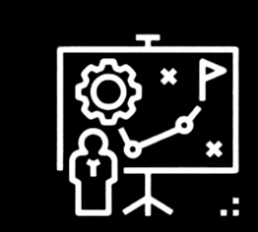
Student Portfolio
Track Your Learning
Reflect
Project Development

Slide 5




Objectives:
Project Wall
Project Wall
Word Wall
Skills for the Future
Social media algorithms
Misinformation
Digital well-being
Quantitative
Qualitative
​​​Empathy
Critical Thinking
Collaboration
Communication
Word Wall
​​​Social Media Algorithms
Misinformation
Digital Well-Being
Quantitative
Qualitative
Skills for the Future
​​​Empathy
Critical Thinking
Collaboration
Communication
Notes:
The Project Wall is a dynamic, evolving resource that supports students in mastering key vocabulary, concepts, and future-ready skills throughout the unit. Whether displayed physically in the classroom or virtually using tools like Padlet or Wakelet. The Word Wall reinforces academic language, encourages reflection, and helps students articulate their thinking with clarity. Reviewing the Word Wall regularly—either before each lesson or at the start of the week—promotes shared language, critical thinking, and effective collaboration.

Slide 6

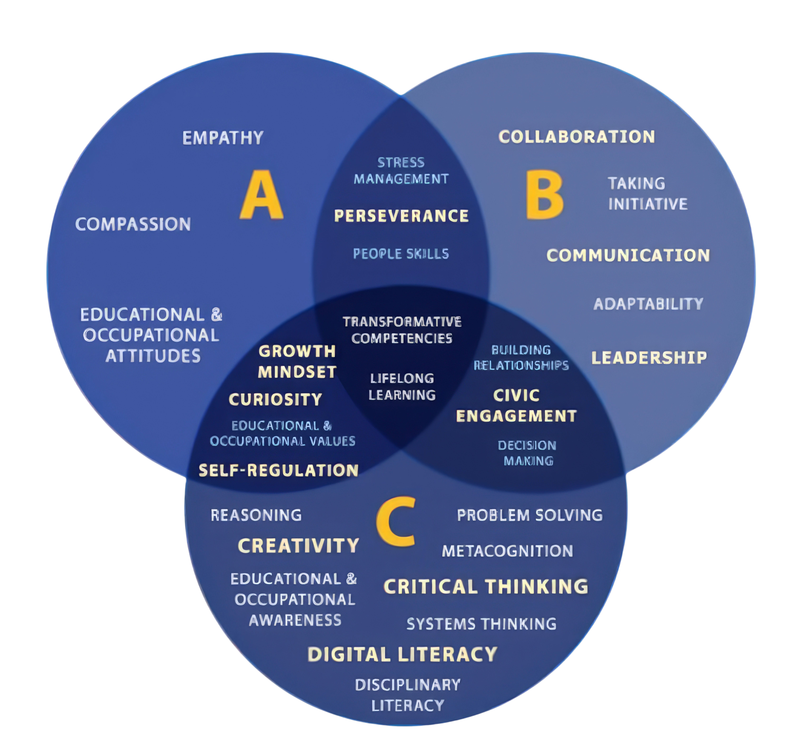
ETS Skills for the Future
Figure 1. SFF Components Classified According to Affective, Behavioral, and Cognitive Domains
Copyright © 2023 ETS. www.ets.org

Slide 7



Social Media and Me
How has social media impacted the way you see yourself or others?
Record your response here…
If you have access to a video recording app (e.g., Adobe Express for Education, Canva for Education, Loom for Education, or Screencastify) consider capturing your reflection in video and uploading it here.

Slide 8


Project Based-Learning (PBL) and Design Thinking
Project Based Learning: Explained.
The Design Thinking Process
Prompts: | Record your thinking:
What stood out to you about PBL and design thinking?
How do these methods help us tackle real-world problems?
How do empathy, creativity, and iteration play a role in designing solutions?

Slide 9

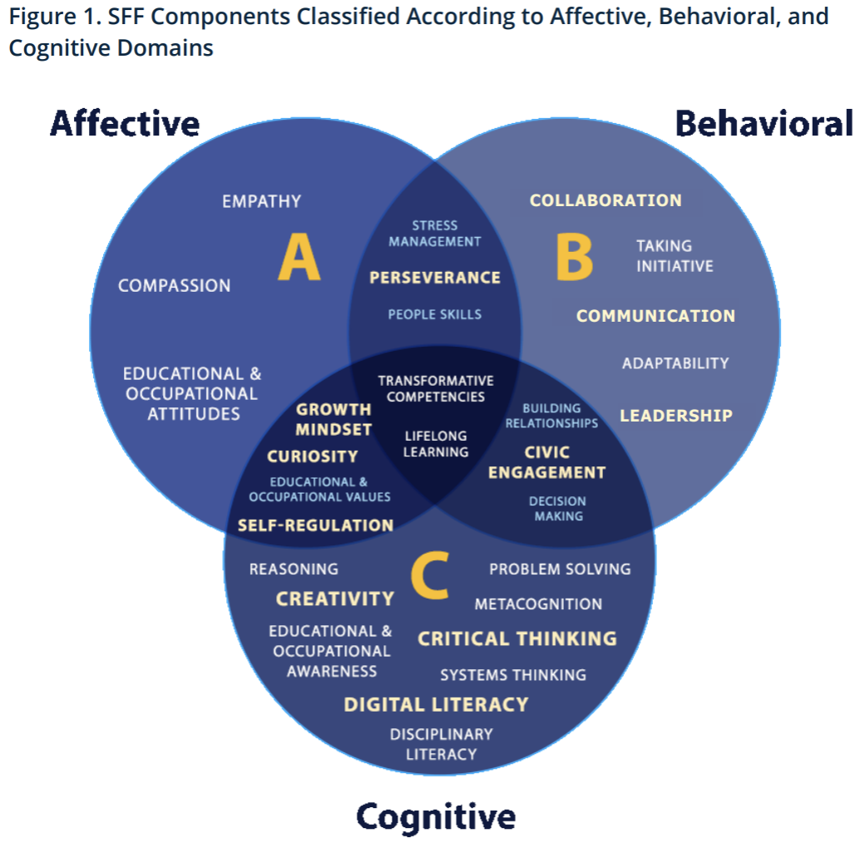
ETS: Skills for the Future
ETS Skills for the Future
What skills do you think will be most important for this project?

Slide 10
Trending or Toxic?
The Hidden Effects of Social Media
LESSON 2
Notes:
Imagine waking up and the first thing you do is check your phone—scrolling through endless posts, updates, and notifications. Before you’ve even gotten out of bed, social media has already shaped your mood, your thoughts, and maybe even how you see yourself. But is social media the real problem, or is it the way we use it? Today, we’re diving into the hidden challenges of social media and thinking critically about its impact. After reflecting on these issues, you’ll team up with classmates to choose a focus area and develop a creative project that raises awareness, offers solutions, or inspires positive change. The first step? Identifying what stands out to you the most and why it matters.

Slide 11
ESSENTIAL QUESTION
How does social media shape our self-perception, relationships, and understanding of the world, and how can we use it in a way that supports well-being and positive change?​

Slide 12
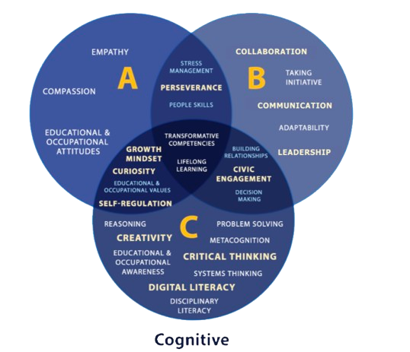
Objectives:
Project Wall
Word Wall
Skills for the Future
Problem definition
​Inquire
​Argumentation
​Algorithm bias
​Echo chambers
Disinformation
​Engagement metrics
New! Building Relationships
Collaboration
Communication
Notes:
The Project Wall is a dynamic, evolving resource that supports students in mastering key vocabulary, concepts, and future-ready skills throughout the unit. Whether displayed physically in the classroom or virtually using tools like Padlet or Wakelet. The Word Wall reinforces academic language, encourages reflection, and helps students articulate their thinking with clarity. Reviewing the Word Wall regularly—either before each lesson or at the start of the week—promotes shared language, critical thinking, and effective collaboration.
This project also focuses on building "Skills for the Future," as identified by ETS, including communication, critical thinking, collaboration, and adaptability. These competencies are embedded in each lesson through activities like problem-solving and evidence-based design. By engaging with these real-world skills and regularly updating the Word Wall, students connect academic content with lifelong learning and career readiness. Definitions for new vocabulary will be added after each lesson to help the Word Wall grow intentionally over time.

Slide 13

Dig Into the Issue
Choose one question to respond to below:
What specific issue related to social media’s influence stands out to me?
How have I seen this issue play out in real life (personally, in my community, or online)?
Who is most affected by this issue, and why does it matter?
What makes this issue challenging to solve?
Record your response here…
If you have access to a video recording app (e.g., Adobe Express for Education, Canva for Education, Loom for Education, or Screencastify) consider capturing your reflection in video and uploading it here.
How has social media impacted the way you see yourself or others?

Slide 14


Reflection
Answergarden
Embed Answergarden
Submit one or two words summarizing the most important takeaway from your discussion.
Notes:
If you have access to Adobe Express for Education, Canva for Education, Google Slides, or Padlet, consider summarizing your takeaway by creating a visual collage to represent your thinking.

Slide 15
The Social Dilemma
The Social Dilemma – Bonus Clip: The Discrimination Dilemma
Prompts | Record Your Thinking
What was the most eye-opening part of this clip?
Did anything feel eerily familiar? Have you noticed algorithms shaping your own experiences?
What are the possible consequences of these unseen forces?

Slide 16
Building Your Team
List Teammates
Team Role
Team Topic
Possible Project Idea
A Challenge You Will Need to Overcome

Slide 17


Fact vs. Fiction
What are some red flags that a source might not be trustworthy?
What’s one new tip you learned about evaluating sources?
How do algorithms or echo chambers make it harder to find balanced, credible information?
How will you make sure your project uses credible data and diverse perspectives?

Slide 18
Viral or Valid
Researching the Influence of Social Media
LESSON 3
Notes:
Envision a world where your every thought, every opinion, and even your self-worth could be shaped by the scroll of your thumb. Social media has become a powerful force in our lives—influencing how we see ourselves, how we connect with others, and how we navigate the challenges of mental health. But how much of what we see is real? How do these digital spaces impact our identity and relationships? In today’s lesson, you’ll take on the role of a researcher—diving deep into credible sources, gathering data, and asking the right questions to uncover the truth about social media’s effects. By the end, you’ll be ready to shape your project with insights that could spark real change. Let’s get started!

Slide 19
ESSENTIAL QUESTION
How does social media shape our mental health, and what strategies can we use to navigate its impact? ​

Slide 20
Objectives:
Project Wall
text
Word Wall
Skills for the Future
​​​​​​​​Credible
Perspective
Synthesize
​Problem framing
Critical Thinking
New! Problem Solving
New! Digital Literacy
New! Empathy
Notes:
The Project Wall is a dynamic, evolving resource that supports students in mastering key vocabulary, concepts, and future-ready skills throughout the unit. Whether displayed physically in the classroom or virtually using tools like Padlet or Wakelet. The Word Wall reinforces academic language, encourages reflection, and helps students articulate their thinking with clarity. Reviewing the Word Wall regularly—either before each lesson or at the start of the week—promotes shared language, critical thinking, and effective collaboration.
This project also focuses on building "Skills for the Future," as identified by ETS, including communication, critical thinking, collaboration, and adaptability. These competencies are embedded in each lesson through activities like problem-solving and evidence-based design. By engaging with these real-world skills and regularly updating the Word Wall, students connect academic content with lifelong learning and career readiness. Definitions for new vocabulary will be added after each lesson to help the Word Wall grow intentionally over time.

Slide 21

Social Media’s Impact
Record questions below:
What is one thing you already know about social media’s impact, and what is one question you have about it?
Record your response here…
If you have access to a video recording app (e.g., Adobe Express for Education, Canva for Education, Loom for Education, or Screencastify) consider capturing your reflection in video and uploading it here.

Slide 22
Research Questions
Record research questions below:
Start with a broad topic, then refine it using who, what, when, where, why, or how to help you create a more actionable question.
Record your response here…

Slide 23
Evaluating Sources for Reliability
What makes a source reliable?
How do we identify bias in a source?
Why is it important to use multiple sources rather than just one?
Record your response here…

Slide 24

Conduct Internet Research
Choose one research question as a team and conduct a keyword search using one of the provided sources.
Prompts for Internet Research:
What is the main argument or takeaway from this source?
How does this source connect to our research question?
Does this source confirm or challenge our prior understanding?
Suggested Research Sources
Common Sense Media
Pew Research Center
American Psychological Association (APA)
Government reports
University research (Google Scholar, JSTOR, EBSCOhost, academic studies)
Record your response here…

Slide 25
Beyond the Surface:
Analyze, Connect, Question
Record key takeaways (summary of the source, main argument, supporting evidence, etc.)
Prompts to support your research:
What is the main argument or takeaway from this source?
How does this source connect to our research question?
Does this source confirm or challenge our prior understanding?

Slide 26
Conduct Internet Research
Use school or local library databases (Gale, ProQuest, or EBSCOhost) to find one academic or news article. Discuss what you found with your team and answer the prompts below.
What patterns or themes are emerging in our research?
What gaps or unanswered questions still remain?
Which sources were most helpful, and why?
Record your response here…

Slide 27
Reflection
Add at least one key finding and one remaining question you have to help guide your future research.
One key finding….
One question you still have….
Notes:
If you have access to a video recording app (e.g., Adobe Express for Education, Canva for Education, Loom for Education, or Screencastify) consider capturing your reflection in video and uploading it on the slide above.

Slide 28
Framing the Problem
Framing the Right Problem: How Designers Ask Better Questions
What was the most important takeaway from the video?
How does problem framing apply to the way we research social media’s impact?
Record your response here…
If you have access to a video recording app (e.g., Adobe Express for Education, Canva for Education, Loom for Education, or Screencastify) consider capturing your reflection in video and uploading it here.

Slide 29
Developing Your Empathy Map
Identify the End-User
Who will be impacted by your project?
What specific group, demographic, or persona represents your target audience?
Define Your Goal
What are you trying to do, solve, or achieve?
Record your response here…
Record your response here…

Slide 30
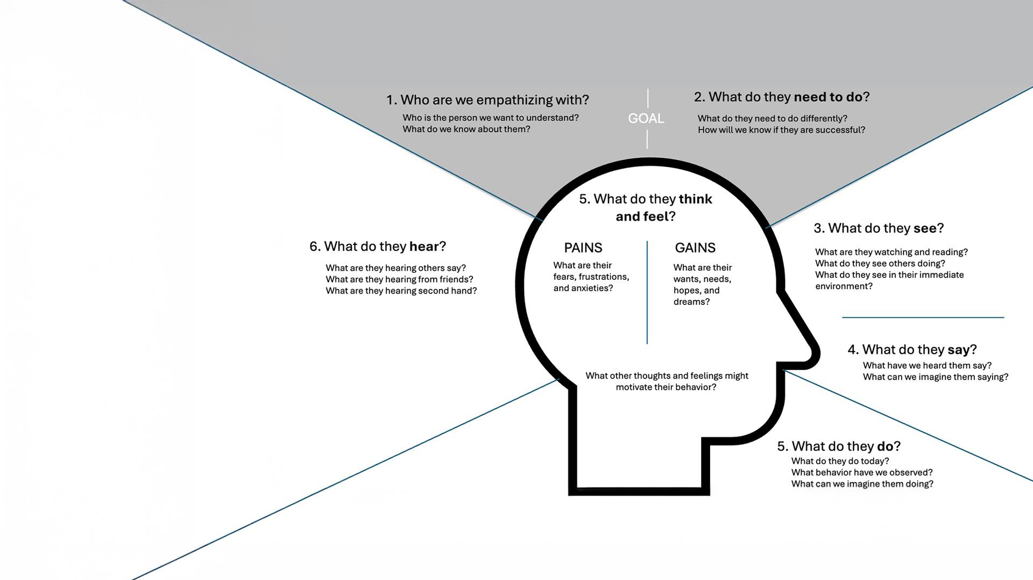
You will work in your project teams to fill in each quadrant of the map, thinking from the perspective of the end-user’s experience.
Work clockwise, starting at the top of the map with the external observations before moving into the internal thought process. additional prompts)
Notes:
Work clockwise, starting at the top of the map with the external observations before moving into the internal thought process.
Seeing: What does this person see in their daily life? (e.g., social media posts, ads, peer interactions)
Hearing: What do they hear from friends, family, influencers, or society? How does it influence them?
Saying: What do they say out loud about this issue? How do they express their thoughts or feelings?
Doing: What actions or behaviors do they take in response to their experience? How do they engage with social media?
Thinking & Feeling: What are their internal thoughts, worries, or motivations? What emotions drive their choices?

Slide 31

Capture Insight
What are two or three major insights about your end-user?
How does this information shape your project direction?
Upload an image of your empathy map.
Place image of your empathy map here.
Record your response here…
If you have access to a video recording app (e.g., Adobe Express for Education, Canva for Education, Loom for Education, or Screencastify) consider capturing your reflection in video and uploading it here.

Slide 32
Reflection
Write down one key insight from today’s research.
What is one question you still have about social media’s influence on mental health?
What is your team’s next step?
Record your response here…
If you have access to a video recording app (e.g., Adobe Express for Education, Canva for Education, Loom for Education, or Screencastify) consider capturing your reflection in video and uploading it here.

Slide 33
Sandbox
Use the following slides to document your research process.

Slide 34
Sandbox
Add a new title for each slide to identify the topic and source of your research.

Slide 35
Sandbox
Add a new title for each slide to identify the topic and source of your research.

Slide 36
Sandbox
Add a new title for each slide to identify the topic and source of your research.

