Slide 1


Future Lab
Social Media and Mental Health
Unit 3, Lesson 8
Notes:
In this lesson, students continue building and refining their prototypes through structured iteration and user-centered feedback. Using the Product Development Checklist, they assess key components—such as content, messaging, and user experience—to ensure alignment with their storyboard, audience, and original problem statement. Depending on project complexity, this build phase may extend over multiple class periods to support deeper development and real-time problem-solving. Students then conduct a beta test using the Google Ventures Five-Act Interview method to simulate end-user feedback. Finally, they enter a Revision Studio to apply systems thinking and transformative competencies, using peer insights to strengthen the clarity, cohesion, and impact of their solutions.
This lesson reinforces that strong design is a process—rooted in iteration, collaboration, and a deep understanding of user needs.

Slide 2

Beta Test Your Impact
Making Your Project Even Stronger
LESSON 8
Notes:
Understanding the true impact of social media requires more than just reading articles and analyzing studies—it’s about listening directly to the people who live with these experiences every day. In this lesson, you’ll become both a researcher and an investigator, gathering real-world input from your peers and examining how social media platforms shape narratives, trends, and opinions. By collecting survey responses, comparing platform content, and beginning to map your audience’s experiences, you’ll gain valuable insights that will help your team refine your project focus. This hands-on research will ensure your final project is grounded in authentic voices, experiences, and evidence—helping you design solutions that truly matter. Let’s dive in and see what we can uncover together.

Slide 3

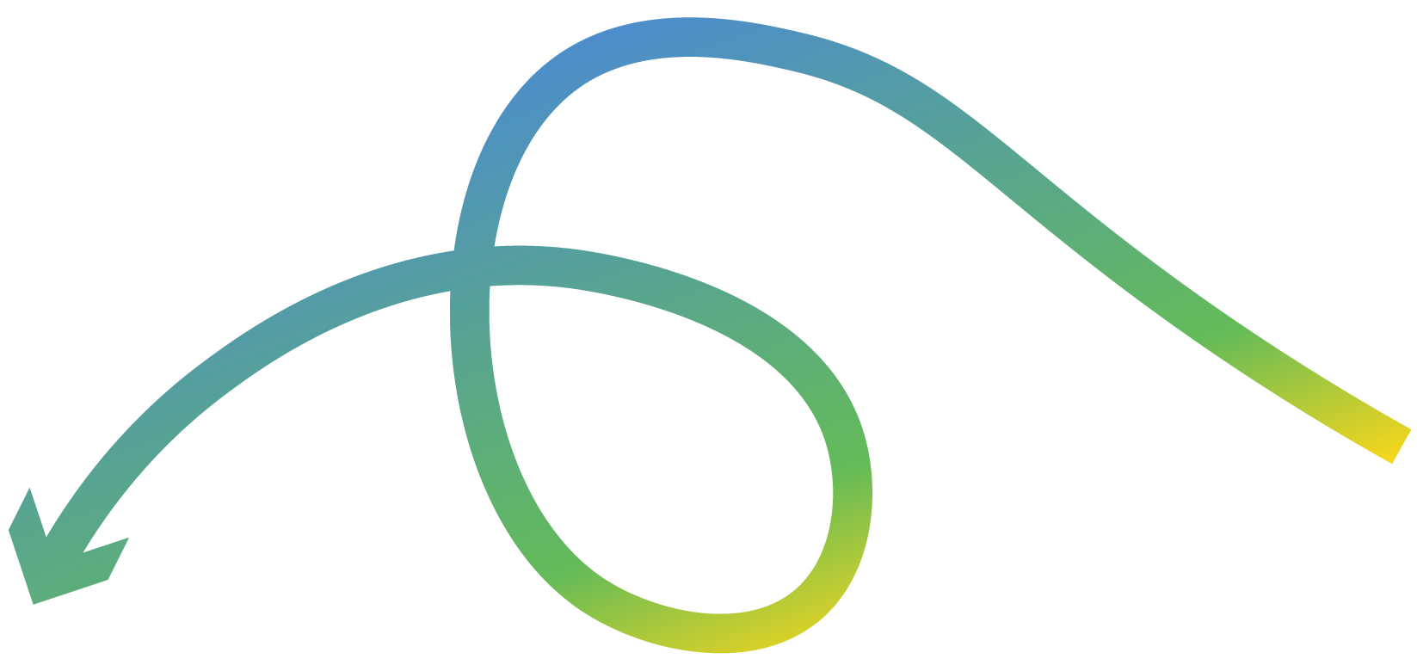
Objectives
Students will:
Iterate on their prototype using the Product Development Checklist, ensuring alignment to their storyboard, problem statement, and audience goals.
Apply systems thinking and collaborative planning to evaluate and prioritize design and content elements of their solution.
Conduct a beta test using the Five-Act Interview method, gathering structured feedback from peers simulating real users.
Analyze feedback using a sorting strategy to distinguish between quick fixes, deeper design questions, and low-priority items.
Demonstrate transforming competencies by refining their prototype with the goal of increasing audience engagement, clarity, and potential real-world impact.
Reflect on the role of iteration, feedback, and adaptability in the design process.

Slide 4

How do creators refine their ideas to better meet user needs, and how can feedback help us build stronger, more impactful solutions?
ESSENTIAL QUESTION
ESSENTIAL QUESTION
How do creators refine their ideas to better meet user needs, and how can feedback help us build stronger, more impactful solutions?

Slide 5
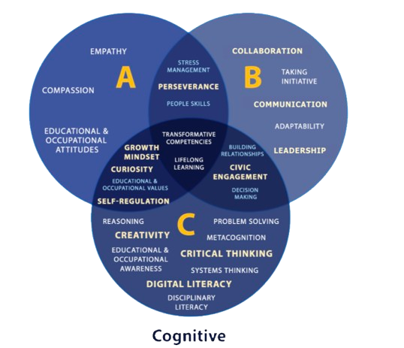
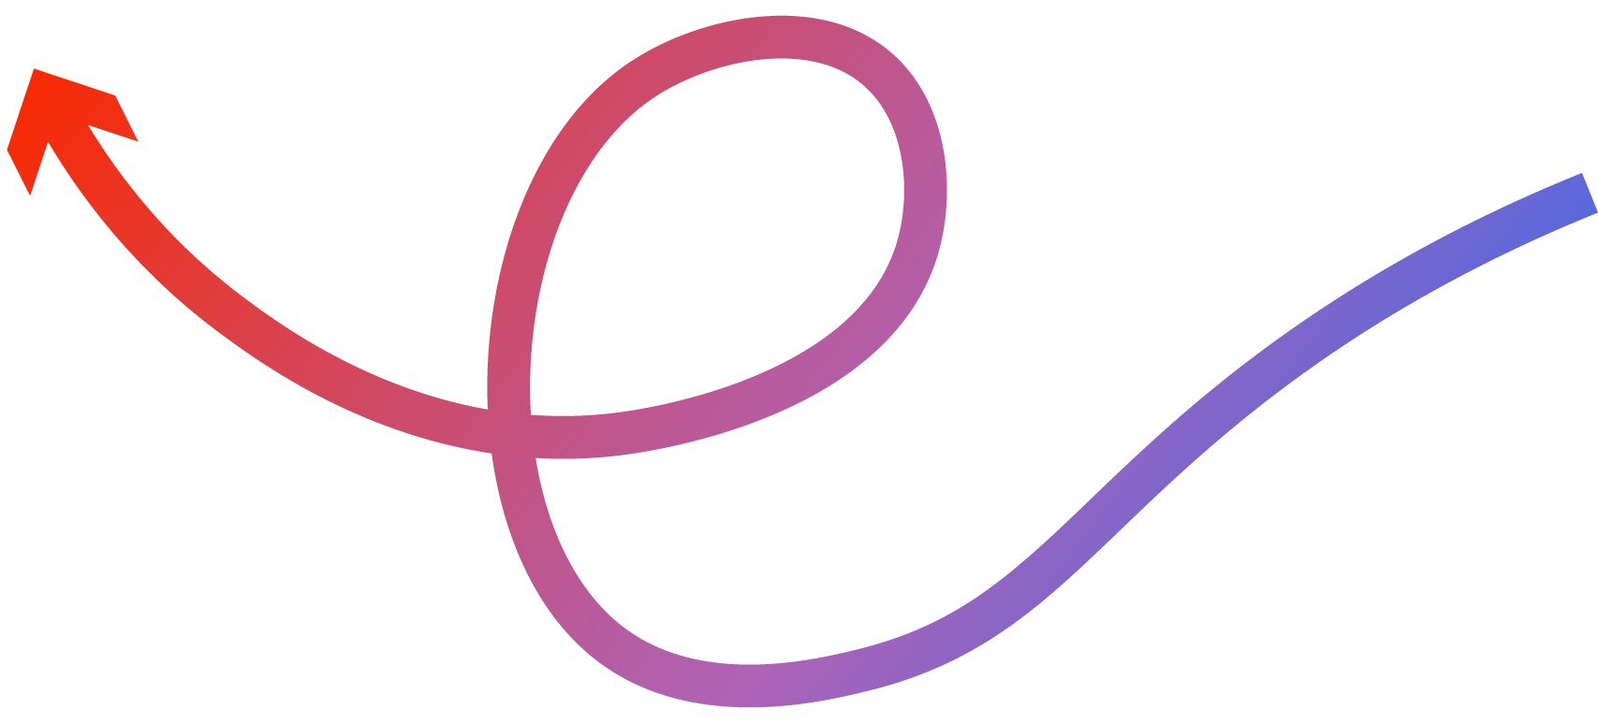

Objectives:
text
Project Wall
Word Wall
Skills for the Future
Beta test
Five-Act Interview
​​​NEW! Transformative Competencies

Slide 6


How the Pros Iterate
WWDC17: 60-Second Prototyping | Apple
Respond in your student portfolio:
What part of the design process stood out to you?
How did this designer adapt his solution based on testing and feedback?
What can we take from their process that we can use today?
Notes:
Teacher Script: Before we dive into today's build session, let’s see how real-world creators—like designers at Apple—approach prototyping and iteration. Pay attention to how feedback shapes what they build and how they respond to failure.
Video (10.40 minutes): Play WWDC17: 60-Second Prototype | Apple
While watching the video have students respond to these prompts in their student portfolio:
What part of the design process stood out to you?
How did this designer adapt his solution based on testing or feedback?
What can we take from their process that we can use today?

Slide 7

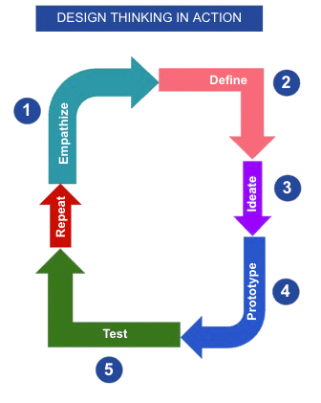
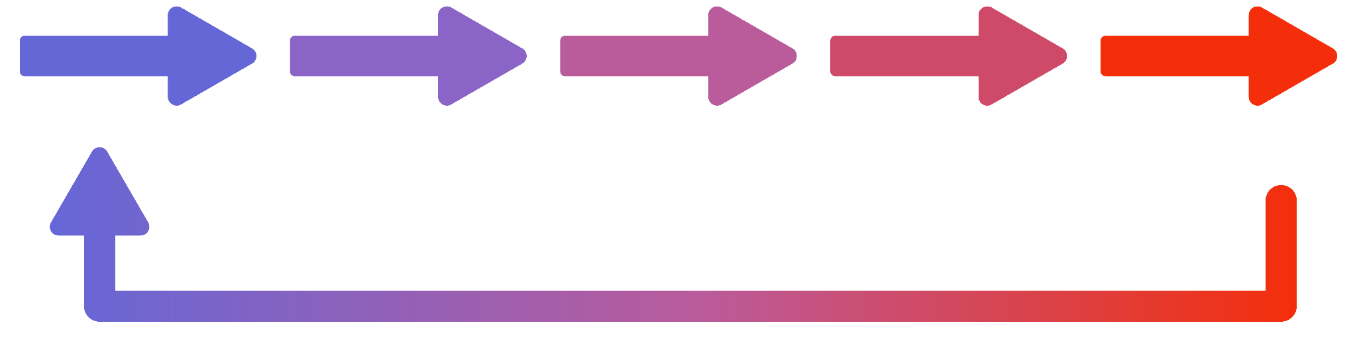
Design Thinking in Action
Empathize
Define
Ideate
Prototype
Test
Repeat
Notes:
What can we take from this process that we can use today?
Use a Design Thinking anchor chart to visually show the iterative loop: Prototype → Test → Refine → Repeat and highlight where students are now.

Slide 8

Bringing Your Vision to Life
Let’s step back and revisit:
Storyboard (Lesson 6)
Peer feedback (Lesson 7)
Problem statement and audience personas
What is your team goal for today’s prototyping session?
Notes:
Deep Build – Bringing the Vision to Life
Before each build session begins, encourage students to:
· Revisit their Storyboard (Lesson 6) and Peer Feedback (Lesson 7)
· Review their Problem Statement and Audience Persona
· Set a team goal for the session (e.g., “Today we’ll complete the intro section and begin our second segment.”)

Slide 9
Prototype Development Checklist
Use the checklist not as a linear to-do list, but as a systemic thinking guide—a way to step back, assess progress, and ensure that each part of the prototype aligns with your goals, audience needs, and original problem statement.
Revisit this checklist throughout your
prototyping process.
Notes:
Prototype Development Checklist & Guiding Questions
Distribute the Prototype Development Checklist (available in the Teacher Resource Guide) to each team at the start of any prototype-building session.
This tool is designed to support students as creative problem-solvers and collaborative designers, helping them manage the multiple interdependent components of their solution—content, functionality, storytelling, and user experience.
Encourage teams to use the checklist not as a linear to-do list, but as a systemic thinking guide—a way to step back, assess progress, and ensure that each part of the prototype aligns with their goals, audience needs, and original problem statement.
Teams should revisit this checklist throughout their build process to:
Stay focused on their core message and call to action
Track design decisions and ensure visual and narrative consistency
Monitor team roles and progress
Surface obstacles early and adapt their approach
Prepare for effective beta testing and iteration

Slide 10
Purpose and Problem Statement
What is the main problem we are solving?
Who is our target audience?
Does our current prototype clearly connect to our original problem statement?
Does our message align with our call to action (CTA)?
✔️ Checkpoint Prompt:
Write your team’s CTA on a sticky note and post it near your screen. Does each section of your build support that CTA?
Notes:
Briefly review each section of the Product Development Checklist with students:
Alignment to Purpose & Problem Statement
What is the main problem we are solving?
Who is our target audience?
Does our current prototype clearly connect to our original problem statement?
Does our message align with our Call to Action (CTA)?
✔️ Checkpoint Prompt: Write your team’s CTA on a sticky note and post it near your screen—does each section of your build support that CTA?

Slide 11
Storyboard Fidelity and Narrative Flow
Are we following the flow and structure outlined in our storyboard?
Are there places we’ve deviated—and if so, why?
Are the sections or scenes building toward a compelling user experience?
✔️ Checkpoint Prompt:
Pause and review: Does each section of your prototype have a clear purpose, visual, and message?
Notes:
Storyboard Fidelity & Narrative Flow
Are we following the flow and structure outlined in our storyboard?
Are there places we’ve deviated—and if so, why?
Are the sections or scenes building toward a compelling user experience?
✔️ Checkpoint Prompt: Pause and review: Does each section of your prototype have a clear purpose, visual, and message

Slide 12
Feature and Content Completion
What features or sections still need to be built (e.g., intro video, landing page, final CTA)?
Is the intro engaging and informative?
Do we have strong transitions between sections?
Are our visuals and text balanced and on-message?
✔️ Checkpoint Prompt:
Mark off each section on your storyboard as it is completed. Identify one section that needs more development.
Notes:
Feature & Content Completion
What features or sections still need to be built? (e.g., intro video, landing page, final CTA)
Is the intro engaging and informative?
Do we have strong transitions between sections?
Are our visuals and text balanced and on-message?
✔️ Checkpoint Prompt: Mark off each section on your storyboard as it is completed. Identify 1 section that needs more development.

Slide 13
Audience and User Experience
Is it easy to navigate or follow our solution?
Are we making design decisions based on what our audience needs, not just what we like?
Is our prototype accessible (font, color contrast, pacing, etc.)?
✔️ Checkpoint Prompt:
Close your eyes and describe your solution to a partner. Do they understand it? Would they engage with it?
Notes:
Audience & User Experience
Is it easy to navigate or follow our solution?
Are we making design decisions based on what our audience needs, not just what we like?
Is our prototype accessible (font, color contrast, pacing, etc.)?
✔️ Checkpoint Prompt: Close your eyes and describe your solution out loud to a partner. Do they understand it? Would they engage with it

Slide 14
Team Collaboration and Project Management
Have we assigned roles for this session (e.g., builder, editor, QA, timekeeper)?
Are we tracking progress toward our goal for today?
Are we reviewing and updating our task list?
✔️ Checkpoint Prompt:
Before the session ends, each team member should write one specific contribution they made to the prototype today.
Notes:
Team Collaboration & Project Management
Have we assigned roles for this session (e.g., builder, editor, QA, timekeeper)?
Are we tracking progress toward our goal for today?
Are we reviewing and updating our task list?
✔️ Checkpoint Prompt: Before the session ends, each team member writes one specific contribution they made to the prototype today.

Slide 15
Plan for the Next Iteration
What’s our next step after today?
What part of the prototype still needs to be tested?
What questions do we have for future testers?
✔️ Checkpoint Prompt:
Write one feedback question your team would like to ask during the next beta test.
Notes:
Plan for Next Iteration
What’s our next step after today?
What part of the prototype still needs to be tested?
What questions do we have for future testers?
✔️ Checkpoint Prompt: Write one feedback question your team would like to ask during the next beta test.

Slide 16


Capture Insights and Note Progress
Take a screenshot or photo of your storyboard.
Upload the image to your student portfolio.
Write a brief progress note.
Notes:
Product Development Tracking
To document their progress over time, students should capture the evolution of their solution throughout the build phase.
At the end of each development session, have students:
Take a snapshot of their current prototype—this can be a screenshot, photo, or short screen recording.
Write a brief progress note in their Student Portfolio describing what they worked on during the session, decisions they made, and any challenges or breakthroughs.
This running documentation will serve as a visual and reflective timeline of their design process, highlighting their iterative thinking and growth from concept to creation.

Slide 17
Throughout Your Build Process
Revisit your Product Development Checklist throughout your build process to:
Stay focused on your core message and call to action.
Track design decisions and ensure visual and narrative consistency.
Monitor your team roles and progress.
Surface obstacles early and adapt your approach.
Prepare for effective beta testing and iteration.
Notes:
By the end of the session, each team should briefly review the checklist together, identify areas of strength, and outline next steps for refinement.

Slide 18

Practice Real-World Feedback Gathering
From ‘Sprint’: The Five-Act Interview
Five-Act Interview Protocol:
Friendly Welcome
Context Questions
Introduction to the Prototype
Tasks/Observation
Wrap-Up/Debrief
Notes:
Teacher Setup: Practicing Real-World Feedback Gathering
Hand out Five-Act Interview Feedback Protocols
Teacher Note: This activity simulates how real-world designers, developers, and marketers collect feedback from end-users to improve their product or message. Shift students from a creator mindset to an audience-centered design mindset by framing feedback as a tool for improvement—not as criticism. Reinforce the value of iteration and encourage teams to approach this session as a form of user research.
Students should customize their feedback forms to reflect their project format and goals. For example, a social media campaign might focus on engagement and clarity, while a website prototype may prioritize navigation and content hierarchy.
Introduce the Five-Act Interview model from Google Ventures to structure this session and give students a practical approach to testing with users.
Teacher Script: Today, you're going to step into the shoes of professional designers and product teams. Whether you're creating a video, website, campaign, or app, all creators—yes, even at Google or Apple—know that real feedback from real users is one of the most powerful tools for improvement.
Before we begin, I want to emphasize something important: feedback isn't a critique of you—it's a gift that helps you create something more impactful. This session is about making your idea even better by seeing how others experience it.
Let’s take a few minutes to watch a real example from Google Ventures so you can see this approach in action.
From Sprint: The Five-Act Interview

Slide 19
Beta Testing Time
1
2
3
Have your team assign roles:
Presenter
Note-taker
Timekeeper
Review the Five-Act Interview Feedback Protocol. Add one or two questions that fit your project.
Go to your assigned station.
Notes:
Teams prepare for beta testing, using the Five-Act Interview Process • Designate roles: Presenter, Note-Taker, and Timekeeper. NOTE: For team members who don’t have a designated role, have them observe the process and record responses to the questions in the Debrief & Wrap Up section.
• Review the Five Act Interview Feedback Protocol Notes and customize 1–2 questions that fit their project (optional). • Get set up at stations or workspaces.
Mock Audience Rotation • Students rotate in pairs to interact with at least 2–3 different teams’ prototypes. • Use the Prototype Walk & Feedback Form (make copies and hand out the mock audience) process to answer key questions:
What is this prototype trying to accomplish?
Is the message clear and easy to follow?
What parts were most engaging or memorable?
What feedback would help the creators improve?
How might you respond if this solution appeared in your feed/inbox/in the real world?
Debrief & Wrap-Up • Teams return to their stations and reflect as a group:
What patterns did you notice in the feedback?
Was anything surprising?
What feedback will you act on first?

Slide 20

Gather Beta Feedback
What is this prototype trying to accomplish?
Is the message clear and easy to follow?
What parts were most engaging or memorable?
What feedback would help the creators improve?
How might you respond if this solution appeared in your feed/inbox/in the real world?
Team Debrief:
What patterns did you notice in the feedback?
Was anything surprising?
What feedback will you act on first?
Team Debrief
Notes:
Teams prepare for beta testing, using the Five-Act Interview Process • Designate roles: Presenter, Note-Taker, and Timekeeper. For team members who don’t have a designated role, have them observe the process and record responses to the questions in the Debrief & Wrap Up section.
• Review the Five Act Interview Feedback Protocol Notes and customize 1–2 questions that fit their project (optional). • Get set up at stations or workspaces.
Mock Audience Rotation • Students rotate in pairs to interact with at least 2–3 different teams’ prototypes. • Use the Five Act Interview Feedback Protocol (make copies and hand out the mock audience) process to answer key questions. Record your responses in your Student Portfolio.
What is this prototype trying to accomplish?
Is the message clear and easy to follow?
What parts were most engaging or memorable?
What feedback would help the creators improve?
How might you respond if this solution appeared in your feed/inbox/in the real world?
Debrief & Wrap-Up • Teams return to their stations and reflect as a group:
What patterns did you notice in the feedback?
Was anything surprising?
What feedback will you act on first?

Slide 21
Revision Studio
Turn feedback into impact:
Review all peer feedback as a team.
In your student portfolio, summarize two or three themes or insights that surfaced across the feedback sessions.
Feedback Sort Strategy
Prioritize revisions into:
Quick Fix: Small edits or improvements that are easy to implement now
Big Question: A complex issue that needs deeper team discussion or testing
Not Yet Sure: Input you’re still processing or may address later
Notes:
Teacher Script: Feedback is only powerful if we do something with it. Today, you’ll step into the mindset of professional creators—not just to fix what’s broken, but to strengthen what’s working and create something that can genuinely make an impact. This is where Systems Thinking and Transforming Competencies come in.
In this Revision Studio, you’ll think like innovators. You’ll look at how the pieces of your solution—your content, visuals, message, platform, and call to action—work together as a system. You'll reflect on how your prototype creates value, responds to real-world needs, and empowers your audience. And you’ll decide what to improve, what to rethink, and how to move forward with purpose.
Tip: Use color-coded sticky notes or a digital board to visually organize feedback into categories.
How to move forward with purpose.
1) Make Meaning from Feedback
· Review all peer feedback as a team.
· In your Student Portfolio, summarize 2–3 themes or insights that surfaced across the feedback sessions.
2) Feedback Sort Strategy
Use the “Feedback Sort” method to prioritize revisions:
· Quick Fix: Small edits or improvements that are easy to implement now.
· Big Question: A complex issue that needs deeper team discussion or testing.
· Not Yet Sure: Input you’re still processing or may address later.

Slide 22


Apply Systems Thinking
As a team, reflect on how your prototype functions as a whole.
How do the parts of our project, story, visuals, tone, and delivery, work together to influence our audience?
Where are the weak links in our system? Is anything misaligned or creating friction?
Are we still addressing the problem we set out to solve in a meaningful way?
Notes:
Apply Systems Thinking
Guide your team through these questions to reflect on how your prototype functions as a whole:
· How do the parts of our project—story, visuals, tone, delivery—work together to influence our audience?
· Where are the weak links in our system? Is anything misaligned or creating friction?
· Are we still addressing the problem we set out to solve in a meaningful way?

Slide 23
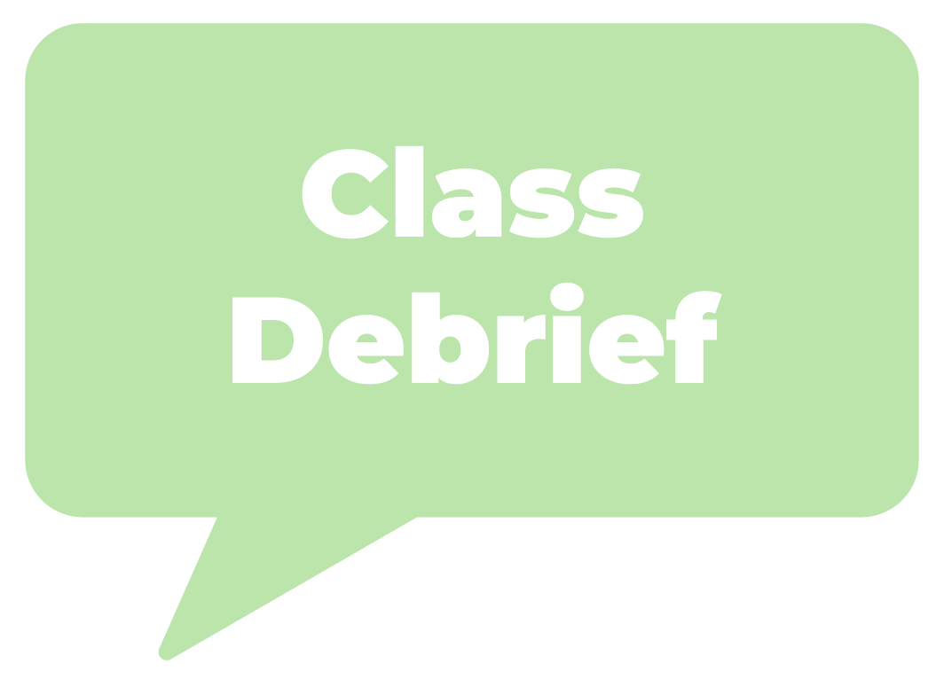
Practice Transforming Competencies
What new value are we creating for our users or audience?
Are there any tensions or dilemmas in our message or format that we need to resolve?
How will we take responsibility for the impact our solution has on our audience or the world?
Team Debrief
Notes:
Prompt students to reflect and act like social innovators:
· What new value are we creating for our users or audience?
· Are there any tensions or dilemmas in our message or format that we need to resolve?
· How will we take responsibility for the impact our solution has on our audience or the world?

Slide 24




Finalize Your Plan
List three to five specific revisions:
List one design choice your team is proud of and want to preserve:
List one risk or bold move your team is willing to test before final submission:
Notes:
Student Portfolio Entry: Final Revision Plan
Teams document their Final Revision Plan in their Student Portfolio:
List of 3–5 specific revisions they will make
One design choice they are proud of and want to preserve
One risk or bold move they are willing to test before final submission

Slide 25
Resilience in the Creative Process
The Art of Failing Forward
What’s one creative risk you took during this project?
What’s one mistake or challenge you encountered, and how did you respond?
How has your mindset about failure changed during this project?
Respond in your Student Portfolio.
What’s one creative risk you took during this project?
What’s one mistake or challenge you encountered—and how did you respond?
How has your mindset about failure changed during this project?
Notes:
Teacher Script: Even the best creators struggle. What sets them apart is how they respond to mistakes and keep going. Let’s hear how creatives use setbacks as fuel for innovation.
Watch the Video (2–3 minutes): Fail Forward: How Creatives Turn Mistakes into Breakthroughs
Video Reflection Prompts in Student Portfolio:
What’s one creative risk you took during this project?
What’s one mistake or challenge you encountered—and how did you respond?
How has your mindset about failure changed during this project?
Teacher Script: Iteration is messy—but powerful. You’ve worked hard to build something meaningful. As we head into our final stretch, remember: the goal isn’t perfection—it’s progress with purpose.

