Slide 1


AVID Future Lab
Social Media and Mental Health
Unit 1, Lesson 1

Slide 2

Digital Mirror:
How Social Media Shapes Our Reflection
LESSON 1
Notes:
Consider the last time you scrolled through social media—did it leave you feeling inspired, connected, or perhaps a bit insecure? Social media is a powerful tool that shapes our self-perception and influences our emotions, perceptions, and behaviors. While it can foster connection and creativity, research indicates it may also contribute to mental health challenges. For instance, a study highlighted by Yale Medicine notes that adolescents spending over three hours daily on social media face twice the risk of experiencing depression and anxiety symptoms (Yale Medicine, 2024). Additionally, a Pew Research Center survey revealed that 43% of teens feel pressure to post content that makes them look good to others, underscoring the impact of comparison culture (Pew Research Center, 2018).
In this lesson, we’ll explore social media’s complex impact on mental health using Project-Based Learning (PBL) and Design Thinking, two creative problem-solving approaches. You’ll examine key themes like self-esteem, comparison culture, and misinformation, while also recognizing the positive aspects of social media, such as advocacy and community-building. By the end, you’ll have a deeper understanding of social media’s influence and a plan to turn your insights into action. Let’s jump in!

Slide 3



ESSENTIAL QUESTION
How does social media shape identity and mental health?
ESSENTIAL QUESTION
How does social media shape identity and mental health?

Slide 4
Objectives
Students will:
​​Understand the project-based learning (PBL) approach and the design thinking process as frameworks for problem-solving.
Explore the guiding question, “How does social media influence the way we see ourselves and others?”
​Identify key themes related to social media’s impact on mental health.
Brainstorm initial project ideas and establish learning expectations for the unit.

Slide 5

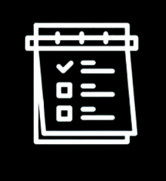

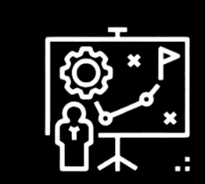
Student Portfolio
Track Your Learning
Reflect
Project Development
Notes:
Student Portfolio Setup
A student portfolio will serve as a centralized workspace for tracking learning, reflections, and project development. Choose a format that aligns with school-approved technology and student accessibility.
Portfolio Format Options
Digital: Google Slides, Microsoft PowerPoint, or Adobe Express
Analog: Printed portfolio binders with designated sections for research, brainstorming, and reflections.
Portfolio Management
Templates: See the templates provided for the student portfolio. Choose the option that works best for your students (Google Slides (link), Microsoft PowerPoint (link), Adobe Express Website Template (link)

Slide 6




Objectives:
Project Wall
Project Wall
Word Wall
Skills for the Future
Social media algorithms
Misinformation
Digital well-being
Quantitative
Qualitative
​​​Empathy
Critical Thinking
Collaboration
Communication
Word Wall
​​​Social Media Algorithms
Misinformation
Digital Well-Being
Quantitative
Qualitative
Skills for the Future
​​​Empathy
Critical Thinking
Collaboration
Communication
Notes:
The Project Wall is a dynamic, evolving resource that supports students in mastering key vocabulary, concepts, and future-ready skills throughout the unit. Whether displayed physically in the classroom or virtually using tools like Padlet or Wakelet. The Word Wall reinforces academic language, encourages reflection, and helps students articulate their thinking with clarity. Reviewing the Word Wall regularly—either before each lesson or at the start of the week—promotes shared language, critical thinking, and effective collaboration.

Slide 7

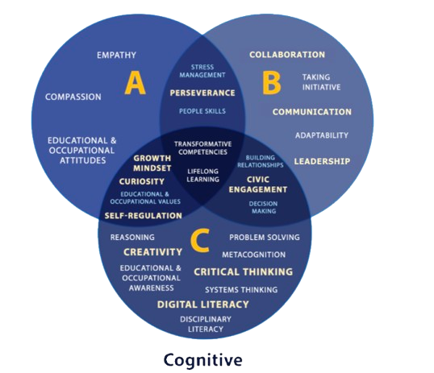
ETS Skills for the Future
Figure 1. SFF Components Classified According to Affective, Behavioral, and Cognitive Domains
Copyright © 2023 ETS. www.ets.org
Notes:
This project also focuses on building "Skills for the Future," as identified by ETS, including communication, critical thinking, collaboration, and adaptability. These competencies are embedded in each lesson through activities like problem-solving and evidence-based design. By engaging with these real-world skills and regularly updating the Word Wall, students connect academic content with lifelong learning and career readiness. Definitions for new vocabulary will be added after each lesson to help the Word Wall grow intentionally over time.

Slide 8






Social Media and Me
Think
Pair
Share
How has social media impacted the way you see yourself or others?
Share your thoughts with a partner and find common themes.
Pairs, share your discussion with the class.
Class Discussion
What are some common themes that you are hearing in your class?
Notes:
Teacher Script: Before we dive into this project, I want us to take a moment to reflect on our personal experiences with social media. Have you ever found yourself comparing your life to what you see online? Do social media platforms make you feel more connected, or do they sometimes make you feel isolated? Today, we begin our journey by exploring how social media shapes the way we see ourselves and others.
Prompt: How has social media impacted the way you see yourself or others?
Think: Students individually jot down their thoughts in their student portfolio.
Pair: Students discuss their thoughts with a partner and find common themes.
Share: Each pair summarizes their discussion for the class. The teacher captures key themes (e.g., comparison culture, self-esteem, misinformation, social validation) on the board or a digital whiteboard (e.g., Padlet, Mentimeter).
Class Discussion: Teacher facilitates a short discussion highlighting student responses and connecting them to the broader essential question: How does social media shape identity and mental health?

Slide 9


Project Based-Learning (PBL)
and Design Thinking
Project-Based Learning: Explained.
The Design Thinking Process
Notes:
Teacher Script: Now that we’ve started thinking about how social media influences us, let’s talk about how we will approach this topic throughout the unit. Instead of just reading about these ideas, we are going to use a method called Project-Based Learning (PBL), combined with Design Thinking, to research, analyze, and develop real solutions. Let’s watch two short videos that introduce these concepts.
Watch & Discuss (Whole-Class or Small Groups)
Video 1: Project-Based Learning Explained – Sprouts (3:46)
Video 2: The Design Thinking Process – Sprouts (3:56)
Discussion Questions in Student Portfolio. Students respond to questions in Student Portfolio. Then, have them discuss in Pairs or Small Groups. Share Out as time permits.
What stood out to you about PBL and Design Thinking?
How do these methods help us tackle real-world problems?
How do empathy, creativity, and iteration play a role in designing solutions?
Key Takeaways (Teacher Summarizes on Board or Digital Display): Share PBL and Design Thinking resource documents (see Teacher Resource Guide) with students as you discuss the following:
PBL is learning by doing: Students will research, create, test, and present a project that addresses social media’s influence.
Design Thinking is a user-centered approach that starts with empathy and ends with a tested, refined solution.
Real-world Impact: The process is iterative, and students will test and improve their work over time.

Slide 10






Breaking it Down: What’s the Big Idea?
How does social media shape our emotions and mental wellbeing?
What's the double-edged sword of social media—how can it both lift us up and tear us down?
What would “healthy” social media look like? And how could we make it a reality?
Who wins and who loses in the social media game?
Notes:
Teacher Script: We’ve now explored the process we’ll use for this project, but what exactly will we be investigating? Social media is a powerful tool—it connects us, informs us, and entertains us. But it also has challenges. We are going to explore multiple perspectives on this topic through a collaborative activity.
Gallery Walk (Digital or Analog)
Teacher posts four key questions around the room (or on a Padlet).
Students rotate in small groups (3-4 students) and add their thoughts on sticky notes or a digital board.
Use the following questions to guide this activity, as needed.
Gallery Walk Questions to Consider
How does social media shape our emotions and mental well-being?
Teacher tip: If students get stuck and need additional prompts to support their discussion, using the following brainstorm prompts:
Does scrolling make you feel more connected or more alone?
Have you ever logged off feeling better… or worse? Why?
How do different platforms (Instagram, TikTok, Snapchat, etc.) affect your mood in different ways?
What’s the double-edged sword of social media—how can it both lift us up and tear us down?
Brainstorm prompts, if needed: 3
When have you seen social media being used for good (e.g., mental health awareness, activism, support groups)?
What’s an example of social media making things worse (e.g., misinformation, cyberbullying, toxic trends)?
Are some platforms “safer” for mental health than others? Why?
Who wins and who loses in the social media game?
Brainstorm prompts, if needed:
Which groups of people are most vulnerable to social media’s effects (e.g., teens, influencers, younger kids, marginalized communities)?
How does social media impact self-esteem differently for different people?
Do algorithms treat everyone the same, or do they amplify some voices while silencing others?
What would “healthy” social media look like—and how could we make it a reality?
Brainstorm prompts, if needed:
What would happen if we redesigned social media to put mental health first?
If you had the power to change one thing about social media, what would it be?
How can we help people use social media in a way that protects their mental health rather than harming it?
Debrief (Whole-Class Discussion)
Teacher facilitates a discussion on emerging themes and patterns in student responses.
Big Idea: There are multiple perspectives on social media’s impact—some positive, some negative. Our goal is to develop a thoughtful, research-based approach to understanding these effects and creating solutions.

Slide 11
Scoping the Project
1. Project Goals
Develop, test, and present a product that addresses a social media-related issue.
2. Focus on Skills For the Future
Empathy, critical thinking, collaboration, and communication
3. Creative Career Skills
Use multimedia tools to create digital artifacts (videos, infographics, campaigns, etc.).
4. Portfolio Development
Document the research and design process in a digital or physical portfolio.
Notes:
Looking Ahead at Unit Objectives & Expectations
Teacher Script: Now that we have started to think critically about social media’s impact, let’s shift our focus to the big picture—what we’ll be working toward throughout this project. By the end of this unit, you will have developed a creative project that explores a real issue related to social media and mental health.
1) Scoping the Project
Display the following and discuss each topic area with students.
· Project Goals:
o Develop, test, and present a product that addresses a social media-related issue.
· Focus on Skill for the Future:
o Empathy, critical thinking, collaboration, and communication
· Creative Career Skills:
o Use multimedia tools to create digital artifacts (videos, infographics, campaigns, etc.).
· Portfolio Development:
o Document the research and design process in a digital or physical portfolio.

Slide 12




Consider the following…
Specific Lens or Issue
Examples: Comparison culture, misinformation, digital well-being, etc.
Potential Audience
Examples: Peers, younger students, parents, school staff, etc.
Final Project
Examples: Video, infographic, social media campaign, live presentation, etc.
Notes:
Have students consider the following as they envision their final project:
· A specific lens or issue (e.g., comparison culture, misinformation, digital well-being).
· A potential audience (e.g., peers, younger students, parents, school staff).
· A final project format (e.g., video, infographic, social media campaign, live presentation, etc.).

Slide 13

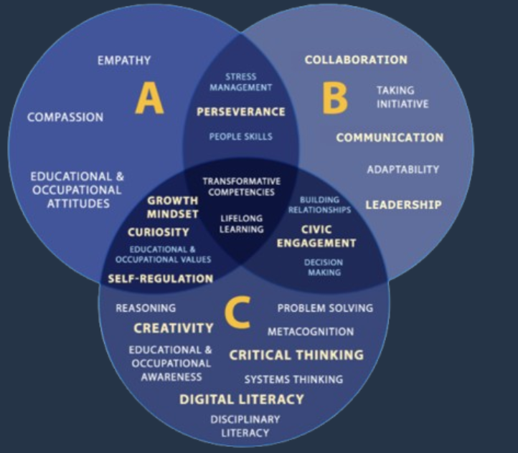
ETS Skills for the Future
What skills do you think will be most important for this project?
Figure 1. SFF Components Classified According to Affective, Behavioral, and Cognitive Domains
Copyright © 2023 ETS. www.ets.org
Notes:
Display the ETS Skills for the Future Venn Diagram and have students’ brainstorm, building on each other’s ideas.

Slide 14
Idea Generation
Reflection
Great Design Starts with Empathy
Exit Ticket
Choose one:
What role does empathy play in creative careers?
Why do you think empathy is an important skill for this project?
Notes:
Reflection & Idea Generation Exit Ticket
Teacher Script: To wrap up today’s lesson, I want you to take a moment to reflect on everything we’ve discussed so far. Social media affects each of us in different ways. What issue interests you the most? What would you like to explore in more depth?
Watch & Reflect: Whole class or small group
Play the Lesson 1 video: “The Power of Perspective: Why Empathy is the Key to Innovation”
After the video, students choose 1 question to answer for their exit ticket:
What role does empathy play in creative careers?
Why do you think empathy is an important skill for this project?
Submission Options:
Analog Option: Write on a sticky note and place it on a class idea board.
Digital Option: Submit via Google Forms, Padlet, or Canvas discussion.
Next Steps (Transition to Lesson 2: The Problem and Project Overview Team formation)
Teacher Script (as students are completing the Exit Ticket): In the next lesson, we’ll dive deeper into the research process—exploring credible sources, surveys, and media analysis to understand social media’s effects more thoroughly. Start thinking about how you want to approach your project!

