Slide 1


Future Lab
Social Media and Mental Health
Unit 2, Lesson 4

Slide 2

From Data to Insights
Surveys, Media, Analysis, and Interviews
LESSON 4
Notes:
Understanding the true impact of social media requires more than just reading articles and analyzing studies—it’s about listening directly to the people who live with these experiences every day. In this lesson, you’ll become both a researcher and an investigator, gathering real-world input from your peers and examining how social media platforms shape narratives, trends, and opinions. By collecting survey responses, comparing platform content, and beginning to map your audience’s experiences, you’ll gain valuable insights that will help your team refine your project focus. This hands-on research will ensure your final project is grounded in authentic voices, experiences, and evidence—helping you design solutions that truly matter. Let’s dive in and see what we can uncover together.

Slide 3


Objectives
Students will:
Conduct peer surveys to gather initial perceptions related to their topic.
Compare social media content across platforms to identify trends and biases.
Identify gaps in their understanding that can be addressed through interviews or observational research.
Begin completing their empathy map using audience input.

Slide 4

ESSENTIAL QUESTION
Why is it important to hear directly from the people affected by a problem, rather than relying only on existing research?

Slide 5


Objectives:
Project Wall
text
Word Wall
Skills for the Future
Convergent thinking
Divergent thinking
Ideation
​Insight
Problem statement
Synthesis
User-centered design
New! Adaptability
New! Curiosity

Slide 6



Crafting Questions That Matter
Who are you surveying?
What do you want to learn from your audience?
How will this data help refine your project?
Are your questions clear and unbiased?
Notes:
In their teams, have students craft an end-user survey to gather initial input from their target audience.
Survey Criteria:
Develop 3-5 questions
Choose from Google Forms, Padlet, or Paper Survey
Add your survey format to your Student Portfolio.
Consider the following as you develop your questions:
Who are you surveying (e.g., high school students, teachers, community members)?
What do you want to learn from your audience (e.g., opinions, experiences, behaviors)?
How will this data help refine your project (e.g., confirming assumptions, revealing gaps)?
Are your questions clear and unbiased (e.g., avoid leading questions like, “Don’t you think social media is harmful?”)

Slide 7

Well-Designed Survey Questions
Social Media Usage
How much time do you spend on social media daily?
Which social media platforms do you use the most?
How do you feel after using social media for an extended period?
Notes:
Examples of Well-Designed Survey Questions: (Adjust to project focus)
Use the following slides to help students explore potential themes for their projects. Each slide includes examples of well-crafted survey questions that are clear, purposeful, and designed to generate meaningful insights from their target audience.

Slide 8


Well-Designed Survey Questions
Misinformation and Trust
How confident are you that the news you see online is accurate?
Have you ever believed and shared a piece of information online that turned out to be false?
Where do you usually fact-check information online?

Slide 9

Well-Designed Survey Questions
Mental Health and Well-being
Have you ever felt pressured to look a certain way because of social media?
Do you think social media positively or negatively impacts your self-esteem? Why?
What strategies do you use to manage your mental health when using social media?

Slide 10

Well-Designed Survey Questions
Cyberbullying and Online Safety
Have you ever witnessed cyberbullying on social media?
How did you respond to cyberbullying?
What online safety strategies do you use to protect yourself?
Notes:
Distribute the Survey
Decide on a method for gathering responses:
Google Forms for quick digital collection
Padlet for collaborative brainstorming
Paper surveys for in-class responses
Surveying Classmates:
Teams should aim to gather at least 5-10 responses during class.
Encourage teams to extend their survey to students outside of class to gather data from their target audience.

Slide 11




Conduct Your Survey
Gather Feedback
Collect 5–10 responses from your classmates.
Extend your survey to end-users outside of your classroom for feedback from your target audience.
Notes:
Distribute the Survey
Decide on a method for gathering responses:
Google Forms for quick digital collection
Padlet for collaborative brainstorming
Paper surveys for in-class responses
Surveying Classmates:
Teams should aim to gather at least 5-10 responses during class.
Encourage teams to extend their survey to students outside of class to gather data from their target audience.

Slide 12
Survey Says… Now What?
What trends or patterns stand out in your results?
Did anything surprise you?
How do your findings compare to what you expected?
Do your results confirm or challenge any of your previous assumptions?
What additional questions do your responses raise?
Notes:
Analyze & Summarize Survey Data
Teacher Script: Data is most useful when we can interpret and apply it to our research. Now that you have collected responses, your team will summarize key takeaways in your student portfolio.
Guiding Prompts for Analyzing Survey Responses:
What trends or patterns stand out in your results?
Did anything surprise you?
How do your findings compare to what you expected?
Do your results confirm or challenge any of your previous assumptions?
What additional questions do your responses raise?

Slide 13


From Data to Direction
Write a one-paragraph summary in your student portfolio addressing:
Key findings.
Unexpected results.
Implications for research.
Next steps.
Notes:
Student Portfolio Entry: Summarize Responses
Have students write a 1-paragraph summary in their student portfolio addressing:
· Key Findings (e.g., "Most students spend an average of 4+ hours on social media daily.")
· Unexpected Results (e.g., "Surprisingly, 60% of respondents say social media has improved their mental health rather than harmed it.")
· Implications for Research (e.g., "Our team originally assumed social media was mostly harmful, but these responses suggest a more nuanced perspective.")
· Next Steps (e.g., "We need to conduct interviews to better understand how students define ‘positive’ vs. ‘negative’ experiences on social media.")
Teacher Script: Beyond surveys, researchers also analyze media to identify trends, messaging, and audience engagement. Now, your team will compare how your topic is discussed across different platforms. This will help us understand how social media shapes public perception.

Slide 14

How Are Your Topics
Trending
Note the differences in how your topic is discussed across two platforms (Instagram, TikTok, YouTube, etc.)
Messaging and tone
Visuals and formats
Engagement strategies
Audience reactions
:
Connect to the survey and discuss:
One key insight from your survey or media analysis.
Common emerging themes.
Notes:
Media Content Analysis (10 minutes)
· Teams compare how their topic is discussed on 2 platforms (Instagram, TikTok, YouTube, etc.).
· Use a T-chart to document team differences in the Student Portfolio:
o Messaging & Tone (How is the topic framed? Positive? Negative?)
o Visuals & Formats (Are posts mainly videos, images, or text? What visuals are used?)
o Engagement Strategies (How do influencers or brands encourage interaction?)
o Audience Reactions (What are the comments and shares like? What’s the sentiment?)
Whole-Class Discussion (2 minutes) Connecting to the survey:
Discussion Prompts:
o Ask teams to share one key insight they found in their survey responses or media analysis.
o Note common emerging themes on the board or a digital Padlet to track class-wide patterns.

Slide 15

Trends, Surprises, and Takeaways
Categorize your findings into key themes. Consider:
What patterns or trends emerge?
Were there any surprises in the data?
How does media messaging differ across platforms?
How do our survey findings compare to what we expected?
Are there any gaps in your research that you need to explore further?
Notes:
Teacher Script: Now that we’ve gathered input from both peer surveys and media analysis, it’s time to make sense of the data. Researchers don’t just collect information—they analyze patterns, compare perspectives, and ask deeper questions. Let’s look at what we’ve found so far.
Team Review & Brainstorming
Each team opens a digital whiteboard (e.g., Figjam, Padlet, or Miro) to visually map out their findings. Teams categorize their data into key themes using sticky notes or mind maps.
As they analyze, they should consider:
What patterns or trends emerge?
Were there any surprises in the data?
How does media messaging differ across platforms?
How do our survey findings compare to what we expected?
Are there any gaps in our research that we need to explore further?

Slide 16


Capture Insights
Take a screenshot or photo of your brainstorm.
Upload the image to your student portfolio.
Notes:
Capture Insights
Teams take a screenshot or photo of your brainstorming board when finished.
Upload the image to your Student Portfolio

Slide 17

Reflection
Key Takeaways: What are the two biggest insights from our research so far?
Surprising Findings: Did anything challenge or change our perspective?
Next Steps: What additional questions do we need to answer before moving forward?
Project Relevance: How do these insights inform our approach to solving the problem?
Notes:
Individual Reflection in Student Portfolio
Students respond to the following reflection prompts in their portfolio:
· Key Takeaways: What are the two biggest insights from our research so far?
· Surprising Findings: Did anything challenge or change our perspective?
· Next Steps: What additional questions do we need to answer before moving forward?
· Project Relevance: How do these insights inform our approach to solving the problem?

Slide 18


Let’s Compare Notes
Share one insight from your peer responses and one from your media analysis.
What’s one interesting trend we noticed in our survey results?
Did any team find conflicting data between survey responses and media messages?
How does media messaging differ across platforms?
What’s a next step we should take based on our findings?
Notes:
Whole-Class Debrief
Teams share one insight from their peer responses and one insight from their media analysis.
Discussion Prompts:·
What’s one interesting trend we noticed in our survey results?
Did any team find conflicting data between survey responses and media messages?
How does media messaging differ across platforms?
What’s a next step we should take based on our findings?
Teacher Script: Great work! You’re beginning to see how real-world researchers identify trends and refine their focus. Keep these insights in mind as we move forward—your data will help shape the direction of your project.

Slide 19

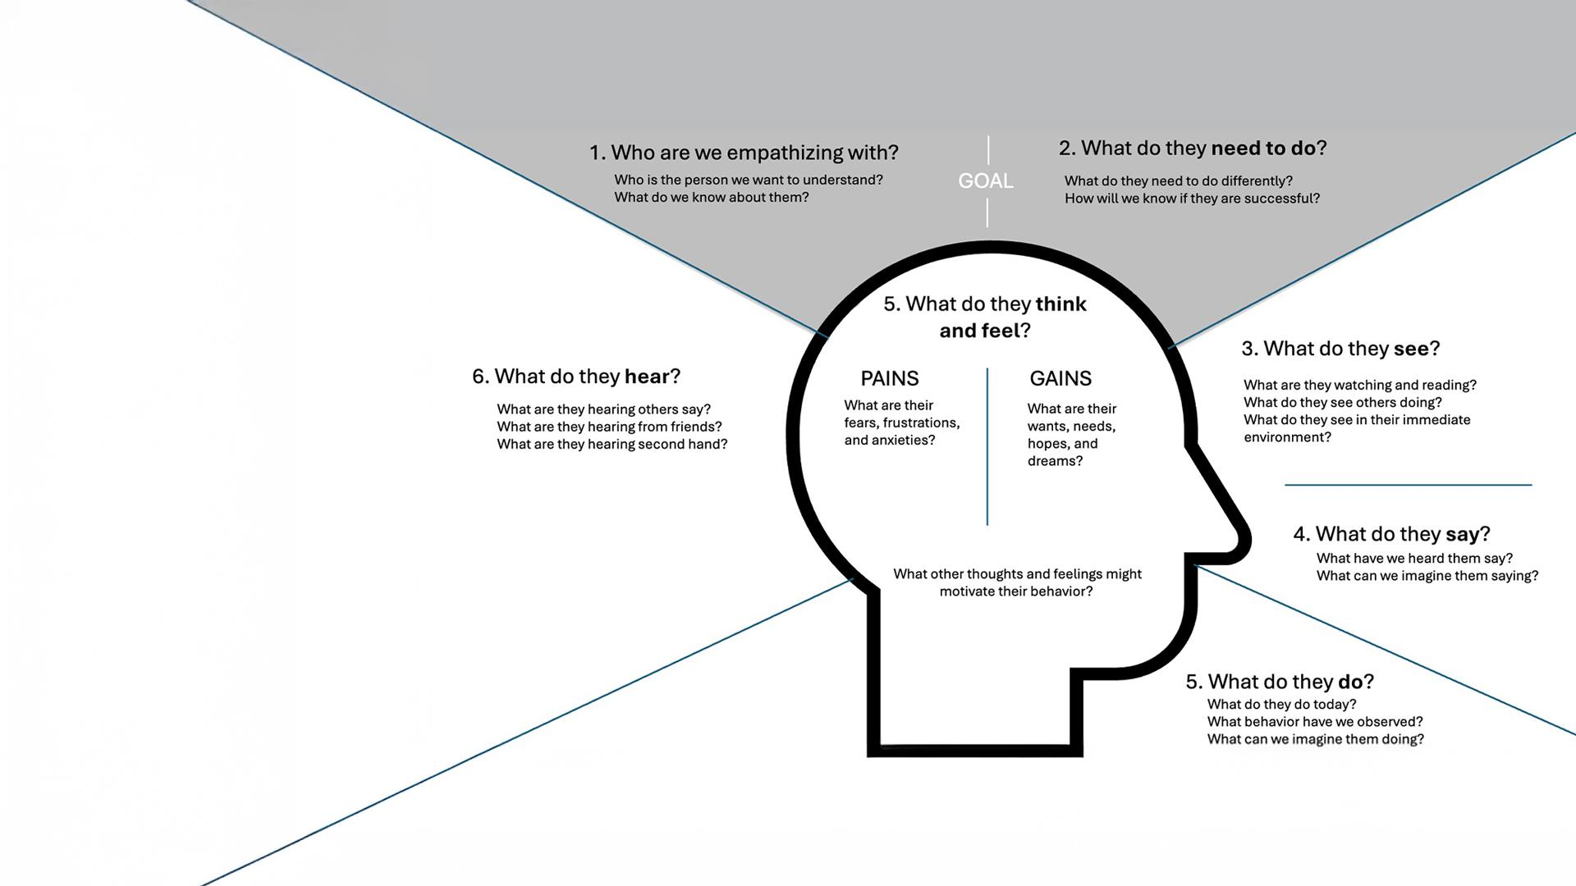

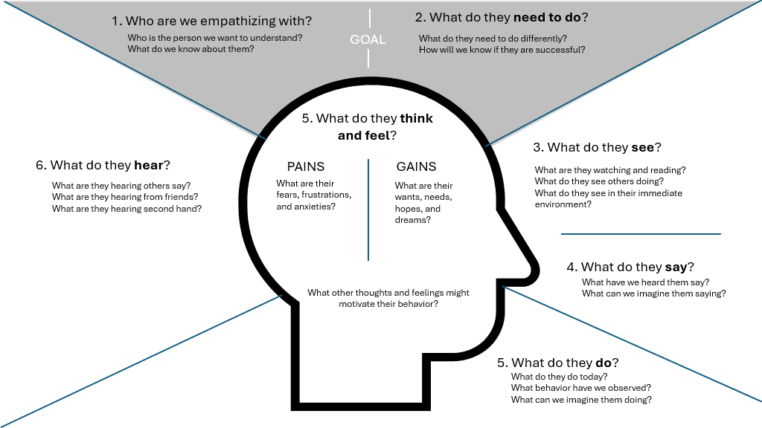
Walking In Their Shoes
Class Debrief
Update your empathy map:
New perspectives from surveys (What did people actually say?)
Observations from media analysis (How does media influence people’s thoughts or actions?)
Contradictions or gaps (Do people’s actions match what they say they believe?)
Notes:
Completing the Empathy Map
Teacher Script: Now that we’ve gathered and analyzed our data, we’re going to use it to complete our Empathy Maps. This will help us better understand how people experience this issue—what they see, hear, think, and do. The more detailed our maps, the better we’ll be at designing solutions that truly meet user needs.
Empathy Map Completion (8 minutes)
Team adds new insights from their peer research and media analysis.
Have students revisit the Empathy Map they completed in lesson 3 in their student portfolio. Prompt them to complete the following questions in their student portfolio:
Focus on updating the Hearing, See, and Doing quadrants with:
New perspectives from surveys (What did people actually say?)
Observations from media analysis (How does media influence people’s thoughts or actions?)
Contradictions or gaps (Do people’s actions match what they say they believe?)
Whole-Class Discussion
Invite teams to share one key contradiction they found (e.g., “People say social media makes them feel connected, but they also say it makes them feel isolated.”
Record common themes on the board .

Slide 20



Turning Data Into Insight
Simple Strategies for Turning Data into Insights
Turning Data Into Insight
Respond to these reflection prompts in your student portfolio:
What’s the difference between raw data and an insight?
How can talking to real people, our target audience, help us uncover the real root problem we need to solve?
What’s one key insight your team has uncovered so far from your user research (surveys, interviews, and media analysis)?
What is one gap or unanswered question your team still has about your topic?
Notes:
Exit Activity: Turning Data into Insight
Teacher Script: Before we wrap up today, let’s pause and think about the work we’ve done to gather input from the people affected by our project. Designers use user research—things like interviews, surveys, and content analysis—not just to collect data, but to uncover the real problem they need to solve. Let’s watch a quick video that explains how designers move from data to insight and why framing the right problem makes all the difference.
Video Reflection (3-4 minutes): Play: "Turning Data into Insight: How Designers Find the Real Problem" (Length: 1-2 minutes)
After the video, pose these reflection prompts for students to respond to in their student portfolio:
What’s the difference between raw data and an insight?
How can talking to real people—our target audience—help us uncover the real root problem we need to solve?
What’s one key insight your team has uncovered so far from your user research (surveys, interviews, media analysis)?
What is one gap or unanswered question your team still has about your topic?
Quick Team Debrief (Optional–3 minutes)
Teams pair up to share one insight and one remaining question with another team.
The teacher records key takeaways on the whiteboard, chart paper, or digital
Teacher Script: Today, you practiced something professional designers and researchers do every day—gathering input from the people who are closest to the problem. Remember: the most innovative solutions come from understanding the real problem, not just the surface symptoms. As we move into the next lesson, we’ll use these insights to start brainstorming creative solutions, always keeping our audience at

