Slide 1



Future Lab
Social Media and Mental Health
Unit 1, Lesson 3

Slide 2

Viral or Valid
Researching the Influence of Social Media
LESSON 3
Notes:
Envision a world where your every thought, every opinion, and even your self-worth could be shaped by the scroll of your thumb. Social media has become a powerful force in our lives—influencing how we see ourselves, how we connect with others, and how we navigate the challenges of mental health. But how much of what we see is real? How do these digital spaces impact our identity and relationships? In today’s lesson, you’ll take on the role of a researcher—diving deep into credible sources, gathering data, and asking the right questions to uncover the truth about social media’s effects. By the end, you’ll be ready to shape your project with insights that could spark real change. Let’s get started!

Slide 3
Objectives
Students will:
Frame their research focus by developing clear, specific research questions.
Conduct initial research using credible sources, evaluating the quality and relevance of each source.
​Begin to synthesize research findings into themes to inform their project direction.
​Learn how problem framing helps ensure they are addressing the root cause rather than symptoms. ​

Slide 4

ESSENTIAL QUESTION
How does social media shape our mental health, and what strategies can we use to navigate its impact?

Slide 5


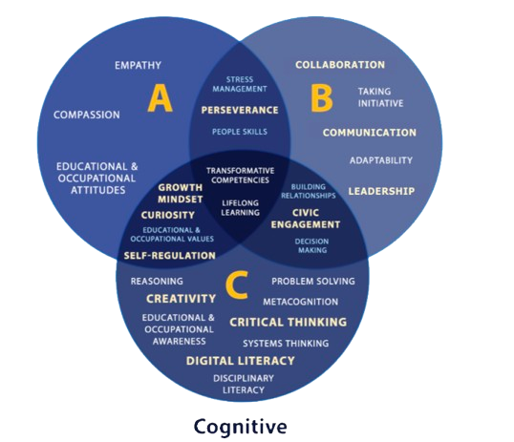


Objectives:
Project Wall
text
Word Wall
Skills for the Future
​​​​​​​​Credible
Perspective
Synthesize
​Problem framing
Critical Thinking
New! Problem Solving
New! Digital Literacy
New! Empathy
Notes:
The Project Wall is a dynamic, evolving resource that supports students in mastering key vocabulary, concepts, and future-ready skills throughout the unit. Whether displayed physically in the classroom or virtually using tools like Padlet or Wakelet. The Word Wall reinforces academic language, encourages reflection, and helps students articulate their thinking with clarity. Reviewing the Word Wall regularly—either before each lesson or at the start of the week—promotes shared language, critical thinking, and effective collaboration.
This project also focuses on building "Skills for the Future," as identified by ETS, including communication, critical thinking, collaboration, and adaptability. These competencies are embedded in each lesson through activities like problem-solving and evidence-based design. By engaging with these real-world skills and regularly updating the Word Wall, students connect academic content with lifelong learning and career readiness. Definitions for new vocabulary will be added after each lesson to help the Word Wall grow intentionally over time.

Slide 6

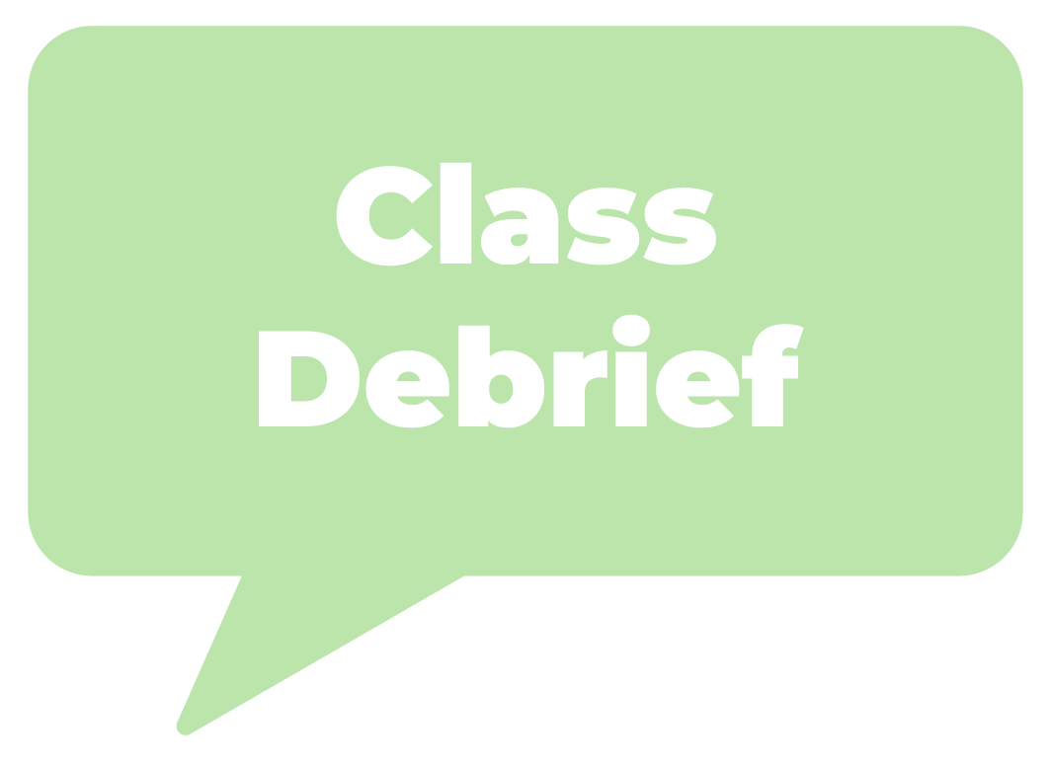

Social Media’s Impact
What is one thing you already know about social media’s impact, and what is one question you have about it?
Team Discussion
What are some common themes that you are hearing in your class?
Notes:
Teacher Script: Now that we’ve started to define our project focus, it’s time to investigate the issues we want to address. Research helps us understand the problem more deeply, separate fact from fiction, and ensure our solutions are effective. Let’s start by reflecting on what we already know about social media and mental health.
Activating Prior Knowledge
Individual Reflection: Set a timer. Students get 2 minutes to respond to the prompt in their student portfolio:
What is one thing you already know about social media’s impact, and what is one question you have about it? Respond to the prompt in your student portfolio.
Team Discussion (4 min)
Gather in teams, students take turns sharing their responses.
Teams identify common themes or surprising insights.
Whole-Class Share-Out (4 min)
Invite a few students to share their key takeaways.
Record major themes on the board to guide further research.

Slide 7

Frame Your Research Question
THIS or THAT
Notes:
Teacher Script: Good research starts with asking the right questions and looking at multiple perspectives. We will use different methods to collect information—reading credible sources, surveying our peers, and analyzing media content. But before we dive into research, we need to think critically about how the way we frame a research question impacts the kind of information we gather.
Today, we’ll kick off with a decision-making activity called "This or That." Your task is to evaluate two types of research questions—one that is broad and one that is more specific—and decide which is more useful for conducting focused, meaningful research. This activity will help guide your team in crafting a well-defined research question for your own project.
Learn to Frame Research Questions (10 minutes)
Explain the Purpose
Strong research questions help focus investigations and guide project development.
A well-crafted research question is clear, specific, and researchable—not too broad and not too narrow.
In this activity, teams will compare two research questions in three rounds, deciding which is more useful for conducting meaningful research.
Movement & Discussion
Display the first pair of questions on the slide.
Instruct students to move to the side of the room that represents their choice (either the broad or specific question).
Once in place, give teams 1 minute to discuss their choice with the people near them.
Repeat for the next two rounds.

Slide 8

Frame Your Research Question
What strategies help teens manage digital stress?
How does social media affect mental health?
Notes:
“This or That” Questions - Round 1
What strategies help teens manage digital stress? (More Specific)
How does social media affect mental health? (Broad)
Call on a few students from each side to explain why they made their choice.

Slide 9


Frame Your Research Question
Do social media algorithms influence what people believe?
How do TikTok recommendation algorithms affect political opinions among teenagers?
Notes:
“This or That” Questions - Round 2
Do social media algorithms influence what people believe? (Broad)
How do TikTok recommendation algorithms affect political opinions among teenagers? (More Specific)
Call on a few students from each side to explain why they made their choice.

Slide 10


Frame Your Research Question
What role do beauty influencers play in shaping teen self-perception?
Does influencer culture shape body image?
Class Debrief
Notes:
“This or That” Questions - Round 3
What role do beauty influencers play in shaping teen self-perception? (More Specific)
Does influencer culture shape body image? (Broad)
Whole-Class Debrief
Call on a few students from each side to explain why they made their choice.
Guide a short discussion with prompts:
What makes a question too broad?
How does a more specific question help direct research?
Can a broad question ever be useful? If so, when?

Slide 11


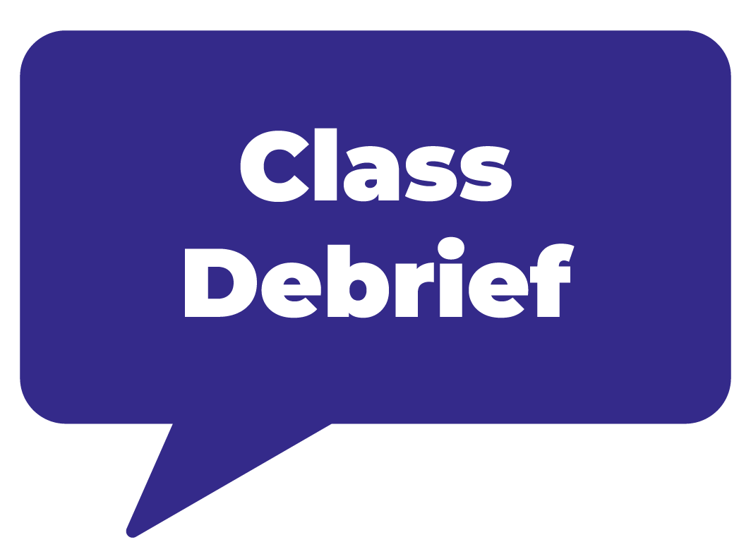







Evaluating Sources for Reliability
Think
Pair
Share
What is one strategy to check if a source is reliable?
Give an example of a biased source you’ve seen?
What would happen if you only relied on one source for research?
Think
What makes a source reliable?
How do we identify bias in a source?
Why is it important to use multiple sources rather than just one?
Pairs, share your key takeaway with the class.
Pair
Share
What makes a source reliable?
How do we identify bias in a source?
Why is it important to use multiple sources rather than just one?
What is one strategy to check if a source is reliable?
Give an example of a biased source you’ve seen?
What would happen if you only relied on one source for research?
Pairs, share your key takeaway with the class.
Notes:
Evaluating Sources for Reliability & Bias: Think-Pair-Share
Think (Individual Reflection)
Teacher Script: Take a moment to think about these questions on your own. Jot down your thoughts in your student portfolio or on a sticky note.
What makes a source reliable?
Think about who wrote it, what evidence they provide, and whether it’s accurate and unbiased.
How do we identify bias in a source?
Consider the language, whether it presents both sides, and if it includes credible sources.
Why is it important to use multiple sources rather than just one?
Imagine if you only got information from one person – how do you know it’s true?
Pair (Partner Discussion – 3 minutes)
Teacher Script: Now that you have individual reflected about the reliability of sources turn to a partner and compare your answers. Record your thoughts in your student portfolio or on your sticky notes.
Discuss the following:
What is one strategy to check if a source is reliable?
Can you give an example of a biased source you’ve seen (e.g., a social media post, news article, or advertisement)?
What would happen if you only relied on one source for research?
Share (Whole-Class Discussion – 5 minutes): Each pair shares one key takeaway with the class.
Guiding Questions
What is one strategy to check if a source is reliable?
Can you give an example of loaded language that signals bias?
How does cross-checking information improve the quality of research?

Slide 12
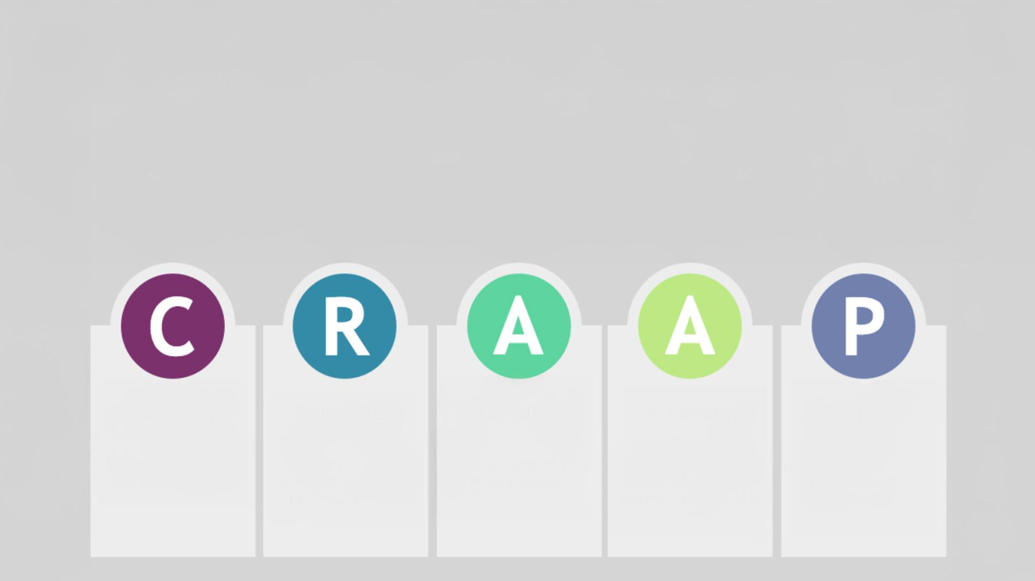


Evaluating Resources with CRAAP
Currency
Relevance
Authority
Accuracy
Purpose
The timeliness of the information
The Importance of the information for your needs
The source of the information
The reliability, truthfulness, and correctness of the content
The reason the information exists
Evaluating Resources With CRAAP
Notes:
Resource Option: Show short video on how to evaluate sources (e.g., CRAAP Test: Currency, Relevance, Authority, Accuracy, Purpose).
Evaluating Resources with CRAAP

Slide 13



Recommended Resources
Common Sense Media: Digital citizenship and media literacy
Pew Research Center: Social media trends and generational data
American Psychological Association (APA): Mental health studies
Government Reports (CDC, WHO, and FTC): Impact of social media on well-being
University Research (Google Scholar, JSTOR, EBSCOhost): Academic studies
Conduct Internet Research
Notes:
Conducting Internet Research
Students will use their research questions to search for credible sources online.
Suggested Research Sources
Common Sense Media (Digital citizenship, media literacy)
Pew Research Center (Social media trends, generational data)
American Psychological Association (APA) (Mental health studies)
Government Reports (CDC, WHO, FTC) (Impact of social media on well-being)
University Research (Google Scholar, JSTOR, EBSCOhost) (Academic studies)
Student Task
Each team selects one of their research questions and conducts a keyword search using one of the sources above.
Record key takeaways (summary of the source, main argument, supporting evidence) in the student portfolio.
Guiding Prompts for Internet Research:
What is the main argument or takeaway from this source?
How does this source connect to our research question?
Does this source confirm or challenge our prior understanding?

Slide 14

Conduct Internet Research
What is the main argument or takeaway from this source?
How does this source connect to our research question?
Does this source confirm or challenge our prior understanding?
Conduct a keyword search. Record takeaways:
Explain the main idea.
Point out the best evidence.
Show how it connects to your topic.
Notes:
Conducting Internet Research
Student Task
Each team selects one of their research questions and conducts a keyword search using one of the sources above.
Record key takeaways (summary of the source, main argument, supporting evidence) in the student portfolio.
Guiding Prompts for Internet Research:
What is the main argument or takeaway from this source?
How does this source connect to our research question?
Does this source confirm or challenge our prior understanding?

Slide 15

Suggested Resources
Use school or local library databases to find one academic or news article.
Compare information between library sources and online sources:
Does the library article provide deeper analysis than online sources?
What kinds of experts or researchers are cited?
Is there a historical perspective that broadens our understanding?
Conduct Library Research
Notes:
Conducting Library Research
If library access is available, students will explore print and database resources. If not, alternative research methods (e.g., database tutorials, librarian Q&A) can be used.
Library/Database Research Task
Use school or local library databases (Gale, ProQuest, EBSCOhost) to find one academic or news article.
Compare information between library sources and online sources:
Does the library article provide deeper analysis than online sources?
What kinds of experts or researchers are cited?
Is there a historical perspective that broadens our understanding?

Slide 16
Research Synthesis
What patterns or themes are emerging in your research?
What gaps or unanswered questions still remain?
Which sources were most helpful, and why?
Were the sources you used reliable? Why or why not?
Notes:
Conducting Library Research
Research Synthesis & Team Reflection
Teams briefly discuss what they found and answer:
What patterns or themes are emerging in our research?
What gaps or unanswered questions still remain?
Which sources were most helpful, and why?
Were the sources you used reliable? Why or why not?

Slide 17

Reflection
Add one key finding and one remaining question to your student portfolio.
Notes:
Reflection
Each team adds at least one key finding and one remaining question to their Student Portfolio to guide future research.

Slide 18

Framing the Problem
Design Thinking: Reframe the Problem
Think about…
How problem framing changes the way we approach solutions.
Examples of good and bad problem framing.
How this connects to your team’s research.
Notes:
Team Share Out. Jot down your notes in your Student Portfolio:
· What was the most important takeaway from the video?
· How does problem framing apply to the way we research social media’s impact?

Slide 19
How can we refine our research focus based on what we learned?
What assumptions might we be making about social media’s impact?
How can asking better questions help us find stronger solutions?
Connecting the Video
Notes:
Connecting to the Video: Whole-Class Discussion
Teacher Script: Now that we’ve explored our research findings, let’s apply what we learned from the video. How can we reframe our research questions to ensure we are solving the right problem?
1) Discussion Prompts:
· How can we refine our research focus based on what we learned?
· What assumptions might we be making about social media’s impact?
· How can asking better questions help us find stronger solutions?

Slide 20
Developing Your Empathy Map
Identify the End User
Define Your Goal
Who will be impacted by your project?
What specific group, demographic, or persona represents your target audience?
What are you trying to do, solve, or achieve?
Notes:
Problem Definition and Ideation Setup
Teacher Script: Before designing a solution, we must deeply understand the people affected by the problem. Today, we’ll create an Empathy Map—a tool that helps us see the world through our end-user’s perspective. This will help us design a project that truly meets their needs.
Developing Your Empathy Map
Defining the End-User & Goal—Set the Stage
In project teams, have students respond to the following questions in their Student Portfolio to begin to develop their end-user profile.
Identify the End-User
Who will be impacted by your project?
What specific group, demographic, or persona represents your target audience?
Define Their Goal
What is this person trying to do, solve, or achieve?
Frame it in terms of an observable behavior (e.g., "A high school student navigating social media while struggling with self-esteem.").

Slide 21
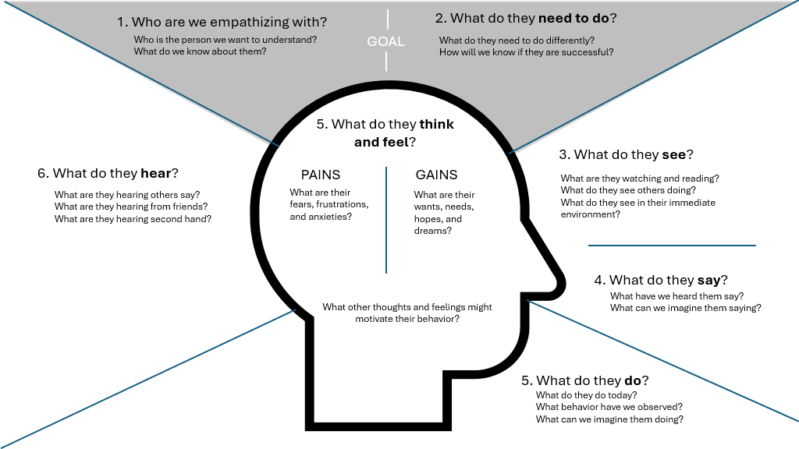
Empathy Map
Notes:
Mapping the Experience – Walking in Their Shoes
Display or distribute Empathy Map one-pager.
Students work in their project teams to fill in each quadrant of the map in their student portfolio thinking from the perspective of their end-user’s experience.
Work clockwise, starting at the top of the map with the external observations before moving into the internal thought process.
Seeing: What does this person see in their daily life? (e.g., social media posts, ads, peer interactions)
Hearing: What do they hear from friends, family, influencers, or society? How does it influence them?
Saying: What do they say out loud about this issue? How do they express their thoughts or feelings?
Doing: What actions or behaviors do they take in response to their experience? How do they engage with social media?
Thinking & Feeling: What are their internal thoughts, worries, or motivations? What emotions drive their choices?

Slide 22


Capture Insights
Take a screenshot or photo of your empathy map.
Upload the image to your student portfolio.
Notes:
Capture Insights
Teams take a screenshot or photo of you empathy map.
Upload the image to your Student Portfolio

Slide 23

Refine and Validate Insights
What new or surprising insights emerged?
Are there contradictions or disconnects between quadrants?
What assumptions are we making? How can we validate them?
Does this feel like a real person’s experience?
Notes:
Refining & Validating Insights–Group Reflection & Discussion
Teams step back and review their empathy map.
Ask:
What new or surprising insights emerged?
Are there contradictions or disconnects between quadrants?
What assumptions are we making? How can we validate them?
Students swap maps (digital or paper) with another team for quick feedback—Does this feel like a real person’s experience?

Slide 24



Reflection
Choose one:
What role does empathy play in creative careers?
Why do you think empathy is an important skill for this project?
Notes:
Teacher Script: Before we wrap up, take a moment to reflect on what you learned today. Research in an on-going process and identifying gaps in knowledge helps us ask better questions.
Exit Ticket Prompt: Set a timer. Students respond to the prompts in the student portfolio.
Guiding Questions to Support Research:
· Write down one key insight from today’s research.
· What is one question you still have about social media’s influence on mental health?
· What is your team’s next step?
Teacher Script: In the next lesson, we’ll refine our ideas and begin brainstorming solutions. Keep thinking about how we can turn research into real challenges!

