Slide 1
TOC
Design Thinking
Teacher Resource Guide
PBL
Teaching Resources
Career Videos
ETS/ Project Word Wall

Slide 2


Thank You: Adobe and ETS
TOC
We would like to extend our sincere gratitude to Adobe Express and ETS for their invaluable partnership and contributions to the AVID Future Lab: Creative Careers project.
Adobe Express, thank you for providing a platform that empowers students to express themselves creatively and communicate their ideas with clarity and confidence. Your tools have made it possible for students to explore design, storytelling, and digital creation in ways that align with the future of work—and with their own aspirations. We are grateful for your support in helping students develop creative confidence and showcase their solutions through real-world, media-rich formats.
ETS, we deeply appreciate your collaboration and vision in shaping how we understand and assess the development of essential skills. Your framework for Skills for the Future and your commitment to reimagining skills-based assessment have helped us center this project around reflection, metacognition, and meaningful learning. Your thought leadership continues to influence how we equip students for success in college, careers, and life.
Together, Adobe Express and ETS have helped us create a learning experience that is both innovative and grounded in what matters most: giving students the tools and mindset to shape their future with purpose. Thank you for sharing your expertise, your resources, and your unwavering commitment to preparing students to thrive in a rapidly changing world.
Design Thinking
PBL
Teaching Resources
Career Videos
ETS/ Project Word Wall

Slide 3
Table of Contents
TOC
Thank You: Adobe and ETS | Slide 2
Design Thinking | Slide 5
Project Based Learning (PBL) | Slide 7
Teacher Resources - Lesson Presentations | Slide 9
Teacher Resources | Slide 10
PBL Assessment Rubric | Slide 11 & 12
Career Videos | Slide 39
ETS/Project Word Wall | Slide 41
Design Thinking
PBL
Teaching Resources
Career Videos
ETS/ Project Word Wall

Slide 4
TOC
Design Thinking
Design Thinking
PBL
Teaching Resources
Career Videos
ETS/ Project Word Wall

Slide 5
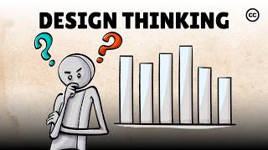
Design Thinking: Problem-Solving Guide
What is Design Thinking?
Design Thinking is a human-centered problem-solving approach that helps you empathize, brainstorm, test, and refine ideas to create meaningful solutions.
Why Use It?
✅ Helps you think creatively and solve real-world problems
✅ Encourages empathy and user-centered solutions
✅ Supports team collaboration and iterative improvement
🚀 The 5 Stages of Design Thinking
Follow these steps as you design your project solution!
TOC
Success Tips for PBL
✅ Stay Curious: Ask “why?” and “what if?” often ✅ Listen to Real Voices: Base your project on real experiences and needs ✅ Embrace Wild Ideas: Even unconventional ideas can spark breakthroughs ✅ Get Hands-On: Build quick prototypes and test them early ✅ Iterate, Iterate, Iterate! Improvement comes from feedback and adjustments
Design Thinking
Stage | What You Do | Guiding Questions
Empathize 👀 | Understand the problem through research, observation, and user experiences. | Who is affected by this problem? What are their challenges and needs? How does social media impact people differently?
Define 🎯 | Clearly state the problem you’re solving based on research and insights. | What specific challenge are we addressing? Why does it matter?
Ideate 💡 | Brainstorm creative solutions and evaluate the best approach. | What are different ways to solve this problem? Which ideas are most effective?
Prototype 🛠️ | Develop an early version of your solution (campaign, tool, product, etc.). | How does this solution address the problem? What features make it impactful?
Test & Iterate 🔄 | Get feedback, refine, and improve your solution before finalizing. | What worked well? What can we improve? How can we make it stronger?
PBL
Teaching Resources
Career Videos
ETS/ Project Word Wall

Slide 6
TOC
Design Thinking
Project Based Learning (PBL)
PBL
Teaching Resources
Career Videos
ETS/ Project Word Wall

Slide 7
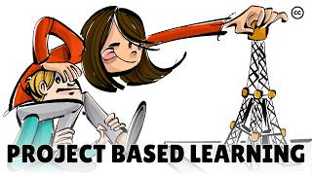
Project Based Learning (PBL):
What You Need to Know
TOC
What is PBL?
Project-Based Learning (PBL) is a hands-on, student-driven approach where you investigate real-world challenges and create meaningful solutions. Instead of just memorizing facts, you research, design, test, and refine ideas to solve problems.
Why Does It Matter?
✅ Helps you think critically and solve complex problems
✅ Strengthens collaboration and communication skills
✅ Encourages creativity and innovation
✅ Prepares you for real-world careers
🚀 Your PBL Journey: Step-by-Step
Keep track of your progress using the Design Thinking Framework, a method for solving problems creatively and effectively.
Success Tips for PBL
✅ Be Curious: Ask questions and explore different perspectives ✅ Think Like a Designer: Consider how people will use and experience your solution ✅ Stay Organized: Keep track of research, brainstorming, and revisions in a portfolio ✅ Embrace Feedback: Your first idea won’t be perfect—improve through testing & iteration ✅ Work as a Team: Collaborate, share ideas, and respect different viewpoints ✅ Make an Impact: Consider how your project can create real-world change
Design Thinking
PBL Phase |  | What You Do |  | Guiding Questions |  | Checkpoints for Success
Explore & Empathize | Investigate the problem, connect with real-world perspectives |  | Who is affected by this issue? How does it impact different people? What do we already know? |  | ✅ Think-Pair-Share Reflection ✅ Research on social media & mental health ✅ Identify key themes
Define the Problem | Narrow your focus, clarify the issue you want to solve |  | What specific challenge within social media’s impact on mental health will we address? |  | ✅ Write a clear problem statement ✅ Gather research & evidence ✅ Refine focus based on feedback
Ideate Solutions | Brainstorm creative solutions and evaluate ideas |  | How might we design a campaign, prototype, or resource to address this issue? |  | ✅ Brainstorm at least 5 possible solutions ✅ Choose one and justify your decision ✅ Plan how to bring your idea to life
Prototype & Develop | Create an initial version of your project |  | How does our prototype/campaign solve the problem? How can we test its impact? |  | ✅ Develop first draft ✅ Gather peer & teacher feedback ✅ Identify areas for improvement
Test & Refine | Improve your project based on feedback |  | What worked well? What needs improvement? How can we make our solution stronger? |  | ✅ Conduct a test run ✅ Make revisions based on feedback ✅ Finalize and polish your work
Present & Reflect | Share your findings, reflect on learning |  | How can we best communicate our ideas? How does our work impact others? |  | ✅ Deliver a compelling presentation ✅ Engage in discussion ✅ Reflect on key takeaways
PBL
Teaching Resources
Career Videos
ETS/ Project Word Wall

Slide 8
TOC
Design Thinking
Teaching Resources
PBL
Teaching Resources
Career Videos
ETS/ Project Word Wall

Slide 9
Teacher Links
TOC
Lesson Presentations | Lesson Videos
Lesson 1 | ​Project Based Learning Video (3:46 min) ​The Design Thinking Process Video (3:56 min) “The Power of Perspective: Why Empathy is the Key to Innovation” - Great Design Starts with Empathy (7.39)
Lesson 2 | ​The Social Dilemma – Bonus Clip: The Discrimination Dilemma (3.36 min) Optional Video - Fact vs. Fake: A Quick Lesson in Media Literacy (1.49) or Examining Headlines: Facts vs. Fiction(12.14) Sort Fact from Fiction Online with Lateral Reading (3.47)
Lesson 3 | Optional Video - Evaluating Resources with CRAAP (6.18 min) Framing the Right Problem: How Designers Ask Better Questions (Need link and time) Design Thinking Skills: Reframe the Problem - (3.25)
Lesson 4 | Turning Data into Insight: How Designers Find the Real Problem (Need Link and time) Simple Strategies for Turning Data into Insights (5.04)
Lesson 5 | How to be Creativity Under Pressure: (5.07) (Need Link and time)
Lesson 6 | “From Concept to Creation: How Designers Test & Iterate” (Need Link and time) Why Iteration Matters in Design (8.25)
Lesson 7 | David Kelly: Design as an Iterative Process (1.33 min)
Lesson 8 | WWDC17: 60-Second Prototype | Apple (10.40 min) From Sprint: The Five-Act Interview (7.47 min) Fail Forward: How Creatives Turn Mistakes into Breakthroughs (Link and time) The Art of Failing Forward (3.34)
Lesson 9 | Storytelling for Impact: How to Pitch Like a Pro (Need Link and time) How to Pitch Like a Pro with Scott Wiser (8.24)
Lesson 10 | “Lifelong Learning: How Creatives Keep Growing” (Adobe Express Employee)(Need Link and time) Invest in Yourself: Gain Personal Growth Through Lifelong Learning (2.53)
Design Thinking
PBL
Teaching Resources
Career Videos
ETS/ Project Word Wall

Slide 10
All Lesson Resources
TOC
Lesson 1 - PBL Assessment Rubric Project Word Wall Think-Pair-Share Gallery Walk Questions ETS Skills for the Future Venn Diagram | Lesson 6 - Format Fit Grid Storyboard Template Storyboard Peer Feedback
Lesson 2 - A/B Partners 1-Pager 4 Corners 1-Pager, 4 Corners Signs - Strongly Agree, Agree, Strongly Disagree, and Disagree Padlet/Answergarden/Figjam Instructions Question Corners: Comparison Culture & Self-Image , Misinformation & Fake News, Cyberbullying & Online Harassment, Digital Well-being & Mental Health | Lesson 7 - Design Thinking Anchor Chart Storyboard Template (Lesson 6) Format Fit Grid (Lesson 6) Peer Feedback Protocols Team Dialogue Protocol
Lesson 3 - This or That 1-Pager Think-Pair-Share Empathy Map 1-Pager | Lesson 8 - Storyboard Templates (Lesson 6) Peer Feedback Protocol Notes Product Development Checklist Five-Act Interview Protocol
Lesson 4 - Empathy Map 1 - Pager (Lesson 3) | Lesson 9 - Storytelling for Impact Graphic Organizer Peer Feedback Protocols (Lesson 7)
Lesson 5 - Jigsaw Activity Debrief - What We Know, What We are Still Wondering, What Needs Changed | Lesson 10 - Sample Audience Engagement Feedback Collection Impact Map
Design Thinking
PBL
Teaching Resources
Career Videos
ETS/ Project Word Wall

Slide 11
Lesson 1 - Project-Based Learning (PBL)
Assessment Rubric
TOC
Project-Based Learning (PBL) Assessment Rubric
Social Media Impact Project
This rubric helps teachers formatively assess both individual contributions and group work throughout the project. It provides clear expectations for creativity, research, teamwork, and final presentation.
Teacher Guidance: Use this rubric for formative feedback throughout the project. You may choose to assess students at multiple checkpoints (e.g., research phase, prototype phase, final presentation).
Criteria | Exemplary (4 pts) | Proficient (3 pts) | Developing (2 pts) | Emerging (1 pt)
Critical Thinking & Problem-Solving | Clearly defines a specific social media-related issue, applies strong research, and presents a well-reasoned solution. Demonstrates original thinking. | Identifies a relevant issue, applies research, and proposes a solution with mostly logical reasoning. Some originality is present. | Identifies a general issue but lacks depth in research or reasoning. Solution may be vague or underdeveloped. | Struggles to define an issue or lacks research. Solution is unclear or missing.
Creativity | Project demonstrates high creativity, with engaging visuals, unique storytelling, or an innovative approach. | Project is engaging and creative but may rely on familiar ideas or formats. Some originality is evident | Shows some effort at creativity, but the approach is conventional or lacks engagement. | Minimal effort in creative approach; little engagement or originality.
Research & Evidence | Uses credible, well-researched sources to support claims. Information is accurately synthesized into the project. Cites sources correctly. | Uses research to support claims, but some sources may lack credibility or synthesis is inconsistent. Cites sources. | Research is minimal or lacks credibility. Some claims are unsupported. Citations may be incomplete. | Lacks research or uses unreliable sources. Little to no citations.
Communication | Ideas are clearly articulated, persuasive, and well-structured. The project has a compelling, well-supported message that connects with the audience. | Ideas are mostly clear and logical but may need more refinement for persuasive impact. Some aspects of the message may lack depth. | Ideas are somewhat unclear or unstructured. The message needs stronger support or more clarity to be engaging. | Ideas are difficult to follow or lack focus. Message is unclear or missing key information.
Presentation | Delivery is engaging, polished, and confident. Strong use of visuals, media, or interactive elements to enhance impact. Well-rehearsed and audience-focused. | Presentation is effective but may lack polish or confidence. Visuals and media support the message but could be improved. Mostly engaging. | Some aspects of the presentation are unclear, rushed, or unstructured. Limited engagement or weak use of supporting visuals. | Presentation lacks clarity, organization, or preparation. Visuals are missing or do not support the message.
Design Thinking
PBL
Teaching Resources
Career Videos
ETS/ Project Word Wall

Slide 12
Lesson 1 - Project-Based Learning (PBL)
Assessment Rubric Cont.
TOC
Criteria | Exemplary (4 pts) | Proficient (3 pts) | Developing (2 pts) | Emerging (1 pt)
Collaboration | Team members work effectively and equitably. Roles are clearly defined. Active listening and constructive feedback are evident. | Team works well together with minor challenges. Roles are mostly clear. Communication is respectful. | Some teamwork challenges exist (unequal participation, unclear roles, or limited collaboration). | Teamwork issues interfere with progress. Lack of communication or unequal contributions.
Leadership | Student actively contributes ideas, research, and effort. Demonstrates leadership, supports teammates, and manages time and tasks independently. | Contributes regularly but may require occasional prompting to stay engaged. Participates in discussions. | Contributes minimally or inconsistently. Needs reminders to stay engaged. | Limited or no contributions. May not complete individual tasks.
Reflection & Metacognition (Individual Assessment) | Thoughtful, deep reflection on strengths, challenges, and learning strategies. Demonstrates awareness of how thinking, learning habits, and self-perception evolved throughout the project. | Reflects on learning and progress, but responses may lack depth. Some connections to skills or challenges are made, but more detail is needed. | Limited reflection on personal learning. May mention some challenges but does not fully explore how learning has evolved. | Minimal or no reflection on learning. Little evidence of personal growth or self-awareness.
Iteration & Applying Feedback | Actively seeks and applies feedback to make meaningful improvements. Iterative process is clear, with strong revisions based on testing and critique. | Applies feedback with some improvements, but revisions may be surface level rather than fully addressing critiques. | Makes minor revisions but does not fully integrate feedback. Changes may be minimal or lack impact. | Little to no revision based on feedback. No evidence of iteration or refinement of ideas.
Lifelong Learning & Initiative | Demonstrates clear connections between project learning and future goals. Takes initiative to explore real-world applications beyond class. | Makes connections to future learning or personal relevance. Some initiative shown to extend work beyond classroom. | Some effort to relate project to personal growth, but limited initiative or follow-through. | Some effort to relate project to personal growth, but limited initiative or follow-through.
Design Thinking
PBL
Teaching Resources
Career Videos
ETS/ Project Word Wall

Slide 13
Lesson 1 & 3 - Think-Pair-Share
TOC
What is Think-Pair-Share?
Think-Pair-Share is an active learning strategy that encourages students to process information individually, discuss their thoughts with a partner, and then share their insights with the larger group. This method promotes critical thinking, active engagement, and deeper understanding
How It Works:
THINK (Individual Reflection)
The teacher poses a question, problem, or prompt related to the lesson.
Students take 1-2 minutes to reflect and jot down their own thoughts, ideas, or responses.
PAIR (Partner Discussion)
Students turn to a partner and discuss their responses.
Each student shares their thoughts while actively listening to their partner.
Partners compare ideas, clarify misunderstandings, and expand on their thinking. (3-5 minutes)
SHARE (Classroom Discussion)
Pairs volunteer to share their key insights with the whole class.
The teacher facilitates discussion, encouraging different perspectives.
Connections are made between responses to deepen understanding. (5 minutes or more, as needed)
Benefits of Think-Pair-Share:
✅ Encourages all students to participate
✅ Builds confidence in sharing ideas
✅ Develops communication and collaboration skills
✅ Helps students refine their thinking through discussion
✅ Reinforces content understanding in a low-pressure setting
Tips for Effective Implementation:
Use open-ended or thought-provoking questions.
Set clear expectations for listening and respectful discussion.
Rotate partners to expose students to diverse viewpoints.
Encourage students to build on each other’s ideas.
Use Think-Pair-Share at different points in a lesson: as a warm-up, mid-discussion check-in, or closing reflection.
Example Question Prompts:
What was the most important takeaway from today’s lesson?
How does this concept connect to real-life experiences?
What are the potential solutions to this problem?
Why do you agree or disagree with this statement?
Design Thinking
PBL
Teaching Resources
Career Videos
ETS/ Project Word Wall

Slide 14
Lesson 1 – Gallery Walk
TOC
How does social media shape our emotions and mental well-being?
What’s the double-edged sword of social media—how can it both lift us up and tear us down?
Who wins and who loses in the social media game?
What would “healthy” social media look like—and how could we make it a reality?
Design Thinking
PBL
Teaching Resources
Career Videos
ETS/ Project Word Wall

Slide 15
Lesson 2 - A/B Partner Instructions 1-Pager
TOC
A/B PARTNERS: A Structured Peer Discussion Strategy
What is A/B Partners?
A/B Partners is a structured discussion strategy that promotes active listening, critical thinking, and deeper understanding by pairing students for focused conversations. Each student is assigned either "A" or "B", with specific roles during the discussion. This method encourages equitable participation and helps students articulate their thoughts clearly while engaging with different perspectives.
Instructions:
1. Partner Assignment & Question Prompt
The teacher presents a thought-provoking question, problem, or topic.
Students are paired up and assigned Partner A and Partner B roles.
2. Round 1: Partner A Speaks, Partner B Listens (2-3 minutes)
Partner A shares their thoughts while Partner B listens attentively without interrupting.
Partner B may take notes or jot down follow-up questions.
3. Round 2: Partner B Responds (2-3 minutes)
Partner B summarizes what they heard from Partner A and then shares their own perspective.
This ensures active listening and encourages meaningful responses.
4. Open Discussion & Reflection (3-5 minutes)
Partners discuss their perspectives, ask questions, and connect ideas.
The teacher may invite a few pairs to share insights with the class.
Example Question Prompts:
How does today’s topic connect to a real-world issue?
What is one idea you strongly agree with or challenge?
How would you explain this concept to someone unfamiliar with it?
What evidence supports or contradicts this argument?
Benefits of A/B Partners:
✅ Ensures equal participation in discussions
✅ Develops listening and paraphrasing skills
✅ Encourages deeper critical thinking and reasoning
✅ Provides a structured way to build confidence in speaking
✅ Reinforces content comprehension through peer interaction
Tips for Effective Implementation:
Use thought-provoking, open-ended questions.
Set clear expectations for listening and respecting different viewpoints.
Rotate partners periodically to expose students to diverse perspectives.
Encourage students to summarize or rephrase their partner’s ideas before responding.
Design Thinking
PBL
Teaching Resources
Career Videos
ETS/ Project Word Wall

Slide 16
Lesson 2 - 4 Corners 1-Pager
TOC
What is 4 Corners?
4 Corners is an interactive discussion strategy that encourages students to think critically, express their opinions, and engage in meaningful conversations. In this activity, the teacher presents a statement, and students move to one of four designated corners of the room labeled Strongly Agree, Agree, Disagree, and Strongly Disagree based on their personal stance. Once in their groups, students discuss their reasoning with peers, providing evidence or personal experiences to support their views. This strategy promotes active learning, allows for diverse perspectives, and helps students refine their critical thinking and communication skills.
Materials Needed:
Signs labeled Strongly Agree, Agree, Disagree, Strongly Disagree (placed in four corners of the room)
Pre-selected thought-provoking statements related to the lesson topic
Instructions:
Introduce the Activity
Explain that students will hear a statement and must decide their stance by moving to one of the four labeled corners.
Emphasize that there are no “right” or “wrong” answers—just perspectives to explore.
Present a Statement
Read a statement related to the lesson. Example: “Social media does more harm than good for mental health.”
Give students a few moments to think before moving to their chosen corner.
Justify & Discuss
Once in their corners, students discuss their reasoning with peers.
Invite representatives from each group to share why they chose their stance.
Encourage students to respectfully challenge or build on each other’s ideas.
Re-evaluate & Reflect
After discussion, give students the option to switch corners if their perspective has changed.
Conclude with a class reflection: What new insights did you gain? Did anything challenge your thinking?
Example Discussion Prompts:
“Technology makes life easier but also creates dependency.”
“Grades are the best way to measure a student’s ability.”
“AI will replace more jobs than it creates.”
“Influencers have too much impact on young people’s decisions.”
Benefits 4 Corners?
✅ Encourages movement and active participation
✅ Develops critical thinking and argumentation skills
✅ Promotes respectful discussion and perspective-taking
✅ Creates an engaging way to explore complex topics
Tips for Effective Implementation:
Ensure a respectful and open environment.
Encourage students to explain why they hold a certain view.
Allow time for reflection and wrap-up discussions to solidify learning
For quieter students, allow them to write their thoughts before speaking or use a digital response board
Design Thinking
PBL
Teaching Resources
Career Videos
ETS/ Project Word Wall

Slide 17
Lesson 2- 4 Corners
TOC
Strongly Agree | Strongly Disagree
Agree | Disagree
Design Thinking
PBL
Teaching Resources
Career Videos
ETS/ Project Word Wall

Slide 18
Lesson 2 - AnswerGarden
What is AnswerGarden?
AnswerGarden is an interactive online tool that allows students to share short responses to a prompt in real time. As students submit their answers, a word cloud forms, highlighting the most common responses. This tool is great for brainstorming, formative assessment, and class discussions.
Instructions:
SETUP (Creating an AnswerGarden Question)
Go to www.answergarden.ch.
Click "Create AnswerGarden."
Enter a question or prompt (e.g., "What is the biggest challenge in online learning?").
Choose settings:
Answer Length: 20 or 40 characters per response.
Spam Filter: Enable to block inappropriate responses.
Mode: Brainstorm, Classroom, or Moderator Mode.
Click "Create" and share the link or QR code with students.
HOW IT WORKS:
STEP 1: Ask a Question
The teacher posts a question or prompt relevant to the lesson.
STEP 2: Students Respond
Students enter short responses, which appear in a live word cloud. The more a word is submitted, the larger it appears.
STEP 3: Discuss & Analyze
The class reviews the word cloud, identifying trends, key themes, and surprising responses. The teacher facilitates discussion based on student input.
Example Question Prompts:
What is the most important takeaway from today’s lesson?
What are three words that describe this concept?
How does this topic connect to real-world experiences?
What questions do you still have about this topic?
Benefits of AnswerGarden:
✅ Encourages all students to participate
✅ Provides instant visual feedback
✅ Helps identify common themes and misconceptions
✅ Creates an engaging and interactive classroom environment
Tips for Effective Implementation:
Use open-ended or reflective questions.
Set clear guidelines for respectful and meaningful responses.
Use the moderation feature to filter responses before they appear.
Take a screenshot of the word cloud for later discussion or review.
Combine AnswerGarden with other tools like Padlet or Google Docs for extended discussions.
TOC
Design Thinking
PBL
Teaching Resources
Career Videos
ETS/ Project Word Wall

Slide 19
Lesson 2 - Padlet 1-Pager
What is Padlet?
Padlet is an interactive online bulletin board that allows students to post and organize ideas, responses, and multimedia content in real time. It fosters collaboration, creativity, and engagement in discussions, brainstorming, and reflection activities.
Padlet Account Set-up:
Go to www.padlet.com and sign up using an email, Google, or Microsoft account. Once logged in, click “Make a Padlet” to create a new board, choosing from various layouts like Wall, Grid, or Timeline. Customize settings, including privacy options and posting permissions, before sharing the link with students. Reminder: The free version allows only three Padlets, so consider reusing or archiving boards to maximize usage.
Instructions:
1. Set Up the Padlet Board
The teacher creates a Padlet board and shares the link or QR code with students.
Choose a format (Wall, Grid, Timeline, Canvas, etc.) based on the lesson’s objectives.
Set posting guidelines (e.g., respectful language, relevant responses, and appropriate media use).
2. Post & Engage (5-10 minutes)
The teacher poses a question, prompt, or discussion topic.
Students individually post their responses, which can include text, images, links, videos, or voice recordings.
Encourage students to read, like, or comment on at least two peers’ posts to foster interaction.
3. Group Discussion & Analysis (10-15 minutes)
The teacher highlights key themes, trends, or insights from student posts.
Guide students in analyzing patterns, contrasting perspectives, or identifying missing viewpoints.
Encourage students to expand on each other’s ideas through replies and multimedia contributions.
4. Reflection & Takeaways (5 minutes)
Students summarize key takeaways in a follow-up post or a class discussion.
The teacher connects insights to the lesson’s objectives and real-world applications.
Optionally, students can revisit the Padlet later to add new thoughts or resources.
Example Uses for Padlet:
Brainstorming: Generate ideas for a group project or research topic.
Discussion Board: Respond to an essential question or debate topic.
Exit Tickets: Post one key takeaway or lingering question at the end of a lesson.
Collaborative Research: Share credible sources, articles, and insights on a subject.
Multimedia Reflections: Upload images, videos, or voice notes for creative responses.
Benefits of Padlet:
✅ Encourages all students to participate, including quieter learners
✅ Supports multimedia learning with images, videos, and links
✅ Fosters collaboration and peer interaction in a digital space
✅ Creates a visual record of class discussions for future reference
✅ Enhances critical thinking by allowing students to engage with diverse perspectives
Tips for Effective Implementation:
Set clear expectations for respectful and meaningful participation.
Use Padlet’s privacy settings to control visibility and commenting.
Encourage peer feedback by asking students to comment on at least two posts.
Organize responses using columns, color coding, or sections for structured discussions.
Use Padlet as an ongoing class resource where students can add insights over time.
TOC
Design Thinking
PBL
Teaching Resources
Career Videos
ETS/ Project Word Wall

Slide 20
Lesson 2 - Question Corners 1-Pager
What is Question Corners?
Question Corners is an interactive learning strategy that encourages critical thinking, discussion, and perspective-sharing. In this activity, the teacher poses a question, and students move to one of four designated corners, each representing a possible answer or viewpoint. Students discuss their reasoning with peers, providing evidence or experiences to support their choices. This strategy promotes engagement, deeper understanding, and the ability to articulate and defend ideas.
Materials Needed:
✅ Signs labeled with questions or words placed in four corners of the room
✅ Pre-selected thought-provoking questions related to the topic
Instructions:
1. Introduce the Activity
Explain that students will hear a question and must choose their answer by moving to the corresponding corner.
Emphasize that the goal is to engage in discussion, not just pick a side.
2. Present a Question
Read a multiple-choice question aloud. Example:
“What is the most important skill for future success?”
A) Problem-solving
B) Collaboration
C) Creativity
D) Adaptability
Give students a moment to think before moving.
3. Justify & Discuss
Once in their corners, students discuss their reasoning with peers.
Call on representatives from each group to explain their choice.
Encourage students to respectfully challenge or build on others’ ideas.
4. Re-evaluate & Reflect
After discussion, allow students to switch corners if their perspective has changed.
Wrap up with a reflection:
  What new insights did you gain?
  Did anything challenge your thinking?
Example Discussion Questions:
“Which factor most impacts student success?” (A) Motivation, (B) Resources, (C) Teaching Methods, (D) Mindset
“What’s the biggest challenge with technology in education?” (A) Distraction, (B) Equity, (C) Privacy, (D) Misinformation
“What is the most valuable leadership trait?” (A) Communication, (B) Empathy, (C) Vision, (D) Decision-Making
Benefits of Question Corners:
✅ Encourages movement and active participation
✅ Strengthens reasoning and argumentation skills
✅ Promotes diverse perspectives and respectful discussion
✅ Creates an engaging way to explore complex topics
Tips for Effective Implementation:
✔ Foster a safe and open environment for discussion.
✔ Encourage students to explain their reasoning rather than just choosing an option.
✔ Allow reflection time and discussion wrap-ups to solidify learning.
✔ For quieter students, provide the option to write responses first or use digital tools like Padlet.
TOC
Design Thinking
PBL
Teaching Resources
Career Videos
ETS/ Project Word Wall

Slide 21
Lesson 2- Question Corners
TOC
Comparison Culture & Self-Image | Misinformation & Fake News
Cyberbullying & Online Harassment | Digital Well-being & Mental Health
Design Thinking
PBL
Teaching Resources
Career Videos
ETS/ Project Word Wall

Slide 22
Lesson 3 - This or That 1-Pager
What is This or That?
This or That is an interactive decision-making strategy that encourages students to analyze, compare, and evaluate two different choices. In this activity, students choose between two presented options—such as a broad research question or a more specific one—and justify their choice. This strategy helps students think critically, develop reasoning skills, and refine their decision-making process. It is particularly effective for guiding students in creating strong, focused research questions.
Materials Needed:
A set of "This or That" question prompts related to the lesson topic
Chart paper or digital whiteboard for recording responses
Student notebooks or digital portfolios for reflections
Instructions:
1. Introduce the Activity
Explain to students that they will engage in a decision-making activity called This or That to help them analyze the effectiveness of different types of research questions.
Emphasize that there are no right or wrong answers—just different perspectives to consider.
2. Present the Options
Display a pair of research questions: one broad and one more specific. Example:
  Broad: "How does technology impact education?"
  Specific: "How do online learning platforms improve student engagement in high school classrooms?"
Give students time to think and choose their preferred option.
3. Justify & Discuss
Students move to different areas of the room (or use digital polling tools) based on their choice.
In small groups, they discuss their reasoning with peers, using examples or prior knowledge to support their decision.
Ask representatives from each group to share their reasoning with the class.
4. Re-Evaluate & Reflect
After discussion, give students the option to change their choice if their perspective has shifted.
Conclude with a class reflection: What did they learn about crafting strong research questions? How does specificity impact research quality?
Example Discussion Prompts:
"Is it better to ask a broad question first and narrow it down later?"
"Which type of question leads to deeper research and why?"
"How can we balance specificity with open-ended inquiry?"
Benefits of This or That:
✅ Encourages critical thinking and decision-making
✅ Helps students refine their research questions
✅ Promotes discussion and evidence-based reasoning
✅ Engages students in active learning through movement and conversation
Tips for Effective Implementation:
Encourage students to explain their reasoning with examples.
Provide opportunities for students to revise their own research questions after the activity.
Use digital tools like Padlet, Google Forms, or polling apps to engage virtual learners.
For quieter students, allow written reflections before verbal discussion.
TOC
Design Thinking
PBL
Teaching Resources
Career Videos
ETS/ Project Word Wall

Slide 23
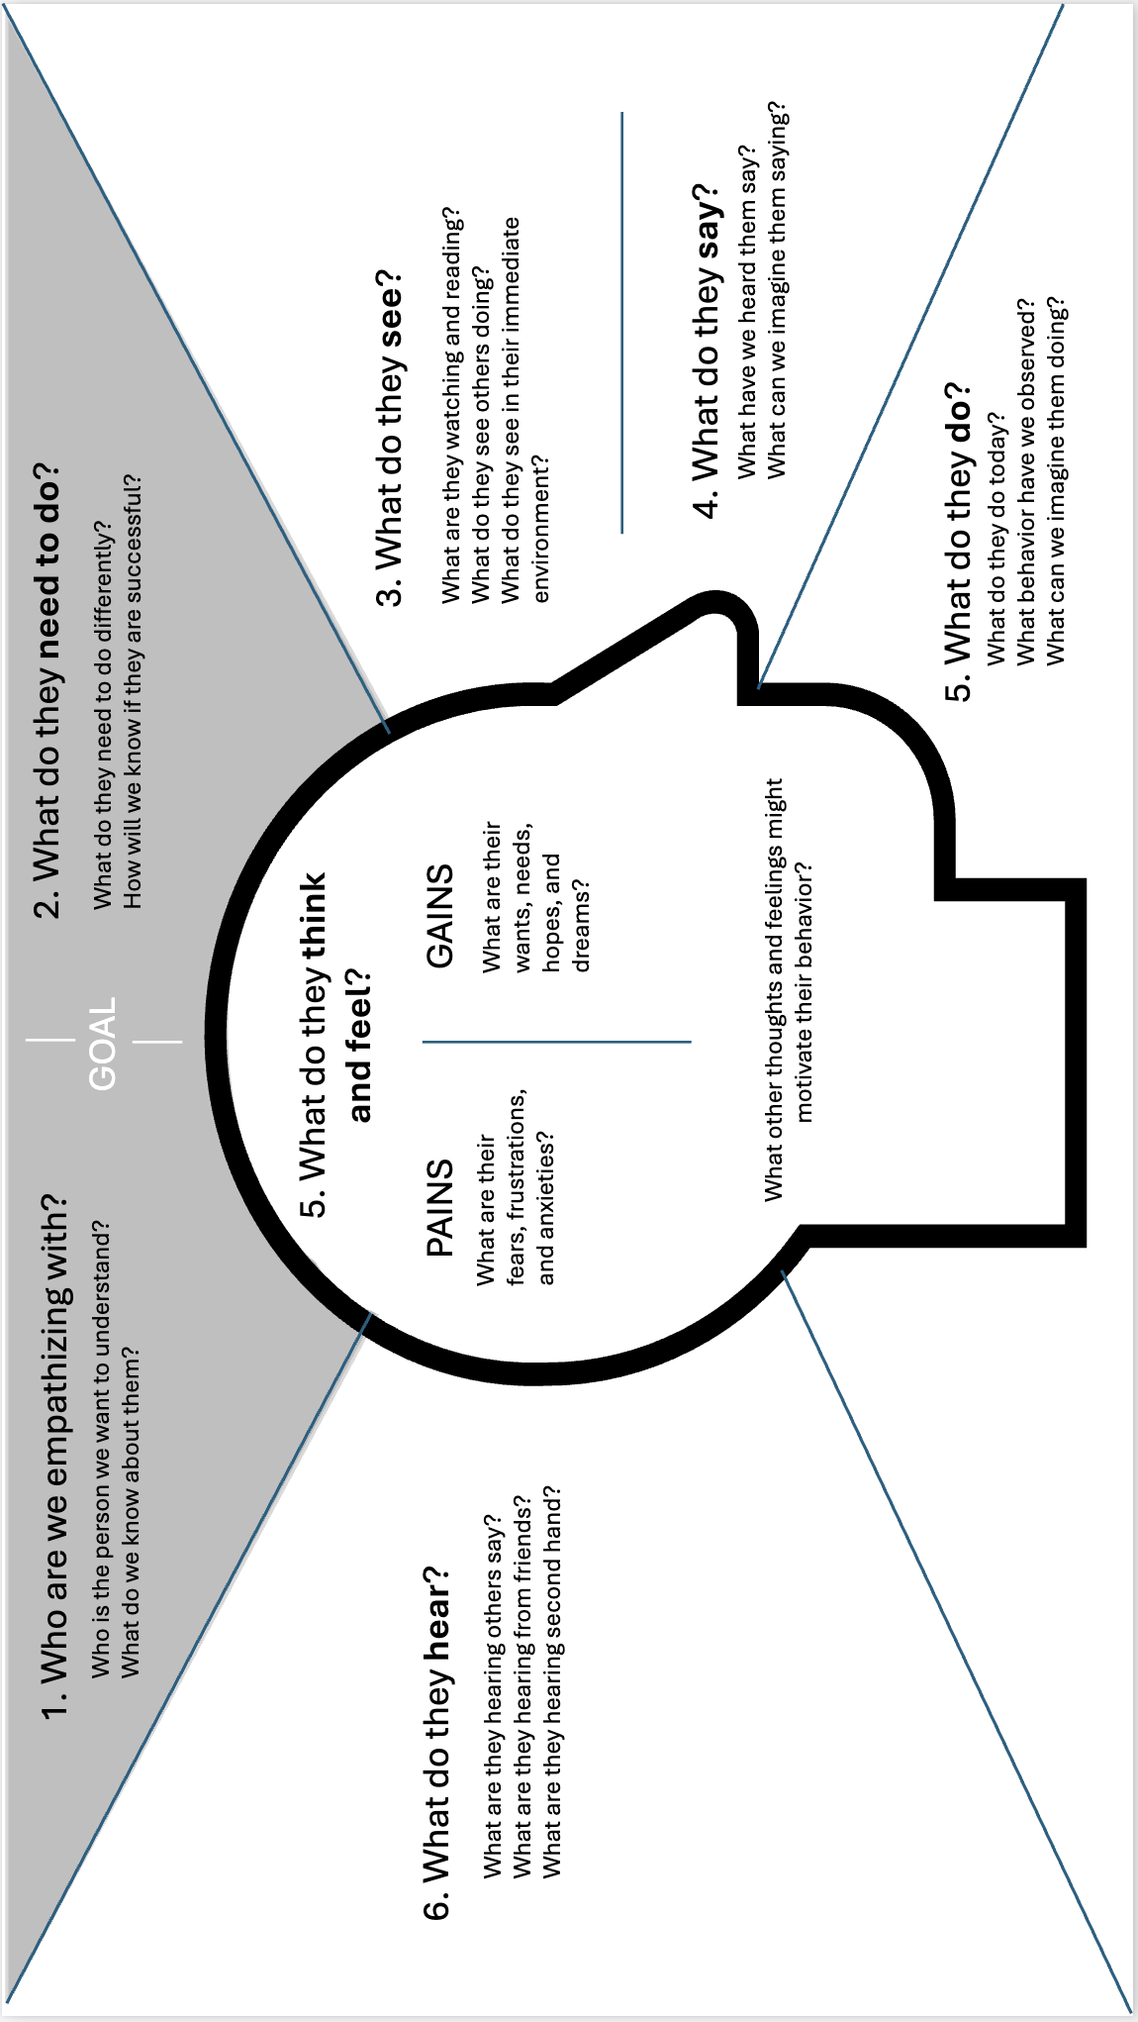
Lesson 3/4 - Empathy Map 1-Pager
TOC
Design Thinking
PBL
Teaching Resources
Career Videos
ETS/ Project Word Wall

Slide 24
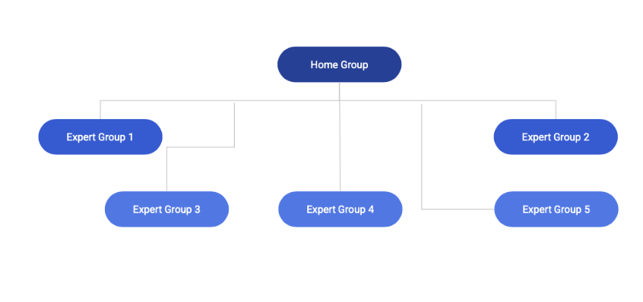
Lesson 5 - Jigsaw Discussion One-Pager
TOC
JIGSAW ACTIVITY: A Collaborative Learning Strategy
What is a Jigsaw Activity?
A Jigsaw Activity is a cooperative learning strategy where students become “experts” on one piece of a larger topic. They first meet in Expert Groups to learn and discuss, then return to their Home Groups to teach their section to their peers. This structure builds responsibility, collaboration, and deep understanding through peer-to-peer learning.
Instructions:
1. Assign Home Groups
Divide the class into small, diverse groups (4–6 students).
These are their Home Groups for the activity.
2. Number Off & Move to Expert Groups
Assign each student a number or topic (e.g., 1–5).
All students with the same number/topic meet in Expert Groups.
Each group receives a unique reading, video, or infographic to analyze.
3. Expert Group Learning (5–10 minutes)
Students work together to:
Read/view the material.
Identify 2–3 key takeaways.
Answer guiding questions like:
What is the main idea?
Why is this information important?
How does it connect to the bigger topic?
4. Return to Home Groups & Teach (10–15 minutes)
Students return to their Home Groups.
Each student teaches their topic in 1–2 minutes.
Other group members take notes, ask questions, and fill in gaps.
5. Group Reflection & Synthesis (5 minutes)
Home Groups discuss:
What connections do you see across all topics?
What new insights did you gain?
How does this information help you understand the big picture?
Benefits of the Jigsaw Activity:
✅ Promotes student ownership of learning
✅ Builds teamwork and communication skills
✅ Encourages active listening and peer teaching
Tips for Effective Implementation:
Give clear, engaging resources to each Expert Group.
Monitor Expert Groups for understanding and support.
Reflect as a class to bring all the pieces together.
Design Thinking
PBL
Teaching Resources
Career Videos
ETS/ Project Word Wall

Slide 25
Lesson 5 - Whole-Class Debrief
TOC
What we Know | What We’re Still Wondering | What Needs to Change
Design Thinking
PBL
Teaching Resources
Career Videos
ETS/ Project Word Wall

Slide 26
Lesson 6 - Format Fit Grid
TOC
Student Example
Solution | Audience Reach | Engagement | Feasibility | Excitement | Total
Infographic | High | Medium | High | Medium | xx
Social Media Campaign | Medium | High | Medium | High | xx
Website | Low | Medium | Medium | Medium | xx
Design Thinking
PBL
Teams should rate each category with a 1–3 scale (1 = low, 3 = high) and total the points to determine their strongest candidate.
Guiding Questions:
Who are we trying to reach?
How do people in this group typically engage with information?
What are we excited to make?
What can we realistically create in the time and tools we have?
Teaching Resources
Solution | Audience Reach | Engagement | Feasibility | Excitement | Total
Infographic
Social Media Campaign
Website
Career Videos
ETS/ Project Word Wall

Slide 27
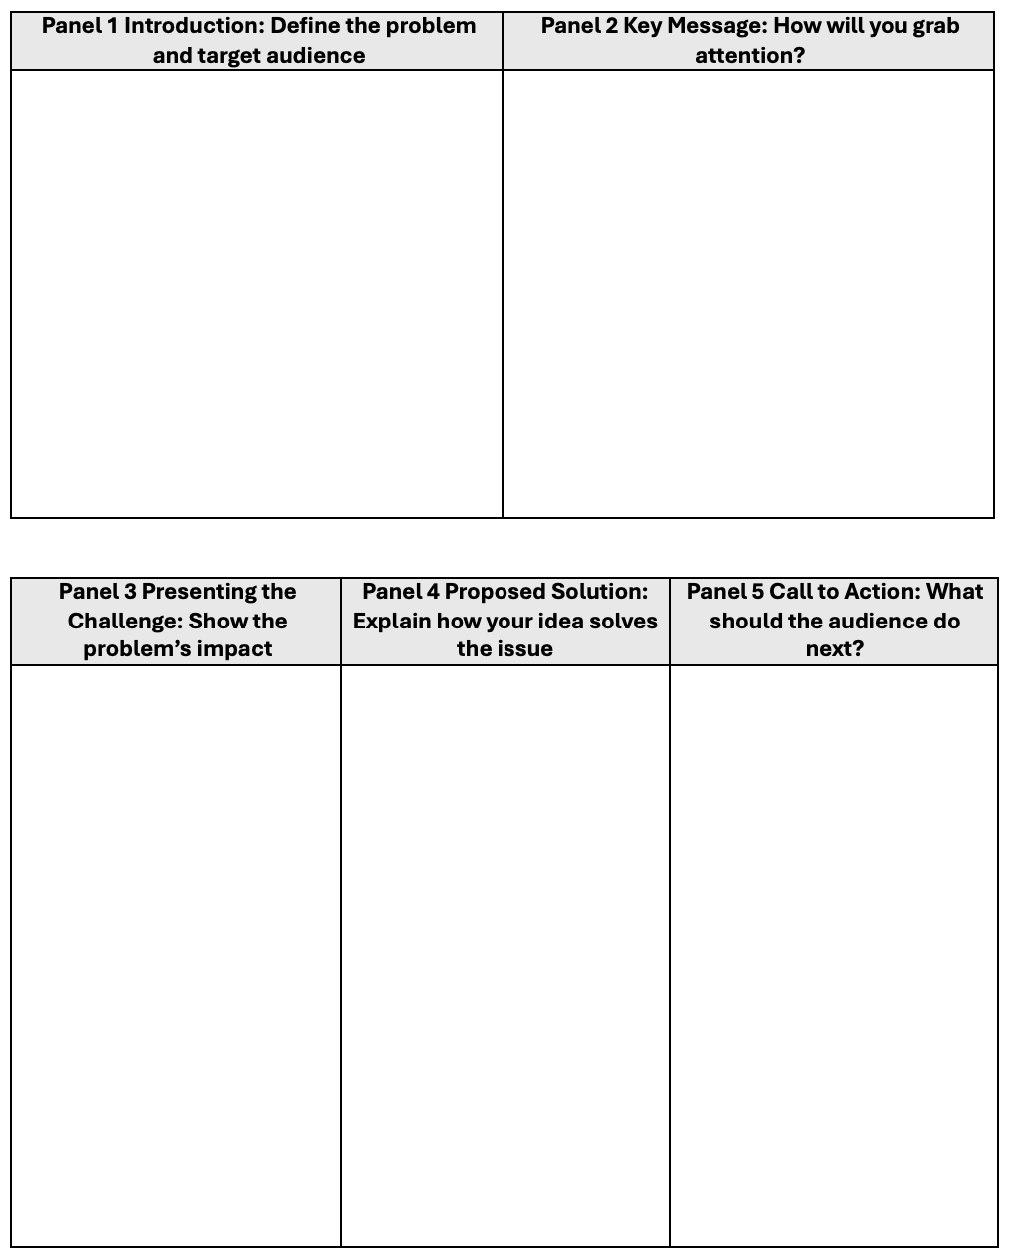
Lesson 6 - Storyboard Template
TOC
Design Thinking
PBL
Teaching Resources
Career Videos
ETS/ Project Word Wall

Slide 28
Lesson 6 - Storyboard Peer Feedback
TOC
Warm Feedback - What’s working well?
Use these
sentence starters to highlight strengths:
One thing I really liked about your storyboard is…
The message felt clear when…
Your visuals really matched the tone, especially in the part where…
The sequence kept me engaged because…
Your call to action stood out because…
Cool Feedback -What could be clearer or stronger?
Use these
sentence starters to gently point out areas of confusion or inconsistency:
I was a little confused by…
It was hard to tell what the message was in the part where…
Some of the visuals didn’t seem to match the purpose, like when…
The sequence felt a little unclear or rushed around…
I wasn’t sure what you wanted the audience to do at the end because…
Constructive Feedback -What could be improved?
Use these sentence starters to offer helpful suggestions:
You could make the message more consistent by…
Try changing the visuals in this part to better show…
To improve the flow, you might consider rearranging…
One way to strengthen your call to action could be…
I think the project would be stronger if you added more detail to…
Design Thinking
PBL
Teaching Resources
Career Videos
ETS/ Project Word Wall

Slide 29
Lesson 7 - Design Thinking Anchor Chart
TOC
DESIGN THINKING IN ACTION
2
Design Thinking
Define
1
Empathize
PBL
Ideate
3
Repeat
Teaching Resources
Prototype
4
Career Videos
Test
5
ETS/ Project Word Wall

Slide 30
Lesson 7 - Peer Feedback Protocols
TOC
Option 1: Glow / Grow / Clarify
Glow: What is working well? What’s clear, compelling, or creative?
Grow: What’s confusing or could be stronger? What needs more explanation or polish?
Clarify: What question do you still have after viewing this prototype?
Sentence Starters
Glow – What is working well?
“One thing I found really strong about your prototype was…”
“Your project really shines in the way it…”
“The message feels clear and powerful when you…”
“I really liked how you used ___ to capture attention.”
“The design element that stood out most was…”
Grow – What could be improved?
“One area that felt a little unclear was…”
“You might consider adding/changing ___ to make it stronger.”
“I was a bit confused by ___ and wondered if you could explain more.”
“This part could be even better if you…”
“I suggest simplifying ___ so the message is easier to understand.”
Clarify – What questions do you still have?
“What do you want your audience to feel or do after seeing this?”
“How do you plan to share this with your intended audience?”
“What’s the next step you’re planning for your prototype?”
“Why did you choose ___ as your format?”
“Who do you imagine using this in real life?”
Option 2: TAG Method (Tell, Ask, Give)
T: Tell something you liked
A: Ask a question you had
G: Give a suggestion for improvement
Sentence Starters
Tell: “I liked how your call to action felt clear and urgent.”
Ask: “How do you plan to get this in front of your audience?”
Give: “You might try shortening the text so it’s easier to scan.”
Design Thinking
PBL
Teaching Resources
Career Videos
ETS/ Project Word Wall

Slide 31
Lesson 7 - Team Dialogue Protocols for Feedback & collaboration
TOC
Active Listening Prompts
Let me make sure I understand—are you saying that...?
That’s an interesting point. Can you tell me more?
I heard you say ___. I agree because… / I see it differently because…
Seeking Clarification
Can you explain what you mean by…?
I’m not sure I understand your idea yet—could you rephrase it?
What do you think the biggest takeaway should be for the audience?
Offering Feedback Respectfully
Can I offer a suggestion that might help us clarify this?
Here’s something I noticed that could make it stronger…
Would you be open to trying ___ to improve this section?
Receiving Feedback with Openness
Thanks—that’s helpful to hear.
Let me think about how we could apply that suggestion.
That’s something we didn’t consider. What if we tried ___?
Decision-Making as a Team
What’s our main goal here—and which option supports that best?
Let’s list the pros and cons before we choose.
Should we test both ideas and compare the results?
Equity of Voice (Making Space)
We haven’t heard from ___. What do you think?
Let’s go around and hear one idea from each person.
Can we take a moment to pause and check if we’re all on the same page?
Design Thinking
PBL
Teaching Resources
Career Videos
ETS/ Project Word Wall

Slide 32
Lesson 8 - Google Venture Five-Act Interview Structure
TOC
Act 1: Friendly Welcome (5 minutes)
Goal: Put the participant at ease and establish a relaxed atmosphere.
Tips:
Thank the participant for coming.
Explain that you're testing the product, not them.
Let them know there are no right or wrong answers.
Mention that you’ll be quiet during parts of the session to observe their natural reactions.
Encourage them to “think aloud” so you can understand what they’re thinking.
Act 2: Context Questions (5–10 minutes)
Goal: Learn about the participant's background, habits, and experiences relevant to your product.
Tips:
Ask open-ended questions (e.g., “Tell me about how you use social media.”).
Keep the conversation natural and focused on behaviors, not opinions.
This phase helps you understand their mental models and motivations.
Act 3: Introduce the Prototype (1–2 minutes)
Goal: Set expectations and frame the prototype appropriately.
Script Sample: Now I’m going to show you something we’re working on. It’s an early version, so not everything might work or be finished. That’s totally okay—we just want your honest reaction.
Tips:
Don’t explain the product—let them explore naturally.
Be transparent that it’s not a finished product.
Act 4: Tasks and Observations (15–30 minutes)
Goal: Observe the participant interact with the prototype.
Tips:
Ask them to complete realistic tasks (e.g., “Imagine you want to report a harmful comment—how would you do that?”).
Stay quiet—observe and take notes.
Encourage “thinking aloud” if they stop narrating.
Probe gently with questions like:
“What do you expect to happen next?”
“What’s confusing about this screen?”
Act 5: Debrief and Wrap-Up (5–10 minutes)
Goal: Collect final thoughts and reactions.
Questions you might ask:
“What did you think this product was designed to do?”
“What stood out to you as helpful or confusing?”
“If you could change one thing, what would it be?”
Tips:
Thank them for their time.
Remind them how their feedback will help the team.
Design Thinking
PBL
Teaching Resources
Career Videos
ETS/ Project Word Wall

Slide 33
Lesson 8 - Prototype Development Checklist
TOC
Development Step | Guiding Questions | Not Started | In Progress | Needs Feedback | Complete | Checkpoint Prompt
Alignment to Purpose & Problem Statement | What is the main problem we are solving? Who is our target audience? Does our current prototype clearly connect to our original problem statement? Does our message align with our Call to Action (CTA)? |  |  |  |  | Write your team’s CTA on a sticky note and post it near your screen—does each section of your build support that CTA?
Storyboard Fidelity & Narrative Flow | Are we following the flow and structure outlined in our storyboard? Are there places we’ve deviated—and if so, why? Are the sections or scenes building toward a compelling user experience? |  |  |  |  | Pause and review: Does each section of your prototype have a clear purpose, visual, and message
Feature & Content Completion | What features or sections still need to be built? (e.g., intro video, landing page, final CTA) Is the intro engaging and informative? Do we have strong transitions between sections? Are our visuals and text balanced and on-message? |  |  |  |  | Mark off each section on your storyboard as it is completed. Identify 1 section that needs more development.
Design Thinking
PBL
Teaching Resources
Career Videos
ETS/ Project Word Wall

Slide 34
Lesson 8 - Prototype Development Checklist Cont.
TOC
Development Step | Guiding Questions | Not Started | In Progress | Needs Feedback | Complete | Checkpoint Prompt
Audience & User Experience | Is it easy to navigate or follow our solution? Are we making design decisions based on what our audience needs, not just what we like? Is our prototype accessible (font, color contrast, pacing, etc.)? |  |  |  |  | Close your eyes and describe your solution out loud to a partner. Do they understand it? Would they engage with it?
Team Collaboration & Project Management | Have we assigned roles for this session (e.g., builder, editor, QA, timekeeper)? Are we tracking progress toward our goal for today? Are we reviewing and updating our task list? |  |  |  |  | Before the session ends, each team member writes one specific contribution they made to the prototype today.
Plan for Next Iteration | What’s our next step after today? What part of the prototype still needs to be tested? What questions do we have for future testers? |  |  |  |  | Write one feedback question your team would like to ask during the next beta test.
Design Thinking
PBL
Teaching Resources
Career Videos
ETS/ Project Word Wall

Slide 35
Lesson 8 - Five-Act Interview Protocol
TOC
Google Venture Five-Act Interview Structure
Act 1: Friendly Welcome (5 minutes)
Goal: Put the participant at ease and establish a relaxed atmosphere.
Tips:
Thank the participant for coming.
Explain that you're testing the product, not them.
Let them know there are no right or wrong answers.
Mention that you’ll be quiet during parts of the session to observe their natural reactions.
Encourage them to “think aloud” so you can understand what they’re thinking.
Act 2: Context Questions (5–10 minutes)
Goal: Learn about the participant's background, habits, and experiences relevant to your product.
Tips:
Ask open-ended questions (e.g., “Tell me about how you use social media.”).
Keep the conversation natural and focused on behaviors, not opinions.
This phase helps you understand their mental models and motivations.
Act 3: Introduce the Prototype (1–2 minutes)
Goal: Set expectations and frame the prototype appropriately.
Script Sample: Now I’m going to show you something we’re working on. It’s an early version, so not everything might work or be finished. That’s totally okay—we just want your honest reaction.
Tips:
Don’t explain the product—let them explore naturally.
Be transparent that it’s not a finished product.
Act 4: Tasks and Observations (15–30 minutes)
Goal: Observe the participant interact with the prototype.
Tips:
Ask them to complete realistic tasks (e.g., “Imagine you want to report a harmful comment—how would you do that?”).
Stay quiet—observe and take notes.
Encourage “thinking aloud” if they stop narrating.
Probe gently with questions like:
“What do you expect to happen next?”
“What’s confusing about this screen?”
Act 5: Debrief and Wrap-Up (5–10 minutes)
Goal: Collect final thoughts and reactions.
Questions you might ask:
“What did you think this product was designed to do?”
“What stood out to you as helpful or confusing?”
“If you could change one thing, what would it be?”
Tips:
Thank them for their time.
Remind them how their feedback will help the team.
Design Thinking
PBL
Teaching Resources
Career Videos
ETS/ Project Word Wall

Slide 36
Lesson 9 - Storytelling for Impact: Presentation Planning Organizer
TOC
1. Hook – Grab Their Attention How will you grab your audience’s attention in the first 10 seconds? What surprising fact, quote, or personal anecdote can set the stage? | Sentence Starters - Grab attention with a powerful question, surprising fact, or relatable moment. “Have you ever wondered why…?” “Imagine a world where…” “Every day, millions of people…” “When I first started this project, I had no idea that…”
2. Problem – Show What’s at Stake What real-world problem are you solving? Who is affected and why does this matter now? | Sentence Starters Clearly define the issue and who it impacts. “The problem we set out to solve is…” “This issue matters because…” “We discovered this challenge affects people by…” “Through our research, we found that…”
3. Journey – Share Your Process What did you learn, explore, or test during the project? How did your ideas evolve from research to prototype? | Sentence Starters Great storytelling includes the process—not just the outcome. “At first, we thought the solution would be ____, but after doing research, we realized ____.” “Our biggest shift came when we discovered ____ through ____.” “One challenge we faced was ____. To solve it, we ____.” “We tested our idea by ____, and the feedback helped us realize ____.”
4. Solution – Present Your Idea What is your final product or idea? How does it solve the problem and support your audience’s needs? | Sentence Starters Introduce your solution and show how your solution meets the audience’s needs and creates positive change. “Our solution is…” “This matters to our audience because…” “We hope this will make a difference by…” “If adopted, this could help…” “One way we’ve addressed user feedback is…”
5. Call to Action – Leave Them Inspired What do you want your audience to do, feel, or remember? How can they get involved or take action after hearing your presentation? | Sentence Starters Leave the audience with a clear next step. “We invite you to…” “Join us in…” “You can take action by…” “The next step is…”
Design Thinking
PBL
Teaching Resources
Career Videos
ETS/ Project Word Wall

Slide 37
Lesson 10 - Sample Audience Feedback Form
TOC
Thank you for supporting our student presentations! Your feedback helps students reflect, grow, and consider how their work could impact others.
Presenter(s): ____________________________________
Project Title or Topic: _______________________________
What Stood Out to You?
What part of the presentation made an impression?
☐ The storytelling was powerful
☐ The visuals were engaging
☐ The message was clear and persuasive
☐ The call to action was compelling
☐ Other: _______________________________________
Impact & Possibility
What potential do you see in this project?
• Who might benefit from this message?
• What kind of change could this create?
Your thoughts:
Curious to Know More
What questions or suggestions do you have for the creators?
In One Word...
How would you describe this project or presentation?
My word: __________________________
Design Thinking
PBL
Teaching Resources
Career Videos
ETS/ Project Word Wall

Slide 38
Lesson 10 - Impact Map
TOC
Design Thinking
Steps | Future Vision | Steps Backward | Actionable Next Steps
Key Milestones
People or Partners Needed
Challenges to Solve
Immediate First Steps
PBL
Teaching Resources
Career Videos
ETS/ Project Word Wall

Slide 39
TOC
Design Thinking
Career Videos
PBL
Teaching Resources
Career Videos
ETS/ Project Word Wall

Slide 40
Career Videos
TOC
Lesson 1 Video - “The Power of Perspective: Why Empathy is the Key to Innovation”
Lesson 2 Video - “Fact vs. Fiction: How to Spot & Use Credible Sources”
Lesson 3 Video - “Framing the Right Problem: How Designers Ask Better Questions”
Lesson 4 Video - “”Turning Data Into Insight: How Designers Find the Real Problem”
Lesson 5 Video - “Creativity Under Pressure: How to Generate Ideas Like a Pro”
Lesson 6 Video - “From Concept to Creation: How Designers Test & Iterate”
Lesson 7 Video - “Fail Forward: How Creatives Turn Mistakes into Breakthroughs”
Lesson 8 Video - “Storytelling for Impact: How to Pitch Like a Pro”
Lesson 9 Video - “Lifelong Learning: How Creatives Keep Growing”
Lesson 10 Video - “Designing for the Future: How to Evolve Great Ideas”
Design Thinking
PBL
Teaching Resources
Career Videos
ETS/ Project Word Wall

Slide 41
TOC
Design Thinking
ETS/Project
Word Wall
PBL
Teaching Resources
Career Videos
ETS/ Project Word Wall

Slide 42
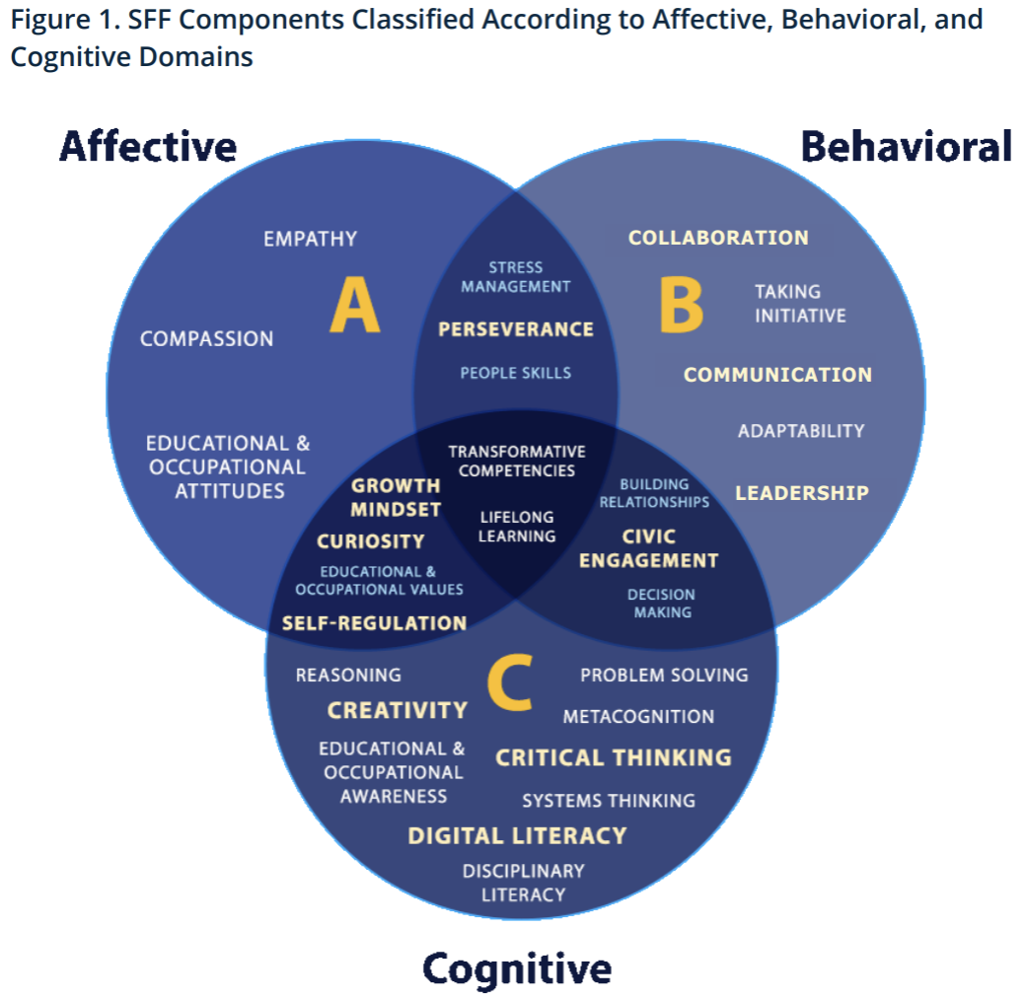
Educational Testing Service (ETS)
TOC
Design Thinking
PBL
Teaching Resources
Career Videos
ETS/ Project Word Wall
Copyright © 2023 ETS. www.ets.org.

Slide 43
Project Word Wall
TOC
1 Social Media Algorithm | A set of rules or calculations used by social media platforms to determine what content users see.
1 Misinformation | False or misleading information that spreads online, intentionally or unintentionally.
1 Digital Well-Being | The balance of technology use and personal health, ensuring that social media and digital interactions support mental and emotional well-being.
1 Quantitative | Information that can be measured or counted using numbers, statistics, or mathematical calculations.
1 Qualitative | Information that describes qualities, characteristics, or opinions that cannot easily be measured with numbers. Instead, it focuses on words, observations, and themes.
2 Problem Definition | Clearly identifying the issue and understanding its scope.
2 Inquire | Asking deep, research-driven questions to uncover new insights.
2 Augmentation | Constructing a well-supported stance based on evidence and reasoning.
2 Algorithm Bias | How social media algorithms reinforce specific perspectives.
2 Echo Chambers | How online spaces reinforce existing beliefs and limit exposure to diverse viewpoints.
2 Disinformation | The spread of false or misleading information online.
2 Engagement Metrics | How likes, shares, and comments influence behavior and self-perception.
3 Credible | Important when evaluating sources for reliability.
3 Perspective | Used when considering multiple viewpoints on social media’s impact.
Design Thinking
PBL
Teaching Resources
Career Videos
ETS/ Project Word Wall

Slide 44
Project Word Wall
TOC
3 Synthesize | Critical in combining information from various sources to form conclusions.
3 Problem Framing | The process of clearly defining and understanding a problem before attempting to solve it.
4 Convergent Thinking | The process of narrowing down many ideas to focus on the strongest, most realistic, or most innovative options.
4 Divergent Thinking | Brainstorming as many creative ideas as possible without worrying if they are good or realistic—exploring every possibility before narrowing down.
4 Ideation | The creative process of generating a wide range of possible solutions—from practical to wild ideas—before deciding which ones to explore further.
4 Insight | A clear, deeper understanding gained from combining multiple pieces of data, personal stories, and observations. Insights help uncover the real root of a problem, not just its surface symptoms.
4 Problem Statement | A clear, concise description of the specific problem the team will solve, framed to focus on the user’s needs and the challenge at hand.
4 Synthesis | The process of combining ideas, data, and feedback from multiple sources to create a complete picture of the problem. Designers use synthesis to make sense of complex information and find meaningful patterns.
4 User-Centered Design | An approach to problem-solving that keeps the needs, experiences, and feedback of the target audience (or "end user") at the center of every decision.
5 Inquiry | An act of asking for information; an official or formal investigation.
5 Bias | A tendency to favor one person, group, thing, or idea over another, often in an unfair way.
5 Feasibility | The state or degree of being easily or conveniently done; the practicality or possibility of something happening.
5 Pitch | A persuasive presentation or speech, often used to propose an idea, product, or project.
Design Thinking
PBL
Teaching Resources
Career Videos
ETS/ Project Word Wall

Slide 45
Project Word Wall
5 Problem Statement | A clear, structured description of an issue, its affected group, and the intended outcome.
6 Iteration | A design methodology involving a cyclical process of prototyping, testing, evaluating, and refining a product or process. This approach allows designers to continuously improve and evolve a product based on results and user feedback.
6 Storyboard | A sequence of drawings or images representing the shots planned for a film or television production, often with notes about scenes and transitions. In design, it serves as a visual representation of user interactions and experiences.
6 User Feedback | Information provided by users about their experience with a product or service, used to identify areas for improvement, validate design decisions, and enhance usability.
6 Audience Engagement | The extent to which an audience interacts with a product, service, or content, reflecting their level of interest and participation.
6 Design Constraints | Limitations or restrictions in the design process, such as budget, materials, technology, or regulations, that influence the development of a product or solution.
6 Call to Action (CTA) | An element in a web page that solicits an action from the user, often in the form of clickable buttons like "Buy this now!" or "Learn more...". ​
7 Prototype | An early model of a product that simulates its design and functionality. Prototypes are created to test concepts, gather feedback, and iterate on the design before the final product is developed.
7 Iteration | The process of improving a design by testing, getting feedback, and making changes.
7 Test | Trying out your prototype with real users to see what works and what needs to change.
7 Refine | To improve or make something better by adjusting the small details based on feedback.
TOC
Design Thinking
PBL
Teaching Resources
Career Videos
ETS/ Project Word Wall

Slide 46
Project Word Wall
TOC
8 Beta Test | Testing a prototype with real users to identify strengths and areas for improvement before final release.
8 Five-Act Interview | A structured user testing method that guides how to observe and gather feedback during prototype interaction.
9 Narrative Arc | A structured path that a story follows from beginning to end.
9 Audience Impact | The effect your message has on those who receive it—emotionally, cognitively, or behaviorally.
9 Delivery | The way you communicate your ideas during a presentation, including voice, pacing, eye contact, and gestures.
10 Agency | Owning your learning choices
10 Creative Confidence | Trusting your ability to express ideas and solve problems creatively.
10 Impact | The effect your work has on others, your community, or the world.
Design Thinking
PBL
Teaching Resources
Career Videos
ETS/ Project Word Wall

