Slide 1
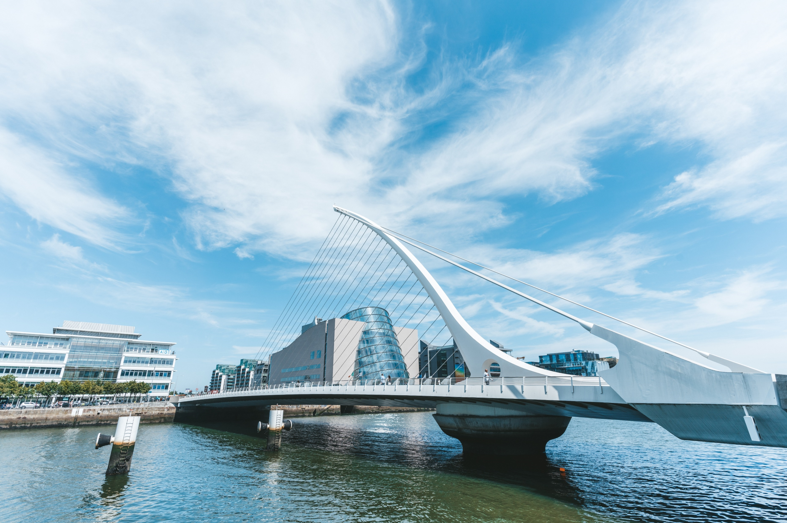

Financial Services Regulatory
Our Capabilities - Global and Ireland
Private and confidential

Slide 2





Our Global Financial Service Regulatory Practice
In an increasingly interconnected global financial system, coordinated regulation is essential to address cross-border risks and ensure a level playing field for financial institutions operating across different jurisdictions.
As one of the largest global regulatory teams, we lead the way across the entire financial services regulatory landscape, offering comprehensive support on both contentious and non-contentious fronts.
Benefit from our unrivalled sell-side, buy-side, payments and fintech coverage, offering invaluable full-service and client servicing perspectives.
The team advises a wide range of clients, including investment banks, asset managers, hedge funds, private equity firms, payment firms, non-bank lenders and insurance companies. This diverse client base benefits from the team's ability to navigate complex regulatory environments.
Supported by an award-winning range of cross border regulatory products, you will benefit from current advice sourced from leading jurisdictional experts. Delivered on demand in a consistent format, this information provides a cost-effective regulatory solution backed by our international team for your bespoke queries.
Collaborating with peers across various disciplines within our firm, the team provides a seamless, multidisciplinary service. To remain at the forefront of the financial services industry, we build and grow our knowledge of upcoming regulatory change through relationships with global regulators and participation in key industry bodies around the world. This ensures that our clients receive innovative solutions and strategic insights to navigate regulatory complexities effectively.
The Global Financial Service Regulatory team's commitment to excellence, combined with its deep sector knowledge and global reach, positions it as a leading advisor in the complex world of financial services regulation.
“Simmons & Simmons have a capable cross-border offering and a team of exceptional individuals who are experts and provide practical advice in a commercial manner.”
Chambers & Partners – FS Regulatory
“Simmons & Simmons are distinguished by their approachability and the time they take to get to know the ins and outs of businesses.”
Chambers & Partners - FS Regulatory
“Insightful, commercial advice which is grounded in common sense and an intuitive approach to finance and regulation.”
Legal 500 – FS Regulatory

Slide 3


Our Irish Capabilities
Global Fund Registrations
As part of our integrated global offering, Simmons Dublin holds a reputation in the market for the depth and quality of its expertise across the firm’s key industry sectors. Our team of expert lawyers offer the firm’s international and Irish clients a worldwide legal and regulatory solution, advising on complex local and cross-border mandates.
Our highly specialised Irish team is renowned for its wealth of experience in financial transactions. We advise some of the world’s largest asset managers and financial institutions on a wide variety of legal issues from multi-jurisdictional transaction work to contentious risk issues.
Asset Management & Investment Funds
Tax & Tax Disputes
Banking & Finance
Regulatory
Simmons & Simmons Ireland
Real Estate
Corporate
Services
Dispute Resolution, Restructuring & Insolvency
Corporate
M&A
“A superb global reputation with the presence of experienced Irish partners.”
Chambers

Slide 4
Governance - IAF/ SEAR, Fitness + Probity and Outsourcing
Our Financial Services Regulatory Offering - Dublin
Post-Brexit regulatory structure options / application of Irish regulatory perimeter
Retail and consumer related issues including RIS, the European Accessibility Act and consumer credit
Irish regulatory authorisations / additional permissions
business
Our Financial Services Regulation team in Dublin has deep cross sectoral expertise, obtained through intensive client and regulatory engagement. We are a diverse and versatile, cross-disciplinary team spanning top-tier in-house and international private practice backgrounds.
Our team provides pro-active and pragmatic legal advice on the full range of financial services regulatory matters including advising on regulatory authorisations, strategic regulatory mandates, conduct of business and other supervisory aspects, together with disputes and disciplinary issues. We pride ourselves on working with our clients to understand their business so that our advice is appropriately targeted and may be operationalised and integrated in a way that allows business to thrive.
Drawing on the insights of our international teams, our team undertakes technical, complex and innovative regulatory work for a wide range of Irish and international financial services firms including domestic and international banks, MiFID firms, asset managers and funds, Fintechs (including payment and e-money firms and VASPs), retail lenders, credit servicers, insurance operations and rating agencies.
Regulatory characterisation of payments / e-money and virtual assets and implications of PSD3
Advising a range of domestic and international banks, MiFID firms, asset managers, funds, Fintechs (including payment, e-money firms and VASPs), retail lenders, credit servicers, insurance operations and rating agencies on:
Engagement with CBI and pan-European regulators
Conduct of business obligations across the regulatory arena
Capital, CRD6 and liquidity-related issues
Irish share disclosure and takeover rules
Application of EU ESG Regulations (Taxonomy Regulation and CSRD) and SFDR
Establishment / operation of lending platforms and crypto exchanges under MiCAR
Acquisitions of regulated entities and associated regulatory engagement

Slide 5
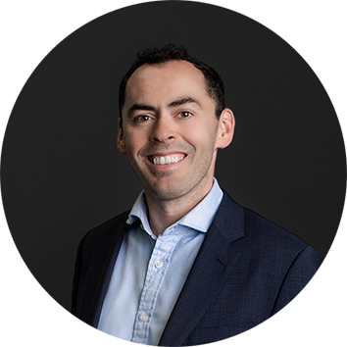

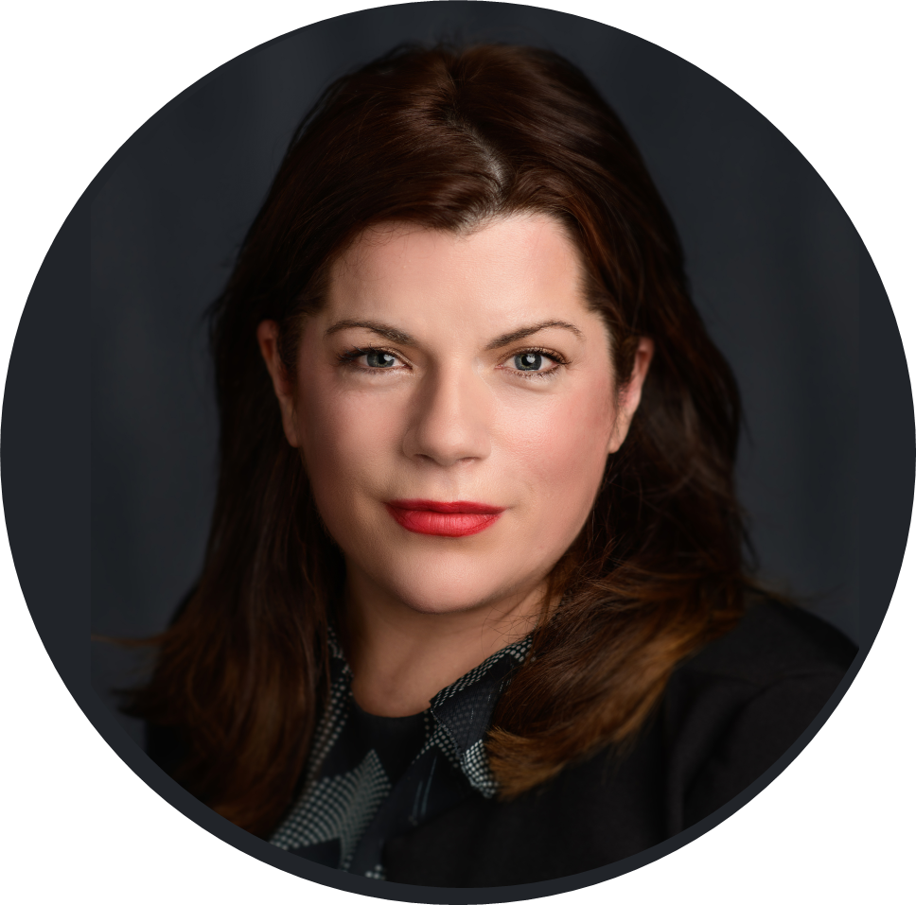
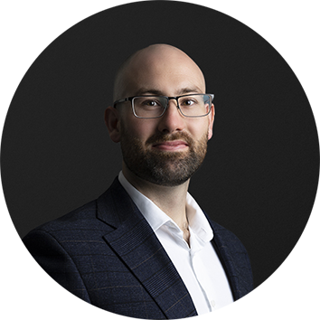
Our Irish FS Regulatory Team
Derek Lawlor
Partner, Financial Services Regulatory
Dublin
T: +3531 266 1158
E: derek.lawlor@simmons-simmons.com
Louise Dobbyn
Partner
Financial Services Regulatory
Dublin
T: +3531 266 2982
E: louise.dobbyn@simmons-simmons.com
Nora Beausang
Consultant, Financial Services Regulatory
Dublin
T: +3531 266 2967
E: nora.beausang@simmons-simmons.com
Jeffrey Horahan
Managing Associate,
Financial Services Regulatory
Dublin
T: +3531 266 2959
E: jeffrey.horahan@simmons-simmons.com
Derek is a partner and leads our Financial Services Regulation practice in Dublin.
Derek is a specialist across the spectrum of Irish and EU financial services regulation, including the areas of MiFID, EMIR REFIT, MAR, ESG (Taxonomy and CSRD), DORA, regulatory frameworks for Fintechs (including VASPs) and all other supervisory, conduct of business and enforcement rules applied by the Central Bank of Ireland and other relevant domestic and international regulatory authorities.
Derek has been extensively involved in advising our international financial service clients on regulatory structure options/application of the regulatory perimeter in Ireland post-Brexit, is widely recognised as an expert in the implication of the IAF/ SEAR regimes in Ireland and regularly presents to clients and peers on all aspects of the Irish and EU financial services regulatory regime. With Jeffrey Horahan, Derek is the subject matter expert for LexisNexis PSL+ (Ireland) on MiFID and the regulation of virtual assets.
Louise Dobbyn is a partner and co-leads our Financial Services Regulation practice in Dublin. She is a market-leading adviser on Irish and EU financial services regulation.
Louise advises a broad range of financial entities, including banks and fintech startups, on complex regulatory compliance matters. She is at the forefront of post-Brexit strategies, ensuring seamless EU market access for clients.
Louise is committed to excellence in governance, conduct, and consumer protection, delivering innovative solutions and upholding the highest standards of regulatory and compliance advisory services within a dynamic regulatory landscape.
Nora practised in banking and financial services regulatory law for over a decade in McCann FitzGerald and King & Wood Mallesons (Sydney). She has also served as Head of Legal and Regulatory Risk for over six years in the Corporate Banking division of a major domestic and international bank and has consulted widely across a range of regulated firms including banks (incorporating insurance operations), MiFID firms and Fintechs as to authorisation and ongoing financial services conduct of business rules. Nora is the author of “Consumer and SME Credit Law” (Bloomsbury Professional, 2021) which has been described as “a landmark in its field for years to come”. She is the subject matter expert for LexisNexis PSL (Ireland) on credit, credit servicing and conduct of business obligations in the financial services sphere. Nora is admitted as a solicitor in Ireland and New Zealand.
Jeffrey advises a range of domestic and international clients on varied aspects of the Irish financial services regulatory regime including the Irish and EU regulatory perimeter, virtual assets and payments regulation, AML/CTF, Individual Accountability, Fitness & Probity, ESG and sustainable finance and data protection. With Derek Lawlor, Jeffrey is the subject matter expert for LexisNexis PSL+ (Ireland) on MiFID and the regulation of virtual assets. Prior to joining the team in 2022. and in addition to practising as a barrister for several years, involving a broad range of commercial legal proceedings, Jeffrey was an adjudicator for the Financial Services and Pensions Ombudsman and a Panel Member for the provision of legal services to the Central Bank of Ireland. Jeffrey is a Fellow of the Chartered Institute of Arbitrators.

Slide 6
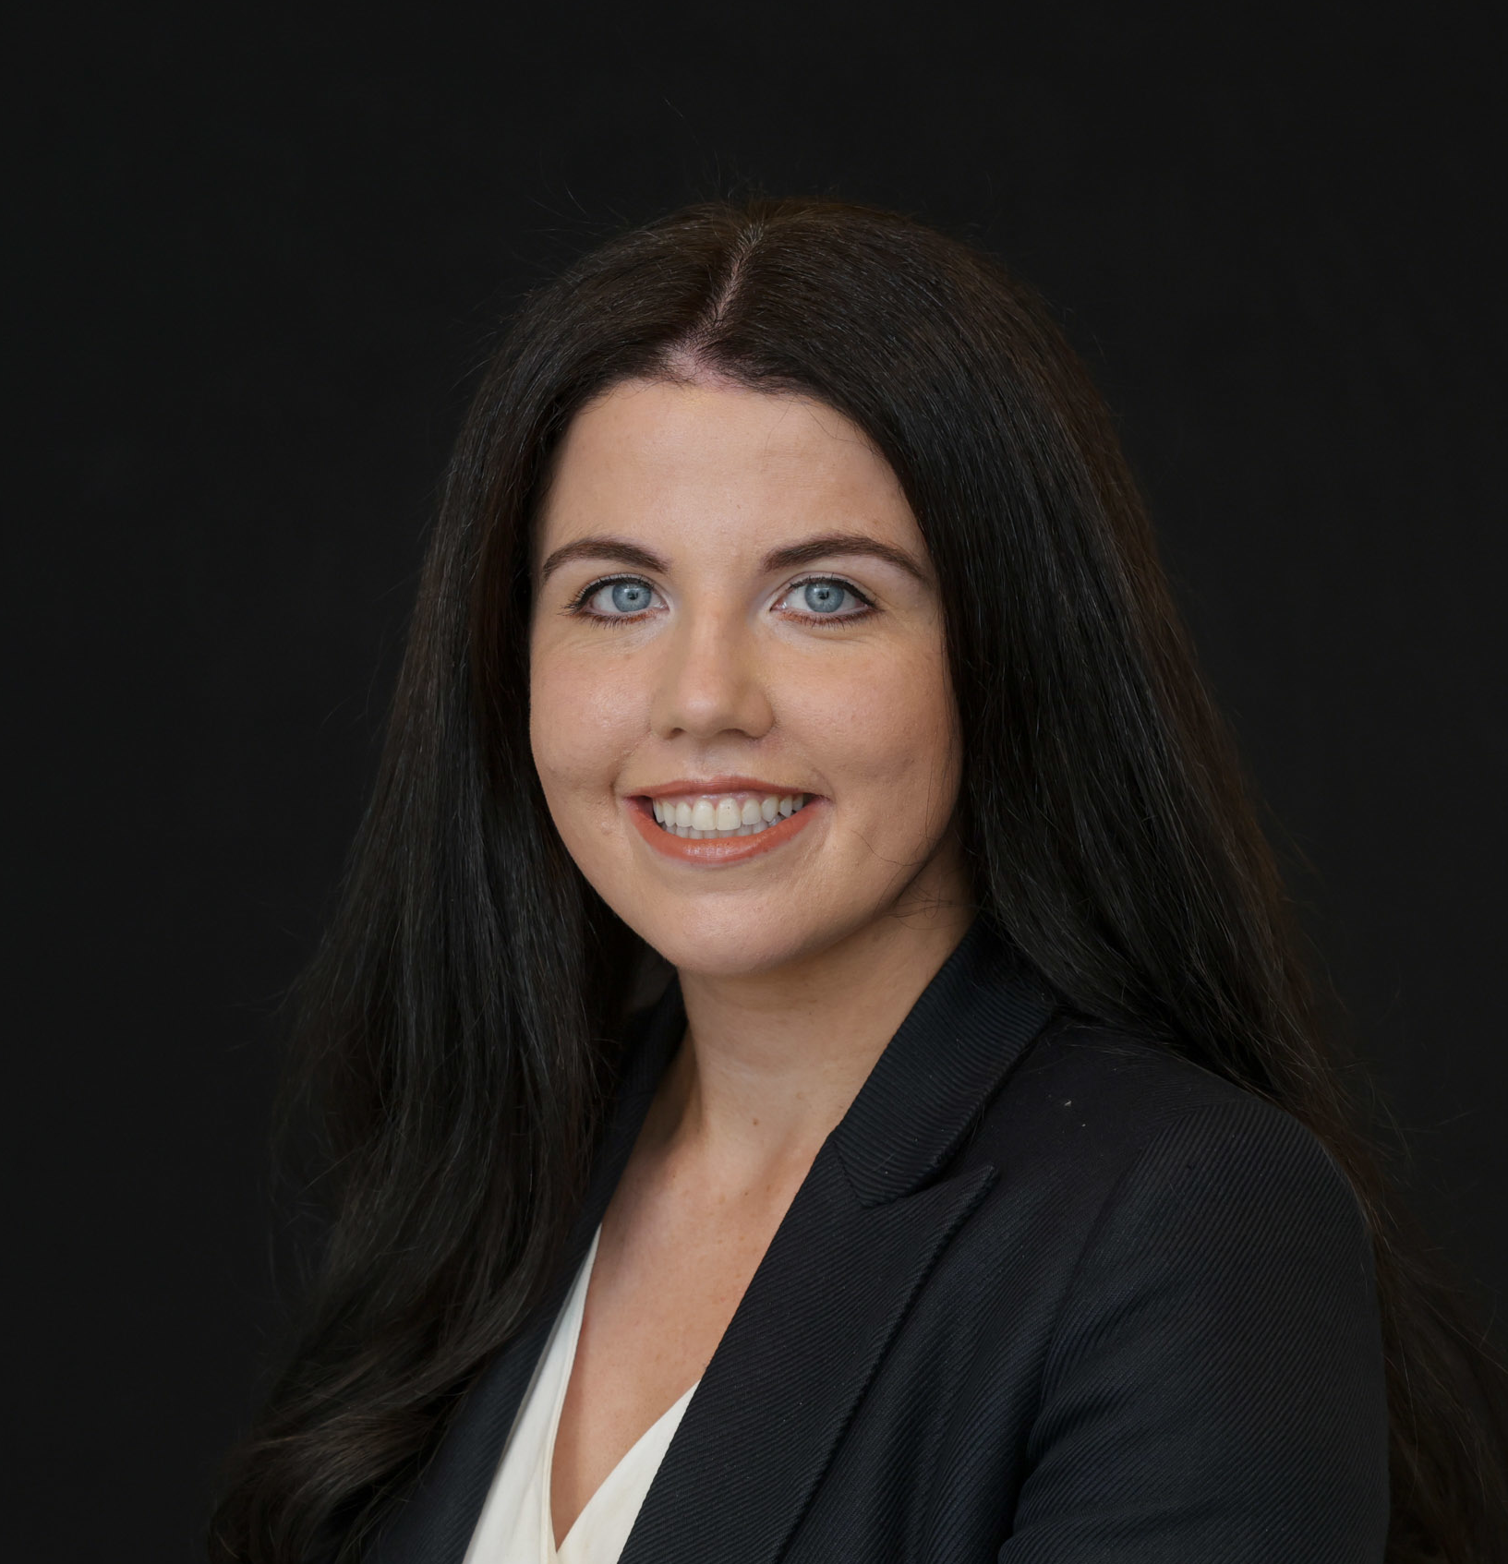
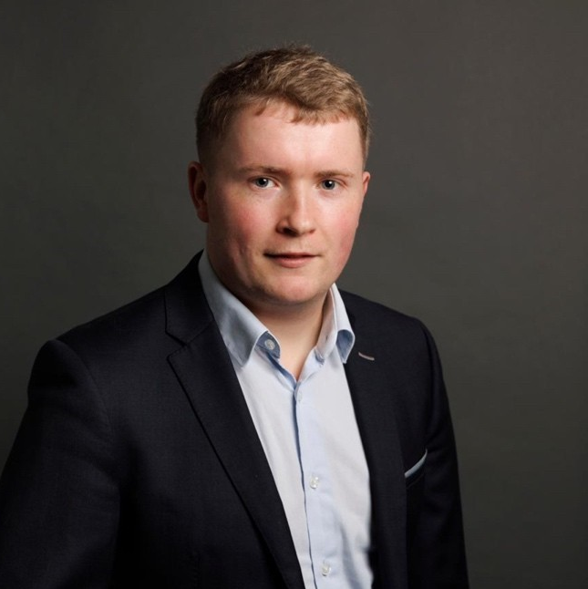
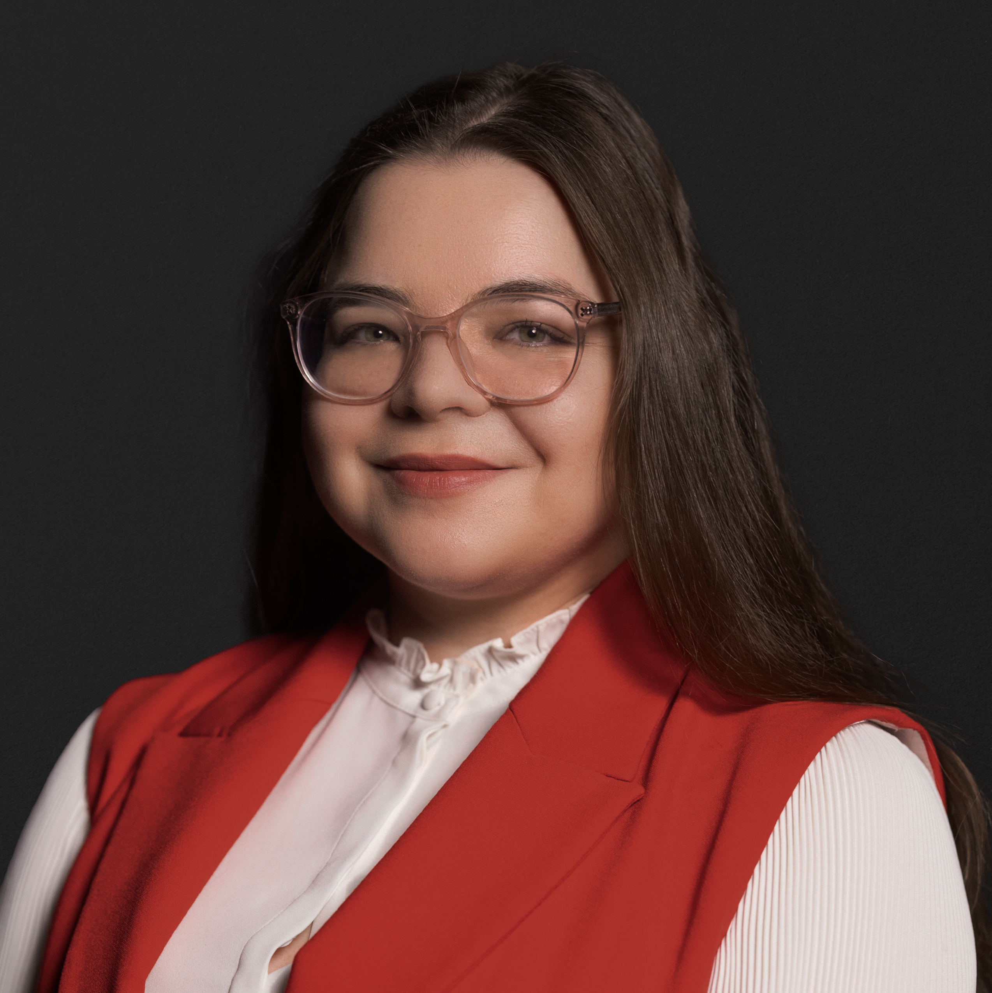
Our Irish FS Regulatory Team
Aisling Healy
Associate, Financial Services Regulatory
Dublin
T: +353 12661156
E: aisling.healy@simmons-simmons.com
Timothy Murphy
Associate,
Financial Services Regulatory
Dublin
T: +353 1266 2951
E: timothy.murphy@simmons-simmons.com
Anzhelika Samuilova
Trainee Solicitor, Financial Services Regulatory
Dublin
E: anzhelika.samuilova@simmons-simmons.com
Aisling is an associate in Simmons & Simmons' Financial Services Regulatory team, where she advises clients on a broad range of regulatory matters within the financial services sector. Prior to joining Simmons & Simmons, Aisling trained at a leading corporate law firm in Dublin where she gained extensive experience across the spectrum of financial services law. She previously worked in the financial services industry where she gained valuable practical experience in risk and compliance.
Timothy is an associate in the Financial Markets team and has experience advising clients across the full spectrum of the Irish financial services regulatory regime, including in relation to data protection, anti-money laundering and counter-terrorist financing (AML/CTF), and virtual assets. He supports domestic and international banks, asset managers, funds, fintechs (including payment and e-money firms and VASPs), and retail lenders on complex regulatory matters.
In addition to his regulatory expertise, Timothy has a strong background in dispute resolution and investigations. He has acted in a broad range of commercial legal proceedings before the superior courts of Ireland and regulatory investigations, providing clients with practical and strategic advice in contentious matters.
Anzhelika Samuilova is a Trainee Solicitor in Simmons & Simmons’ Financial Services Regulatory team, Ireland. She currently serves as Product Co-ordinator for the CPC Tool, where she manages environment set up, HTML prototyping, UI and product design and leads the development of data structures and guidance mapping, alongside co ordinating legal review and client demonstrations. Anzhelika has experience in deploying legal engineering-enabled solutions to due diligence across 53 jurisdictions. Her work spans cross border regulatory analysis and gap assessments, contributing to restructuring support and the updating of compliance and governance documentation and systems. In addition to working in tax and banking, Anzhelika also brings experience in intellectual property investigations, including work on trade-mark infringement matters. In addition, she contributes to the firm’s AI initiatives, including an EU AI Act literacy programme and the AI View newsletter.

Slide 7
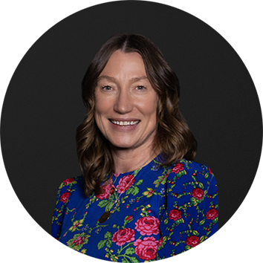
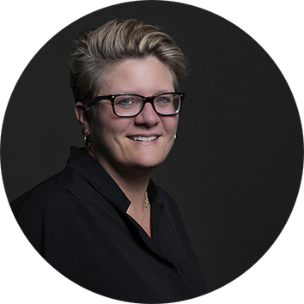
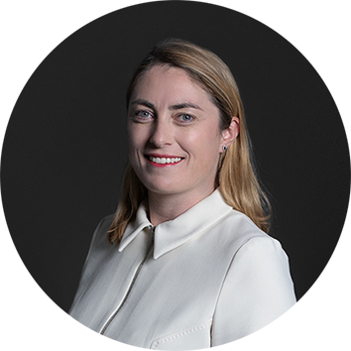

Leading Financial Services Regulatory Team
Our leading Financial Services Regulatory team include the following recognised experts:
Penny Miller
Partner, Head of our Global Financial Services Regulatory
UK
T: +44 20 7825 3532
E: penny.miller@simmons-simmons.com
Mahrie Webb
Partner, International Head of Financial Markets
UK
T: +44 20 7825 2077
E: Mahrie.webb@simmons-simmons.com
Catherine Weeks
Partner,
Financial Services Regulatory
Dublin
T: +44 20 7825 3940
E: catherine.weeks@simmons-simmons.com
Alex Ainley
Partner,
Financial Services Regulatory
UK
T: +44 20 7825 4248
E: alex.ainley@simmons-simmons.com
Penny is a partner and Head of our Global Financial Services Regulatory practice across Europe, Asia and the Middle East bringing together our global team to clients advising on the synergies and divergences between different jurisdictions with a team of over 200 lawyers.
Penny specialises in a wide range of UK and EU regulatory matters including advising a significant number of firms on the implementation and ongoing compliance and enforcement issues relating to the Senior Managers and Certification Regime (SMCR), managing related governance, conduct risk and culture issues and the Consumer Duty. Penny is part of a group of partners who advise in a joined up way across practice areas on all aspects of corporate governance, culture, remuneration and risk. Penny regularly advises the C suite including Boards and Senior Managers on critical strategic issues and FCA engagement and has a real trusted adviser status with some of the world’s largest and most significant institutions.
Mahrie is the International head of Financial Markets and leads the practice firmwide.
She specialises in investment funds and financial services regulatory work with an emphasis on regulated funds such as UCITS. She acts for fund and wealth managers, administrators, platforms and distributors as well as financial advisers and other intermediaries.
Catherine specialises in financial services regulatory work with a focus on advising on products and financial services offered by the buy-side community. She advises institutional managers, private banks and wealth managers.
She has significant experience in advising clients on complex regulatory change projects and the impact of these on fund ranges and financial services.
Catherine leads navigator: registrations - our cost-effective, reliable and user-friendly service to manage and maintain cross border registrations. She also manages our specialist KIID production facility.
Alex is a partner in our financial services regulation practice in London. Alex specialises in a range of UK and EU regulatory matters, including advising financial institutions on MiFID 2, MAR, the Benchmark Regulation and SMCR. Alex has particular expertise in advising on regulatory matters connected with corporate finance such as product regulation, financial promotion, prospectus issues and licensing.
Alex contributes to the Simmons & Simmons navigator service and has worked extensively on cross-border licensing matters. Alex presents regularly to clients on regulatory change and has spoken at industry events in the UK and on the continent as well as being involved in trade industry discussions.
Alex qualified as a solicitor in 2000 at a magic circle firm and spent 14 years in-house at major banks before going back into private practice at Simmons & Simmons in 2017.

Slide 8

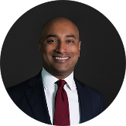
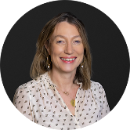



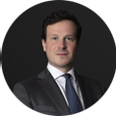
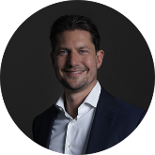
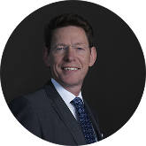

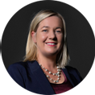





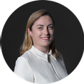




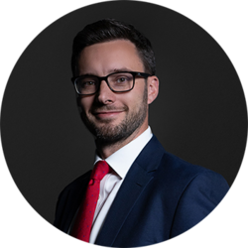






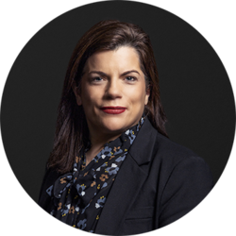








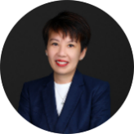

The Netherlands
UK
Rezah Stegeman
Penny Miller
Nicholas Colston
Belgium
Germany
Alex Ainley
Oliver Irons
Our Global Financial
Services
Regulatory Team
Martin Carlier
Harald Glander
Jochen Kindermann
Darren Fox
Charlotte Stalin
Daniel Lühmann
Sabrina Schwlebert
Rosali Pretorius
James Wallace
We have one of the leading Financial Services Regulatory practices in the market and extensive experience of building cross-border teams to suit the needs of the most demanding clients.
The map illustrates our international Financial Services Regulatory network and is further supported by our team of associates, paralegals and professional support lawyers.
Luxembourg
Louise Tudor-Edwards
Catherine Weeks
Augustin de Longeaux
Julie Carbiener
Louis-Maël Cogis
Mahrie Webb
Tom Harkus
Pieter Leguit
Catherine Foldberg Moller
Ireland
China
Derek Lawlor
France
Melody Yang
Middle East
Louise Dobbyn
Ian Rogers
Muneer Khan
Hong Kong
Nora Beausang
Ivy Yam
Emilien Bernard-Alzias
Italy
Singapore
Eva Chan
USA
Office in San Francisco
Established relationships with recommended law firms
Spain
Romeo Battigaglia
Jek Aun Long
Kenneth Hul
Maria Tomillo
Maria Giusy Naccarato
Sonia Lim
Andreas Elofs
Portugal and Switzerland
Established relationships with recommended law firms

Slide 9

Simmons Wavelengths Legal Design
Legal Design: Enhancing the Experience of Law
Core Principles: Utilises human-centred design, design thinking, and innovative technology to improve legal interactions.
Goals: Better access, increased understanding, and improved decision-making.
Approach:
Content: Simplifying legal information for clarity.
Visual Design: Engaging and dynamic presentation.
Usability: Optimising information for user needs.
Accessibility: Ensuring universal access.
Testing & Analysis: Employs qualitative and quantitative research to measure effectiveness.
Collaboration:
Simmons Wavelength: Integrates legal design with data science, legal engineering, and process automation.
Global Network: Leverages expertise from over 2,000 lawyers across 20+ offices.
Financial Services Regulation:
Compliance: Assists with consumer-focused regulations and accessibility acts.
Self-Service & Trust: Enhances user understanding and business-customer relationships.
Professional Development: Upskills legal professionals in collaboration, creativity, and empathy.
“The combination of the Simmons & Simmons lawyers with the leading legal engineering unit Simmons Wavelength is a powerful proposition: it allows the firm to offer not just advice on AI but practical solutions as well”. Legal 500 2024

Slide 10








Simmons & Simmons in a nutshell
A leading business law firm
Strong Resources: Founded in London in 1896, Simmons & Simmons is a multi-specialised law firm encompassing the entire range of business law. We have approximately 350 Partners and 1400 lawyers worldwide.
We are committed to delivering not only technical excellence, market awareness and first-class service, but also a team which considers your requirements in the fullest sense.
Truly Global Firm
23 offices in Europe, Asia, the Middle East and North America – we have offices in the UK, Ireland, France, Germany, Italy, Luxembourg, Hong Kong, Singapore, Dubai and the US.
Extensive network of affiliated law firms around the world.
Partner-lead and multi-disciplinary teams are specifically formed according to client needs in order to cover the largest scope of matters. We take the time to understand the demands our clients face and tailor our services to anticipate their needs.
Our reputation for excellence means that our clients bring us their toughest business challenges and we set the highest standards for the work we do, meaning that clients benefit from the highest quality client service.
We are structured as an integrated international firm with a single profit pool. This leads to a consistent service level, irrespective of geography.
Innovative solutions: From landmark deals and cases, through online services and knowhow, to new delivery models, we have a track record of innovation. Demonstrating our market leading innovative capabilities, we acquired Wavelength, the world’s first regulated firm of legal engineers.
Our international financial services regulatory practice operates as a single cross-border group with specialist partners based in our offices in Europe, the Middle East and Asia.

