Slide 1


Can People Hack Nuclear Plants?
December 29, 2020
Gabriel Agboruche
Senior ICS/OT Security Consultant, Mandiant FireEye

Slide 2
Flow
Intro
What it is like working @ a nuclear plant?
Ask a 14-year-old!
Widely Publicized Hacking
Nuclear Hacking?
Questions?

Slide 3
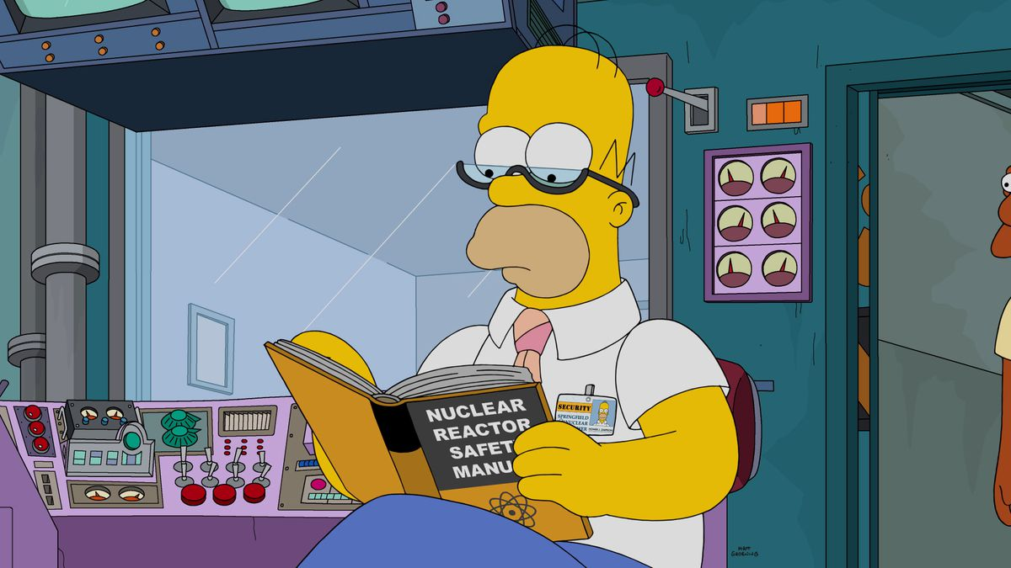
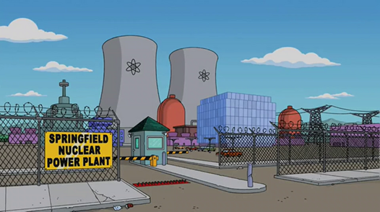
Introduction
Gabriel Agboruche
  Sr. Consultant @Mandiant @FireEye
Stuxnet changed my life…
Socials
@ICS_Gabe
@ICS with Gabe

Slide 4
Current USA Commercial Nuclear Plant Locations

Slide 5
What is it like working @ a Nuclear plant?

Slide 6
Ultimate Heat Synch (UHS)
“The UHS is the system of structures and components and associated assured water supply and atmospheric condition(s) credited for functioning as a heat sink to absorb reactor residual heat and essential station heat loads after a normal reactor shutdown or a shutdown following an accident or transient including a loss-of-coolant accident (LOCA).”
NRC REGULATORY GUIDE 1.27 “Background”

Slide 7
Ask a 14-year-old!

Slide 8
Ask a 14-year-old!
How would you define hacking?
TJ: Breaking something or breaking into something that was running perfectly fine before.
Would you consider a “hackers” to be a positive or a negative person?
TJ: Negative.
What can be hacked? Give examples.
TJ: Anything digital can be hacked. Video games, computers, phones, etc.

Slide 9

Widely Publicized Hacking

Slide 10
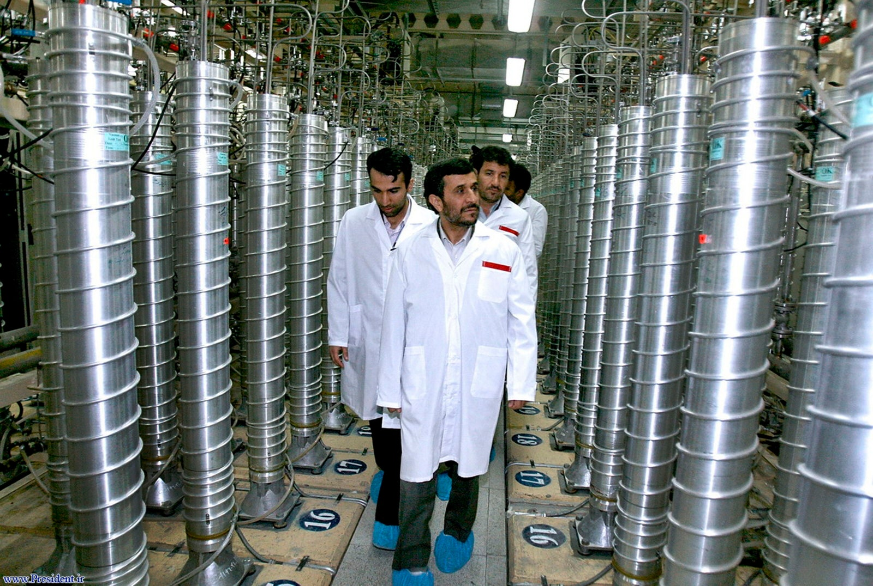
Nuclear Hacking?
It has happened!
Stuxnet Overview
How did this change my life? #StuxnetChangedMyLife

Slide 11






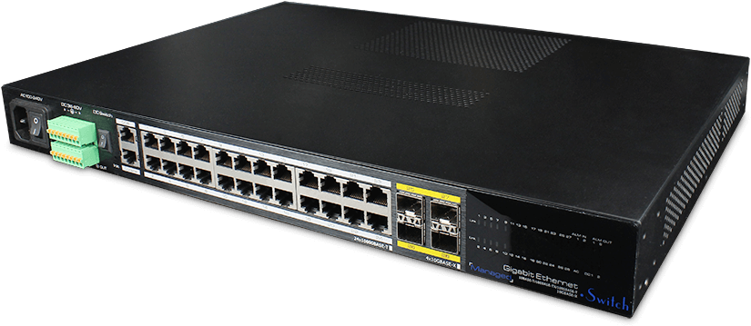









Attack Vector Simulation
Plant Vendor
USB
Network Switch
Nuclear Plant Network

Slide 12












How do we defend?
Scanning
Patching
Physical Security
Network Segmentation

Slide 13
Questions?
Thank you!

Slide 14

Contact Info
Twitter: @ICS_Gabe
Linkedin: Gabriel Agboruche
DMs are open!
http://linktr.ee/gabea

