Slide 1
OB/GYN and Male GU
OUWB School Of Medicine
Beaumont Health System
Department of Emergency Medicine

Slide 2
Pelvic Pain
Many causes from benign to emergent
In ED, we are concerned with life-threatening causes
We must also consider future risk to fertility.

Slide 3
Pelvic Pain
Ectopic Pregnancy
Abortion (miscarriage)
Cervicitis, PID, TOA
  Continuum of same process
Ovarian Torsion

Slide 4
Pelvic Pain
22 yo F with c/o vaginal d/c, pelvic pain. Has been increasing for the last 3 days. (+) nausea, no emesis. (+) sexually active with one partner. Is on OCPs, does not use barrier methods. (+) h/o trich in past. States just finished her period 1-2 weeks ago.

Slide 5
Pelvic Pain
Physical Exam:
  Afebrile, VSS
  Abdomen with suprapubic and B/L LQ tenderness.
  Pelvic exam with (+) yellow-white vag d/c, (+) CMT and uterine tenderness. No adnexal masses palp.

Slide 6
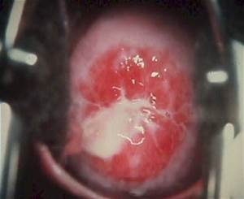
PID
Pt’s speculum exam

Slide 7
PID
Continuum of the same process, ascending infection
Risk factors:
  Multiple sexual partners
  Lack of barrier contraception
  Prior STD
  IUD
  Uterine instrumentation

Slide 8
Cervicitis, PID
Microbes:
  Chlamydia
  Gonorrhea
  Enteric bacteria
Testing:
  Chlamydia, gonorrhea by PCR with cervical swab
  Wet prep for BV, trich
  HCG

Slide 9
PID
Treatment
  Usually treat on clinical suspicion
  Outpt:
    Multiple regimens, most common:
    Ceftriaxone 250mg IM + doxy 100mg po BID x14 days
      +/- metronidizal 500mg po BID x14 days
      Can give zithromax
  Inpatient options:
    Cefoxitin 2 gm q6 + doxy 100mg po/IV q12,
    Clindamycin 900mg IV q8 + gent, or
    Unasyn 3gm IV q6 + doxy 100mg po/IV q12

Slide 10
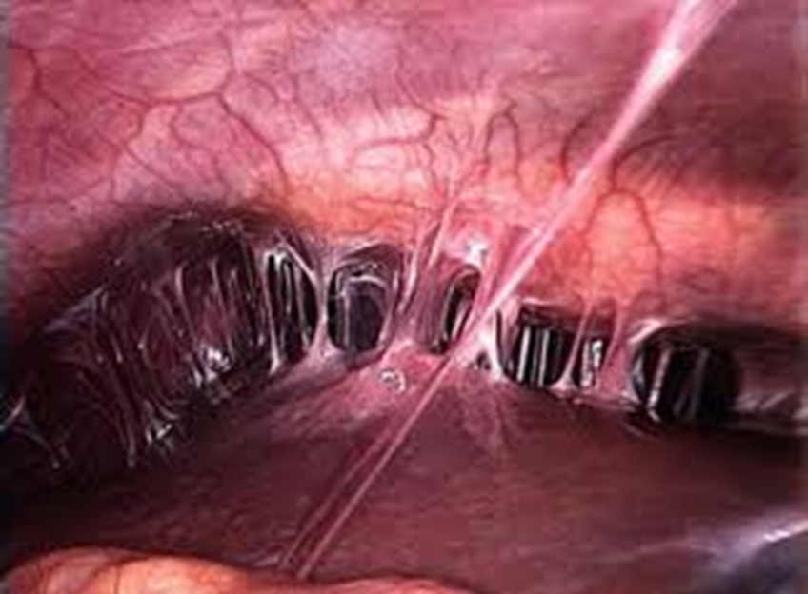
PID
Indications for inpt treatment
  Inability to tol po intake
  Suspicion for TOA, Fitz-hugh-Curtis
  septic appearing
  Pregnancy
  Failure of outpatient tx
  IUD
  Questionable compliance, follow up
  ? Nulliparity-not done as frequently now
Always advise on safe sex practices
Advise partner must be notified and treated

Slide 11
Pelvic Pain
24 yo F presents for dizziness, near syncope. She thinks she is just starting her period, has been having some pelvic pain and cramping. Pain has been increasing over the last few days. Sig increase today which was also associated with her feeling lightheaded.
VS: 98.6, 106/54, 102, 14, 99%

Slide 12
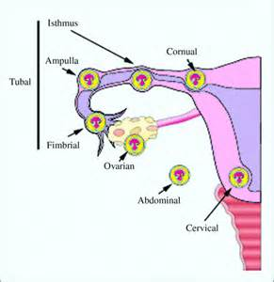
Ectopic Pregnancy
Implantation of embryo outside of the uterine cavity
Most common sites:
  Ampulla
  Isthmus
  cornual

Slide 13
Ectopic Pregnancy
Most common cause of 1st trimester maternal death
Risk Factors:
  Previous ectopic
  PID
  Fertility treatments
  IUD

Slide 14
Ectopic Pregnancy
Physical Exam:
  May not be very impressive
  May have vaginal bleeding
  Uterus may feel enlarged
  Can have palpable adnexal mass
  Abd/pelvic tenderness based on location or intraperitoneal blood

Slide 15
Ectopic Pregnancy
Presentation can vary greatly depending on size, if ruptured
  From mild abd pain, spotting to shock
  Can have RUQ, R shoulder pain if large amount of intraperitoneal blood, causing referred pain
Labs?
Imaging?
  Stay in dept or go to radiology?

Slide 16
Ectopic Pregnancy
Type and Screen!
Crossmatch RBCs
HCG
CBC
BMP
Ultrasound
  If concerned for stability, do not let pt leave the dept for u/s. Tech can come to bedside.
  We can also do a bedside u/s to look for free fluid
  May also see heterogeneous material if clotted blood as well

Slide 17
Ectopic Pregnancy
Ultrasound findings
  Empty uterus with HCG >1500
    Should be able to see a pregnancy transvaginally with this level.
  Complex adnexal mass
  Free fluid in the cul-de-sac (if ruptured)

Slide 18
Ectopic Pregnancy
Treatment
  2 large bore IVs
  STAT OB/GYN consult
  Hemodynamic resuscitation as needed with fluids, blood products
  If Rh (-), rho gam
  Methotrexate for unruptured, no contraindications to medication
  Surgical salpingostomy, salpingectomy

Slide 19
Pelvic Pain
31 yo F with c/o sudden onset LLQ and L lower back pain for the last 3 hours. Pain is severe. (+) N/V. Denies fever, vaginal d/c, bleeding. (+) urinary urgency. No diarrhea, hematuria, BRBPR or melena. Is sexually active with her husband. Is taking clomid for infertility. Does not know if she is pregnant.
VS: 98.9, 115/76, 108, 20, 98%

Slide 20
Pelvic Pain
Physical exam
  (+) pt appears in pain
  Heart tachy, regular, LCTA
  Abd soft, (+) tenderness to LLQ, L flank area.
  Pelvic exam without d/c, bleeding. (+) tenderness to L adnexa without definite masses palp.

Slide 21
Pelvic Pain
Differential:
  Ectopic
  Ovarian cyst rupture
  Ovarian torsion
  Renal colic
  Pyelonephritis
  Diverticulitis less likely with sudden onset

Slide 22
Pelvic Pain
Orders:
  Type and screen
  HCG
  UA, Cx
  CBC
  BMP
  Ultrasound
    Complete pelvic u/s with doppler
    Can also do renal if considering stone/renal colic

Slide 23
Pelvic pain
Results:
  HCG (-)
  UA clean
  U/S showing enlarged L ovary with multiple large cysts with minimal venous flow.

Slide 24
Ovarian Torsion
Twisting of the ovary and or/fallopian tube at its pedicle, compromising vascular supply.
Risk factors include:
  Developmental abn
  Hyperstim of ovaries (fertility tx, ovulation induction)
  Ovarian masses
  Early pregnancy with large corpus luteum

Slide 25
Ovarian Torsion
Ultrasound findings
  Enlarged, swollen ovary
    Impaired venous and lymphatic outflow
  Decreased venous flow due to edema
  May see stromal hemorrhage from outflow obstruction
  Decreased arterial flow is later due to increased edema/pressure to overcome
  May see free fluid surrounding ovary

Slide 26
Ovarian Torsion
Treatment
  Stat Ob/GYN consult
  Laparoscopy with detorsion to preserve ovary and fertility

Slide 27
Pelvic Pain
So, same presentation:
31 yo F with c/o sudden onset LLQ and L lower back pain for the last 3 hours. Pain is severe. (+) N/V. Denies fever, vaginal d/c, bleeding. (+) urinary urgency. No diarrhea, hematuria, BRBPR or melena. Is sexually active with her husband. Is taking clomid for infertility. Does not know if she is pregnant.
VS: 98.9, 115/76, 108, 20, 98%

Slide 28
Pelvic Pain
Physical exam
  (+) pt appears in pain
  Heart tachy, regular, LCTA
  Abd soft, (+) tenderness to LLQ, L flank area.
  Pelvic exam without d/c, bleeding. (+) tenderness to L adnexa without definite masses palp.

Slide 29
Pelvic Pain
Same Tests
Results
  HCG (-)
  UA with (-) leuk est, (-) nitrite, >100 RBCs, 5 WBC, (-) bacteria
  U/S pending

Slide 30
Pelvic Pain
How does this UA change your differential?
Will it change your imaging plan?

Slide 31
Pelvic Pain
With presentation, UA, would consider renal colic, nephrolithiasis more likely
Renal U/S can show hydronephrosis indicating an obstructing stone
CT kidney stone protocol will show hydro, location and size of stone

Slide 32
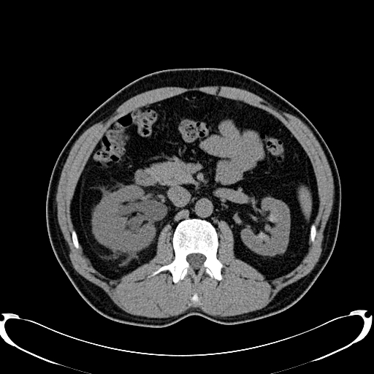
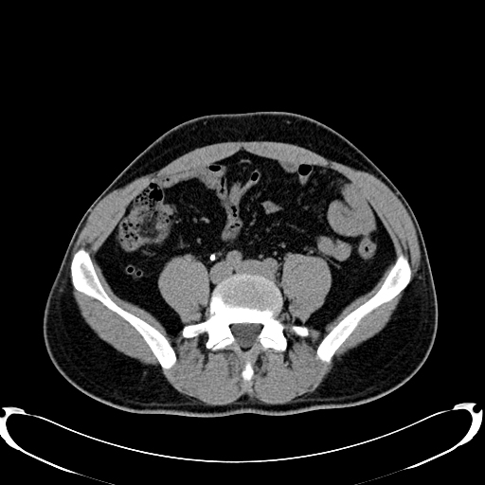
Pelvic Pain
CT shows 4mm L distal UVJ stone with moderate hydronephrosis
Now what?
Imagine the stone is on the L ☺
            hydro

Slide 33
Nephrolithiasis, Renal Colic
If pain, nausea are controlled, UA without signs of infection, can d/c on po meds.
Admit for:
  Intractable pain, nausea
  Solitary kidney
  Infection
Urology consult if:
  Large stone
  Has not passed
  Infected urine-infected stone is a surgical emergency

Slide 34
Nephrolithiasis
Common presentation with flank pain, radiating to groin, even to thigh.
Usually with N/V
CT shows hydronephrosis if obstructing.
  Can have perinephric fat stranding or fluid
  Will also show location and size of stone
Renal u/s can show hydro, does not always see stone

Slide 35
Nephrolithiasis, Renal Colic
Kidney stone pearls
  90% of stones <5mm will pass without any intervention
  Most, but not all stones, have hematuria on UA
  These patients often are writhing/rocking in pain, not lying still as you would expect with an acute inflammatory problem.

Slide 36
Groin pain
21yo M presents to EC for R testicular pain. Onset was 1.5 hrs ago. States he was playing soccer and had pain. Denies trauma during the game or prior. (+) nausea, no emesis. Denies dysuria, urethral d/c. He is a college student. (+) sexually active with multiple partners. (+) barrier contraception most encounters. Denies other sig PMH.

Slide 37
Groin Pain
Differential?
  Testicular torsion vs epididymitis?
  Torsion of appendix testis

Slide 38
Groin Pain
Physical exam
  Abd soft, NT, ND
  No femoral, inguinal hernias
  No penile lesions, no urethral d/c.
  (+) enlarged, swollen R testicle. Rides high and in more horizontal position.

Slide 39
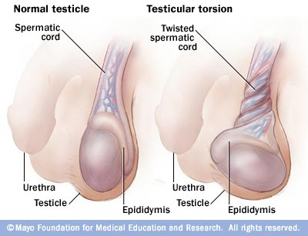
Testicular Torsion
Usually presents with sudden onset testicular, groin, or lower abdominal pain.
Often occurs with physical activity
Can occur in any age group, most commonly in adolescents.

Slide 40
Testicular Torsion
Exam
  Swollen, tender testicle
  Often raised and in a transverse lie
  Absent or abnormal cremesteric reflex
Orders
  Stat testicular u/s with doppler
  UA, Urine cx to r/o infectious causes of pain
  Stat urology consult

Slide 41
Testicular Torsion
Treatment
  Pain control
  Stat Urology consult, transfer if needed
  If at a facility without uro, can attempt detorsion
    “Open-book” maneuver
    Most torsions twist medially, rotate testes outwardly
    Not recommended if duration is longer than 6 hrs
  Ideally Urology to OR for detorsion and orchipexy

Slide 42
Groin Pain
Same case
21yo M presents to EC for R testicular pain. Onset was 1.5 hrs ago. States he was playing soccer and had pain. Denies trauma during the game or prior. (+) nausea, no emesis. Denies dysuria, urethral d/c. He is a college student. (+) sexually active with multiple partners. (+) barrier contraception most encounters. Denies other sig PMH

Slide 43
Groin Pain
Exam:
  Soft abd, NT, ND, BS (+) throughout
  Groin without inguinal, femoral hernias noted
  No penile lesions
  (+) urethral d/c
  (+) post testicular tenderness along the epididymis
  (+) scrotal erythema
  Cremesteric reflex intact

Slide 44
Epididymitis
Post epididymal tenderness and edema
Pain is usually gradual in onset
May have assoc urethral d/c, dysuria
UA with pyuria
Often a STD but may occur as part of a UTI
Use hx, risk factors to determine tx
  i.e. outpt Abx to cover GC, chlamydia
Can also progress to epididymo-orchitis

Slide 45
Epididymitis
Orders:
  UA, UrCx
  Testicular u/s
  Cx/PCR for GC, chlamydia
  Pain control
  Scrotal support
If suspected STD, instruct on safe sex practices, notification and treatment of partners as well as full STD testing.

Slide 46
Fournier’s Gangrene
Rapidly progressive, necrotizing infection to groin/perineum
  Form of necrotizing fasciitis specifically to perineal region
Often in immunocompromised patients, diabetics
Usually a mixed infection of aerobic and anaerobic bacteria
Very high mortality rate
Surgical emergency

Slide 47
Fournier’s Gangrene
Exam
  Typically septic appearing pt
  Erythematous, edematous perineum with necrosis
  (+) crepitus/subq emphysema
  May rapidly progress in size/area during eval

Slide 48
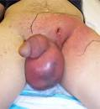
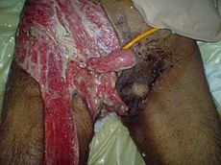
Fournier’s Gangrene

Slide 49
Fournier’s Gangrene
Testing
  Often no imaging as needs to go to OR emergently
  Can do plain film to show sub-q gas
Treatment
  Stat Urology, surgery consult for emergent surgical debridement
  Medical resuscitation for sepsis
  Stat broad spectrum Abx
    Vanco, zosyn
  Hyperbaric oxygen treatment

Slide 50
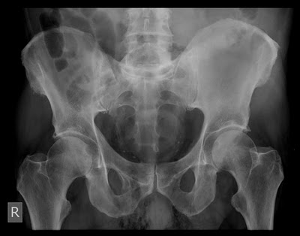
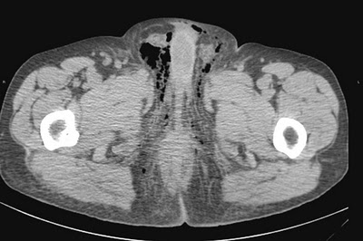


Fournier’s Gangrene
Sub-q gas

Slide 51
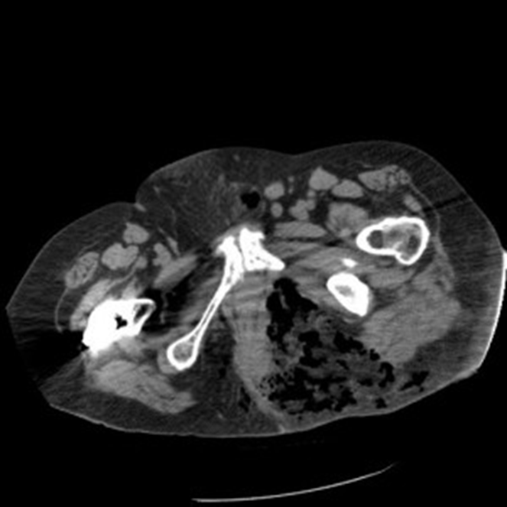

Fournier’s Gangrene
Sub-q gas, edema

Slide 52
The End!

