Slide 1
Dyspnea and Respiratory Failure
OUWB School of Medicine
Beaumont Health System
Department of Emergency Medicine

Slide 2
Overview
Acute Asthma Exacerbation
COPD
Pneumonia
CHF
Respiratory Failure
  Drug OD
  CNS Causes
Airway Obstruction
  Angioedema
  Trauma
  Foreign Body

Slide 3
Dyspnea
Very common complaint
Can be due to many different processes, not just pulmonary
  Cardiac
  Metabolic
  Infectious
  CNS
  Drug induced
  Trauma
  Etc…
Your history, PE, will help focus in on cause

Slide 4
Physical Exam
Just look at the patient!
  Position
  Mentation
    Alert?
    Tired?
    Confused?
  Color/diaphoresis
  Breathing pattern
  Accessory muscle use/belly breathing
  Are they speaking? Full sentences? Sound of their voice?
Vitals
  BP, HR, RR, SpO2, temp

Slide 5
Acute Asthma Exacerbation
Remember asthma is an Inflammatory condition
EM approach
  Asses for current severity, response to treatment
  Can they go home?
History
  Regular info +
    Any previous hospitalizations for asthma?
    Any previous ICU admissions?
    Any previous intubations?

Slide 6
Acute Asthma Exacerbation
Exam
  CV
    HR, peripheral perfusion
  Respiratory
    Pattern
    Retractions
    Wheezing
      Means air is moving-Good!
      Absent breath sounds is BAD!
        Minimal air mvmt vs pneumothorax
Uncomplicated asthma exacerbation needs little in diagnostics.
  Only get CXR if concerned for underlying pneumonia, ptx or other confounder on hx.

Slide 7
Acute Asthma Exacerbation
Treatment
  Bronchodilators
    Albuterol, xopenex, atrovent
    Varying dose per severity
    Mild
      albuterol 5mg/atrovent 0.5 mg
    Severe/status
      Continuous nebs, 10-15mg albuterol
      Atrovent only effective q4 hrs
  Steroids
    If mild, can tol po intake, can do po prednisone
    If severe dyspnea, better to keep NPO and do IV solumedrol
    No difference in the onset of action with po vs IV meds.

Slide 8
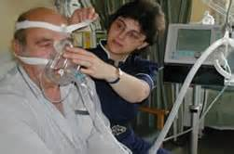
Acute Asthma Exacerbation/Status Asthmaticus
Treatment
  If not responding or very severe
    BiPAP:
      Bilevel Positive Airway Pressure
      External (non-invasive) positive pressure ventilation. Provides ventilatory support without intubation.
      Only in pts who are awake, alert, cooperative.
    Can do inline nebs with BiPAP

Slide 9
Acute Asthma Exacerbation/Status Asthmaticus
Treatment
  Magnesium
    2 gm IV
    Smooth muscle relaxant/bronchodilator
  Terbutaline
    Sub-q or gtt
    0.25 mg subq
    Will cause tachycardia
    Bronchodilator (beta-2 agonist); smooth muscle relaxant
  Epinephrine
    0.3 mg (1:1000) subq/IM
    Bronchodilator
    Caution in those with CAD/older pts

Slide 10
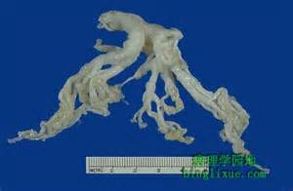
Status Asthmaticus
If still not responding to aggressive respiratory measures, meds
  Intubate
  Last resort!
Avoid breath stacking. Vent settings to allow for prolonged Exp phase
If pt loses pulses, ensure no pneumothorax, may need to perform B/L needle decompression of chest and place chest tubes
  Lungs become so hyperinflated may have spontaneous ptx
Bronchial Cast (sputum) from status asthmatics pt

Slide 11
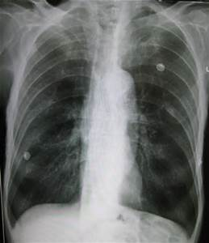
COPD
Emphysema and Chronic Bronchitis
May have components of both
Usually older individuals
Major problem is hypercarbia/CO2 retention due to decreased elastic recoil
Use your Hx & PE to guide workup
  CXR
  EKG
  Labs including troponin
    Most of these pts also have underlying cardiac dz, a COPD flare increases cardiac work and may cause an MI or CHF exacerbation
Hyperinflation
Decreased lung markings
Flattened diaphragms
May see blebs

Slide 12
COPD
Treatment:
  Bronchodilators
  Steroids
  +/- Abx
    Case by case. If infiltrate, definite abx. If no inflitrate, some physicians still prefer atypical coverage (avelox, zithromax)
  BiPAP
    Extremely useful in COPD. Can significantly improved pts ventilatory status.
    Helps blow off CO2, improve hypercarbia
    Can help prevent intubation of these pts!
    Allows for lower FiO2 while providing non-invasive pressure support

Slide 13
COPD
Complications
  VDRF
    Even with optimal therapy, pts may still need intubation
    Those who arrive with diminished mental status need early intubation to improve CO2 retention and hypercarbia
  Apnea
    These pts live at a higher CO2 than healthy individuals
    Due to this, SpO2 is what stimulates their resp drive
    Caution with FiO2, a NRB mask can make them apnic/hypopnic and quickly worsen the situation, further increase their CO2 retention cardiac arrest
    Use lowest FiO2 possible for supplemental oxygen
    Often ok with SpO2 >90% in these pts

Slide 14
Pneumonia
Can often diagnose clinically
Cough, fever, malaise
Elderly may just present with AMS
Aspiration pneumonia risks
  h/o CVA (poor swallow), alcohol abuse, drug use, PEG tube
Diagnostics:
  CXR (2 view optimal)
    Infiltrate may not show initially, may “bloom” after hydration
  Labs including Blood Cx’s if appears septic, anticipate ICU

Slide 15
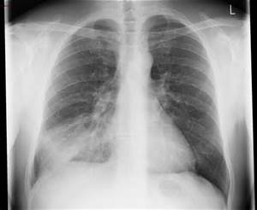
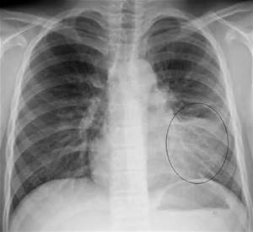
Pneumonia
Findings
  Fever
  Leukocytosis
  Infiltrate on CXR
Again, CXR may lag behind, may diagnose a pneumonia clinically with focal rales/rhonchi and cough, fever

Slide 16
Pneumonia
Treatment
  Outpt vs inpt tx
  Outpt
    Pt overall well appearing
    No significant dyspnea, hypoxia
    Can tol po intake
    No AMS
    Labs stable (no ARF)
    Has appropriate f/u
  Inpt tx
    Typically elderly
    Significant underlying lung dz
    Cannot tol po intake
    Septic appearing
    Clinical impression
  Clinical decision rules:
    Pneumonia severity index
    CURB 65

Slide 17
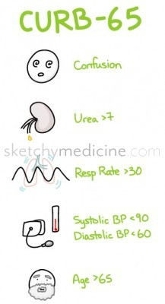
Pneumonia
            from sketchymedicine.com
Confusion
Urea >7
Respiratory rate >30 breaths per minute
Blood pressure <90 systolic or <60 diastolic
65 years or older
Add up your points
  ■0 – 1 points: mild pneumonia (there’s only a 3% chance that your patient will go home and die, leaving you racked with guilt)
  ■2 points: moderate (9% risk of dying) – you should probably hospitalize this person
  ■3 – 5 points: severe (13-53% chance of dying) – you better admit this person, maybe even to the ICU

Slide 18
Pneumonia
Outpatient
Inpatient
Azithromycin (Zpak)
Doxycycline
  100mg po BID
Co-morbidities (COPD, DM)
  Levofloxacin (levaquin)
  Moxifloxacin (avelox)
  Augmentin + zpak
CAP (community acquired pneumonia) vs HCAP (healthcare associated pneumonia)
Dictates your Abx choice
Each hospital has pneumonia protocol

Slide 19
Pneumonia
CAP
HCAP
Ceftriaxone +
  Azithromycin or doxy
Levofloxacin
Moxifloxacin
Pseudomonal coverage
Cefepime or zosyn +
  Cipro or
  Tobramycin
May add vanco for h/o MRSA, septic shock

Slide 20
Pneumonia
Complications
  Septic shock
  VDRF
  Death

Slide 21
Congestive Heart Failure
Diastolic vs Systolic
  Impaired relaxation vs impaired contractility
Typical presentation:
  Dyspnea, orthopnea, LE edema
  Sx’s may increase over days or sudden onset from uncontrolled HTN
Exam:
  Tachypnea, rales, LE edema
Vitals
  Often hypertensive in diastolic CHF
  May be normotensive or hypotensive in systolic CHF

Slide 22
Congestive Heart Failure
Causes of Acute exacerbation
  Medication noncompliance
  Diet noncompliance
  MI
  Thyroid
  Other systemic stress
    Infection, trauma, GIB
    COPD
    etc

Slide 23
Congestive Heart Failure
Labs
  CBC, BMP
  Trop
  BNP
  ABG prn
EKG
CXR
Keep on monitor
Ensure IV access
Supplemental O2

Slide 24
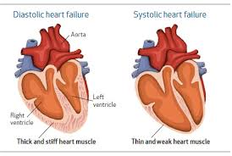
Congestive Heart Failure

Slide 25
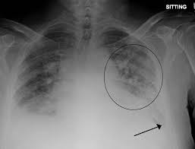
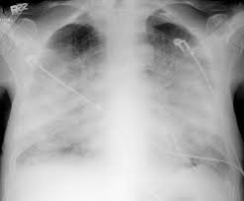
Congestive Heart Failure

Slide 26
CHF
Treatment
  Preload reduction/vasodilation
    Nitroglycerin (paste, drip)
  Diuresis (if normotensive or hypertensive)
    Lasix
  Ionotropic support if needed
    Dobutamine, dopamine
  Respiratory support
    BiPAP is very effective!
    Intubation if needed

Slide 27
CHF
Complications
  VDRF
  Arrhythmia
  Multisystem organ failure
    Inadequate tissue perfusion
  Cardiogenic shock
  Death

Slide 28
Respiratory Failure
Who do we intubate?
  Failure to ventilate
    Not able to inhale enough O2, exhale enough CO2
    Impending airway obstruction
  Failure to oxygenate
    Interruption of gas exchange
  Inadequate mental status to protect airway
    Easily/rapidly reversible? Bag till reversed
    GCS <9, intubate. (“GCS of 8, Intubate!”)

Slide 29
Respiratory Failure
Etiology can vary greatly
  Cardiac
  Pulmonary
  Shock states
  CNS
  Toxic/metabolic
  Drug induced
  Infectious
  Trauma
  Obstructive
  And more!

Slide 30
Respiratory Failure
Remember in the EC, we always follow our ABCs!
  Airway first
Ventilate/Intubate
  Bag mask till you can intubate or reverse underlying cause
    i.e. reverse hypoglycemia in a diabetic, give narcan in narcotic OD
  Use RSI (rapid sequence intubation)
    Drug choice based on patients presentation
  Intubate with cuffed ETT (adults)
    Direct visualization best
    If difficult airway, may need glidescope, fiberoptic
  Always try to anticipate complications
    Know what your next step will be if your attempts fail
    Don’t be a cowboy, call for backup if needed!
      Surgery, anesthesia
  Contraindications to intubation
    DNR/DNI status
    Certain facial, neck trauma indicate a surgical airway

Slide 31
Respiratory failure
Once airway is placed, confirm appropriate tube placement
  Best indicator of appropriate tube placement?
    Watching the tube pass through the cords
  End tidal CO2
  Auscultate over both lung fields, BS equal?
  Auscultate over stomach
  SpO2 appropriate for clinical situation?
  CXR

Slide 32
Respiratory Failure
Now that your airway is secured, what next?
Treat underlying cause of VDRF, admit to ICU
Keep pt sedated
  Again drug choice will be dictated by clinical scenario
  Commonly used drugs:
    Propofol: rapid on and off, can cause hypotension
    Versed/ativan gtts: not as rapid off, hypotension
    Fentanyl: usually in combo with another agent, short acting. Typically does not cause hyptension

Slide 33
Respiratory Failure
Common causes of Respiratory failure due to CNS disease
  Intracranial Hemorrhage
    Traumatic
      Epidural, subdural, intra-parenchymal hematoma, SAH
    Spontaneous
      Aneurysm rupture
      Hemorrhagic CVA
  Large ischemic CVA with edema
  Masses
    Primary or metastatic lesions
  All can lead to Mass effect herniation
    Uncal herniation: ipsilateral nonreactive pupil “blown pupil”

Slide 34
Respiratory Failure
Drug induced
  Narcotics and benzos most commonly
  Alcohol frequently as well
  Check pupils
    Constricted in narcotic OD
    Give Narcan IV/IM/via ETT
    May require large doses
    May require gtt if long acting drug
  Benzos
    Intubate
    Rarely use flumazenil
      Only use in benzo naive
      Can precipitate intractable sz if used in those who are dependent
      Classic case to use in accidental OD in child
  More in Tox lecture

Slide 35
Airway Obstruction
Anticipate impending obstruction
Call backup as needed
  Sx, anesthesia
  If you have time, pt to OR for attempted intubation with anesthesia with sx standing by prepped for surgical airway

Slide 36
Airway Obstruction
Difficult airway examples
  Angioedema
  Epiglottitis
  Retropharyngeal abscess
  Midface trauma
  Anatomic
    Obese
    Small jaw
    Cervical arthritis/rigidity
    Short neck

Slide 37


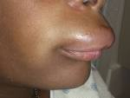
Airway Obstruction
Angioedema
  Etiology
    Allergic
    ACE inhibitor
    C1 esterase deficiency
      “hereditary angioedema”
    Undifferentiated

Slide 38



Angioedema
Treatment
  ABCs-Airway!
    How do you intubate a patient like this?
    Optimally to OR for fiberoptic with sx standby if needed
    Awake nasotracheal in ED
      Anesthetize airway
      Nebulize lidocaine
      Hurricane spray
  Supportive care
  Avoidance/removal of offending agent
  Epinephrine
  Steroids
  Benadryl
  Time

Slide 39
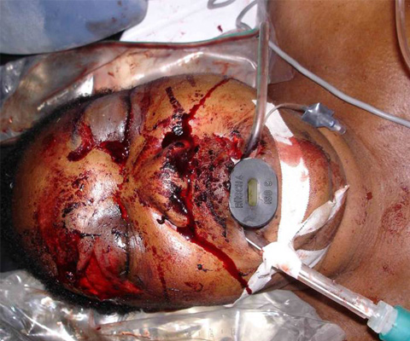
Traumatic Airway Obstruction
Caution with airway in pts with significant facial trauma
May have skull base disruption
Avoid nasotracheal intubation/NGTs
Careful orotracheal intubation or sx airway

Slide 40
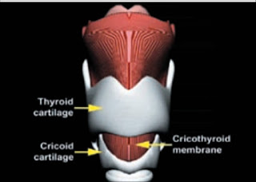
Surgical Airway
EM physicians trained to perform emergent cricothyroidotomy, a “cric”
If at a facility that you have sx and anesthesia, you should call for assistance when difficult airway anticipated
Sx/ENT can perform emergent tracheotomy as well.

Slide 41
Foreign body obstruction
Hx, exam will elicit complete vs partial
Incomplete obstruction presentation will vary based on size/type of object, location of fb
  Upper airway (trachea)
    Stridor
  Lower airway (bronchus and beyond)
    May show wheeze
    Recurrent pneumonia may present with missed dx
Complete airway obstruction, pt will have no air exchange, unless acted upon rapidly cardiac arrest

Slide 42
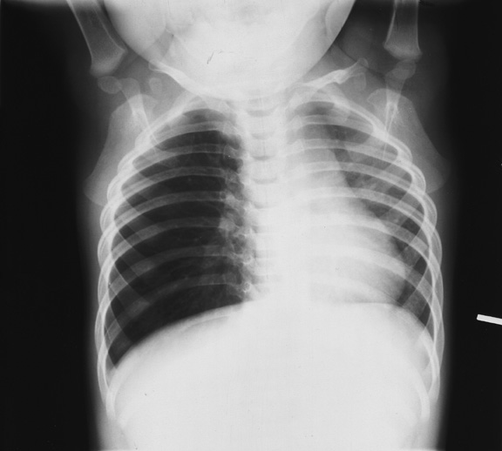
Foreign body aspiration
Incomplete obstruction:
  CXR PA and lat if stable
  Will show if radiopaque
  Even if not radiopaque, may show signs of a fb
    Hyperinflation
    Infiltrate from post-obstructive pneumonia
              Hyperinflation R lung with shift

Slide 43
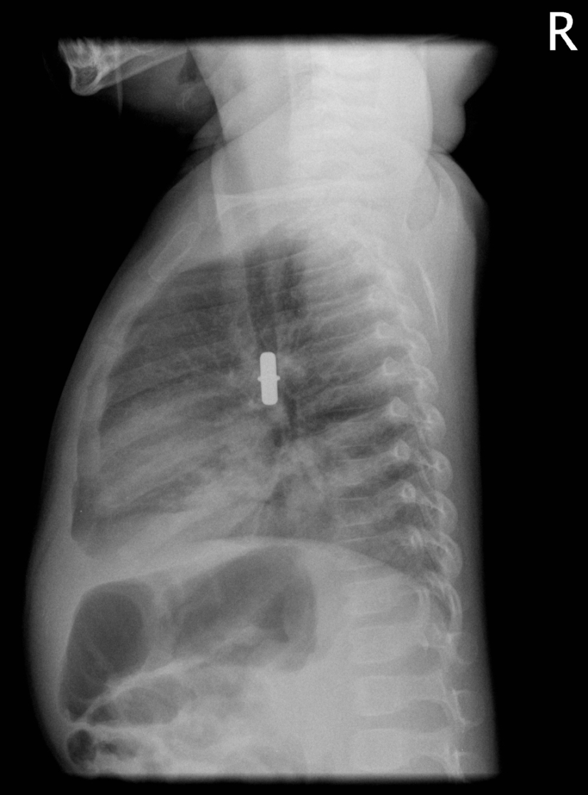
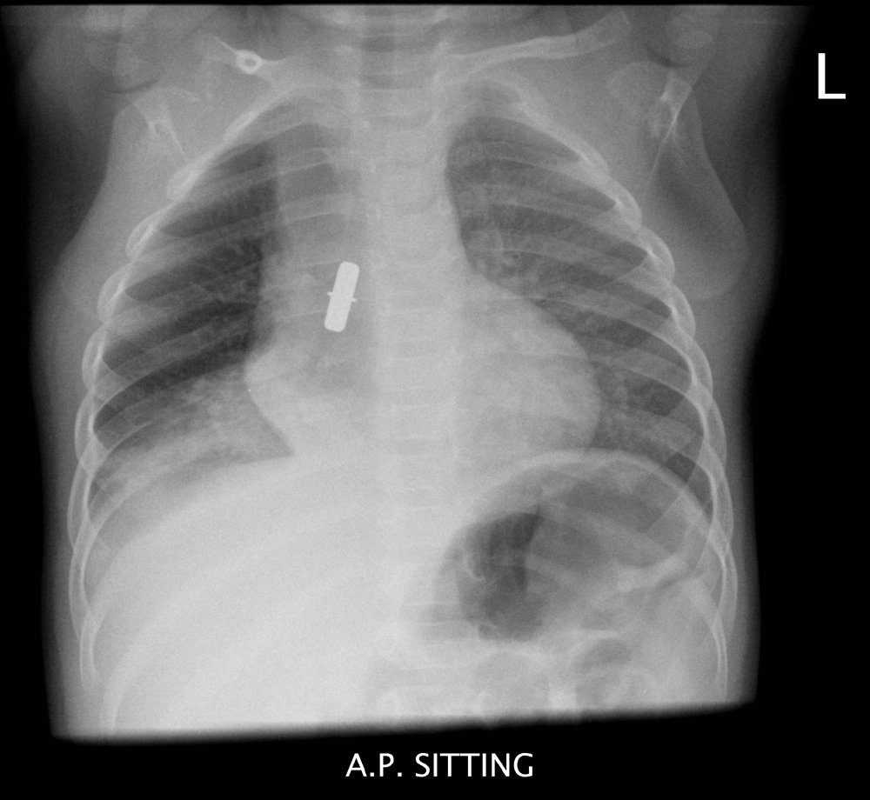
Foreign Body Aspiration

Slide 44
Foreign Body Aspiration
Treatment
  Will need bronchoscopy for removal
  If suspicious hx, exam, and CXR (-), still should have bronchoscopy to r/o radiolucent fb.

Slide 45
Foreign Body Aspiration
Complete Obstruction
  BLS/ACLS protocol
  Awake pt: Heimlich maneuver
  Unconscious pt:
    Out of hospital adult: abd thrusts
    In EC:
      Can attempt intubation
      May be able to visualize and extract fb with forceps
      If lodged in prox trachea, may be able to push distally with ETT to attempt to ventilate one lung
      If prox obstruction you cannot relieve, surgical airway
        Cric or emergent trach

Slide 46
The End
Take a breath!

