Slide 1
Compliance Education
Revised 10/01/2024

Slide 2
Compliance Program
01

Slide 3
What is a Compliance Program?
A compliance program safeguards an organization’s legal responsibility to abide by applicable laws and regulations. An effective compliance program also helps an organization live its values and ethics.
Our Compliance Program/Compliance Plan is in accordance with the “Organizational Sentencing Guidelines: established by the Office of Inspector General (OIG) and contains the required Seven Elements of an Effective Compliance Program.

Slide 4
Seven Elements of an Effective Compliance Program… What does this mean at Corewell Health?
Seven Elements of an Effective Compliance Program | How our Compliance Plan meets the element requirements
1. Implementing Standards of Conduct, Policies and Procedures | Our Code of Excellence sets clear expectations. Policies and Procedures are integral to our operations and essential tools to help detect, prevent and correct potential compliance issues.
2. Establishing Compliance Oversight | Compliance Officers and board of directors through their Compliance Committees implement, monitor and oversee the compliance program.
3. Conducting Effective Training and Education | We empower team to do the right thing by providing education to ensure knowledge of federal, state and local regulations, accreditation standards and contractual obligation to assist in addressing key risk areas.

Slide 5
What does this mean at Corewell Health?
Seven Elements of an Effective Compliance Program | How our Compliance Plan meets the element requirements
4. Developing Effective Lines of Communication | Compliance leaders are here as a resource and partner for you. We provide third party reporting through our Integrity Help Line, 24/7 with an anonymous reporting option.
5. Conducting Internal Monitoring and Auditing | Performing planned audits, onsite visits, interviews and routine monitoring helps identify emerging risks as well as resolved issues in identified areas.

Slide 6
What does this mean at Corewell Health?
Seven Elements of an Effective Compliance Program | How our Compliance Plan meets the element requirements
6. Enforcing Standards Through Disciplinary Guidelines | The compliance department in conjunction with human resources established standardized guidelines for a fair and consistent approach to managing performance and conduct issues.
7. Investigating and Remediating Issues | All reports of concerns or issues are reviewed and investigated by the compliance department and compliance department partners who educate throughout the process to ensure each report is resolved.

Slide 7
Fraud, Waste and Abuse
02

Slide 8
Fraud, Waste and Abuse
Each of use plays a direct role in detecting, preventing and mitigating Fraud, Waste and Abuse.
Fraud: When someone intentionally deceives, makes a false statement or claim or states that information they provide is true and correct, and it is not, it is considered FRAUD.
Waste: Overuse of a services or other practice that results in unnecessary cost is considered WASTE. Waste is generally not considered to be caused by criminally negligent actions but rather by the misuse of resources.
Abuse: Abuse generally occurs when there is not intent deceive.

Slide 9
Laws Governing Fraud, Waste and Abuse
There are many laws that govern fraud, waste and abuse:
False Claims Act
Anti-Kickback Statute
Stark Law
Social Security Act
The United States Criminal Code
Deficit Reduction Act
We will focus on the Deficit Reduction Act and False Claims Act.

Slide 10
Deficit Reduction Act
03

Slide 11
What is the Deficit Reduction Act?
The Deficit Reduction Act of 2005, is multifaceted. The section of the act we will focus on is related to the three provisions that target Medicaid program integrity and fraud and abuse.
First, it provides CMS with funds to fight fraud, waste and abuse.
Second, it created incentives for states to implement fraud and abuse laws that mirror the Federal law.
Third, and most related to us here at SH, it requires that any entity that receives or makes payments to the State Medicaid program of at least $5M annually to provide their employees, contractors and agents training regarding the federal and state false claims laws and related qui tam/whistleblowers provisions.

Slide 12
False Claims Act
04

Slide 13
False Claims Act
What is the False Claims Act?
The Federal False Claims Act (FCA), also known as Lincoln's Law, was initially passed during the Civil War to control fraud that was occurring with military funds. It is now used to fight fraud in ANY federally funded contract or program, for us Medicare and Medicaid.

Slide 14
Activities Covered by the False Claims Act
Knowingly presenting (or causing to be presented) to the federal government a false or fraudulent claim for payment.
Knowingly using (or causing to be used) a false record or statement to get a claim paid by the federal government.
Conspiring with others to get a false or fraudulent claim paid by the federal government.
Knowingly using (or causing to be used) a false record or statement to conceal, avoid or decrease an obligation to pay money or transmit property to the federal government.

Slide 15
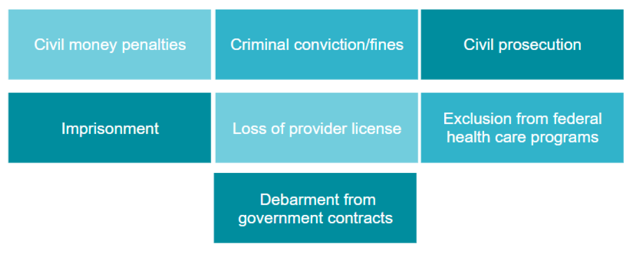
Penalties / Liabilities for Violating FWA Laws and Regulations (False Claims)

Slide 16
Whistleblower Protection Act and Non-Retaliation
05

Slide 17
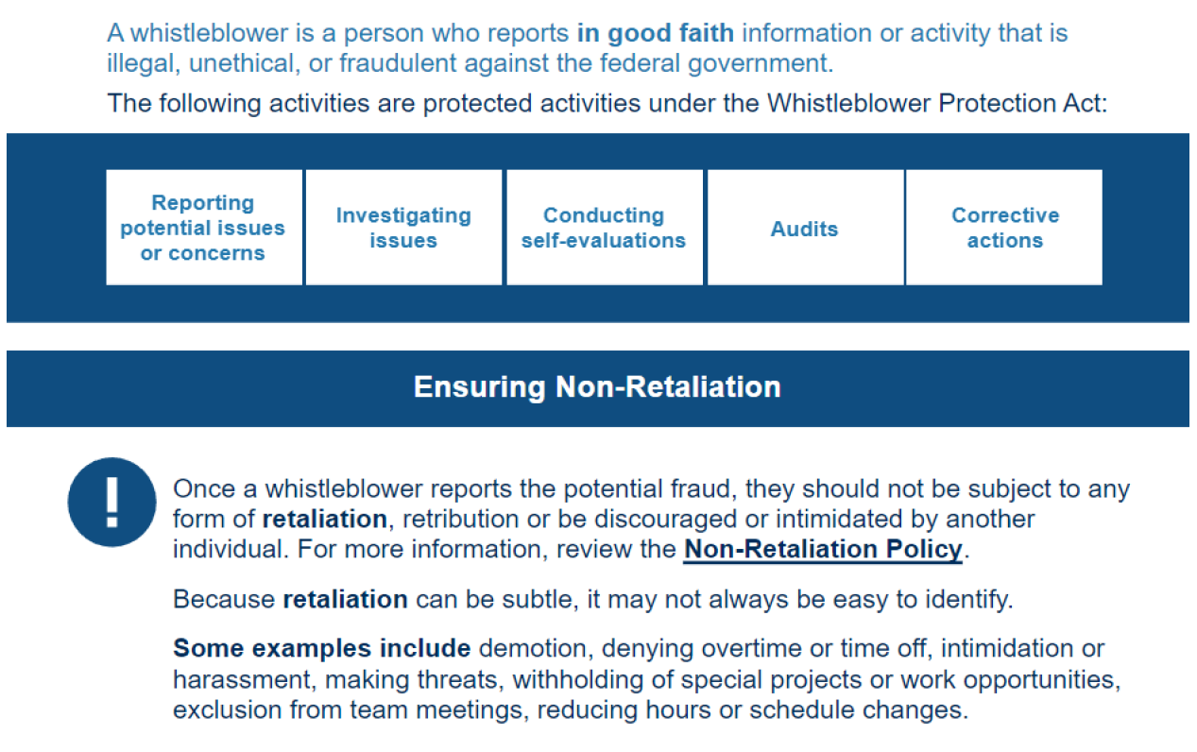
Whistleblower Protection Act / Non-Retaliation

Slide 18
Privacy / Information Security
06

Slide 19
What is HIPAA and the Privacy Rule?
The education in this section will explore and define mandatory policies and best practices to remain compliant with HIPAA regulations for both the Privacy Rule and the Security Rule.

Slide 20
What is HIPAA?

Slide 21
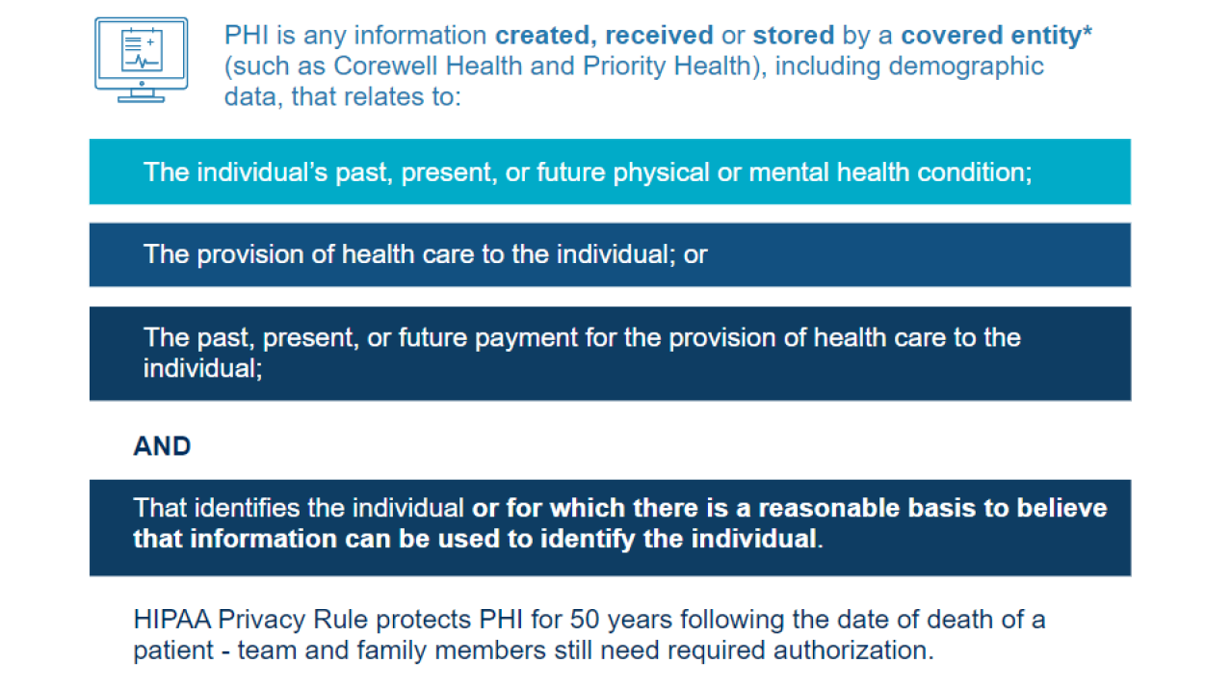
Protected Health Information (PHI)
*Covered entities are defined in the HIPAA rules as (1) health plans, (2) health care clearinghouses, and (3) health care providers who electronically transmit any health information in connection with transactions for which Health and Human Services (HHA) has adopted standards.

Slide 22
Permitted uses for PHI
25

Slide 23
What are the 18 Patient Identifiers?
1. Names
2. All geographical subdivisions smaller than a State, including street address, city, county, precinct, zip code
3. All elements of dates (except year) for dates directly related to an individual, including birth date, admission date, discharge date, date of death 4. Phone numbers 5. Fax numbers 6. Electronic mail addresses 7. Social Security numbers 8. Medical record numbers 9. Health plan beneficiary numbers
10. Account numbers 11. Certificate/license numbers 12. Vehicle identifiers and serial numbers, including license plate numbers 13. Device identifiers and serial numbers 14. Web Universal Resource Locators (URLs) 15. Internet Protocol (IP) address numbers 16. Biometric identifiers, including finger and voice prints 17. Full face photographic images and any comparable images 18. Any other unique identifying number,
characteristic, or code
It is recommended to use at least 3 patient identifiers to identify patients
24

Slide 24
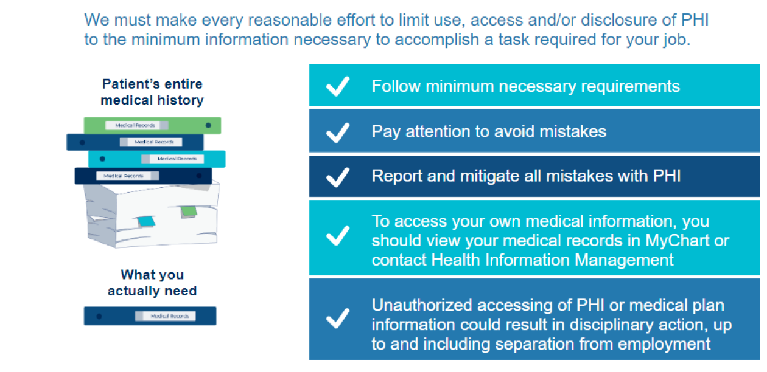
Minimum Necessary
26

Slide 25
Confidentiality
Patients and health plan members expect that their confidentiality is maintained, and this is enforced by HIPAA.
When accessing patient information, be sure you are only using the minimum necessary needed to complete your job functions.
Never access the records of friends or family for reasons outside of Treatment, Payment, or Operation (TPO) purposes. Curiosity and caring are not acceptable reasons to access a patient record. If you are not the care provider for an individual, do not access their information. It is recommended you recuse yourself from patient care involving family members when possible.
Discussing or sharing patient information outside of TPO purposes is a violation of HIPAA and policy. This also includes social media. Never share any information gained through your relationship with the patient on social media. Even in the case of de-identified information, comments from your or your colleagues may lead to inadvertent identification of the individual making the post a breach of privacy.
22

Slide 26
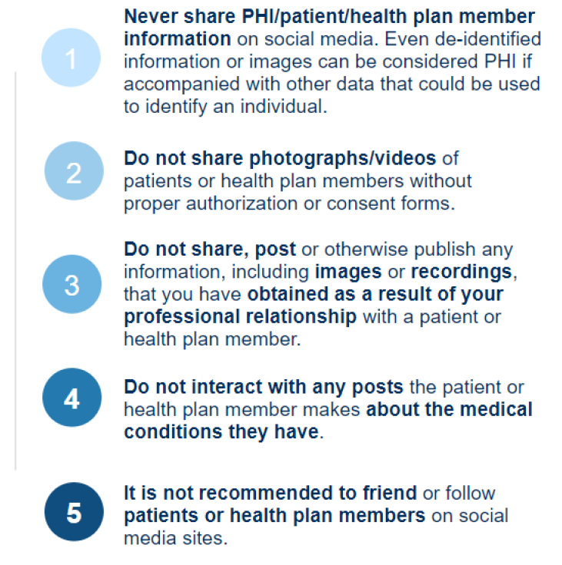
Guidelines for use of Social Media
If you are going to use social media, the following recommendations may be helpful.

Slide 27
Auditing and Monitoring
27

Slide 28
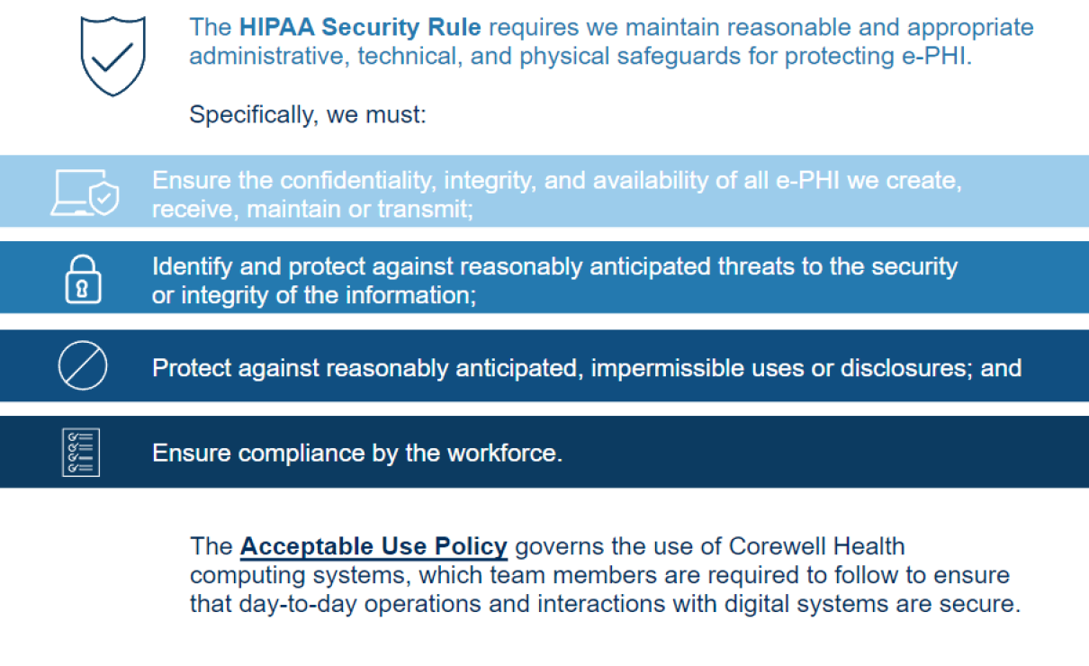
HIPAA Security Rule

Slide 29
Secure your Workspace
Physical access is the quickest way for someone to obtain information.
Do not leave computers / patient files / sensitive data unlocked (Log out with Windows Key + L OR approved department logout procedures) even when working from home
Securely store personal devices or carry them on you
Properly store or dispose of all papers in a secure manner
Be aware and suspicious of unknown individuals in secure areas
Create strong passwords, don’t share or reuse them
It is a violation of policy to share passwords with anyone

Slide 30
Protecting company data and assets
If you are assigned a portable device, or if you are authorized to use a personal device to check Corewell Health resources such as email, you need to review the policies for these devices.
Portable devices such as laptops, tablets and smartphones are often stolen for the data they contain, so it is important to safeguard them.
To protect this data you must:
If you back up confidential information to a USB drive, optical storage device, memory card, flash card or CD/DVD, it must be encrypted and kept in a secure location when it is not being used
Do not take any business assets or data off-site unless your role requires and you have permission
Do not leave your laptop unattended or unsecured, especially if you are outside the office
Install appropriate applications to portable devices to decrease the risk of exposure of Protected Health Information (PHI) or Personally Identifiable Information (PII)
Report all lost or stolen devices (this includes personal devices with access to Corewell Health resources) to the IT Service Desk at 888.481.2448.

Slide 31
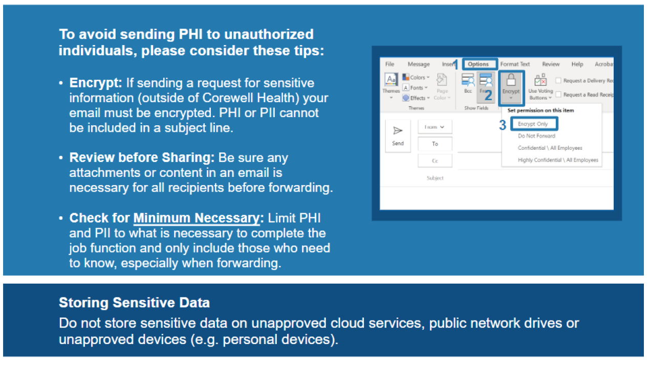
Protecting Sensitive Data
32

Slide 32
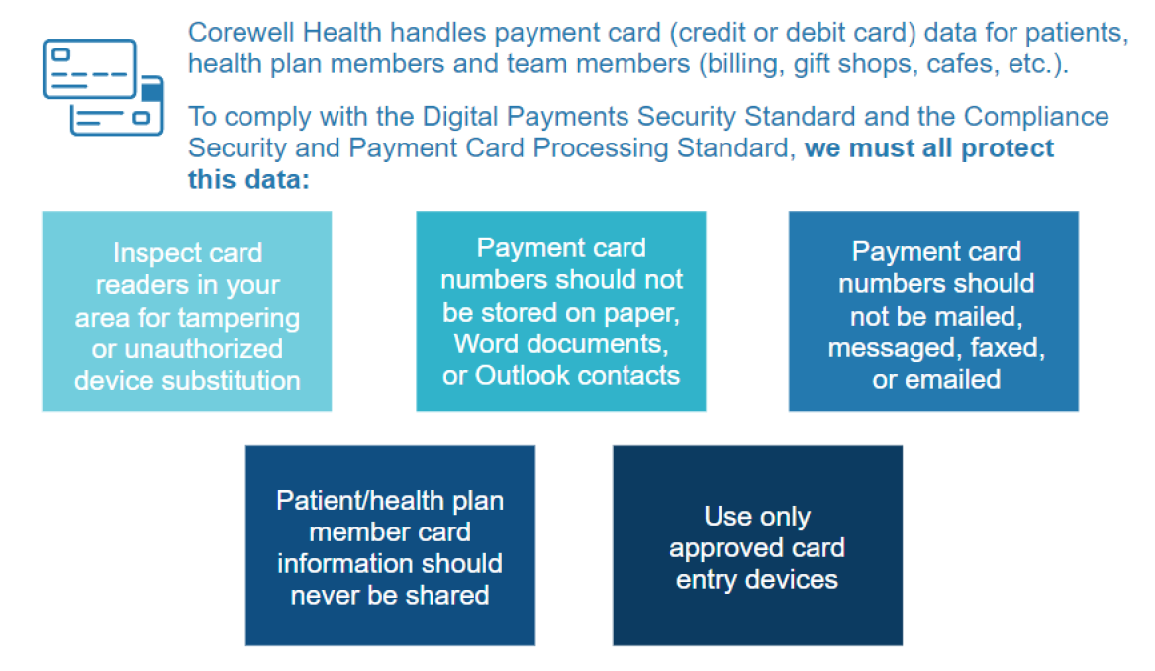
Protecting Credit Card Data
For more information, visit Information Security PCI Homepage
35

Slide 33
Phishing Threats
35

Slide 34
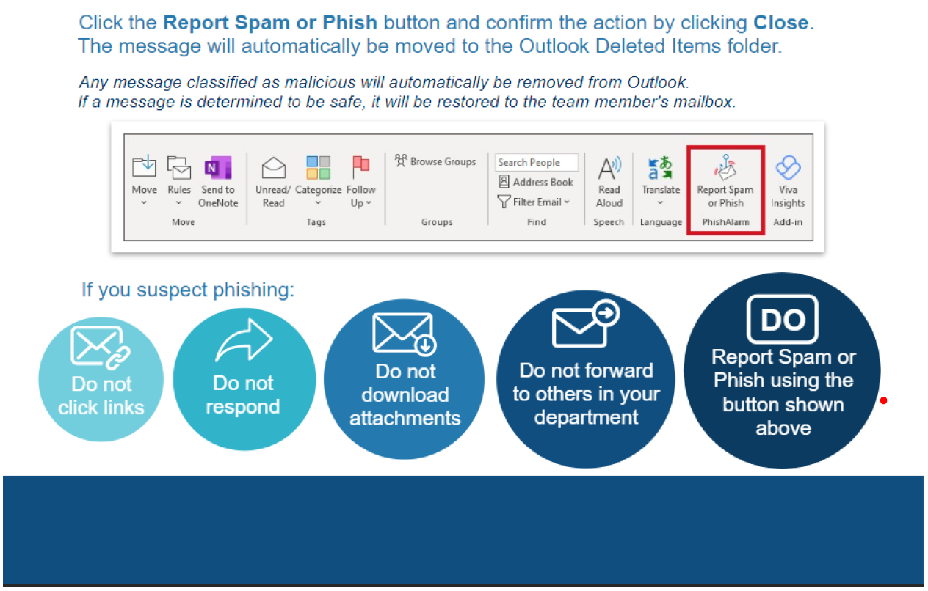
Report Phishing – Desktop Access
36

Slide 35
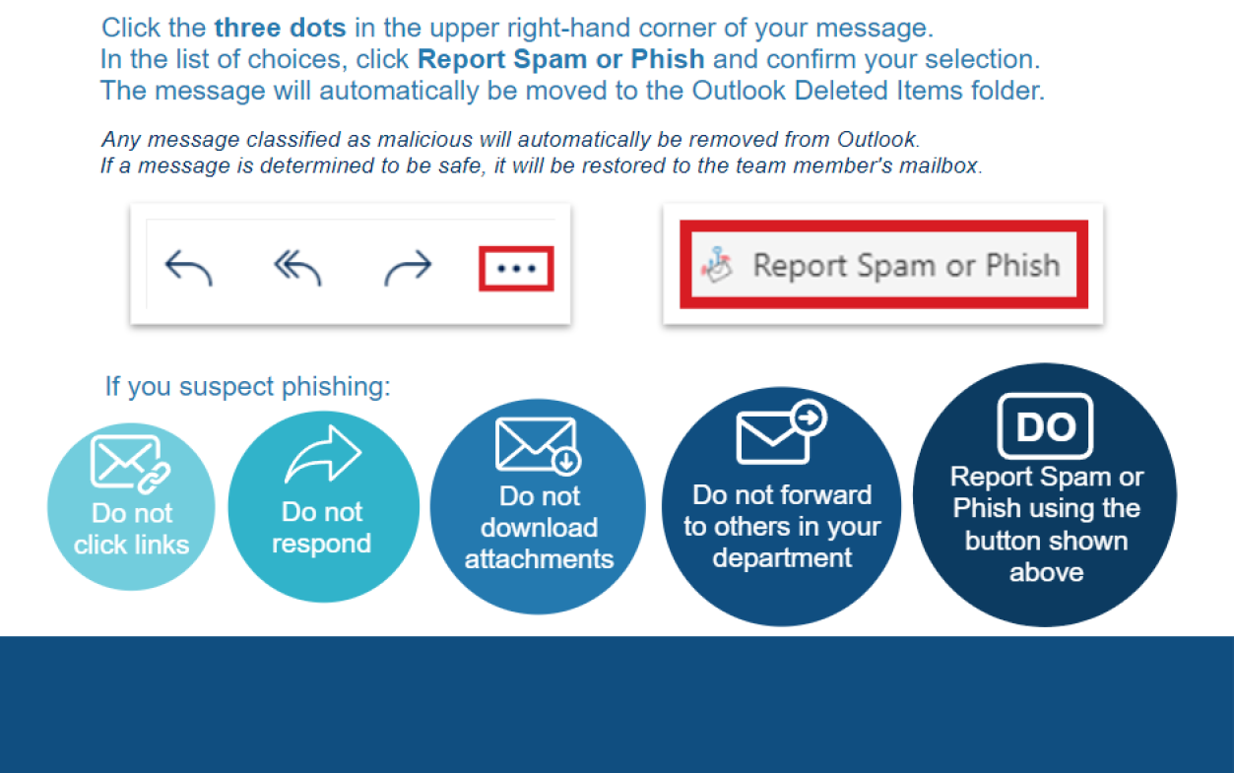
Report Phishing – Web Access
37

Slide 36
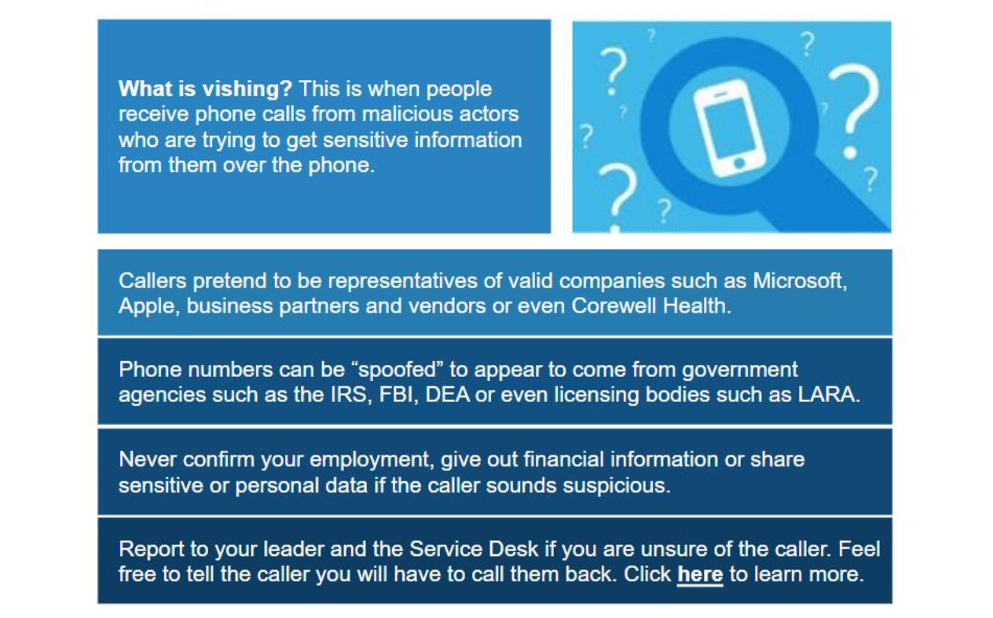
Vishing – Be Aware of Malicious Phone Calls
37

Slide 37
Reporting – Integrity Help Line
06

Slide 38
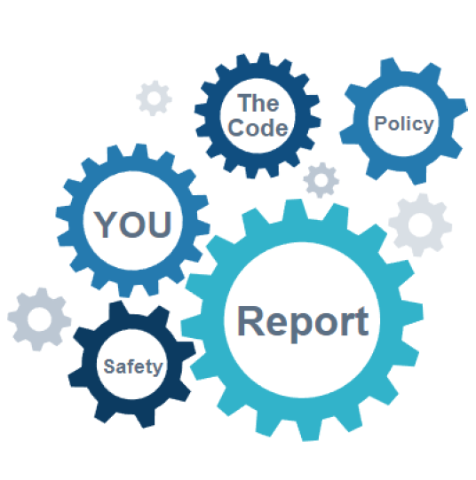
Reporting Your Concerns
Reporting a concern helps us identify gaps in a process or where improvements are needed. It also helps us identify areas of risk. How should you report?
Talk to your contact in Corewell Health
Compliance Department
Integrity Help Line
The Integrity Help Line is managed by an independent vendor and is available 24/7.

Slide 39
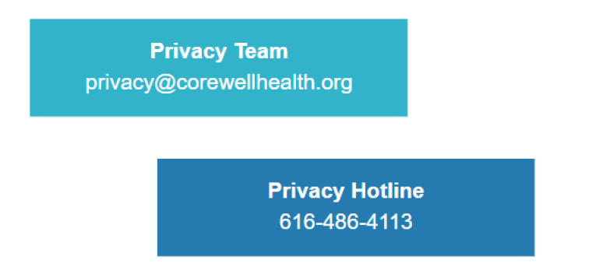
Compliance and Privacy Contact Information
System Privacy Team:
Privacy Hotline: 616-486-4113
Corewell Health IT Service Desk: 888.481.2448
38

