Slide 1
Corewell Health
Podiatric Medicine and Surgical Residency with Reconstructive Rearfoot/Ankle
Corewell Health – Wayne Podiatric Surgical Residency Program
Wayne, Michigan

Slide 2
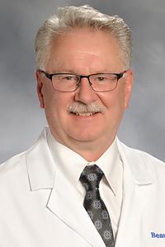
Dr. Fallat has been a residency director 30+ years
AO Trauma fellowship in Ravensburg, Germany
Published over 100 articles
National Lecturer
Led multiple mission trips across the world
Dr. Lawrence Fallat
Program Director

Slide 3
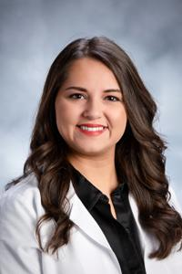
Residency training at Corewell Health Wayne Podiatric Medicine and Surgical Residency program
Published author and actively engaged in research
National Lecturer at ACFAS and national podiatry conferences
Actively participates in development and training for residents
Dr. Ashley Mariano
Assistant Program Director

Slide 4
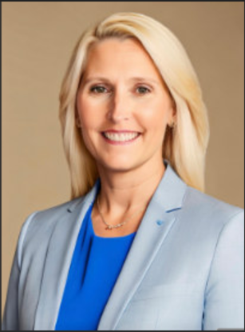
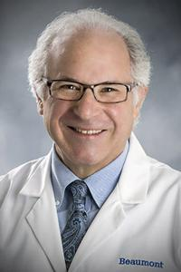
Core Faculty
Dr. Jodie Sengstock
ABPM Certified
MPMA Past-President
Dr. Allan Kalmus
ABFAS Foot Certified

Slide 5
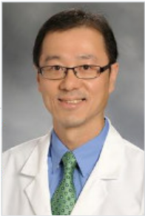
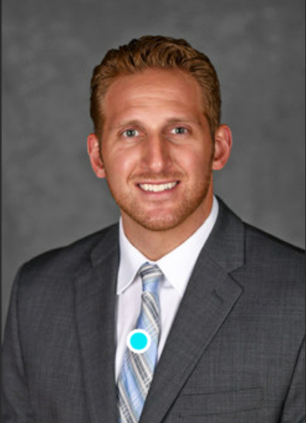
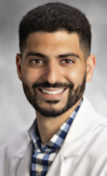
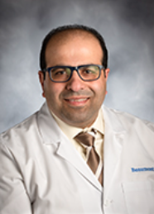
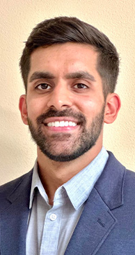
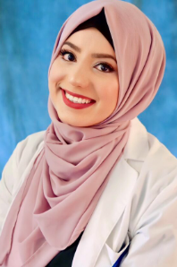
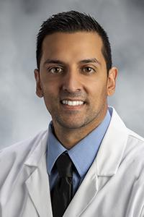
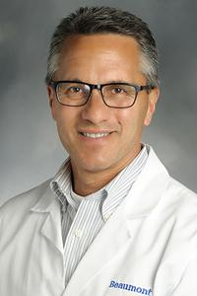
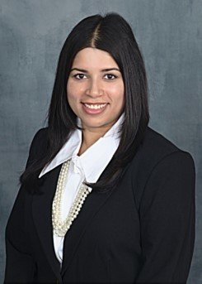
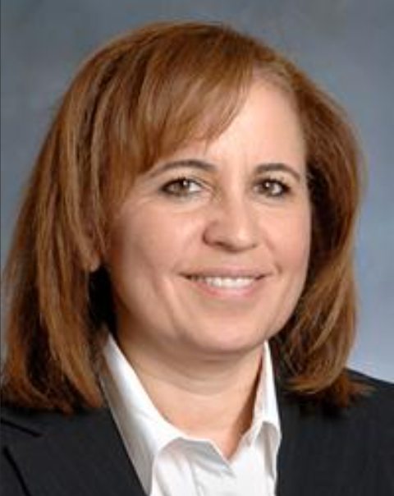
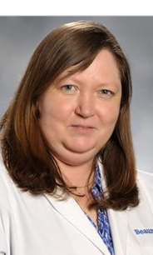
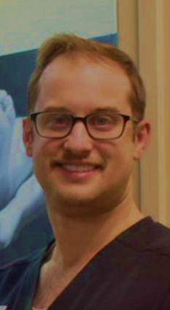
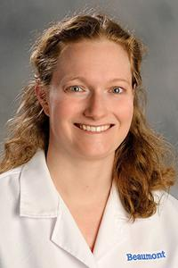
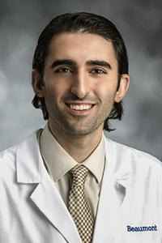
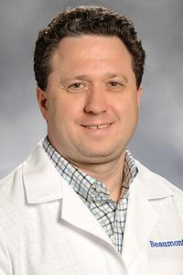
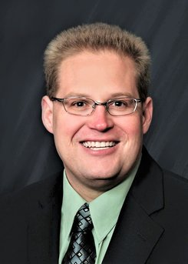
“ ?
Additional Surgical Faculty

Slide 6
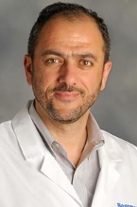
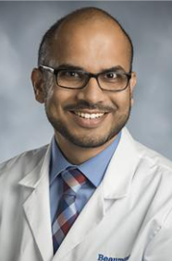
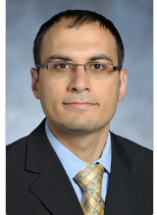
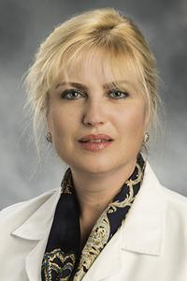
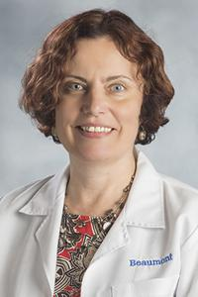
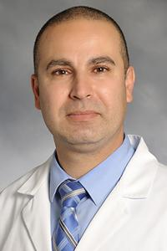
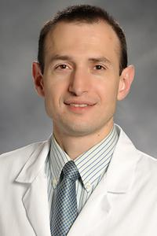
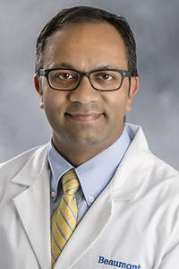
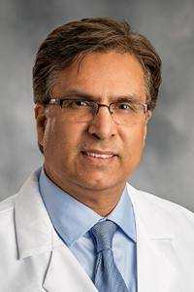
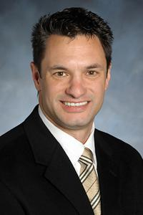
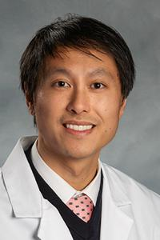
“ ?
Additional Medical Teaching Faculty

Slide 7
Fully accredited by the Council of Podiatric Medical Education as a three-year Podiatric Medicine and Surgical Residency with Reconstructive Rearfoot/Ankle
We are accredited by the council of Podiatric Medical Education
We are approved for 3 slots per year
Participate in CRIP
Externship encouraged but not required

Slide 8
The variety of surgical and clinical experiences allow graduates of our program to practice “full scope” foot and ankle surgery.

Slide 9
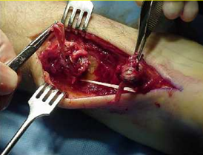
There are NO orthopedic residents at Corewell Health Wayne, therefore, podiatry residents are the “first line of defense” for foot and ankle trauma.
Achilles Tendon Ruptures

Slide 10
As a resident at our program you will receive a mult-faceted education encompassing all aspects of Podiatric Medicine and Surgery, with an emphasis on the following surgical areas:
Reconstructive adult and pediatric foot surgery
Total ankle replacement
Custom 3-D printed implants
Foot and Ankle trauma surgery
Diabetic (Charcot) limb salvage
Elective forefoot surgery
As a resident you have the opportunity to participate in medical mission trips to the underserved areas such as Dominican Republic, Nigeria, Honduras and Guatemala to correct Pediatric deformities.

Slide 11
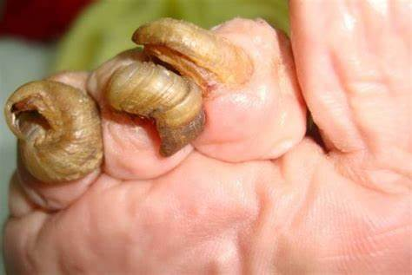
This is NOT a clip and chip program!

Slide 12
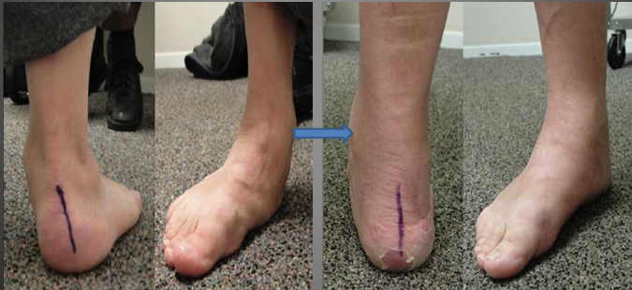
Surgeries include Reconstruction of Flatfoot deformities
Pre-op Post-op

Slide 13
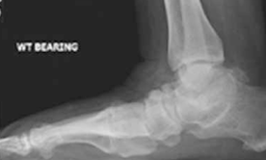
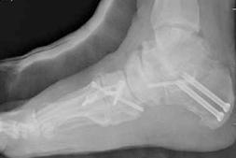
Reconstruction in Flatfoot deformities

Slide 14
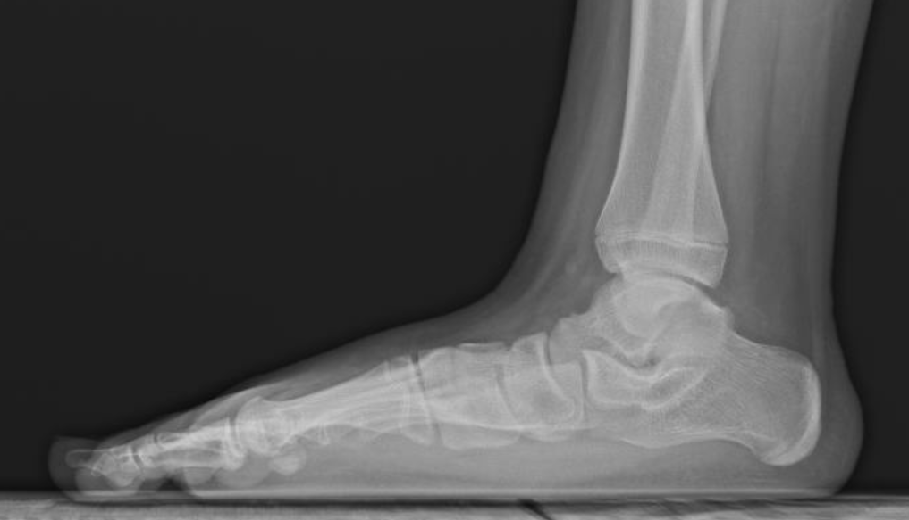
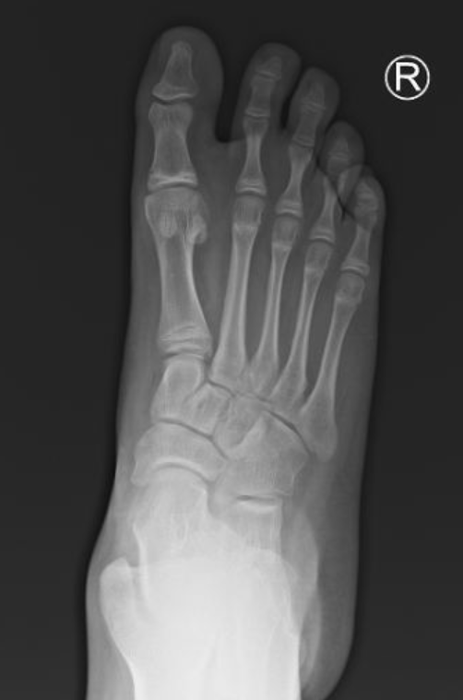
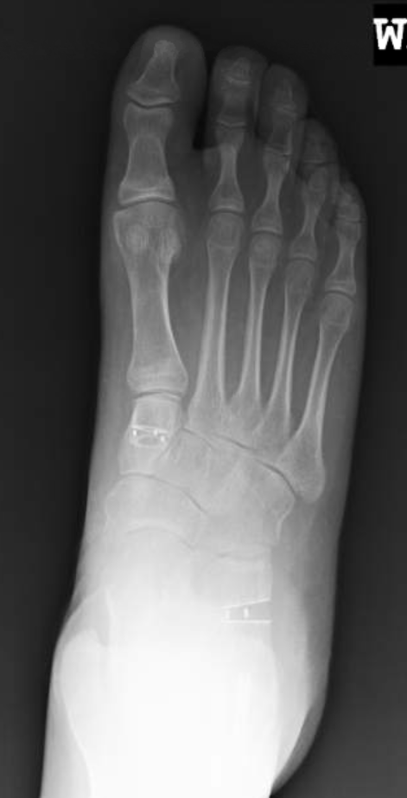
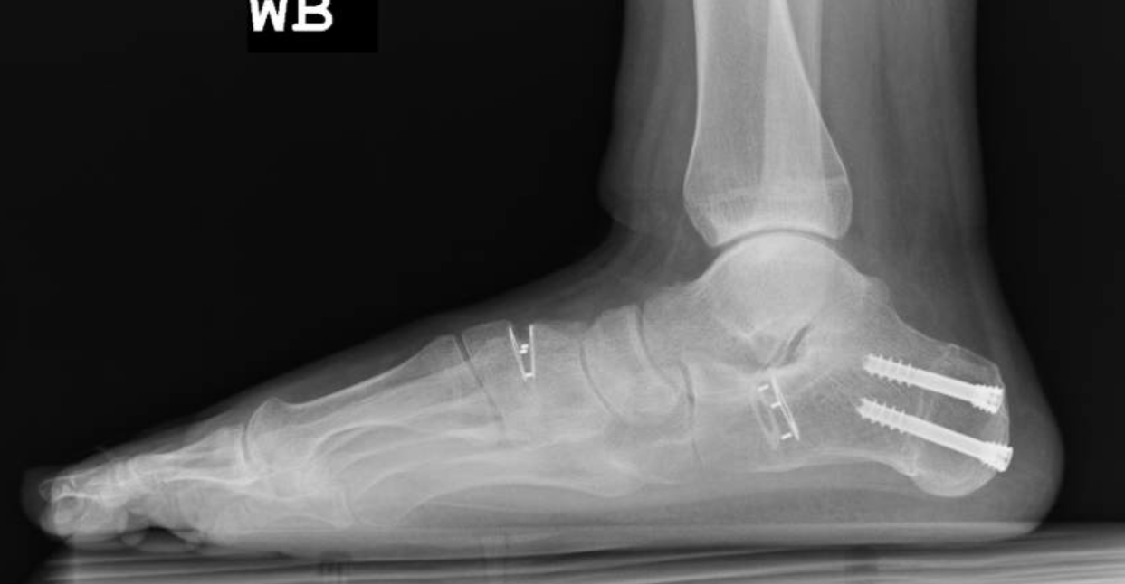
Reconstruction in Pediatric Flatfoot deformities

Slide 15
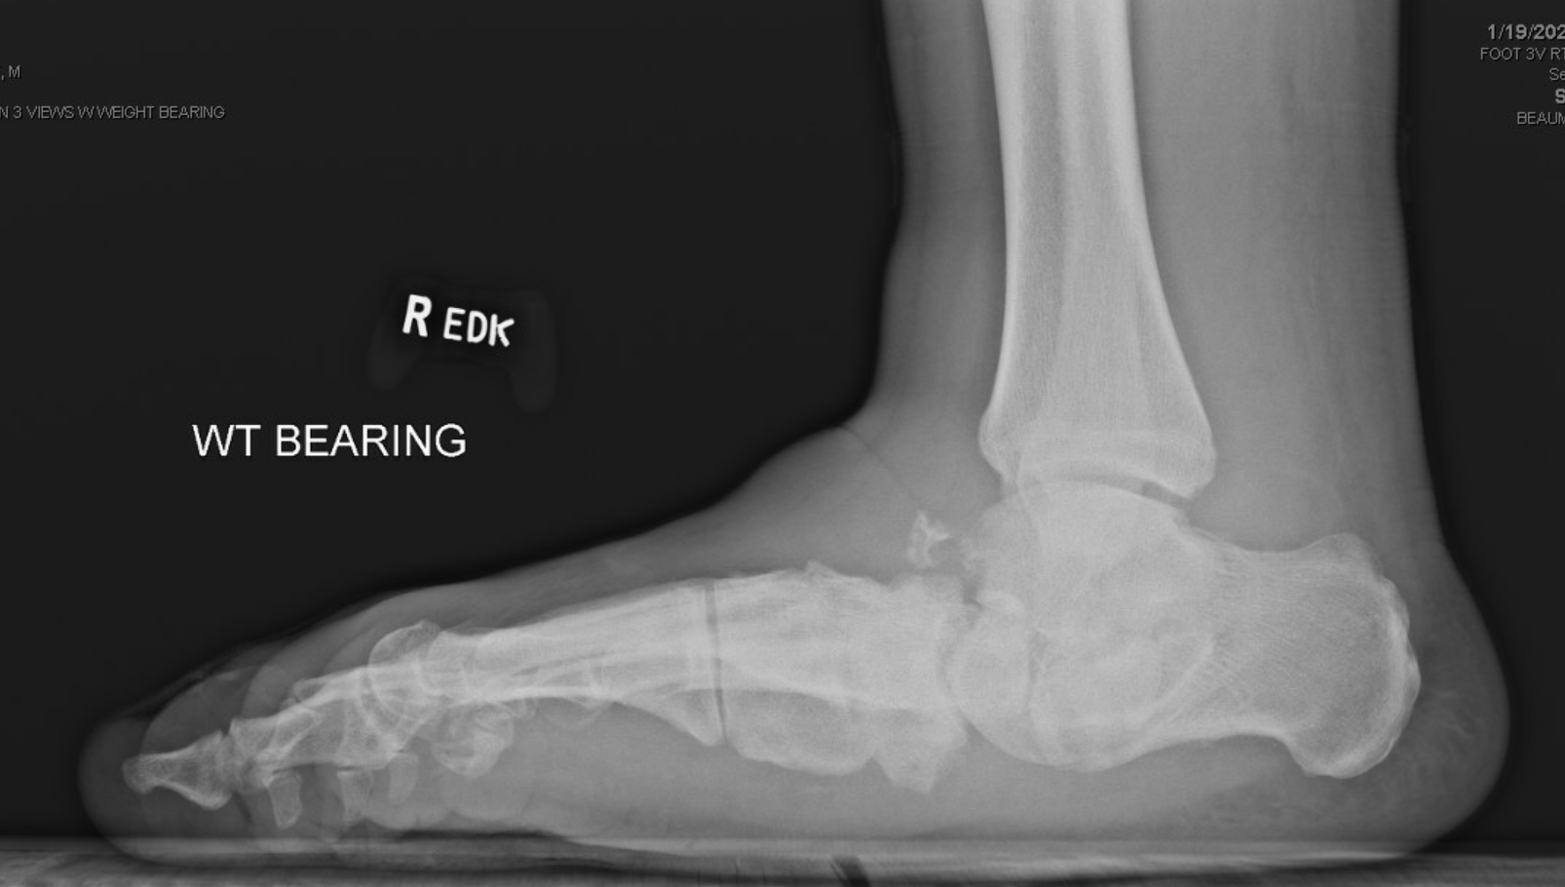
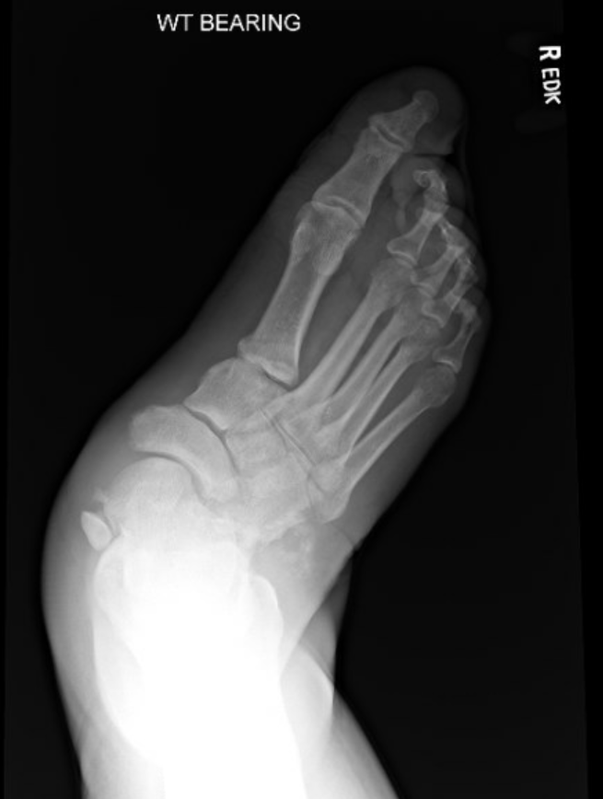
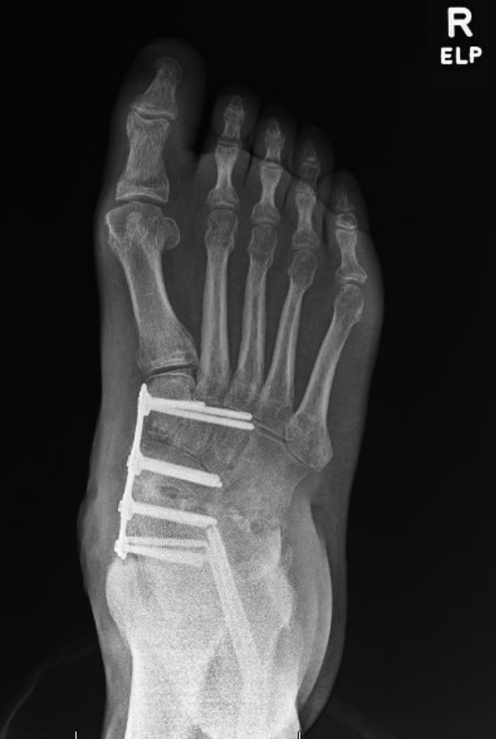
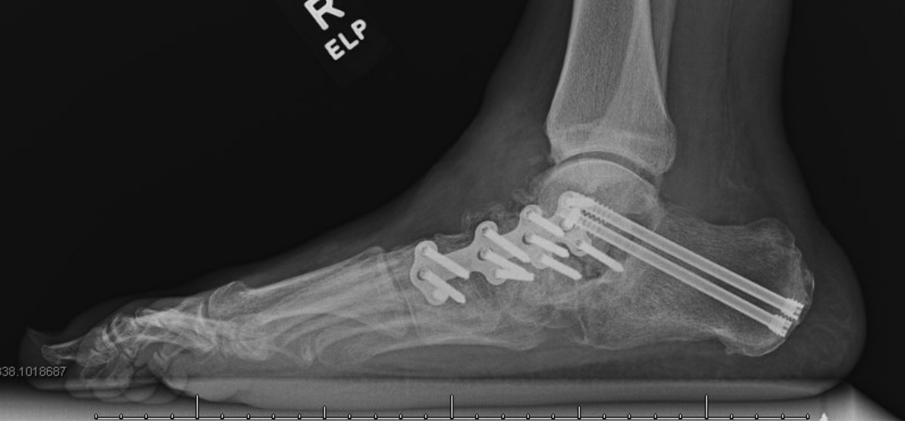
Reconstructive surgery for Charcot deformities

Slide 16
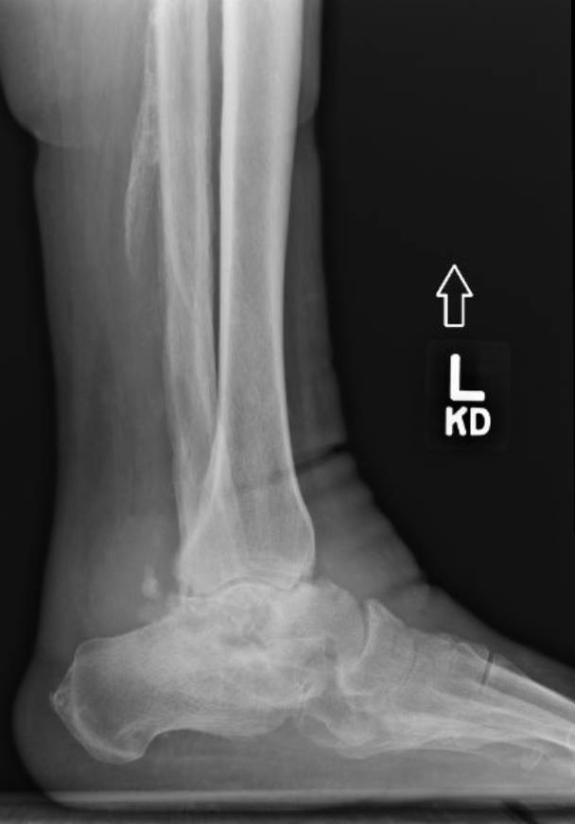
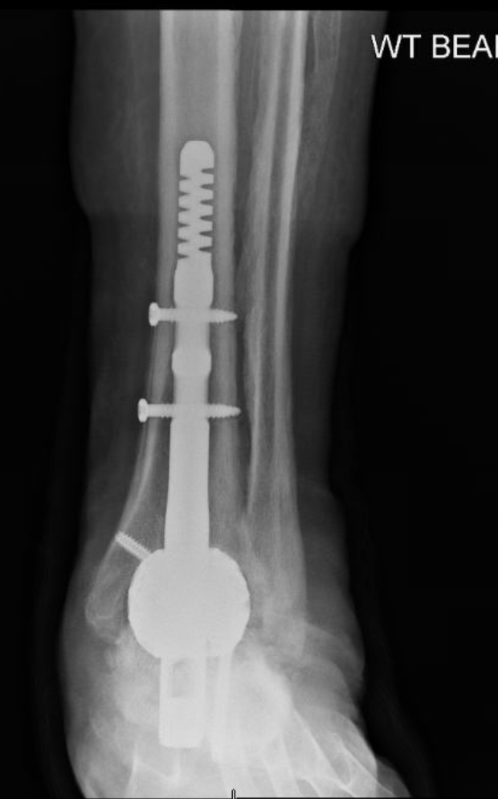
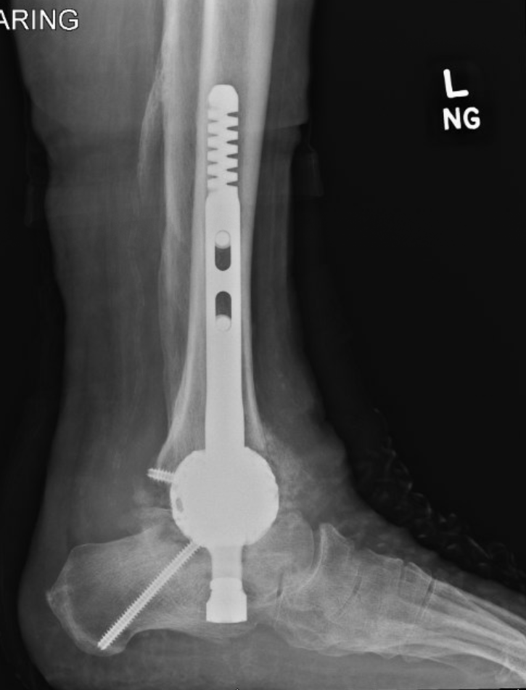
Reconstructive surgery for Charcot deformities

Slide 17
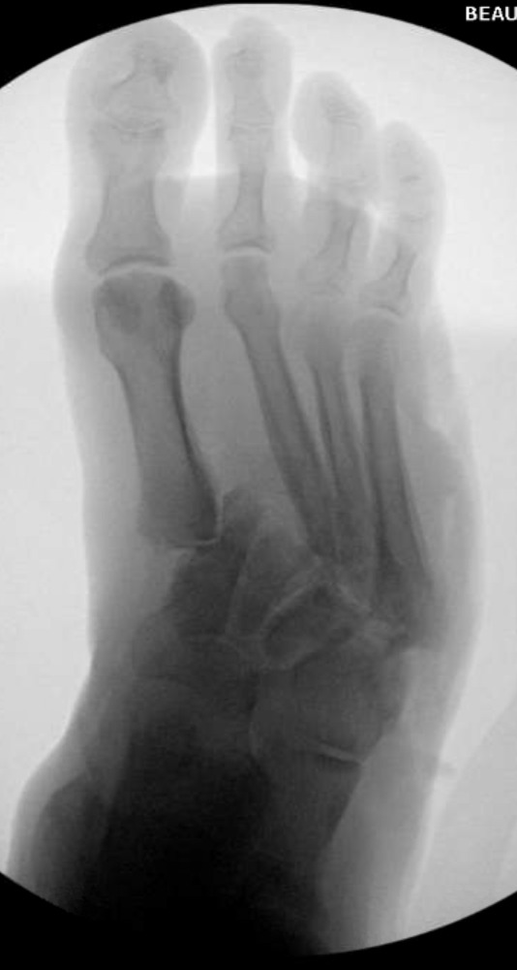
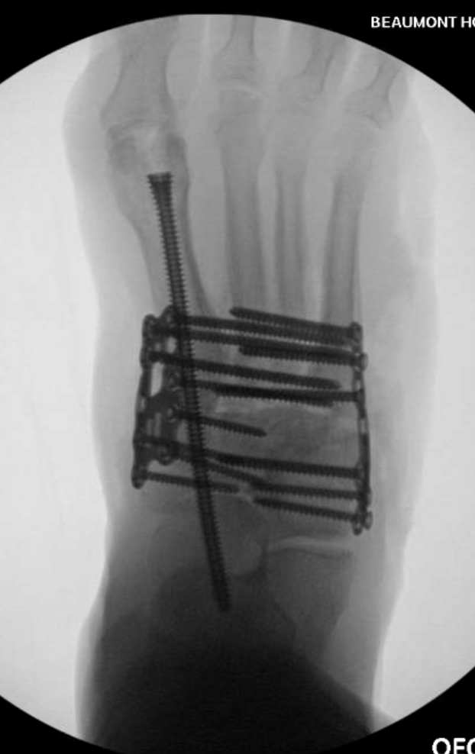
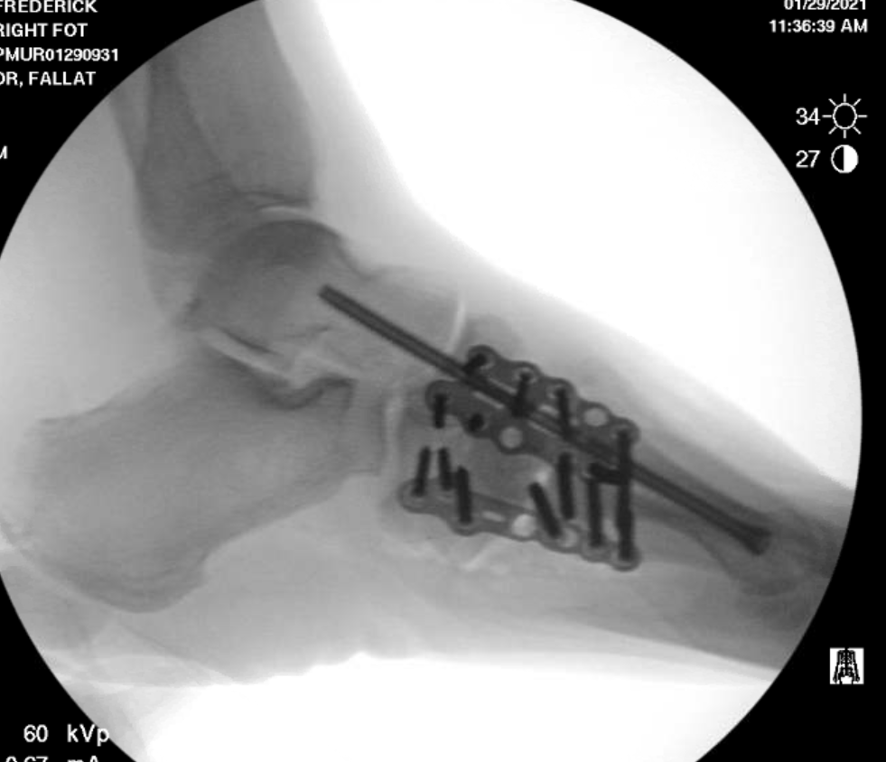
Reconstructive surgery for Charcot deformities
Notes:
INSERT FRED MURRAY CHARCTO RECON

Slide 18
Reconstructive surgery for Post-traumatic arthritis secondary to Pilon fracture

Slide 19
Reconstructive surgery for Post-traumatic arthritis secondary to Pilon fracture

Slide 20
Triple Arthrodesis for Painful Coalition

Slide 21
Reconstructive surgery of Bone Tumors

Slide 22
Reconstructive surgery of Bone Tumors

Slide 23
Reconstructive surgery of Bone Tumors

Slide 24
Surgery includes all types of Traumatic injuries
Extensive surgical training including open and closed fractures, degloving, and crush injuries.

Slide 25
Calcaneal Fractures

Slide 26
Calcaneal Fractures

Slide 27
Open Ankle Fracture following a fall at the railroad

Slide 28
Open Ankle Fracture following a Motorcycle crash

Slide 29
Open Ankle Fracture following slip on ice

Slide 30
Pilon Fractures

Slide 31
Pilon Fractures

Slide 32
Pediatric Ankle Fracture

Slide 33
Ankle Fractures

Slide 34
Dupuytren’s Fracture

Slide 35
Extrusion of the Talar Body Fracture

Slide 36
Talar Body Fracture

Slide 37
Evacuation of Hematoma after crush injury

Slide 38
Total Ankle Replacement

Slide 39
Total Talus Replacement

Slide 40
External Fixation

Slide 41
We have a vast amount of elective procedures that we perform throughout our surgical facilities. These are some of the procedures.
Hallux Abductovalgus
Hallux Rigidus and limitus
Hallux Varus
Hammertoes
Neuromas
Exostectomy
Tarsal Tunnel Decompression
Plantar Fasciotomies

Slide 42
Elective surgeries of the foot and ankle
Neuroma Excision
Posterior Tibial Neurolysis

Slide 43
Elective surgeries of the foot and ankle
Hallux Rigidus

Slide 44
Elective surgeries of the foot and ankle
Hallux Abducto Valgus

Slide 45
Elective surgeries of the foot and ankle
Hallux Abducto Valgus

Slide 46
Elective surgeries of the foot and ankle
Hallux Varus correction

Slide 47
Residents have the opportunity to go on medical mission trips focusing on Pediatric deformities in underserved areas, such as the Dominican Republic, Nicaragua and Guatemala.

Slide 48
Pediatric Flatfoot and Clubfoot deformities are brought to hospitals for correction.
Talipes Equino Varus

Slide 49
14 year old female with a neglected clubfoot deformity from the Dominican Republic

Slide 50
We perform surgeries at all of these facilities
Corewell Health – Wayne
Corewell Health - Taylor
Henry Ford Jackson Hospital
Corewell Health – Dearborn
Dearborn Surgery Center
Henry Ford Surgery Center

Slide 51
Residents manage patients preoperatively, intraoperatively and postoperatively.
We offer an outpatient resident clinic two days a week at our Canton Clinic Specialties office.
Here we evaluate new patients, manage diabetic foot care, peri-operative patients and trauma.
Continuity of care! This peri-operative management sets our program apart from other residency programs

Slide 52
Resident Rotation Schedule
Second Year Rotations
Infectious Disease
Billing and Coding Office Management
Podiatric Surgery – Majority of the year
First Year Rotations
General surgery
Internal Medicine
Pathology
Anesthesiology
Emergency Department
Wound Care Clinic
Orthopedic Surgery
Vascular Surgery
Medical Imaging
Billing and Coding Office Management
Podiatric Surgery – 6 months of first year
Third Year Rotations
Behavioral Medicine
Physical Medicine and Rehabilitation
Plastic Surgery
Pain Management
Billing and Coding Office Management
Podiatric Surgery – all year

Slide 53
As residents we have a strong didactic portion to our program
Journal Club
Board review
Cadaver lab
Casting workshop
Suturing workshops
Weekly academic presentations
Radiology Review

Slide 54
Cadaver Lab Workshop

Slide 55
Resident Wellness

Slide 56
Resident Compensation and Benefits
Salary
1st year: $64,722
2nd year: $67,177
3rd year: $69,492
CME Fund
1st year: $800
2nd year and 3rd year: $1200
Annual Meal Allowance: $1800
Vacation
Paid 4 weeks of vacation
Malpractice insurance
Health, dental and vision options

Slide 57
Requirements of Resident
As a resident, you will submit research abstracts to:
MPMA state annual meeting
ACFAS annual scientific meeting
Corewell Resident Research Day competition

Slide 58
Corewell Health Resident Numbers Prior to Graduation
MAV Category | You Have | MAV Required | Over (Under) | Meeting MAV
1. Digital Surgery | 123 | 80 | 43 | Yes
2. First Ray Surgery | 109 | 60 | 49 | Yes
3. Other Soft Tissue Foot Surgery | 164 | 45 | 119 | Yes
4. Other Osseous Foot Surgery | 73 | 40 | 33 | Yes
5. Reconstructive Rearfoot/Ankle Surgery | 184 | 50 | 134 | Yes
6. Biomechanical Cases | 108 | 75 | 33 | Yes
7. Comprehensive H&Ps | 328 | 50 | 278 | Yes
8. Trauma Cases | 115 | 50 | 65 | Yes
9. Podopediatric Cases | 67 | 25 | 42 | Yes

Slide 59
As a well-respected healthcare system which provides quality comprehensive care of the foot and ankle.
As assembly of high qualified foot and ankle surgeons as well as a diverse consulting staff:
Orthopedics
Vascular surgery
General surgery
Emergency medicine
Pediatrics
Radiology
Cardiology
Family medicine
Internal medicine

Slide 60
Please feel free to contact us with any questions.
BeaumontPodiatry@gmail.com

