Slide 1
Ventricular Arrhythmias
PVCs
V tach
Torsades
V fib

Slide 2
Premature Ventricular Contractions
Generally benign, but may be a consequence of a pathology, esp if multifocal (ectopy)
More concerning causes include hypoxia, ischemia, MI, toxins/drugs, acidosis or alkalosis, electrolyte disturbance (hypo K or Mag)

Slide 3
Ventricular Tachycardia
Results from a dysrhythmia originating at or below the bundle of His
Has a wide QRS complex (>0.12 second)
Rate > 100
May be monomorphic or polymorphic
Usually seen in the setting of ischemia, cardiomyopathy, or previous injury due to scar
Electrolyte disturbance, medications, prolonged QTc, Brugada
Wide complex tachycardia with rate > 100

Slide 4
Monomorphic V-tach
Morphologically consistent QRS complexes
Most common form of v-tach
Seen primarily with cardiac ischemia
Also seen in cardiomyopathy, valvular disease, electrolyte imbalance, myocarditis

Slide 5
Monomorphic V-Tach

Slide 6
Polymorphic V-tach
QRS complexes vary in structure and amplitude
Predominantly caused by CAD
Associated with more severe disease

Slide 7
Torsades de Pointes
A specific form of polymorphic v-tach
Characteristic twisting morphology
Associated with prolonged QTc
May be due to drugs (tricyclics), electrolyte imbalance (hypo K, Mg or Ca), or subarachnoid hemorrhage

Slide 8
Torsades de Pointes
Notes:
This was an alcoholic patient with hypo K and Mag

Slide 9
Treatment: Ventricular Tachycardias
Unstable - immediate cardioversion (if pulses)
If pulseless - defibrillation
Stable - amiodorone 150 mg IVP or lidocaine 1 mg/kg and prepare for elective cardioversion
If torsades de pointes – magnesium 1-2g IV

Slide 10
Ventricular Fibrillation
An irregularly irregular rhythm with no p waves or definite QRS complexes
Disorganized contraction of the myocardium that is unable to pump blood
Commonly seen with ischemia/CAD and cardiac arrest

Slide 11
Treatment of V Fib (pulseless VT)
Initiate CPR, ACLS guidelines
Defibrillate
Adult 200 joules
Children 2 joules/kg
Epinephrine 1 mg IVP q 3-5 min
(0.01 mg/kg)
Amiodarone, Lidocaine, Magnesium

Slide 12
Miscellaneous Topics

Slide 13
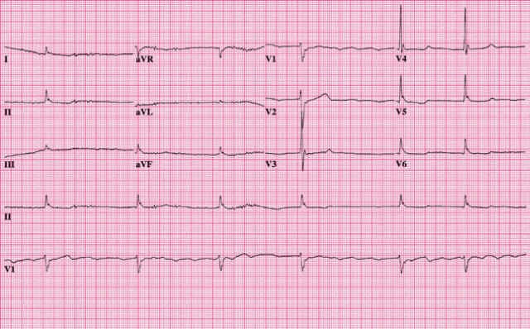
Osborne Waves
Not a true arrhythmia, but an EKG abnormality suggestive of underlying pathology
Seen primarily in hypothermia, < 35.6 degrees
May also be seen in other conditions, such as hypercalcemia or brain injury
Also called J-waves, Camel backs, hathooks

Slide 14
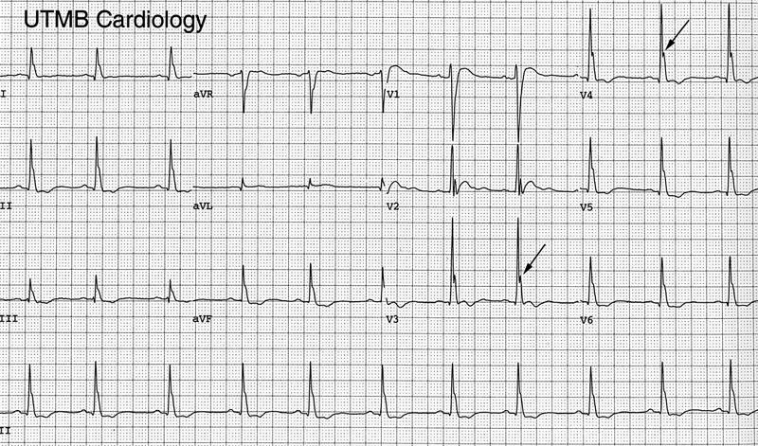
Osborne Waves - Hypercalcemia

Slide 15
Brugada Syndrome
Genetic disease - autosomal dominant
Mutation in the gene that controls the Na channel
Characteristic ECG – ST segment elevation V1-V3
no signs of ischemia, short QT interval
Can present as syncope or sudden death/CPR
Cause of death – polymorphic V tach or V fib
Treatment
no medicine will prevent
AICD to abort lethal arrhythmias

Slide 16
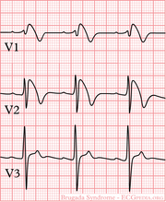
Brugada: Diagnostic Criteria
Type I is the only ECG criterion that is diagnostic of Brugada syndrome. (see figure)
Definitive diagnosis - type 1 ST-segment is observed in >1 right precordial lead (V1 to V3) and one of the following:
Documented Vfib or polymorphic VT
FHx of sudden cardiac death at <45 years old
coved-type ECGs in family members
inducibility of VT with programmed electrical stimulation
syncope
nocturnal agonal respiration

Slide 17
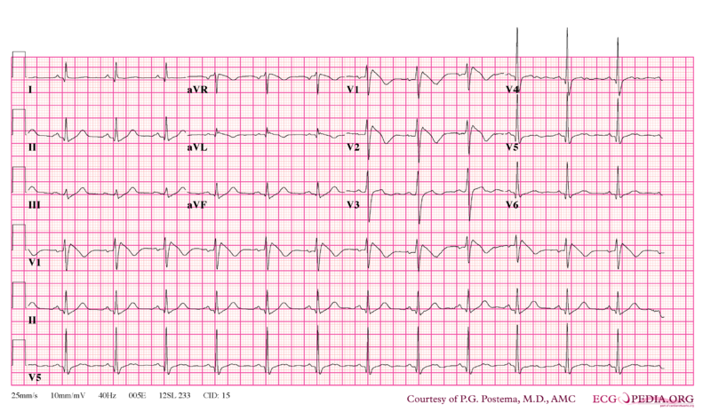
Brugada Syndrome

Slide 18
Brugada Syndrome

Slide 19
Prolonged QTc
Etiology :
Genetic – can be dominant or recessive, 13 genes identified
medications/drugs – sotalol, amiodarone, TCAs, methadone, antipsychotics, procainamide
electrolyte disturbance- hypo K/Mag/Ca
Increases risk for syncope, arrhythmias, and sudden death
Treatment – usually beta blocker or AICD
Avoid QT prolonging drugs and competitive sports

Slide 20
Prolonged QTc

Slide 21
Now for some cases…

Slide 22
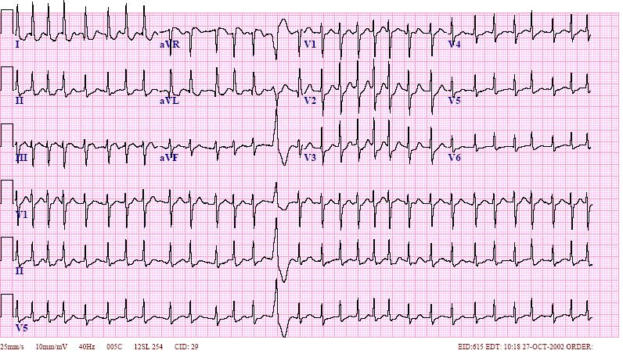
82 yo male with hx HTN c/o weakness, dizziness, and SOB. BP 100/50 HR 155 What does the EKG show? What is the treatment?
Notes:
EKG = a fib with RVR A-adenosine B-beta blockers C-ca channel blocker D-dig

Slide 23
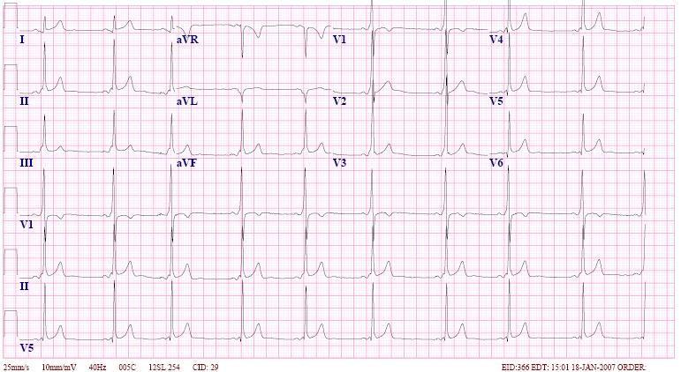
35 yo female c/o palpitations, near syncope, occasional episodes of rapid HR. What does the EKG show What medicines should be avoided in this patient?
Notes:
EKG= WPW avoid adenosine, beta blockers, ca channel blockers, dig

Slide 24
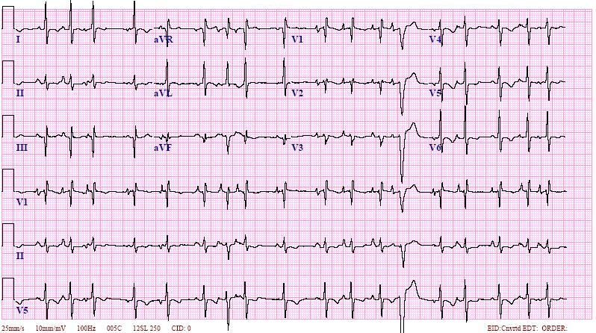
65 yo male with COPD c/o SOB, wheezing and pedal edema. What does the EKG show? What is the treatment?
Notes:
EKG=MAT Treat the COPD

Slide 25
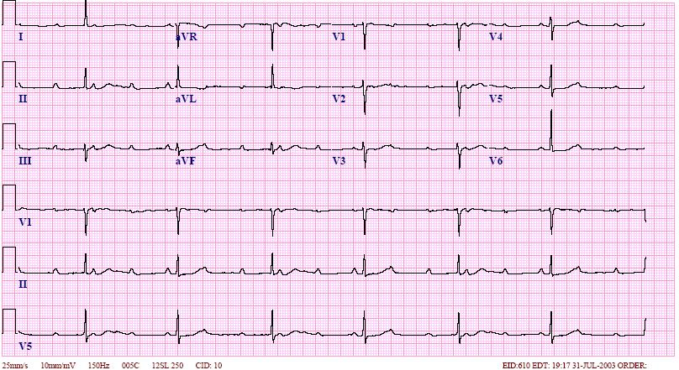
91 yo female c/o weakness and syncope. What does the EKG show? What is the treatment?
Notes:
EKG= 3rd degree block

Slide 26
26 yo medical student presents with N,V altered mental status. She has not been eating well. She is on Erythromycin for a URI. Her K=2.1 Mg=1.0 (nl=1.8-3.0) She collapses in the ER and is placed on a monitor.
What does the monitor show?
What is the treatment?
Notes:
Monitor = torsades treatment = IV magnesium

Slide 27
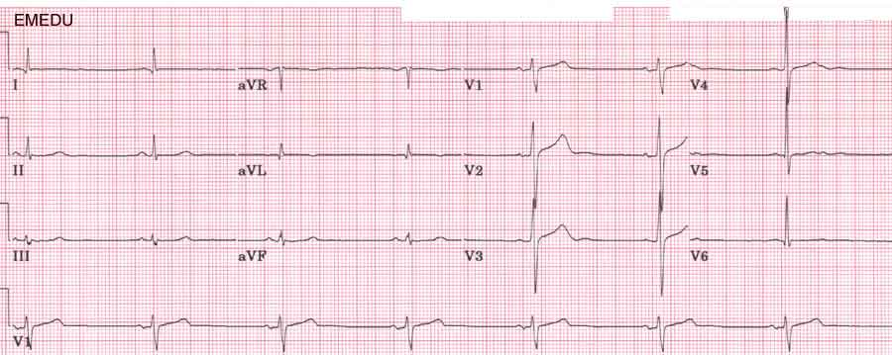
48 y/o F presents lightheaded after walking. She just started metoprolol. What does the ecg show? What is the treatment?
Notes:
Ecg = SB no rx if stable, pacing or atropine if unstable, glucagon and calcium to reverse the BB

Slide 28
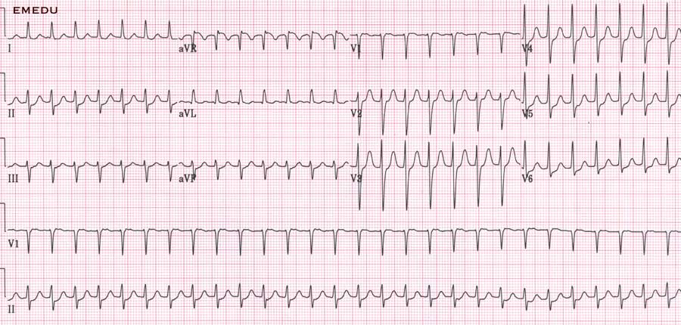
42 y/o F presents with palpitations and DIB? What does the ecg show? How could you differentiate the rhythm?
Notes:
Ecg = SVT, could give adenosine to differentiate SVT, afib, aflutter

Slide 29
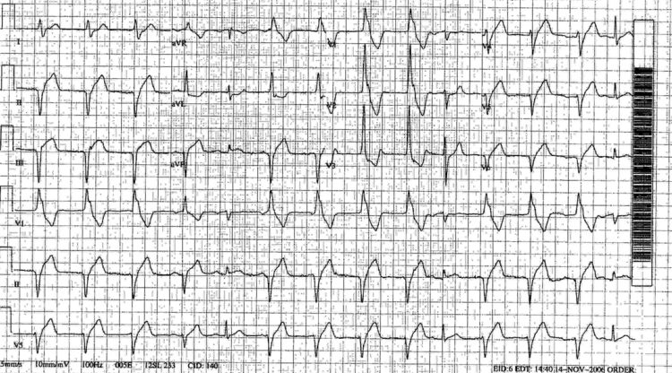
You are working in the EC. The nurses come get you for this rhythm. It appeared 45 min after giving thrombolytics for AMI. Previously it was NSR. What is this? What should you do?
Notes:
Ecg= idioventricular rhythm, do nothing for AMI thrombolytics as it is transient, other circumstances treat if unstable

Slide 30
86 y/o M c/o weakness and DIB.
What rhythm is this on the monitor?
What should you worry about?
Are you going to treat this?
Notes:
Wenckebach, inferior mi, treat with pacing/atropine if unstable

Slide 31
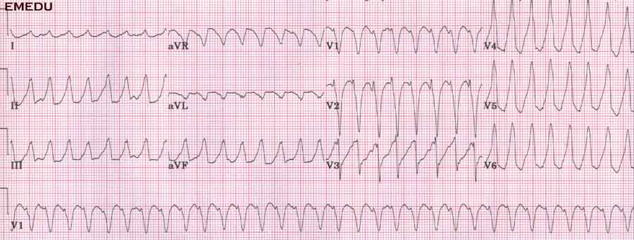
61 y/o M with CP, palpitations, and dizziness. What is the ecg show? What do you want to do?
Notes:
Ecg = VT, cardiovert if there is a pulse and unstable or symptomatic

Slide 32
So you cardioverted the previous rhythm and now this is on the monitor…
What is this?
What should you check?
What should you do (besides soil yourself)?
Notes:
Vfib, pulse, defibrillate

Slide 33
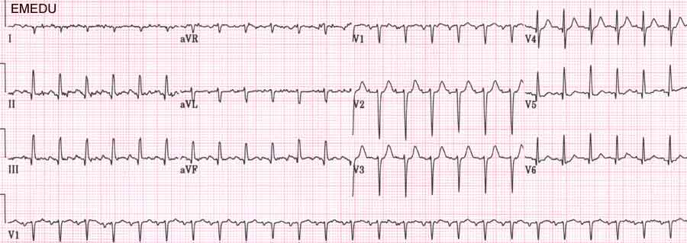
24 y/o pregnant F presents with 3 days of vomiting…
What does the ecg show?
What is the treatment of choice?
Notes:
Ecg = ST, fluids, the p waves are clearly seen in lead III

Slide 34
52 y/o M who is homeless and found sleeping in an alley. What does the ecg show? What is the treatment?
Notes:
Osborne waves, re-warming, check electrolytes

Slide 35
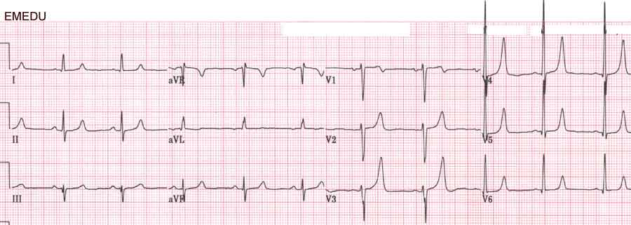
45 y/o M with CKD on HD presents with palpitations and DIB after missing dialysis.
What does this ecg show?
What should you do to treat this?
Notes:
Hyperkalemia, calcium, bicarb, D50/insulin, kayexalate plus fluids and potentially lasix or albuterol

Slide 36
Had enough yet?
The End

